Slide 1
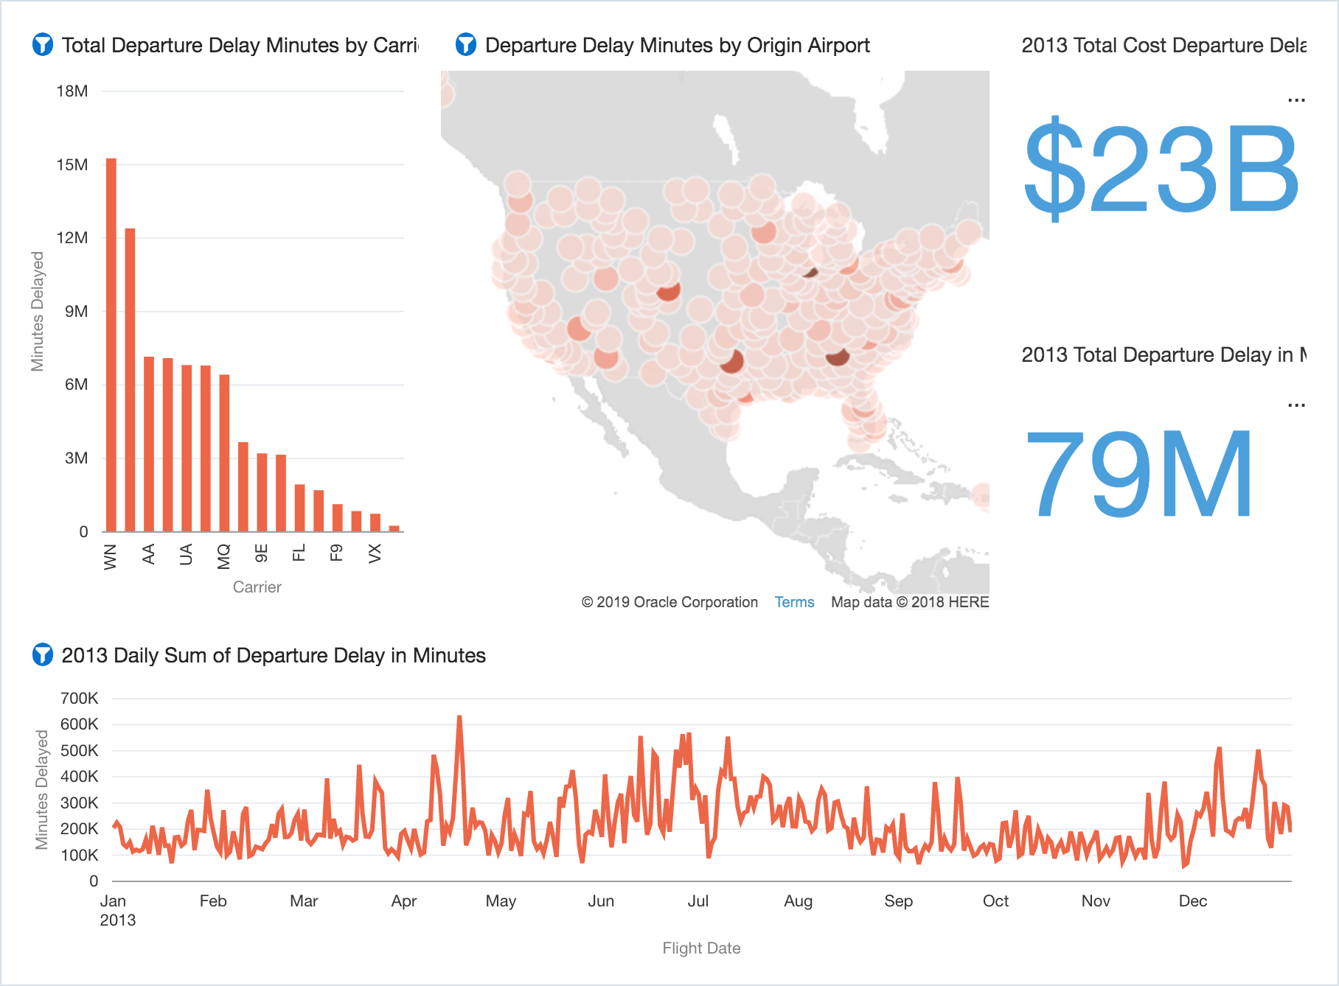
Flights - Descriptive: 2013 Departure Delay Overview

Slide 2
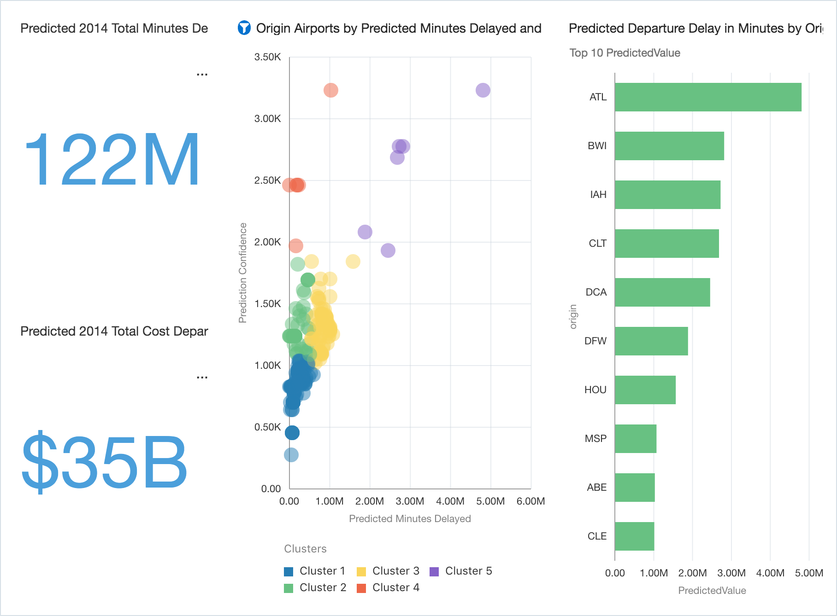
Flights - Predictive: Departure Delay

Slide 3
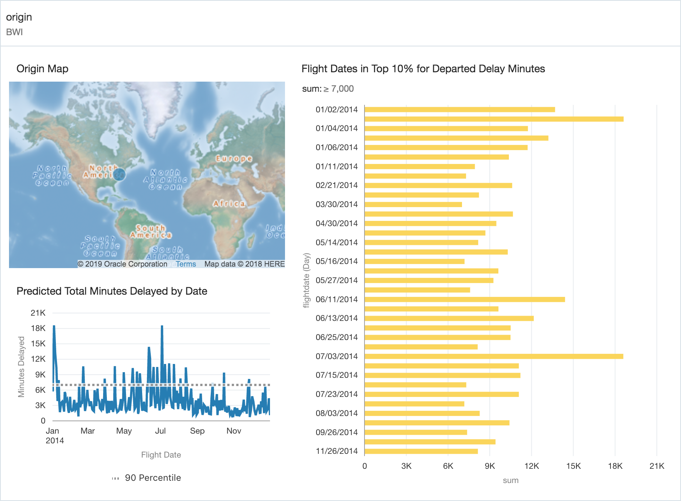
Flights - Prescriptive: BWI Deep-Dive

