Slide 1

Youtube
Data Science Report
Published by: Reina Yu, Michael Woo, Ary Sharifian

Slide 2
Outline
YouTube introduction
Overview of U.S YouTube dataset
Business Case Question
Business Case Results
Looking Ahead
Fun Facts
References
Questions

Slide 3
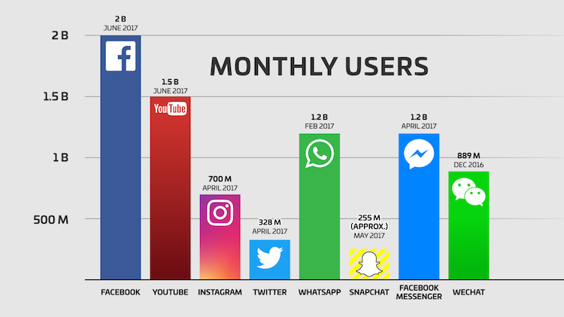
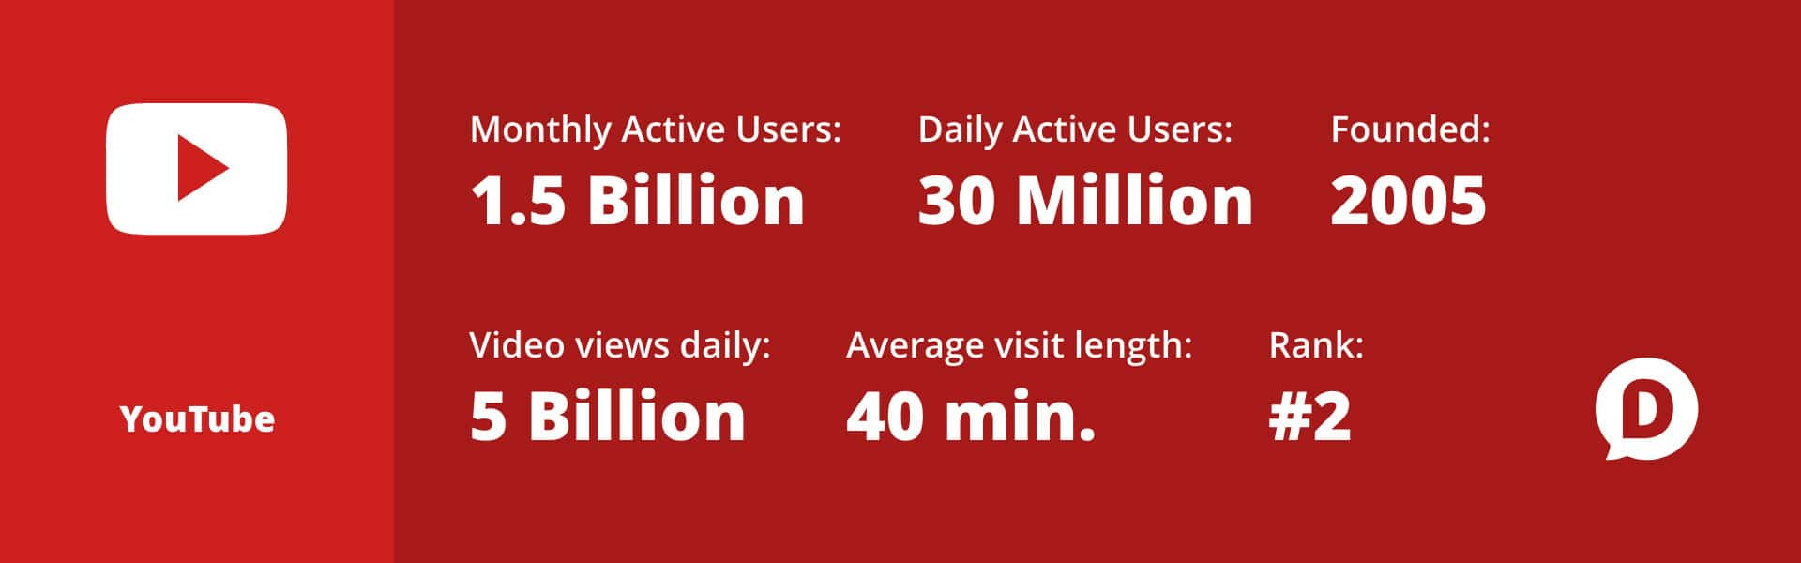
Youtube.com
[1]
Social media platform with over monthly 1.5 billion users
Video platform for users to upload and view videos
Top influencers (like Pewdiepie, LauraDIY, James Charles and etc) amassed over 1 billion views
So what metrics are predictive of view counts?
[2]

Slide 4








U.S YouTube dataset Fun Facts
Childish Gambino - This Is America (Official Video)
Most Viewed
BTS (ë°©íƒ„ì†Œë…„ë‹¨) 'FAKE LOVE' Official MV
Most Liked
Most Disliked,
Commented
So Sorry.
WE MADE OUR MOM CRY...HER DREAM CAME TRUE!
Most Trended

Slide 5
The Dataset

Slide 6



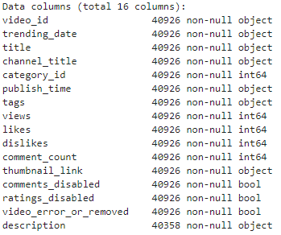




YouTube Dataset By The Numbers
40,949 Records
6,262 Unique Videos
2,614 Unique Channels
23 Erroneous Videos
47 Duplicate Rows
8 Months Of Trended Videos
2017
2018

Slide 7
Correlation Strength between INT Metrics
 | Views | Likes | Dislikes | Comment_Count
Views | 1 | 0.85 | 0.47 | 0.62
Likes | 0.85 | 1 | 0.45 | 0.80
Dislikes | 0.47 | 0.48 | 1 | 0.70
Comment_count | 0.62 | 0.80 | 0.70 | 1
* R values > .70 demonstrates strong linear correlation
Strong linear correlation between likes and views

Slide 8





Business Case
Views/Likes
/Dislikes
Titles
As an aspiring YouTube influencer, I want to identify the levers I can use to optimize view counts from my videos.
Categories
Video tags

Slide 9
titles

Slide 10

queen_reina - What kind of words can I use as clickbait?
Strategy
Extract titles from dataset
Convert to list of strings
And separate elements in list
U.S YouTube
Dataset
Extracting titles from dataset
Remove null values, non-alphabetic values, and numerical values
Remove stop words and case sensitivity from list
Analysis and Actions
Include commonly used keywords in titles
Review and visualize results using matplotlib
Find and count common element in lists

Slide 11
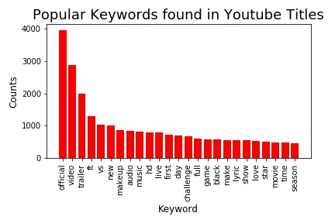


queen_reina - What kind of words can I use as clickbait?
aryshary92 Wow, Reina! Thanks for figuring out the top 20 commonly used keywords in YouTube titles. I’m going to try using these words for clickbait! Subscribe to aryshary92 and give this graph a thumbs up!!
woober_xl The top 20 commonly used words, found in the U.S YouTube dataset, will help attract users to click on your video!

Slide 12
queen_reina - How long should the title of my video be?
Strategy
U.S YouTube
Dataset
Extract titles from dataset
Count length of title in data frame and store results in new data frame
Extracting titles from dataset
Analysis and Actions
Use optimal title length
Review and visualize results using matplotlib
Plot title length vs. view count

Slide 13
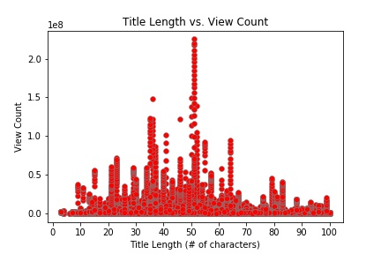
queen_reina - How long should the title of my video be?
aryshary92 @Queen_Reina BTW, YouTube has a 100 character limit for titles, anything longer than 70 characters will be truncated in the search results. P.S, your results make so much sense as to why people keep their title lengths less than 70 characters!
woober_xl @Queen_Reina @aryshary92 So therefore, the optimal title length for a YouTube video is ~50 characters.

Slide 14
Tags

Slide 15
woober_xl - What are the most frequently used tags?
Strategy
Extract titles from dataset
Parse pipe delimited tags using split()
U.S YouTube
Dataset
Iterate through dataframe
Convert tags to string
Append to one list with all tags from the dataset
Analysis and Actions
Look for patterns in the top 20 tags (i.e. comedy-related)
Plot the most frequent tags using a bar chart
Use a Counter to count frequency of tags

Slide 16
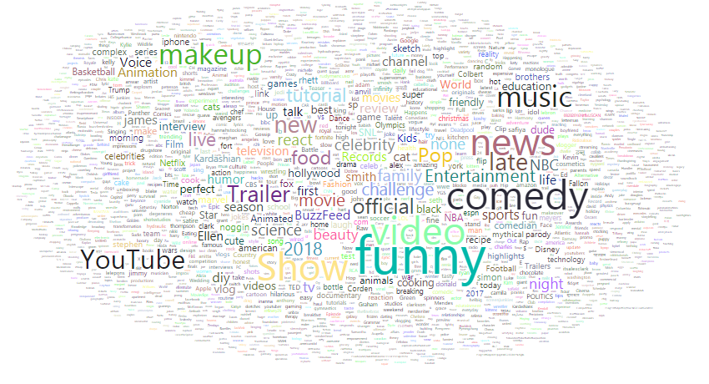
woober_xl - What are the most frequently used tags?
aryshary92 @woober_xl Check out this word cloud. For each video I parsed the Tag string using split() and appended to a giant list. I then used the Counter to aggregate frequencies. There were 58k unique tags! The cloud was generated using Power BI.
queen_reina @woober_xl @aryshary so basically YouTube viewers aim to laugh or learn. You should definitely loop in some of these keywords to expand your audience

Slide 17
Views, likes, dislikes

Slide 18
woober_xl - How do I get my viewers engaged?
Strategy
Extract titles from dataset
Determine measure for likability
and engagement
U.S YouTube
Dataset
Remove videos with comments and ratings disabled
New dataframe with excluded records
Like and engagement index calculated for each video
Analysis and Actions
Dive deeper to understand how dislikes play a role in engagement
Identify where the highest engagement is occuring
Plot like index vs engagement index

Slide 19
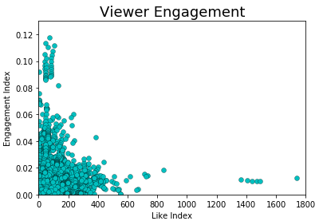
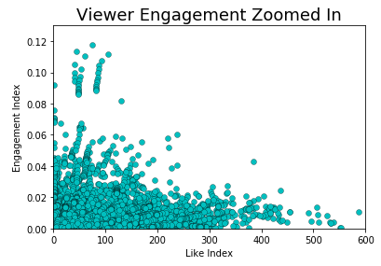
woober_xl - How do I get my viewers engaged?
queen_reina @woober_xl We need a way to measure likability and engagement. Likability = likes:dislikes Engagement = comments:views I created two separate lists with these values and used a scatter plot.
aryshary92 @woober_xl @queen_reina it looks like the highest amount of engagement occurs when there is a good base of dislikes. This makes sense as disagreement would likely trigger comments

Slide 20
Aryshary92 - Are there certain clusters of videos based on likes/dislikes
Strategy
Extracting # of likes/dislikes
from dataset
Used zip () to pair likes and
dislikes
U.S YouTube
Dataset
Extract titles from dataset
Pair like and dislikes for visualizations
Select number of clusters
Analysis and Actions
Determine if clusters are useful or insightful (determine which group is target)
Plot each point to figure
Select Plot type

Slide 21
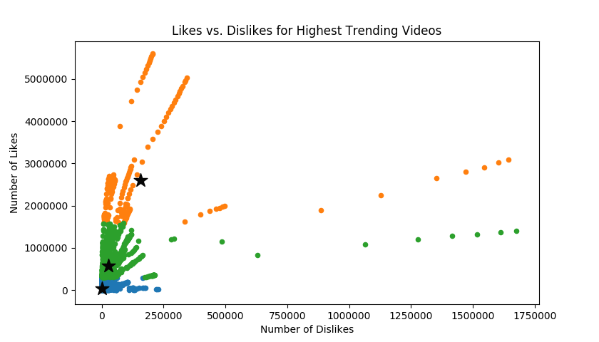
Aryshary92 - Are there certain clusters of videos based on likes/dislikes
woober_xl
@aryshar92 @queen_reina Check out these three clusters from least liked, liked and most liked videos
queen_reina @aryshary92 According to your results, overall it shows the relationship is very linear. We are not seeing other clusters for very disliked or neutral videos for example
Notes:
Defining what viral is?
What does the stars signify?
What is the added value from your conclusions?
Objective of this slide?

Slide 22
Categories

Slide 23
Aryshary92 - What are the most popular video categories?
Strategy
U.S YouTube
Dataset
Extract titles from dataset
Create dictionary of counts of category IDs and category ID
Extracting video category ID from dataset
Analysis and Actions
Upload videos to popular video categories
Review and visualize results using matplotlib
Plot keys and values

Slide 24
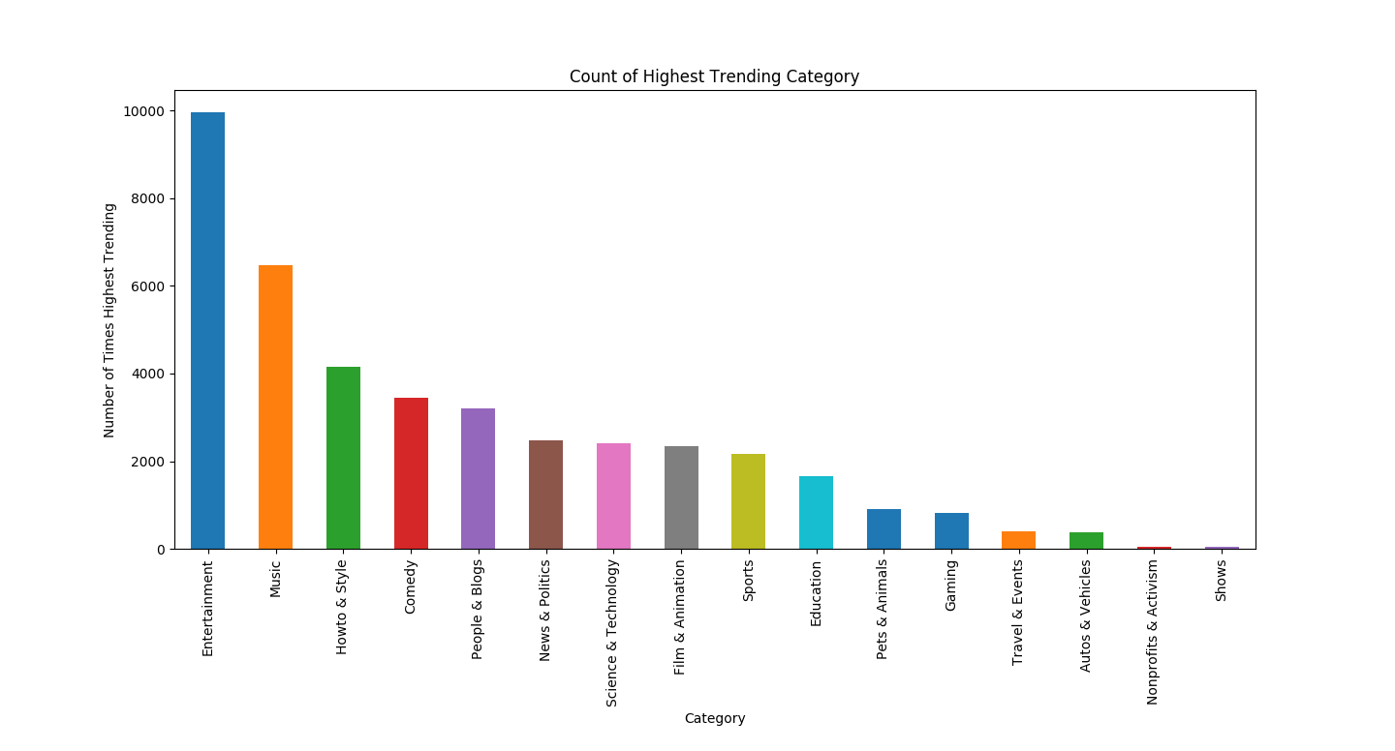
Aryshary92 - What are the most popular video categories?
woober_xl @aryshary92 let’s use a simple histogram to count the number of times a video from a category is trending.
queen_reina Yea, and we learned that the entertainment category blows away the rest of the competition. You should post to this category if you want to go viral.

Slide 25
Machine Learning Approach

Slide 26
queen_reina - Linear regression model (Likes vs. Views)
Strategy
Extract titles from dataset
U.S YouTube
Dataset
Extracting views and likes from respective columns and reshaping array
Splitting train and test dataset
Implementing linear regression based on likes/views dataset
Analysis and Actions
Calculate model evaluation metrics for linear regression
Visualizing Actual vs. Predicted View counts
Utilizing linear regression model to predict view counts

Slide 27
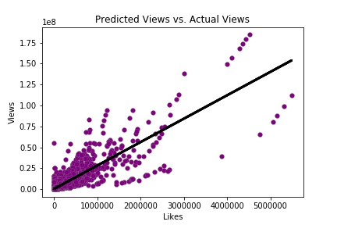
Queen_Reina- LR: ACtual Views vs. Predicted Views
aryshary92 @Queen_Reina @woober_xl The R² value seems to be indicative to our correlation strength (R= 0.82). But what’s with the high MAE and RMSE score?
woober_xl @aryshary92 MAE is the measure of difference between two continuous variables. In this case, it’s the difference of our predicted test data set and prediction data set. It’s due to the outliers. The same can be said for the high RSME, which is the measure distance between each point to the predicted line.
Linear Regression Model Accuracy
R²= 0.75 | MAE= 1.3e6 | RMSE= 3.96e6

Slide 28
Aryshary92 - Next approach
Implementation Steps
U.S YouTube
Dataset
Extract titles from dataset
One-Hot Encoding to create binary matrix for categories
Reshaping arrays for linear regression
Linear Regression
Check predictions using R-squared score and means squared error
Predictions using testing dataset
Fitting linear regression for independent vars (category, likes) to predict views
Notes:
Trained Linear Regression Model using category ID and likes to predict view count.
Since Category ID is listed as a numerical value, I used one-hot encoding to create a binary matrix for categories.
Then I created the Model and tested the accuracy using R-squared, and I noticed a “good” score of around 99% accuracy.
I was skeptical of this result and learned that means squared error is a much more appropriate accuracy test for linear regression models.
Here, we scored very poorly which is what I expect given that the model is fairly simple and that there are outliers.
For the future: If we removed outliers and utilized more attributes in our model, our means squared error score would be much lower.

Slide 29
Looking Ahead...
What additional data elements or approaches would we use to further enhance our analysis?
Subscriber counts
Referral video and tags
Sentiment analysis
Age of YouTuber
How to reduce our means squared error (build a more accurate machine learning model)

Slide 30
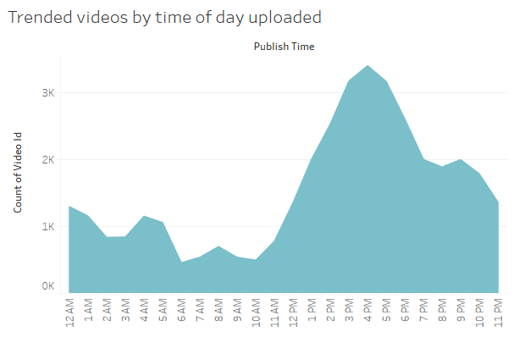
When is the best time to upload your video?

Slide 31
References
[1] http://www.businessofapps.com/data/youtube-statistics/
[2] https://dustn.tv/social-media-statistics/
[3] https://mubaris.com/posts/kmeans-clustering/

Slide 32
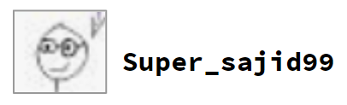
Questions from the class?

