Slide 1
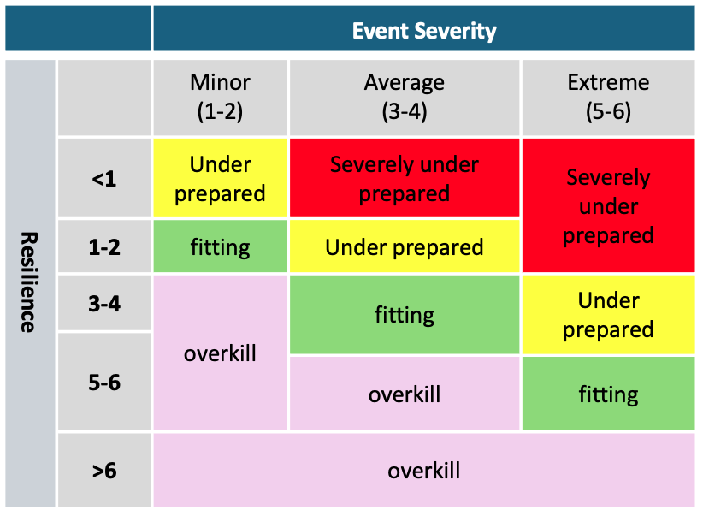
(1-3)
(4-5)
(6)

