Slide 1
Optimising Marketing Efficiency
Paralyzed Veterans of America

Slide 2
Charity campaigns make just $0.17 profit for every $1 spent
The Paralyzed Veterans of America (PVA) is a charity helping wounded veterans
It has a database of 13 million donors it can contact for support
It primarily uses Direct Mail as its primary contact method, with a cost of $0.68 per piece
The average donation from responders is $15.68
So to break even 1 in 24 people must respond to the campaign (4.34% response rate)
The campaign response rate is currently 5.08%
Profits from the campaign are only 17% of the amount spent, a Return on Investment of just 1.17
Actual ROI is lower because underlying costs such as marketing staff and technology are not available and have not been included in the calculation
Such ROIs are very poor by industry standards and can be improved significantly with the use of data analytics

Slide 3
Methodology

Slide 4
Machine Learning will predict the likelihood and gift amount of a response
A logistic regression model will be used to predict the likelihood of each individual responding to the appeal
Reason: Marketing efficiency can be hugely improved by sending the mailing only to those predicted to respond
A multivariate linear regression model will be used to predict the amount gifted by each individual
Reason: Estimated donation can be used to decide the gift sent to each donor to ensure profitability is optimised
The 2 models have been built in R on a random sample of 92,000 people from the PVA database containing various demographic attributes, past mailings to the person and their donation history

Slide 5
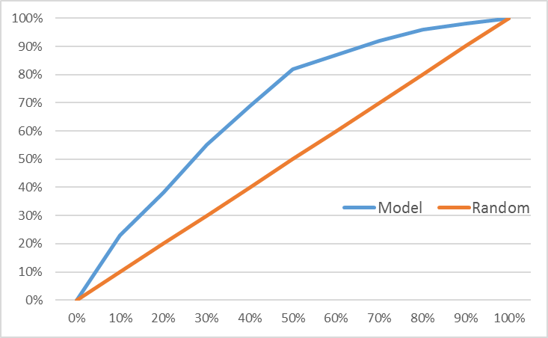
Predicting who will donate
A logistic regression model built in R was developed that can now score every person in the database with a propensity to donate if contacted
Top predictive variables
Time since last donation
Previous donation
Gift received from PVA in mailing
Income
Veterans in the family
Testing the model on a previous campaign showed it can identify:
55% of respondents within the top 30% of people predicted
82% of respondents within the top 50% of people scored
Lift chart showing model performance compared to random selection from the database

Slide 6
Predicting size of donation
2 multivariate linear regression models were constructed to predict the size of donations dependent on if they’ve donated previously
Model 1 – for Previous Donors, achieved a very high R² of 54%
Most important variables- last donation, minimum donation, last gift value, number of donations
People often donate the same amount but can be persuaded to donate more with a higher value gift and donate slightly less on average if they donate more frequently
Model 2 – for those who have never donated
R²⁻ 22%- lower performance as people tend to repeat previous donation levels, for this group we can only use demographics to estimate donations
Most important variables- income, age, veteran in family
Wealthier households tend to donate more, as do older households and those with a veteran in the family

Slide 7
Recommendations

Slide 8

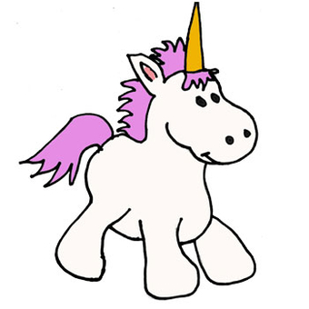


Segment the donor base by value
High estimated donation
Customers have been segmented into 4 groups based on the estimated likelihood to respond and the estimation donation given according to the models
Unicorns- Hard to make donate but valuable when they do
Whales- Regular donators and very valuable each time
Minnow- Numerous but difficult to get donation and low value each
Tuna- Reliable donators but less valuable each
Unicorns
4% of the base
9% of revenue
The Whales
8% of the base
34% of revenue
Low estimated donation
The Minnows
56% of base
22% of revenue
The Tuna
32% of the base
35% of revenue
Low propensity to donate
High propensity to donate

Slide 9
Communication strategies
Emails typically have a cost of $0.02 each so by using this rather than direct mail (cost $0.68) for low likelihood to donate segments we can ensure we have positive returns form the marketing spend. Expected high donors can be sent direct mails and gifts at higher cost to the PVA because we will see a significant response in donations
Each of the four groups needs its own communications strategy to be built in partnership with the marketing team:
Unicorns- target with emails as while valuable, the low response rate will erode profitability if direct mailing were used
Whales- Send premium direct mail with gifts as can expect a good response
Tuna- Send regular emails and occasional more expensive Direct Mailings to keep marketing cost per donation low
Minnows-Target infrequently with emails to keep cost per donor low and so ensure profitability despite low expected returns
This approach will significantly improve the current Return on Investment from campaigns by reducing wasteful spend, greatly improving efficiency
Collaboration with the marketing team will develop the exact strategy and expected improvements to RoI, but my experience and the share of customers among the segments makes me expect a doubling of RoI to 2.34 as a minimum

Slide 10
Future Steps
This is the beginning of the process to embed an analytical approach to the organisation in which a culture of learning from data is in place
Through an ongoing cycle of data driven insight, hypothesis testing and evaluation the PVA can significantly reduce wasteful marketing expenditure and put more money to use helping veterans
Future projects will include:
- Segmenting the donor base further through demographic attributes
- A/B testing different message content, subject lines and calls to action to improve response rates
- Identifying lookalikes of our Whales in the wider society and targeting them for acquisition campaigns to develop a first response from them and get them added to the database
- A data audit to identify any further data sources or engineering of the data that can be used in version 2 of the models to improve performance

