Slide 1

Humanlytics
Feb 19, 2024
Muhammad Tayyab
Ramya
Dallas Diaz
Muhammad Arslan
https://github.com/mtayyab25/Capstone_CS-5588-
https://github.com/THAMBABATTULARAMYAKUMARI2019/Datascience-capstone_CS5
https://github.com/dallasdiaz93/datasciencecapstone

Slide 2


Introduction
The main issue in today’s work world seems to be turnover rates. It can be attributed to COVID, employee satisfaction, benefits, etc.
Not all HR teams within companies know these things so our product should shed more light on what is affecting their turnover rates and how they can get those down.

Slide 3
Objectives
Our Objectives are to create a dashboard that informs HR teams and provides recommendations on how to improve and lower turnover rates
We will look at:
Employee satisfaction
Skills required for new hires
Recommendations for HR staff

Slide 4

Triangle Model Overview
Here are our three main components of our Triangle Model:
FRONT END:
VS Code
Streamlit
Python
BACK END:
Firebase Database
MODEL:
GPT3.5

Slide 5

Backend Functionality
Our main storage of static data and real time data is Firebase.
We are inputting data sets that we’ve found into tables created in Firebase
Our front end allows users to input information that goes to those same tables.

Slide 6
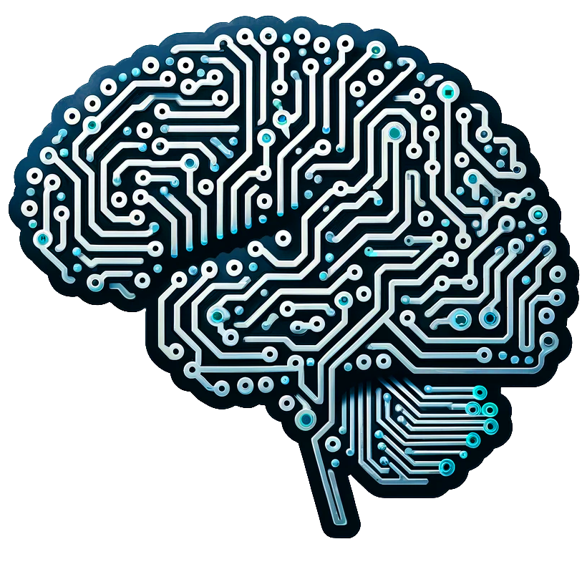
AI ANALYTICS
Al model Being used in this project
GPT3.5 model
VS code
Streamlit
Jupyter notebook

Slide 7
Frontend/User Interface
User Interface is designed using Streamlit is an open-source Python library that allows developers to create web applications for machine learning, data science, and other analytical tasks with minimal effort.
Here , Features we have developed App and Example.
Data entry , Entering job titles into the field will prompt the display of necessary skills associated with that position .

Slide 8
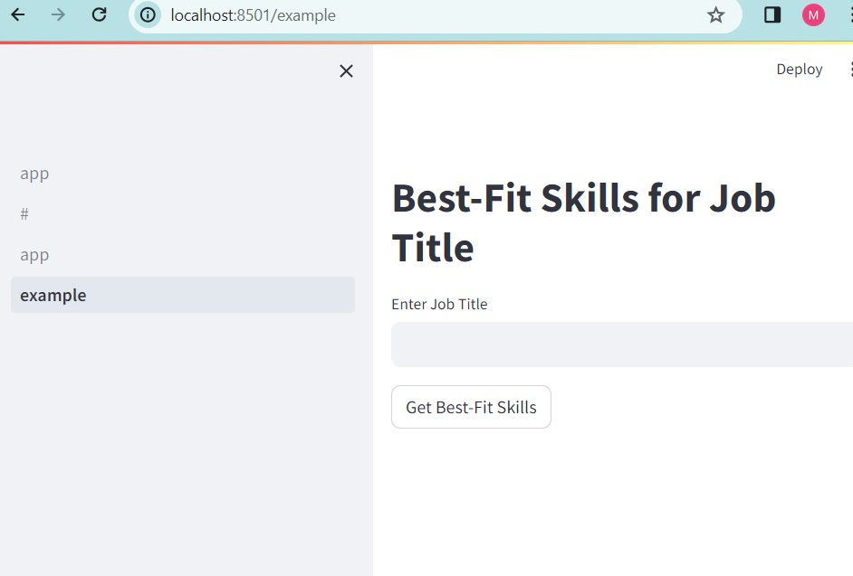
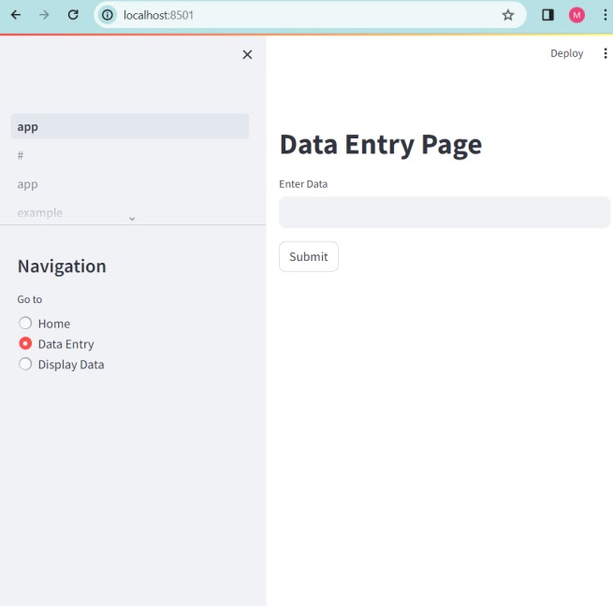
User Interface

Slide 9
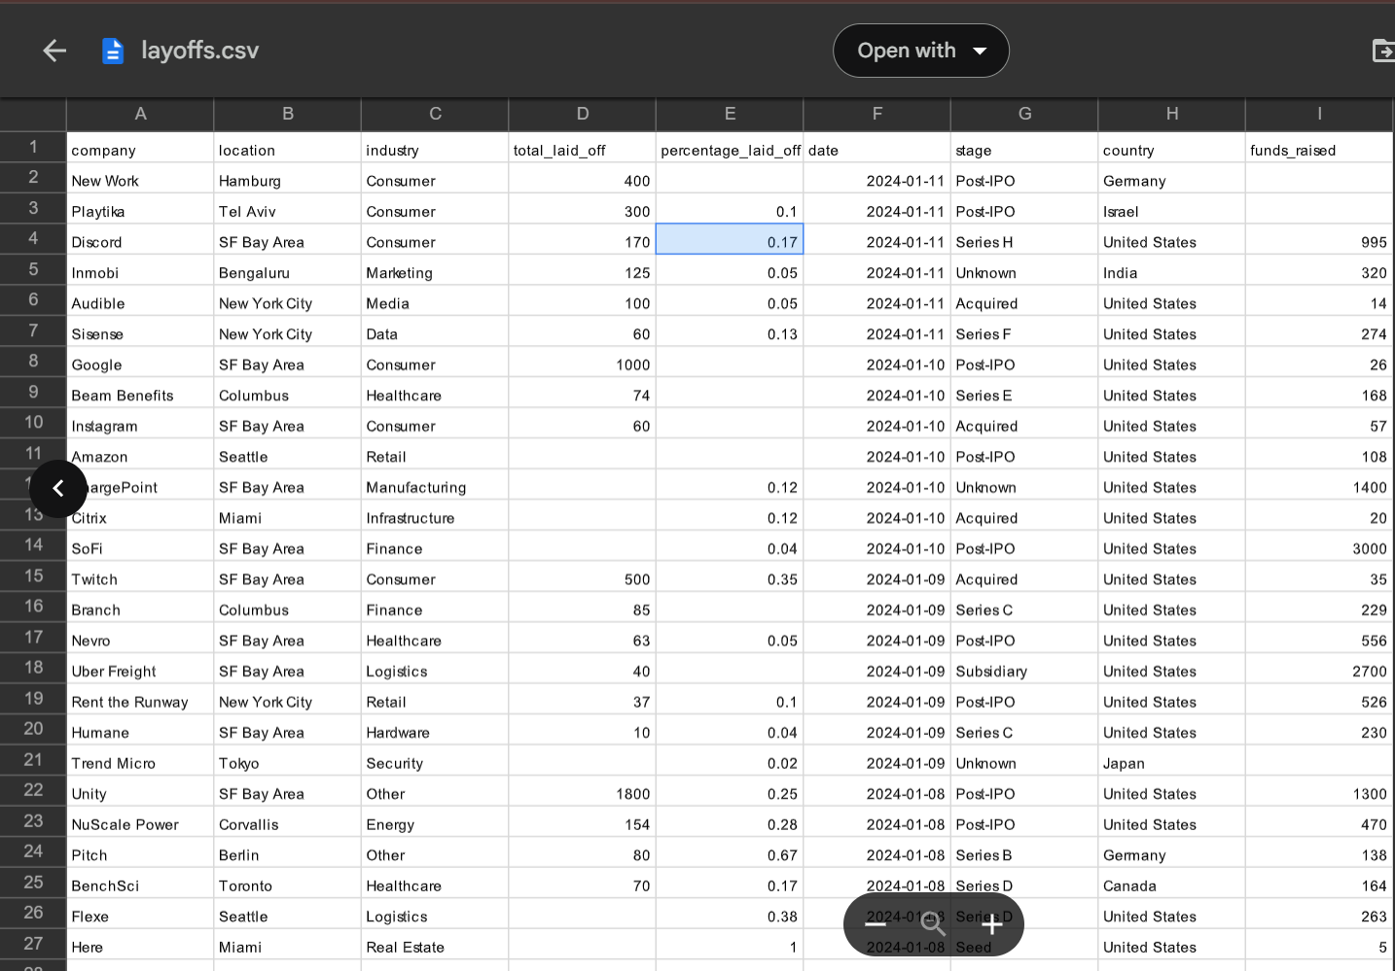
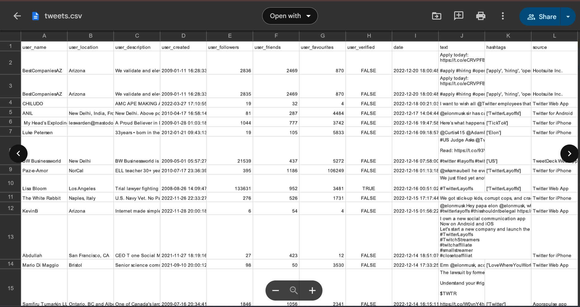
Raw Data

Slide 10
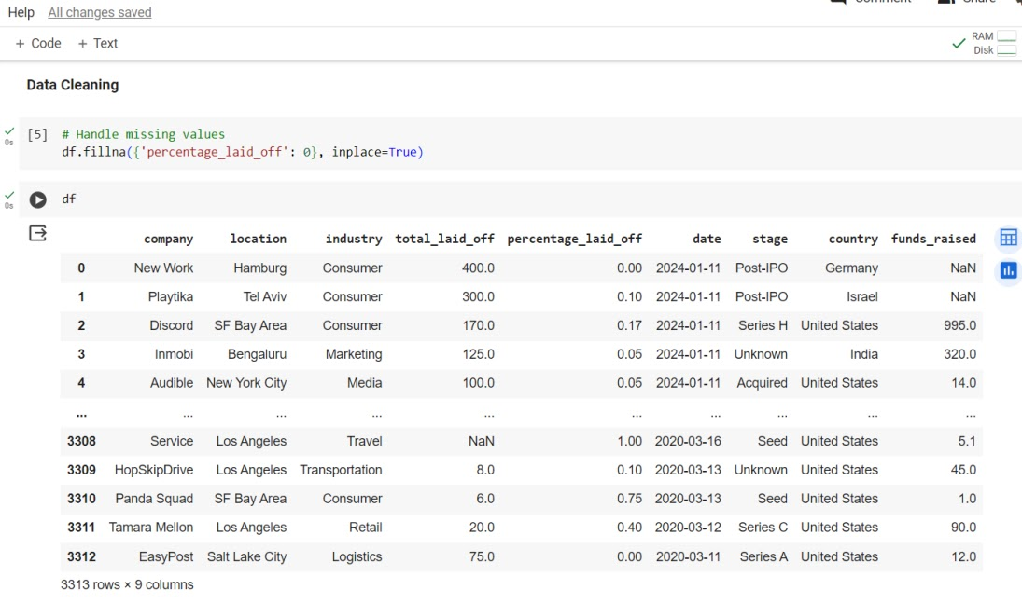
Data Cleaning and PreProcessing

Slide 11
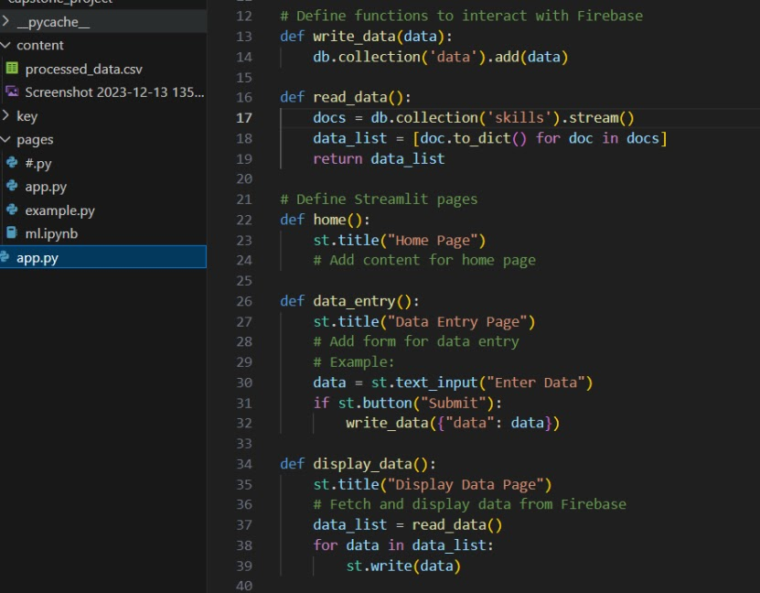
Firebase Connection

Slide 12
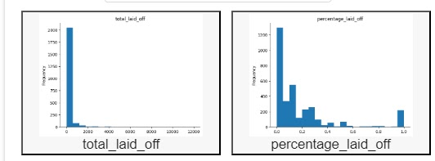
Layoff data_Visualization

Slide 13
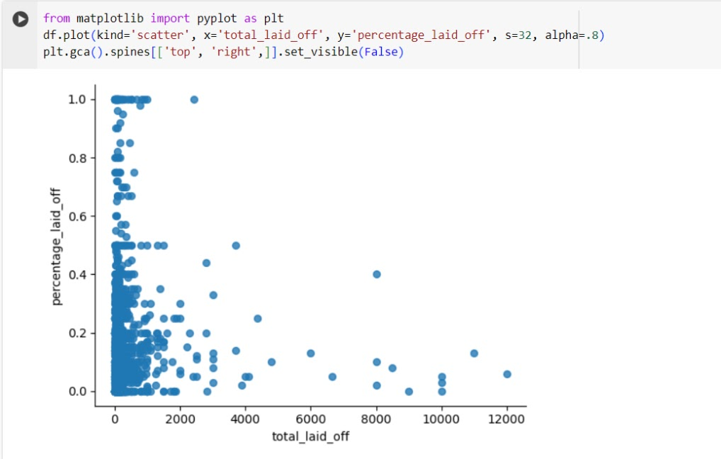
Layoff_ Visualization

Slide 14
Integration
The integration of GPT-3.5 model, VS Code, and Streamlit forms the foundation of our dashboard. GPT-3.5 model provides natural language processing capabilities to interpret user inputs and generate recommendations.VS Code serves as the development environment for coding and managing the project. Streamlit acts as the user interface framework, enabling seamless interaction and visualization of data and recommendations.

Slide 15

Integration Challenges and Solutions
Here are Challenges and
Challenge 1: Handling large datasets efficiently and securely, especially when using Firebase.
Solution 1: Optimizing data storage and retrieval processes, and implementing robust security measures to protect sensitive information.
Challenge 2: Ensuring compatibility and consistency across different platforms.
Solution 2: Conducting thorough testing and debugging, and implementing compatibility checks and version control mechanisms.

Slide 16
Contribution Points For Integration Efforts
Dallas: 25%
Arslan: 25%
Tayyab: 25%
Ramya: 25%

Slide 17
Results and Discussion
The dashboard informs HR teams of turnover rate contributors like employee satisfaction and necessary skills, enabling data-driven decisions. This empowers HR to tackle issues effectively and implement retention strategies.
The Streamlit-designed interface provides HR teams with a seamless, intuitive experience, allowing easy data input and visualization. Integration of AI models like GPT-3.5 enhances usability, making it a valuable tool for addressing turnover challenges.

Slide 18
Data Collection
https://docs.google.com/spreadsheets/d/13LGiJ2aAFWkWvqfayr3bSWlJOvvx4qNsJ_6RFvAUXb0/edit#gid=1208650237
https://docs.google.com/spreadsheets/d/1TZc5gjw6TXprXaLimRwyrWhF4umrBEpun4TuV5xcllA/edit#gid=1508777424
https://docs.google.com/spreadsheets/d/1M_2IrocTETVPClWdZStjdfTqTROA7aJf8Y0WqmdG6KQ/edit#gid=1513922754
https://docs.google.com/spreadsheets/d/1kwamdTZ8bphHfhdDrEdiNA5so2rYiWY0/edit#gid=88241723
https://drive.google.com/drive/search

Slide 19
Conclusion
Summary of Achievements: We've combined Firebase for storing data, GPT-3.5 for AI analysis, and Streamlit for creating the dashboard. This makes our tool complete for tackling turnover rates at work, giving HR teams useful insights and suggestions to handle turnover better.
Impact of Integrated Components: Bringing together Firebase, GPT-3.5, and Streamlit has greatly improved our dashboard usability. HR teams can now understand turnover factors, get new hire skill recommendations, and make better decisions for improving outcomes.
Future Work Suggestions: We plan to make our dashboard even better by adding more data sources and improving our AI algorithms. We also aim to expand its use beyond turnover rates to help HR teams with other workforce management challenges, ensuring continuous improvement and value.

Slide 20
Reference
[1] https://github.com/rrambhia22/ResumeClassification_Parser
[2] https://github.com/ghelanikirtan/HR-Process-Automation
[3] https://github.com/deepak147/resumeClassify
[4] https://gist.github.com/cquangc/1b0d6cf08fe250a680d1d823eff
[5] https://github.com/Spidy20/Smart_Resume_Analyser_App

Slide 21
Thank you for you time
Questions? Please feel free to contact
Dallas Diaz: ddmnh@umsystem.edu
Muhammad Tayyab : mt56w@umsystem.edu
Ramya Thambabattula: tramyakumari.22s@gmail.com
Muhammad Arslan: manbb@umsystem.edu

