Slide 1

📊 Breast Cancer Wisconsin (Diagnostic) Dataset
(Binary Classification: Benign vs Malignant)
By: Arslan Ahmed

Slide 2
1️⃣ What is this dataset?
This dataset is called the Breast Cancer Wisconsin (Diagnostic) Dataset.
It is one of the most widely used datasets for teaching binary classification in Machine Learning.
🎯 Objective (Learning Goal)
Classify a tumor as
Benign (B) → non-cancerous
Malignant (M) → cancerous
based on cell characteristics extracted from medical images.

Slide 3
2️⃣ How was this dataset collected?
🧪 Data Collection Process (Important for students)
Fine Needle Aspiration (FNA) was performed on breast masses
The samples were observed under a microscope
Digital images of cell nuclei were captured
Image processing techniques extracted numerical features
These features describe: Shape, Size, Texture, Smoothness of cells
📌 Important point for students:
👉 This is NOT raw image data
👉 It is pre-processed numeric data extracted from images

Slide 4
3️⃣ Dataset Structure (Columns Overview)
Your data.csv typically contains:
🔹 Identifier
id → unique patient/sample ID (NOT useful for ML)
🔹 Target Variable (Label)
diagnosis
  M → Malignant
  B → Benign
👉 This is the output (y)

Slide 5
4️⃣ Feature Groups (Most Important Part) (1/3)
The dataset has 30 real-valued input features, computed from cell nucleus images.
These features come in three groups:
🟦 Group 1: Mean Features
Describe the average value of each cell property.
Examples: radius_mean, texture_mean, perimeter_mean, area_mean, smoothness_mean
🧠 What this means:
Average size, shape, and texture of tumor cells.

Slide 6
4️⃣ Feature Groups (Most Important Part) (2/3)
🟩 Group 2: Standard Error Features
Describe variation in cell properties.
Examples: radius_se, texture_se, area_se, perimeter_se
🧠 Interpretation:
How much the cells vary → higher variation may signal malignancy.

Slide 7
4️⃣ Feature Groups (Most Important Part) (3/3)
🟨 Group 3: Worst (Extreme) Features
Describe the worst (largest/most irregular) observed values.
Examples: radius_worst, texture_worst, area_worst, perimeter_worst
🧠 Medical intuition:
Malignant tumors often contain extreme, irregular cells, so worst values are very informative.

Slide 8
5️⃣ Meaning of Key Parameters
Feature | Meaning
radius | Distance from center to boundary
texture | Smoothness/roughness of image
perimeter | Outer boundary length
area | Size of nucleus
smoothness | Local variation in shape
compactness | How tightly packed cells are
concavity | Depth of inward curves
concave points | Number of concave parts
symmetry | Shape regularity
fractal dimension | Complexity of shape
Note: Cancer cells are usually larger, irregular, rough, and asymmetric.

Slide 9
6️⃣ Target Variable Encoding
B → 0 (Benign)
M → 1 (Malignant)
This makes it suitable for:
Logistic Regression
KNN
SVM
Decision Trees

Slide 10
7️⃣ Which Parameters are IMPORTANT for Classification?
⭐ Highly Predictive Features (Conceptually)
These features are strong indicators of malignancy:
🔥 Size & Shape
radius_mean, radius_worst
area_mean, area_worst
perimeter_mean, perimeter_worst
🔥 Irregularity
concavity_mean
concave points_mean
symmetry_mean
🔥 Extremes (Very Important)
All *_worst features
(Malignant cells show extreme behavior)

Slide 11
8️⃣ Feature Engineering — What Can Students Do?
✅ Eligible for Feature Engineering
1️⃣ Drop useless columns
❌ id
2️⃣ Encode target
diagnosis → 0 / 1
3️⃣ Feature scaling (VERY IMPORTANT)
StandardScaler
MinMaxScaler
👉 Because: Values range from small (smoothness) to large (area)

Slide 12
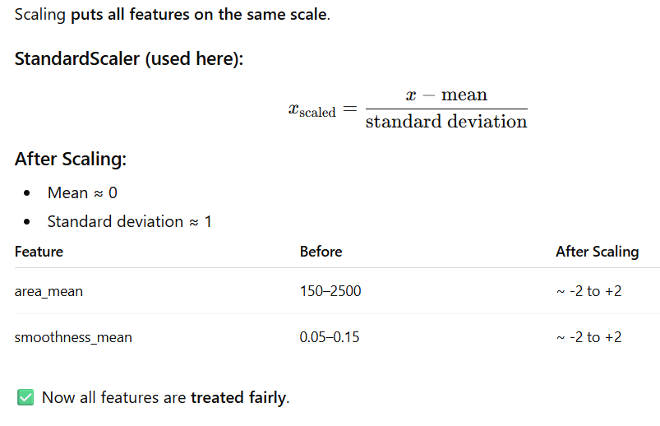
What Does Feature scaling Do?

Slide 13
9️⃣ Why This Dataset is PERFECT for Classification at beginner level
✔ Binary classification
✔ Numeric data only
✔ No missing values
✔ No NLP / images complexity
✔ Clear medical meaning
✔ Works with simple ML models
“We use measurements of cell size, shape, and irregularity to predict whether a tumor is benign or malignant.”

Slide 14
1️⃣0️⃣ step-by-step Python code
Let’s Implement

