Slide 1
Supermarket Inventory Management System
Using Python, Angular, Html & CSS, SQLite and Docker
Name – Arslan Firoz ID : 30443 Superset Id - 4635148

Slide 2
Architecture
The project follows a Microservices Architecture.
• Services: Auth, Sales, Inventory
• Each service runs independently
• Flask for API services
• Angular for frontend
• SQLite as database

Slide 3
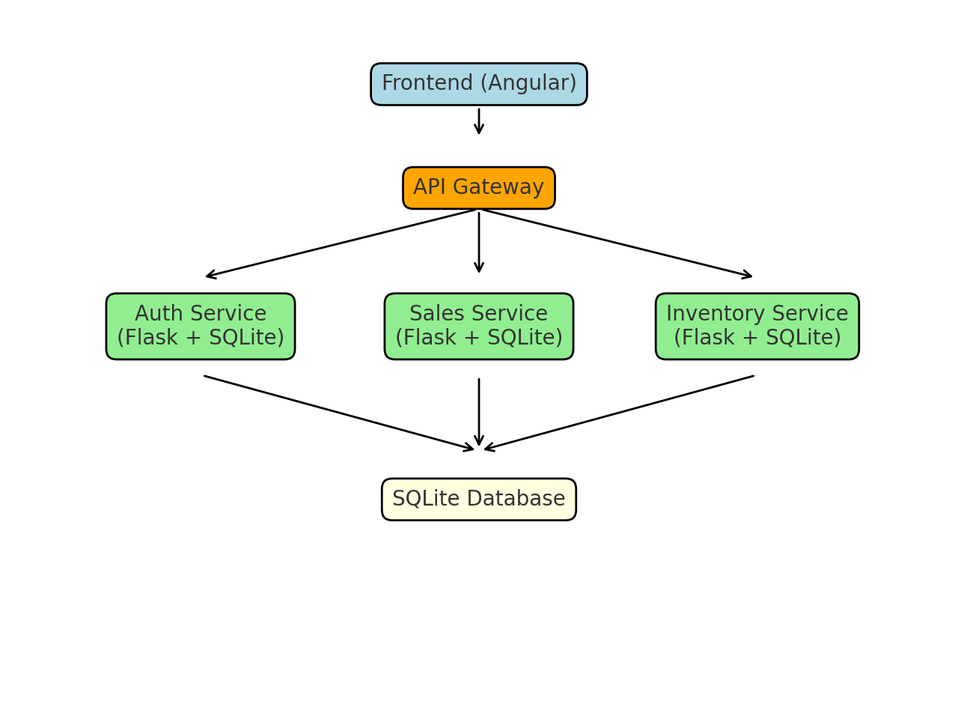
Architecture Diagram

Slide 4
Microservices Overview & APIs
1. Auth Service:
• Manages user authentication & authorization
• APIs: POST /login, POST /register
2. Sales Service:
• Handles sales transactions & billing
• APIs: GET /sales, POST /sales
3. Inventory Service:
• Manages product CRUD operations
• APIs: GET /products, POST /products, PUT /products/{id}, DELETE /products/{id}

Slide 5
Containerization
• Each microservice is containerized using Docker
• Containers created:
- Auth Service Container
- Sales Service Container
- Inventory Service Container
- Angular Frontend Container

Slide 6
Deployment with Docker Compose
Building - Docker compose up -d —build
Start the containers - docker compose up
See logs - docker logs
Info - docker ps (to see information and health of containers.)
Stop - docker-compose down (stop running containers)
Delete - docker container prune -f (delete all stopped containers)

Slide 7
Conclusion
• Implemented Supermarket Inventory Management using microservices.
• Modular and scalable system.
• Flask APIs for each service.
• Angular frontend.
• Containerized and deployed using Docker Compose.

