Slide 1
Социолингвистика
Функциональные модели
Даша Попова
23 ноября 2021

Slide 2
Three waves of variation
Eckert, 2012

Slide 3
The first wave of variation (Eckert, 2012):
The first wave of variation studies established broad correlations between linguistic variables and the macrosociological categories of socioeconomic class, sex, class, ethnicity, and age.
Seminal work: Labov’s (1966) study of the Social Stratification of English in New York City.
Labov defined the notion of the vernacular as each speaker’s first acquired and most automatic, hence maximally systematic, linguistic production

Slide 4
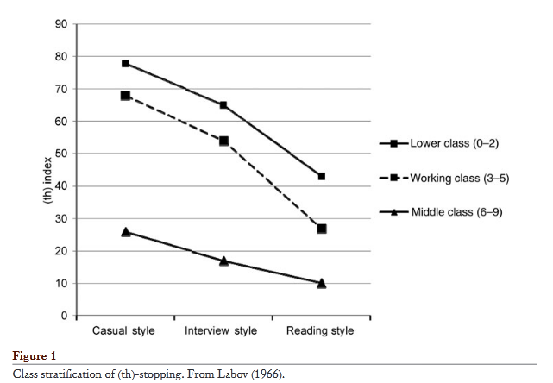
The first wave of variation (Eckert, 2012):

Slide 5
The first wave of variation (Eckert, 2012):
Unaffected by socially motivated correction, the vernacular emerged as a classic natural object of scientific inquiry.
Class, determined according to standard sociological measures, placed individuals passively within a structure that determined their access to standard language and their exposure to linguistic change.
Social agency was limited to self-correction as individuals, sensitive to the relative status of class varieties, moved away from the vernacular as they adopted more standard forms in their more careful speech.
The first wave treated this within-speaker pattern of variation not as involving a choice between socially meaningful forms, but as the result of self-monitoring to suppress a natural cognitive process.
Style, then, was conceived purely as the output of varying attention to speech.

Slide 6
The second wave of variation (Eckert, 2012):
The second wave employed ethnographic methods to explore the local categories and configurations that inhabit, or constitute, these broader categories.
In his work on a sugar plantation in Guyana, Rickford (1986) found a major division between those who worked the sugar (the estate class) and those who worked in the offices (the non-estate class).
These groups showed sharp differences in verbal culture, in language ideology, and in linguistic production.
This study emphasized that although the vernacular maybe stigmatized on a global level, its association with local values and practices gives it positive value on the local level.
Eckert (1989a, 2000): an ethnographic study of adolescents in high schools from the predominantly white Detroit suburban area. The student social order in these schools involved two mutually opposed social categories, jocks and burnouts.

Slide 7
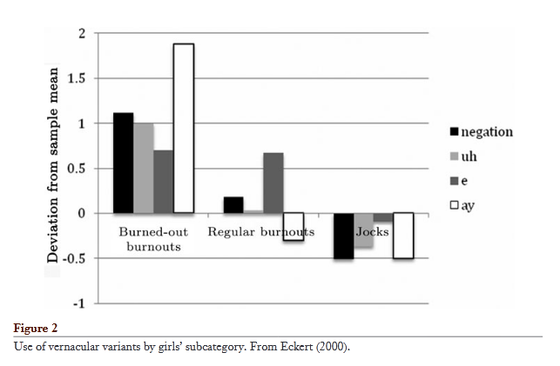
The second wave of variation (Eckert, 2012):

Slide 8
The third wave of variation (Eckert, 2012):
(a) variation constitutes a robust social semiotic system, potentially expressing the full range of social concerns in a given community;
(b) the meanings of variables are underspecified, gaining more specific meanings in the context of styles, and
(c) variation does not simply reflect, but also constructs, social meaning and hence is a force in social change.

Slide 9
The third wave of variation (Eckert, 2012):
Zhang (Zhang 2005, 2008) traces the indexical appropriation of individual Mandarin variables in the emergence of a wealthy elite in Beijing.
China’s move into the global economy has created a new class of yuppies, young managers in the foreign-owned financial sector.
The yuppies’ value in the global financial market depends on the projection of a cosmopolitan self, and they have developed a speech style to match their more general materialistic and cosmopolitan lifestyle—a style that contrasts starkly with that of their peers in state-owned financial institutions.
One variable is the rhotacization of finals (in which “flower” [hwa] is pronounced [hwar]).
Another Beijing feature, the interdental pronunciation of /z/, is commonly associated with a feckless character, the “alley saunterer”. The yuppies stay away from this variable altogether because casual fecklessness is not a desirable trait for a transnational business person.

Slide 10
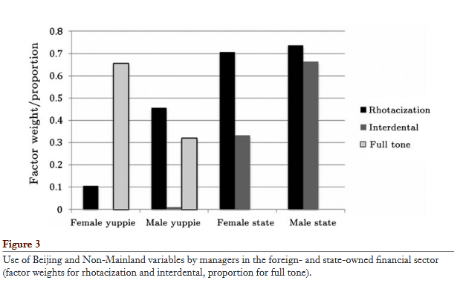
The third wave of variation (Eckert, 2012):

Slide 11
Dimensions of rhythm: The multi-layered nature of rhythmic style
Calder and Popova, 2014
Notes:
Move down subtitle, capitalize “Burnouts” In general: fewer words per slide, more sound files

Slide 12
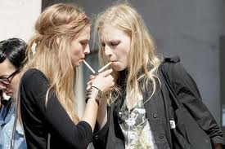
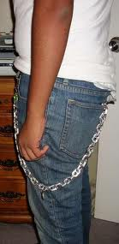
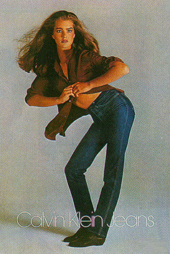
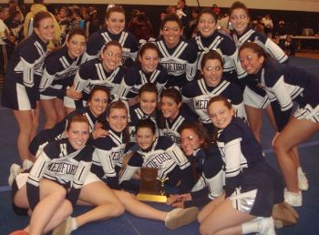
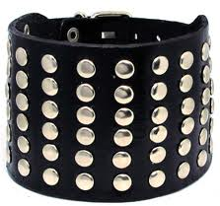
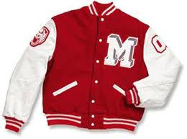

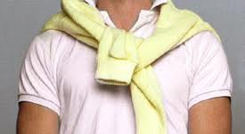
The data: Eckert (1989, 2000)
Belten High
Detroit suburbs, 1980s
burnouts
in-betweens
jocks

Slide 13
The data: Eckert (1989, 2000)
The current analysis is based on the first 5 min of 12-minute samples
from one-on-one interviews with two particular students
who fall at either end of these two social extremes.
burnouts
jocks
Judy
Melody
the most burned-out of the burnouts
interview persona is tough, cool
doesn’t care about social standing
the most squeaky-clean of the jocks
interview persona is sweet, innocent
concerned with her place in the social hierarchy
Neither speaker is a typical member of- or a leader within- her group.

Slide 14
Proposal
Methodological claims:
we suggest zooming in to rhythmic patterns at the IP level to capture differences that might be obscured at the global level
looking at details like accents and pauses to capture rhythmic differences that might be obscured by solely looking at PVI
Empirical claim:
Judy’s and Melody’s rhythmic patterns are phonologically distinct from each other
Rhythmic variation is stylistically informative

Slide 15
Rhythm
Traditionally looks at isochronous units
Rhythm Class Hypothesis: language is made of up rhythmically isochronous units (Pike 1946), (Abercrombie 1965)
Stress-timing (the interval between two stressed syllables is equal ) vs. syllable-timing (the duration of every syllable is equal )
In sociolinguistics:
Prosodic Rhythm (i.e. syllable- vs. stress-timing), as captured by the Pairwise Variability Index (Grabe and Low 2002)
Dialect feature: Thomas and Carter (2006), Coggshall (2008), Szakay (2008), Torgersen and Szakay (2008)
Stylistic feature: Carter (2005), Callier (2011)

Slide 16
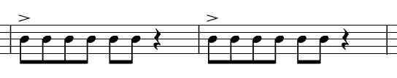
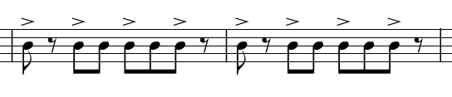
Rhythm in Music

Slide 17
Rhythm
Rhythm is a multi-layered phenomenon comprised of many elements
Though PVI is informative, looking at some of these rhythmic elements can illuminate patterns obscured by PVI
In this study we look at the speakers’ uses of:
Accents
Pauses

Slide 18
Methodology
We propose to study rhythm on the IP level
At the IP level, we propose to look for rhythmic patterns as opposed to e.g. computing the Pairwise Variability Index (PVI, Low and Grabe 1995)
PVI as a measurement might be informative, but less informative than rhythmic patterns
PVI [2 4 2 4 2 4] = PVI [8 16 8 16 8 16]
PVI [2 4 8 16] = PVI [16 8 4 2]

Slide 19
Methodology
A study of rhythmic patterns on the IP level faces two further methodological problems:
IP identification
rhythm characterization
General strategy: agreement between two annotators, decisions rooted in a thorough examination of a number of parameters

Slide 20
Methodology
Parameters considered in IP identification:
pitch contour
pauses
accents
correspondence to clauses

Slide 21
Methodology
Parameters considered in rhythm characterization:
accents (pitch, relative duration, intensity)
pauses: IP-internal (relatively short, clause-internal, bearing an articulatory cue, e.g., glottalized pauses, pauses preceding an emphatically accented syllable) vs. IP-external
Default assumption: IPs with one prominent accent and no internal pauses that correspond to clauses are unmarked
Notes:
Maybe wait to present “Default assumption” until early in Results, or discussion

Slide 22
A taste of rhythmic variation
Judy
“All sixth, we had so much fun”
“Damn, we did some crazy shit”
Melody
(3) “We used to have so much fun”
(4) “She was my first friend”

Slide 23
Results
Quick statistical observations:
 | Judy | Melody
# IPs | 84 | 109
Average # sylls / IP | 5.583 | 5.983
Average IP duration | 1089.046 | 1087.87
Average speech rate | 5.046 sylls/s | 5.384 sylls/s
% Rising IPs | 25% (21 of 84) | 8.257% (9 of 109)
Pitch St Dev | 32.224 | 31.367

Slide 24
Results - PVI
 | Judy | Melody
PVI | 0.626 | 0.583
Linear regression in R using lme4 (Bates et al. 2011)
Factors: speaker, IP-duration, # sylls in IP
 | Estimate | Significance
Speaker | -0.043 | n.s.
Duration | -0.009 | n.s.
# sylls | 0.001 | n.s.

Slide 25
Results - Pauses
Judy has more internal pauses than Melody (***)

Slide 26
Results - Accents

Slide 27
Results - Accents
Linear regression in R using lme4 (Bates et al. 2011)
Factors: speaker, rising/falling, IP duration, number of syllables
 | Estimate | Significance
Speaker (Melody) | -0.873 | ***
Rising/Falling | 0.124 | n.s.
IP Duration | 0.001 | ***
# Syllables | 0.011 | n.s.

Slide 28
Rhythmic variation
Though PVI difference is not significant, Judy and Melody show highly significant differences in their use of accents and pauses!
Judy
variation in duration and pitch (hence, different accents)
IP internal pauses
the majority of IPs have multiple accents
Melody
less variation in duration and pitch (overall, more monotone)
less IP-internal pauses
less IPs with multiple accents
Judy’s IPs are marked, Melody’s IPs are unmarked
Statistical facts above are not unrelated – together they reflect two different rhythmic strategies Judy and Melody use

Slide 29
Rhythmic patterns: Judy
[(x _)_{IP}∨(x_x_x)_{IP}]_{clause,}
where x is a stressed syllable, _ is a sequence of unstressed syllables, ∨ is an optional short (often glottalized) pause. The first IP is often pronounced in a creaky or breathy voice.
[(All sixth)_{IP} ∨ (we had so much fun)_{IP}]_{clause}
[(Damn)_{IP} ∨ (we did some crazy shit)_{IP}]_{clause}
[(Oh my God)_{IP}]_{clause}
The pattern above is not the only pattern Judy uses, and it is not always fully realized, but it prevails.

Slide 30
Disfluencies?
“We uh dressed up as sardines you know”
“We, we got arrested before”

Slide 31
[(x _)_{IP}∨(x_x_x)_{IP}]_{clause}
,
[(All sixth)_{IP} ∨ (we had so much fun)_{IP}]_{clause}
[(Damn)_{IP} ∨ (we did some crazy shit)_{IP}]_{clause}
[(We uh)_{IP} ∨ (dressed up as sardines you know)_{IP}]_{clause}
[(We)_{IP} ∨ (we got arrested before)_{IP}]_{clause}
Disfluencies are not (always) disfluencies – they can be part of the rhythmic patterns!

Slide 32
Rhythmic patterns: Melody
Melody’s accents reflect the Information Structure
“She was my first_{FOC} friend”
Penny: “Do you think that you’ll keep a lot of your high school friends after you graduate?”
Melody: “Not a lot_{FOC}. I’m pretty sure_{FOC} I’ll keep Karen_{FOC}. In fact_{FOC}, I’m almost positive_{FOC} I will_{FOC}. Um, probably Bessie_{FOC} too. …”

Slide 33
Rhythmic variation is stylistically informative
Judy and Melody use distinct rhythmic patterns
Judy’s patterns are less canonical than Melody’s patterns
Judy’s patterns have multiple accents that are dramatic and diverse in nature
Melody’s accent placement is driven by the Information Structure pressures
Judy’s patterns can be perceived as being more “expressive”, whereas Melody’s patterns can be viewed as more “interactive”

Slide 34
Экспрессивные указательные местоимения
Acton and Potts, 2013; Potts, 2013

Slide 35
До Трампа: Sarah Palin
“Americans are cravin’ that straight talk”
Acton and Potts, 2013; Potts, 2013

Slide 36
Бурная реакция на ее речь
FoxNews.com:
“We feel like she talks like we do.”
“She talked like real people to real people”
Huffington Post:
“illusion of straight-talking”
“pseudo-folksiness and fundamental dishonesty”
Acton and Potts, 2013; Potts, 2013

Slide 37
Дебаты 2008
Joe Biden, Palin’s opponent:
“We should be helping them build schools to compete for those hearts and minds of the people in the region”
Acton and Potts, 2013; Potts, 2013

Slide 38
И все, все, все:
В полиции: make that phone call right now
Стюард(есса): get those bags under that seat in front of you
Инструктор йоги: get that left arm up over that head
Acton and Potts, 2013; Potts, 2013

Slide 39
Экспрессивные употребления указательных местоимений
давно известны лингвистам
есть и в русском:
Смех смехом, а в полицию уже обратилось более двадцати горожан, которые уверяют, что после встречи с этим "похитителем человеческих душ"( так окрестили маньяка журналисты) у них чего-то не хватает. Ох, и мнительные эти американцы! У нас бы на такого маньяка народ молился. Лос-анджелесская полиция злоумышленника усиленно разыскивает, но пока безуспешно. [ Похититель душ // «Криминальная хроника», 2003.06.24]
эти дети мне уже надоели
Уберите уже эти ноги из прохода!
Acton and Potts, 2013; Potts, 2013

Slide 40
Корпусный подход
Эти утверждения импрессионистические
Можем ли мы их квантифицировать?
Acton and Potts, 2013; Potts, 2013

Slide 41
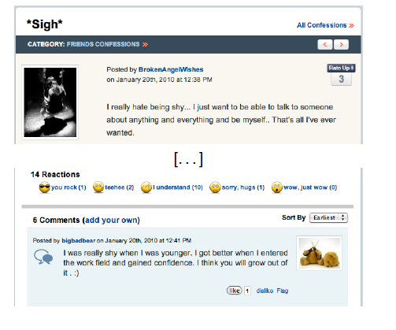
Experience Project: признания
Acton and Potts, 2013; Potts, 2013

Slide 42
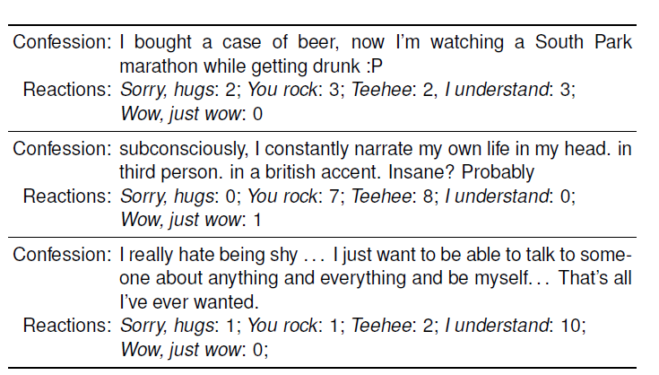
Experience Project: признания
Acton and Potts, 2013; Potts, 2013

Slide 43
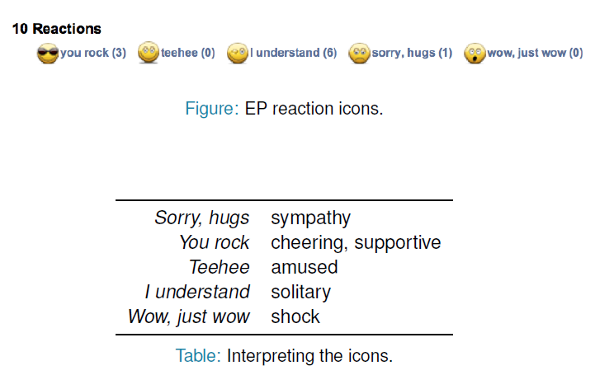
Experience Project: признания
Acton and Potts, 2013; Potts, 2013

Slide 44
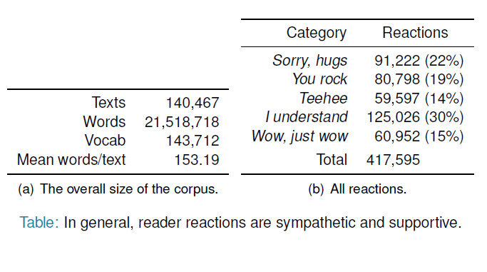
Experience Project: признания
Acton and Potts, 2013; Potts, 2013

Slide 45
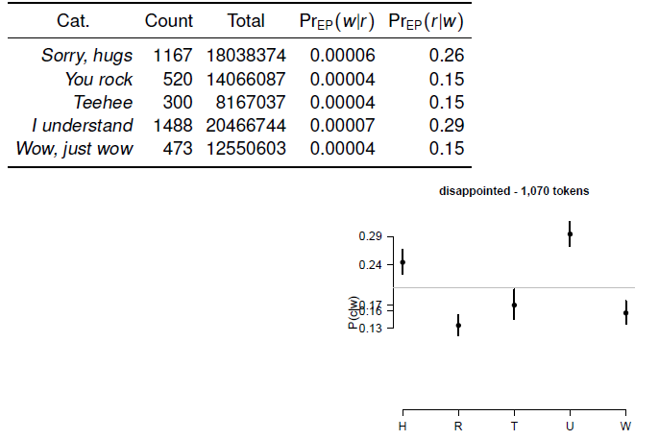
Считаем и изображаем
Acton and Potts, 2013; Potts, 2013

Slide 46
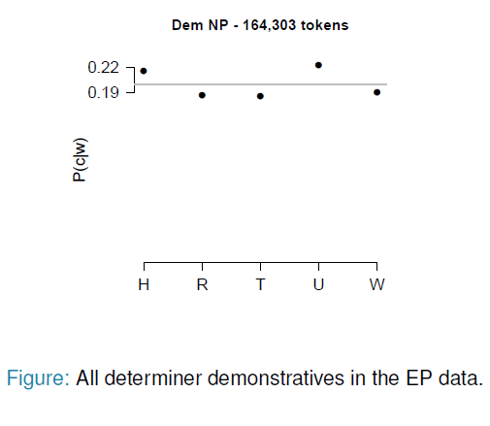
Указательные местоимения
Acton and Potts, 2013; Potts, 2013

Slide 47
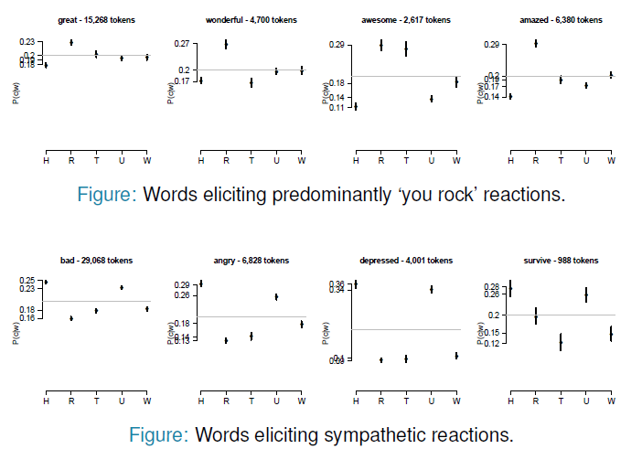
Примеры: слова, вызывающие симпатию
Acton and Potts, 2013; Potts, 2013

Slide 48
Что же особенного в употреблении указательных местоимений у Palin?
16 интервью Palin на шоу
+ интервью до и после нее
всего 48 интервью
Acton and Potts, 2013; Potts, 2013

Slide 49
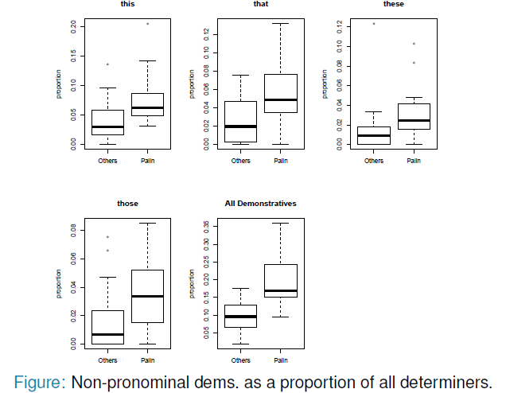
Квантитативный анализ
Acton and Potts, 2013; Potts, 2013

Slide 50
Полярные мнения – почему?
FoxNews.com:
“We feel like she talks like we do.”
“She talked like real people to real people”
Huffington Post:
“illusion of straight-talking”
“pseudo-folksiness and fundamental dishonesty”
Acton and Potts, 2013; Potts, 2013

Slide 51
Свойскость
Указательные местоимения в непрямом значении создают эффект солидарности, свойскости (термин восходит к лекциям Сандро Васильевича Кодзасова, мой перевод для solidarity из анализа статьи)
Проявления свойскости уместны при совпадении отношения к сообщаемому, мнений
При несовпадении эффект обратный: навязанной солидарности, навязанной близости мнений, отношения к сообщаемому
Acton and Potts, 2013; Potts, 2013

Slide 52
Language Attitudes
The Matched Guise Technique

Slide 53
Литература
Acton, Eric K. and Christopher Potts. 2014. That straight talk: Sarah Palin and the sociolinguistics of demonstratives. Journal of Sociolinguistics 18(1): 3-31.
Calder, Jeremy and Popova, Daria. 2014. Dimensions of Rhythm: the multi-layered nature of rhythmic style, University of Pennsylvania Working Papers in Linguistics: Vol. 20 : Iss. 2 , Article 3.
Eckert, Penelope. 2012. Three Waves of Variation Study: The Emergence of Meaning in the Study of Sociolinguistic Variation.
Christopher Potts [joint research with Eric Acton]. 2013. Cravin' that straight talk: the latent affective meaning of demonstratives. Workshop on Computational Social Sciences, Stanford, Jan 11.

