Slide 1
Capstone Project
Global Terrorism Analysis
Presented By
Vishal Rahul Pagare
Sachin Shivaji Gavande
Rushikesh Sunil Sharma
Sandesh Sundarlal Arsud

Slide 2
Points to Discuss
Introduction
Dataset Preparation
Attributes in Global Terrorism Analysis
Number Of Attacks happening in Year and analyse total Number of people killed count
Most active terrorist group
Number of attacks in each state
Number of Attacks by Region, since 1970
Total Number of people killed in Jammu and Kashmir , Since 1970 to 2017
The Most attacks by Year

Slide 3
Introduction
In this data set contain about terrorism activity from 1970 to 2017
and consists of information of more than 180,000 terrorist attacks
In global terrorism .and is also information about where people killed
and his location, target type, motive of terrorist organization, and
most active terrorist group in glob ,attack type and wounded and so more
In this data set consist of year wise ,state wise ,city wise data
This data shows where and which type of attack on city and state.
In this data set we are going to perform exploratory data analysis on global terrorism Such as to find out hot zones of terrorism. exploratory data analysis is nothing but Analyzing given data and finding the trends ,patterns and making sum assumption In this data base we have so many unused columns that are not required for our data analysis so we kept only important columns .

Slide 4
Dataset Prepration
Importing Libraries : Importing all the required libraries like Pandas, Numpy, Matplotlib and Seaborn.
Importing The Dataset : Importing the global terrorism analysis dataset from google drive to our colab notebook
Reading The Data : Reading the csv file and its text encoding option to deal with different format of files ( read_csv('file', encoding = "ISO-8859-1"))
Cleaning the Data : Renaming the columns name and selecting the important columns.
Exploratory Data Analysis : Analyzing the data set and creating insights from it.

Slide 5
Attributes in Global Terrorism Analysis
Year : This column contains Calendar details of the event..
Month : This column contains the month of terror activities.
Day : This column contains the day of terror activities.
Country : This column contains the country of terror activities.
Region : This column contains name of the region where the attack happened. Region consists values like East Asia, South Asia, Western Europe, etc
State : This column contains the state of terror activities

Slide 6
City : This column contains the city of the terrorist activities
Attack Type : This Column consists of categories like explosion, armed assault, assassination, kidnapping, unarmed assaults.
Target Type : This column contains consists of categorical values like private citizens, military, police, government officials, transportation, education, religious institution, airports, etc.
Group Name : This column contains terrorists groups in global terrorism.
Weapon Type : This column contains consists used weapons like Explosives, Firearms, Unknown, Incendiary, Melee in terrorist activities.

Slide 7
Killed : This column contains Number of people killed in any event
Wounded : This Column consists Number of people wounded in any event
Loss/Casualty : This Column consists casualty/loss in any event

Slide 8
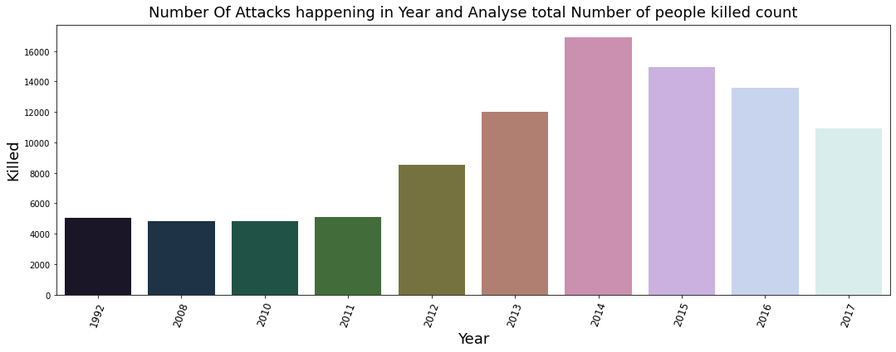
Number Of Attacks happening in Year and Analyse total Number of people killed count
For above barplot as we can see the lowest number of attacks happening in year 1992,2008 & 2010 and killed above 4000 peoples
The most number of attacks happening in year 2014,2015 & 2016 and killed 12000 to 16000 peoples

Slide 9
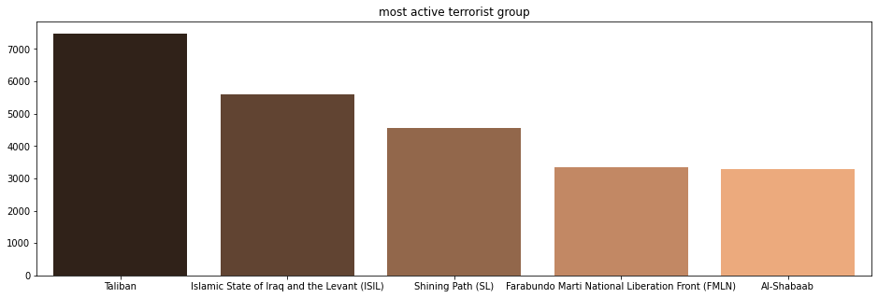
Most active terrorist group
Taliban is most active terrorist group
Taliban and ISIL are the major contributors in the rise in attacks
One of the reasons for this observation could be the resistance terrorist groups have faced from multiple counter-terrorism forces over time.

Slide 10
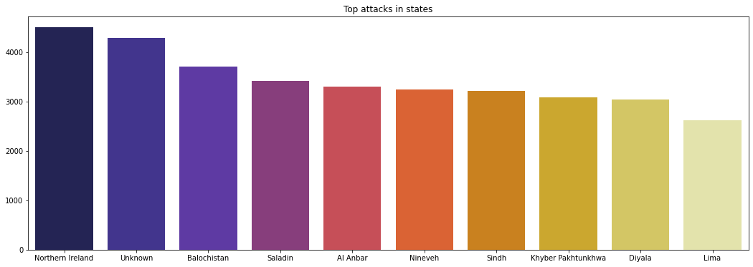
Number of attacks in each state
In this graph we can see large number of attacks has in Northern Ireland state : 4498
Also see the Al Anbar , Nineveh , Sindh has the same number of attacks
Lima has the lowest number of attacks with a total of 2615 attacks

Slide 11
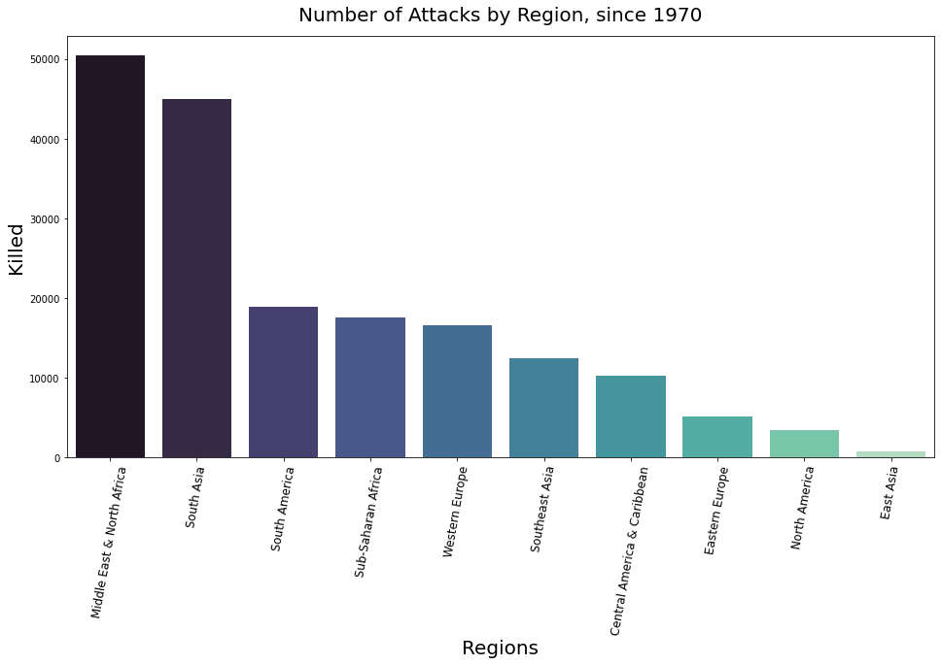
Number of Attacks by Region, since 1970
As we can see Middle E ast & North Africa : most attacked and the large number of people killed in this region
The Middle E ast & North Africa leads 1st among all the regions and then South Asia takes 2nd place.
East Asia has had the fewest attacks and killed the fewest people

Slide 12
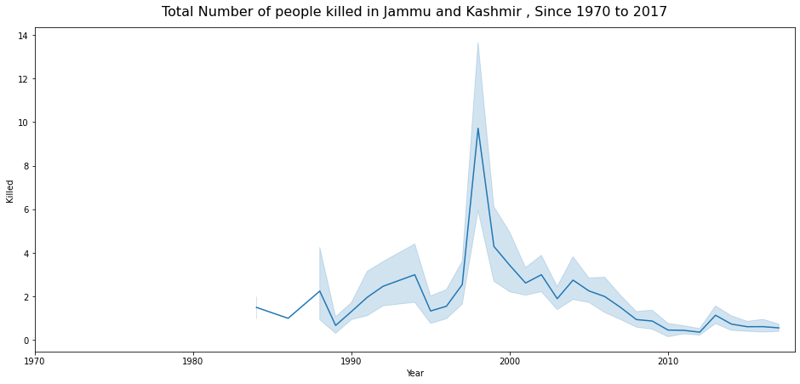
Total Number of people killed in Jammu and Kashmir , Since 1970 to 2017
As we can see in this graph Attacks were more during 1990 to 2000 in between most people Killed. When compared to the last 10 years scored a maximum Killed onwards, 1998 There is huge spike in Jammu and Kashmir.
we can see the from 2000 onwards count started decreasing.

Slide 13
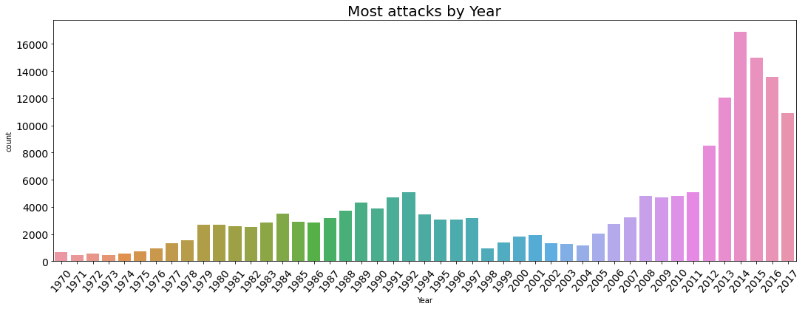
The Most attacks by Year
in 2014 : The large number of attacks took place in this Year
in 1971 & 1973 : The less number of attacks happening in this Years
Attacks were more during 2014 and then in 2015. When compared to attacks from 1970 onwards, the last 6 years scored a maximum. But from 2014 onwards count started decreasing.

Slide 14
Conclusion
Types of Attack in global terrorism
Maximum attacks in Year : 2017
Most used Attack Type : Unknown
Maximum Attacks in Country : Zimbabwe
The statistical destructive Feature of data
State with the most attacks : Baghdad
Region with the most attacks : Middle East & North Africa
Countries with the most attacks : Iraq
City with the most attacks : Unknown
Which were the top most Targets : Private Citizens & Property
Which were the Most attacking modes : Bombing/Explosion
The most dangerous and leading Groups Name : Unknown and Taliban
which were the most chosen weapons for attacks : Explosives

Slide 15
THANK YOU..!

