Slide 1
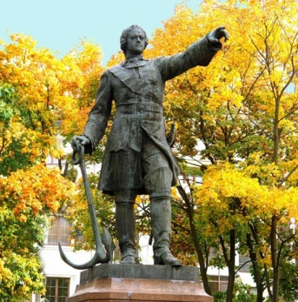
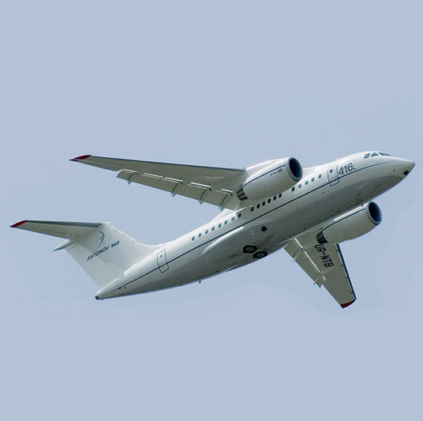
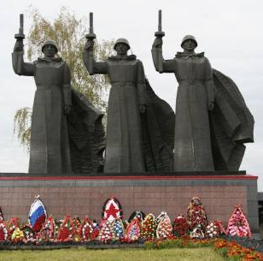
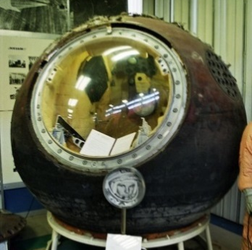
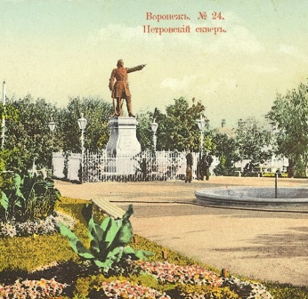
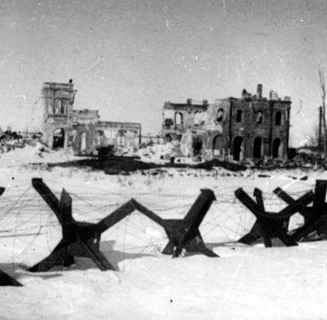
Voronezh is My Motherland

Slide 2
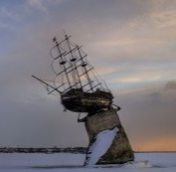
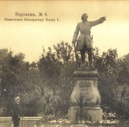
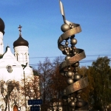
Voronezh
First mentions of Voronezh: dated to 1177
The year of foundation: 1586
Descent of the first ships: April 2, 1696
Voronezh province was created in 1725
Chernavsky Bridge was built in 1768
Since 2008 Voronezh is the City of Military Glory

Slide 3
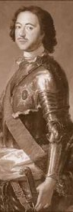
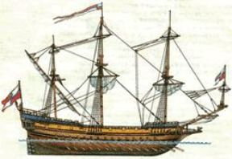
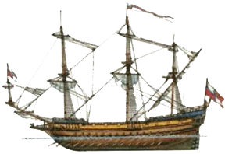
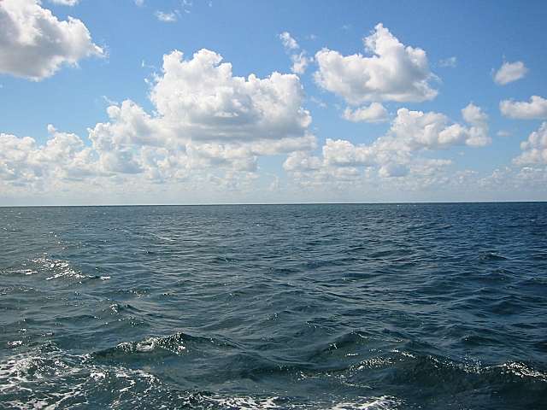
Voronezh- a cradle of the Russian fleet.
Having arrived in Voronezh in the middle of March, 1696, Peter I turned to work at once. Here, in the meadow of the side of the Voronezh river according to Peter’s I drawings, 30 warships were put.

Slide 4
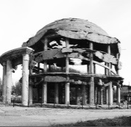
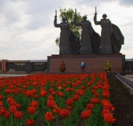
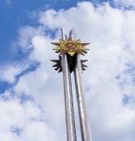
Voronezh-the City of Military Glory.
The Fascists army on June 28, 1942 set them to approached to the city.
The enemy rushed into Voronezh on July 6, 1942 and occupied its western part.
Military operations on the Voronezh front lasted 22 months is 667 days.
On February 6, 2008 Voronezh joined ranks of the cities carrying a rank "The City of Military Glory"

Slide 5
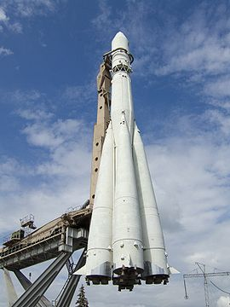
The Russian enterprise of the space-rocket industry is in Voronezh.
My City is the cradle of space engineering
On a raketo-nasitel the "East“ went to space Yury Gagarin went into space on the “Vosrok”("East“ ) space ship.

Slide 6

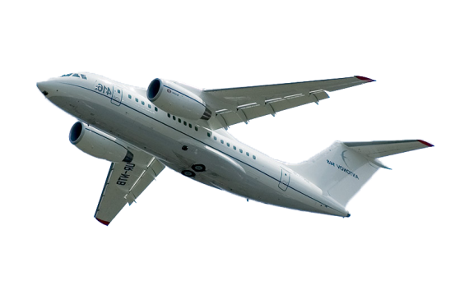
VORONEZH AIRCRAFT PLANT
Such planes as Il-96-300, Il-400Т, An-148, are made at the Voronezh aircraft plant.

Slide 7
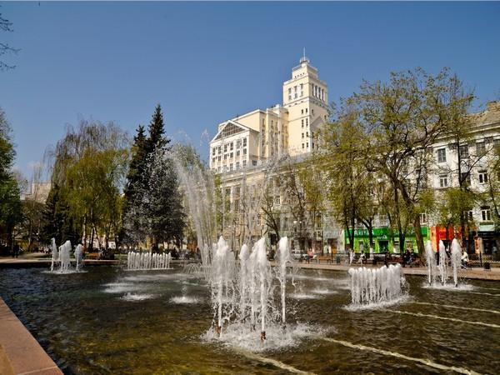
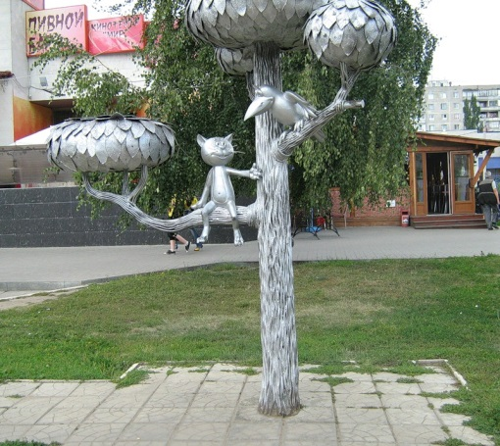
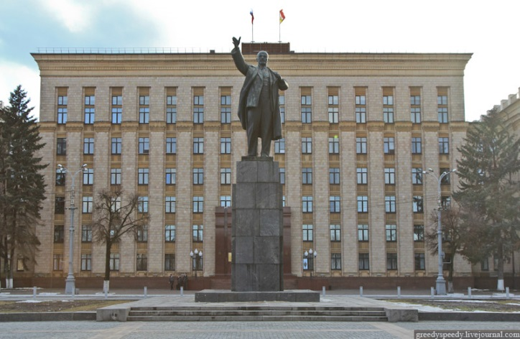
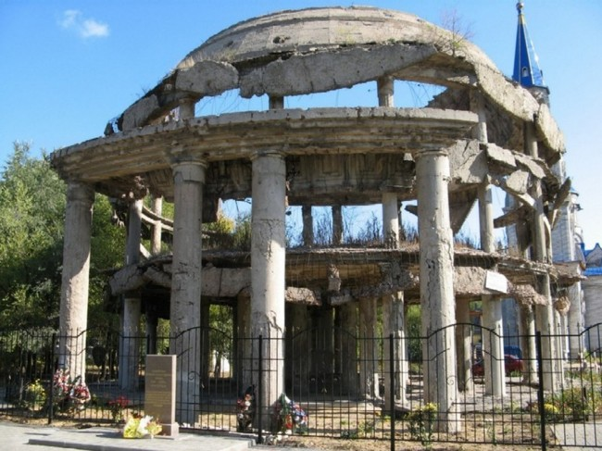
We live in a beautiful City of Military Glory
Koltsovsky Square
The Kitten from Lizyukov Street
And our nice 57 school…
Lenin Square
The Rotonda

Slide 8
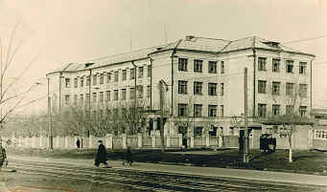
School No. 57
The decision of constructing a new number 30 school was addopted in 1936.
The Military hospital was of placed in 1941-1942 at school.
In August, 1943 the pupils began studying at school.
In 1961the doors of N57 school were opened in this building.
Since 1961it has become a secondary school.

Slide 9
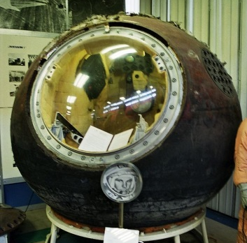

Thank You!

