Slide 1
Consumer Surplus Factor (CSF) study skad
KHC – UK : BBQ and Salad Cream
June 2025

Slide 2
Agenda
Overview of methodology (if needed)
BBQ Brand level results and trend
Salad Cream Brand level results and trend

Slide 3
CSF Methodology

Slide 4



Objective of a Consumer Surplus Factor (CSF) study
Measure cross elasticities with key competitors to identify who our brands interact with most
Have a long term planning tool that enables scenario planning basis price modulation
Develop a strategic price index vs critical competitors by brand, segment or channel

Slide 5
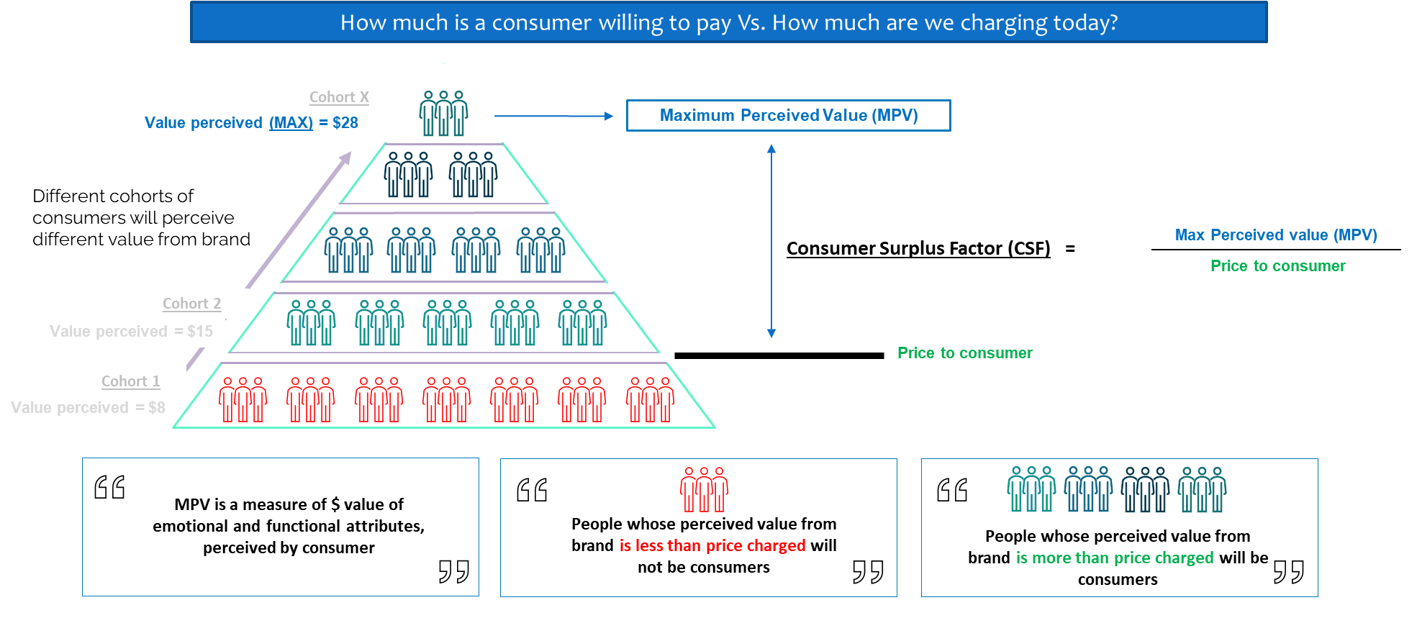

CSF is a measure of value left on the table
Based on analysis of real consumer behaviour data (Sales)

Slide 6
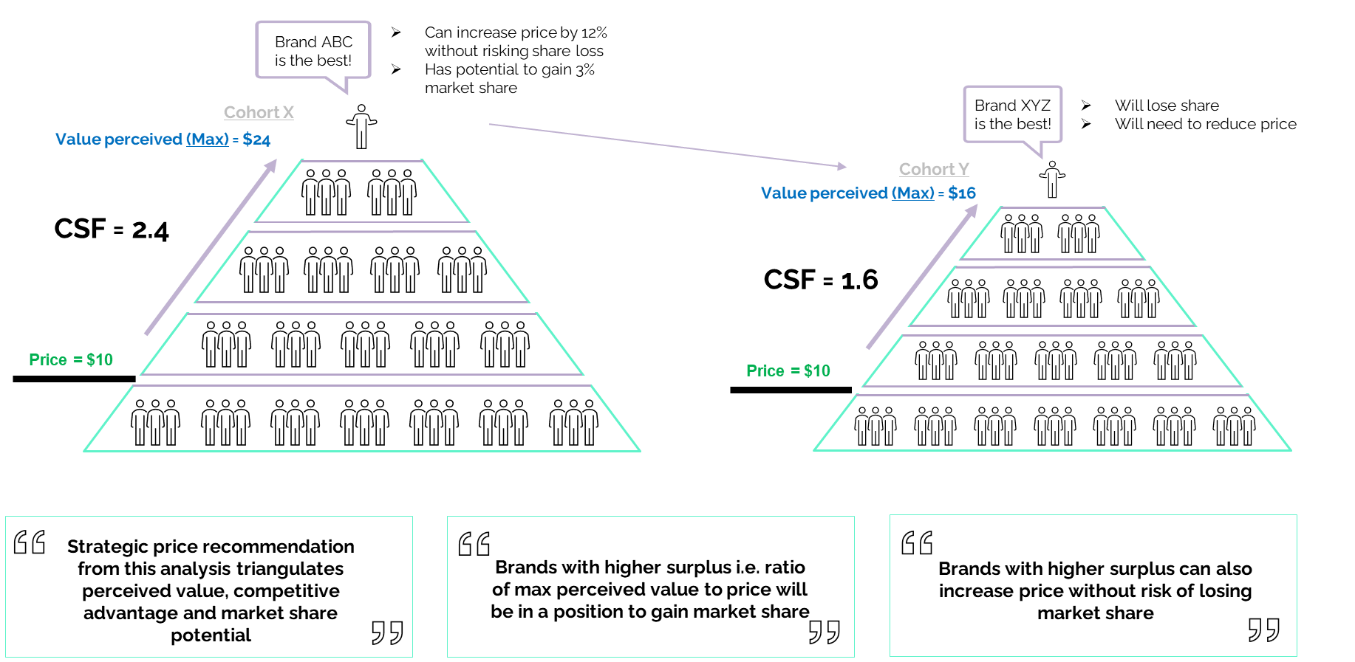
Brands with higher CSF can lead price increase and/or target higher market share

Slide 7
CSF methodology in summary
A CSF analysis runs on a proprietary modelling framework which consists of a series of advanced regression models that run through 100K+ combinations of causal variables per brand with four key milestones:
1
2
3
4
Estimate long term price elasticities (LTEs)
Use LTEs to estimate MCV
Divide MCV by Price to derive CSF
Compare CSFs to estimate MSP
Brand 1
-1.2
4.0 $/L
2.0
+0.5%
Brand 2
-1.3
4.7 $/L
1.8
-1.7%
Brand 3
-0.7
5.1 $/L
2.3
+1.2%
LTE - Estimating long-term (12+) effect of price change
Brand response to price change is represents brand strengh
MCV (Maximum Consumer Value) - a theoretical price at which sales of a brand decrease to Zero.
CSF (Consumer Surplus Factor) –metric that helps assess the surplus offered by brands.
Calculated as difference between price and MCB
MSP (Market share potential) – projected market share in the next 12 months. It is the differential between the equity share and the current market share

Slide 8
Executive Summary – Main takeaways
Overall – Both categories are losing MS in both the channels with Tesco doing better as a channel for the brands
BBQ
Heinz has potential market stability given it’s consolidation at the right price in both the channels
HP in Supermarkets, while offering a similar value proposition to Heinz has a sub-par CSF as compared to HP in Tesco where it is also priced lower to Heinz
A marketing focused approach to set a USP is required for Bull’s eye which has the least CSF in both the channels even after price reductions
Salad Cream
The price disparity between Private label and Heinz plays a major role in determining the market share headroom in an almost duopolistic market
The category has very less differentiation in terms of channel level CSF of both the channels
The CSF of private label is higher than that of Heinz ; the individual brand level CSF of this category are good
Given the improving MCV trend, Heinz has improved its CSF after price consolidation from last year where as Private Label has increased prices year on year

Slide 9
UK – BBQ

Slide 10
UK – BBQ – Market Context - (P52W vs L52W)…..
Supermarkets
Change in:
Value = -3.8% Vol. = 0.5% , Price = -4.3%
Tesco
Change in:
Value = -3.0% Vol. = 6.7% , Price = -9.1%
 | MS% | % Change* | Avg Price | % Change
HEINZ | 31.7% | -1.0% | 5.57 | -1.4%
HP | 9.4% | -0.2% | 5.69 | -0.9%
BULLS EYE | 6.2% | -0.4% | 6.87 | -2.2%
PRIVATE LABEL | 17.8% | -0.2% | 2.45 | -10.6%
LEVI ROOTS | 7.9% | -0.3% | 6.59 | -0.3%
SWEET BABY RAYS | 8.3% | 1.5% | 6.88 | 1.8%
Restofcategory | 18.6% | 0.6% | 6.40 | -1.2%
 | MS% | % Change* | Avg Price | % Change
HEINZ | 34.5% | -1.7% | 5.75 | 0.2%
HP | 10.9% | 0.9% | 5.47 | -1.1%
BULLS EYE | 6.8% | 0.4% | 6.89 | -4.6%
PRIVATE LABEL | 13.3% | -1.1% | 2.04 | -26.5%
LEVI ROOTS | 9.4% | 0.1% | 6.71 | -2.1%
SWEET BABY RAYS | 8.9% | 1.4% | 6.79 | 3.2%
Restofcategory | 16.2% | -0.1% | 6.33 | -8.3%
In Supermarkets, category lost value due to an average price decrease in the present timeframe after consolidating in the previous timeframe whereas in Tesco the loss in value was traded off with gain in volume even after double the average price increase
Heinz is more expensive in Tesco as compared to Supermarkets
HP is priced higher than Heinz in supermarkets and priced lower in Tesco, where it is gaining Market share
Private label is aggressively cutting prices in both the channels, more so in Tesco to set a distinct value proposition as compared to other brands
Sweet Baby Rays is the only brand which is increasing prices and growing in MS in both the channels
The authentic brands (Bulls Eye, Levi roots and Sweet baby rays) are almost priced similar and at premium to core brands indicating a potential premiumization trend
*Change is 2023 vs 2022; Price is in Euro/kg; Share is in Value terms

Slide 11
CSF & MCV Learning: Almost all the brands have a better brand level CSF in Tesco channel
Supermarkets
Tesco
MCV
CSF
Price
(GBP per Unit)
Current MS
32.7% | 9.6% | 6.6% | 18.0% | 8.2% | 6.9% | 18.0% |  | 34.5% | 10.9% | 6.8% | 13.3% | 9.4% | 8.9% | 16.2%
0.2% | -0.2% | -0.3% | -0.2% | -0.2% | 0.1% | 0.6% |  | 0.1% | 0.5% | -0.6% | -0.0% | -0.2% | -0.1% | 0.3%
MSP
The CSF of Supermarkets channel is 3.1 with a MCV of 14.9 and that of Tesco channel is 3.6 with a MCV of 17.1
In supermarkets, HP has to be differentiated in price than Heinz to improve MCV which is being reflected in Tesco
Heinz has a stable market share potential in both the channels with a stable CSF
Bulls Eye need to improve it’s MCV by effective marketing efforts because it has a poor CSF even after correcting its prices over the previous year
Sweet Baby Rays has the highest MCV in both the channels
*All Price and MCVs are in GBP per unit

Slide 12
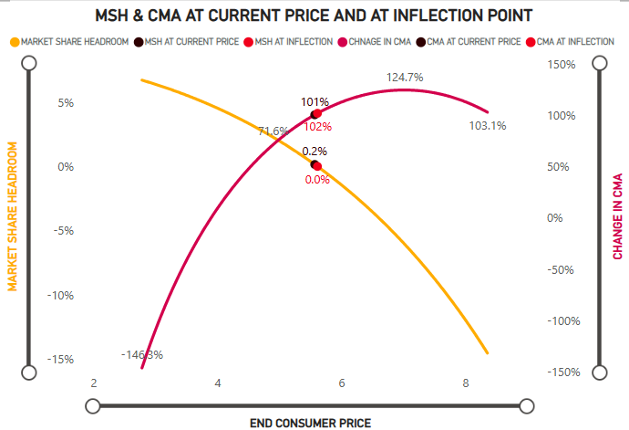
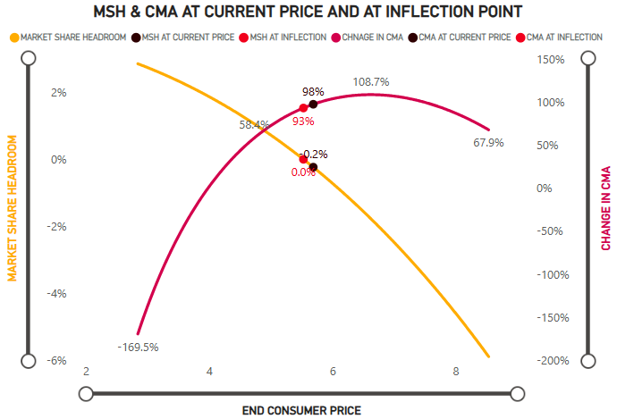
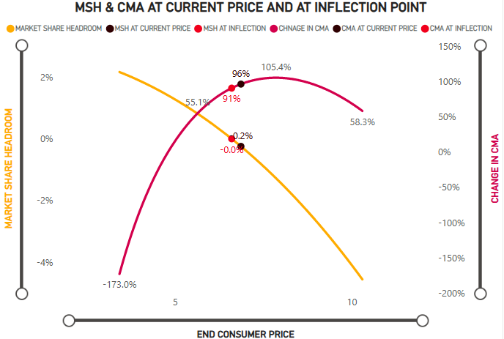
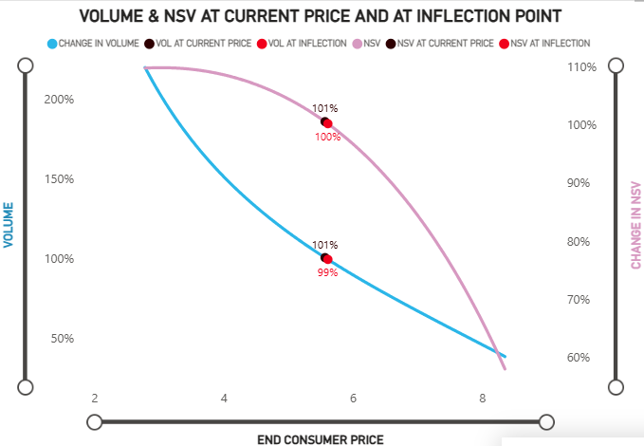
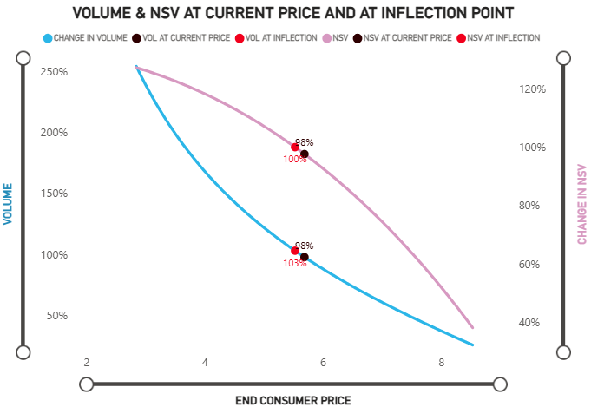
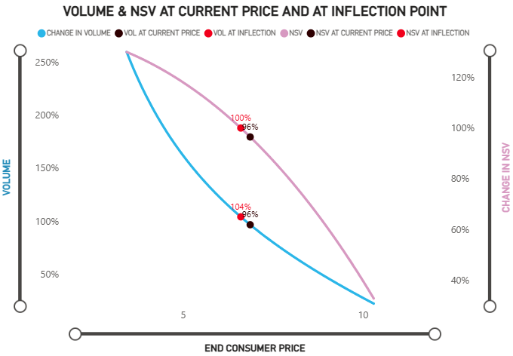
Channel level- RPI Curves for Supermarket
Heinz
HP
Bull’s Eye
Price: 5.57
RPI PL : 227
RPI Cat: 116
Price: 5.62
RPI PL Std: 229
RPI Cat: 117
Price: 5.53
RPI PL Std: 225
RPI Cat: 115
Price: 5.69
RPI PL : 232
RPI Cat: 119
Price: 6.61
RPI PL Std: 270
RPI Cat: 137
Price: 6.87
RPI PL : 280
RPI Cat: 144
L12M
Inflection

Slide 13
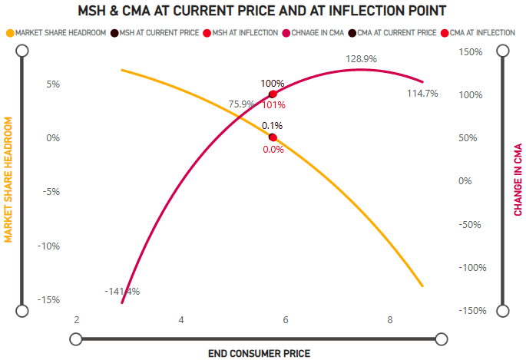
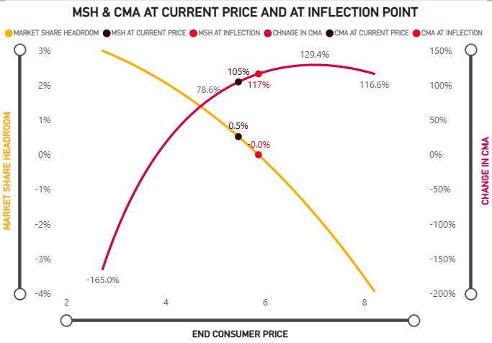
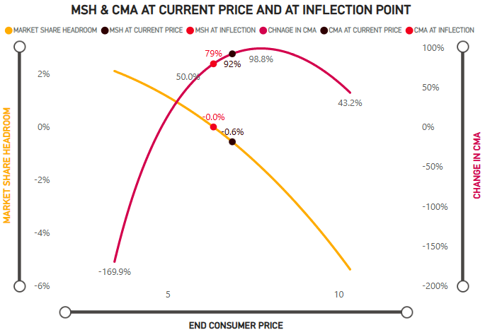
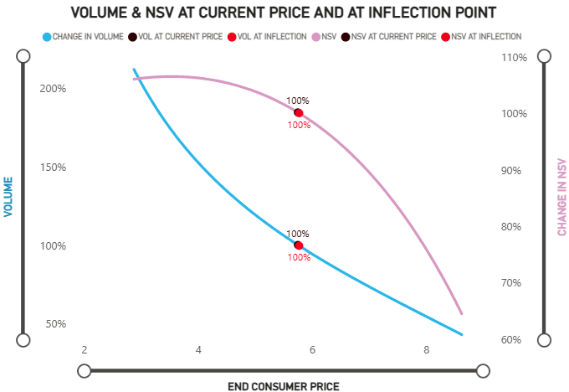
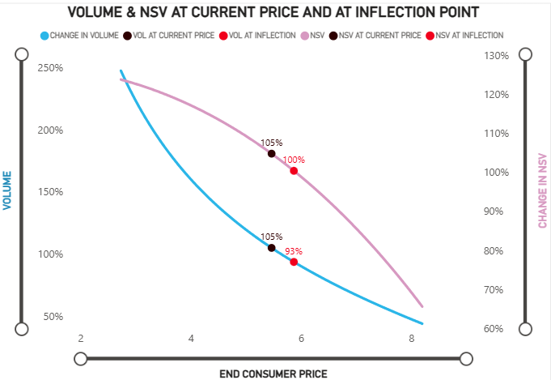
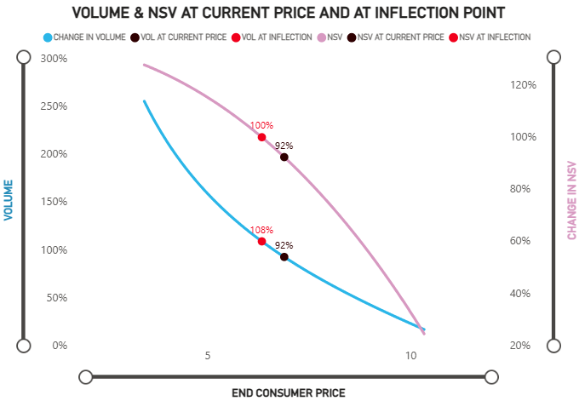
Channel level- RPI Curves for Tesco
Heinz
HP
Bull’s Eye
Price: 5.75
RPI PL : 282
RPI Cat: 120
Price: 5.77
RPI PL Std: 283
RPI Cat: 120
Price: 5.47
RPI PL : 268
RPI Cat: 114
Price: 5.87
RPI PL Std: 288
RPI Cat: 122
Price: 6.34
RPI PL Std: 311
RPI Cat: 132
Price: 6.89
RPI PL : 338
RPI Cat: 144
L12M
Inflection

Slide 14





CSF and MCV trends : No brand has an increasing MCV trend in Supermarkets channel indicating price sensitive consumers
SUPERMARKET CHANNEL
Declining MCV& CSF
Stable MCV
MCV
CSF
Declining MCV
Price
(Moving 52 Wks)
PRIVATE LABEL
REST OF CATEGORY
Heinz and Private Label continue to be on a downward MCV trend even after price reductions
HP and Bull’s Eye seem to have found a stable MCV in the last two years but their CSF is still below par leaving them little scope to exercise pricing power
Levi Roots and Sweet Baby Rays offer distinct USP but their MCV also fell when they increased prices indicating a price sensitive category
Only ROC maintained a stable MCV because of maintaining stable prices
CSF1- Till Mar 23’; CSF2 – Till Mar 24’; CSF3 – Till Mar 25’

Slide 15
UK – Salad Cream

Slide 16
UK – Salad Cream – Market Context - (P52W vs L52W)…..
Supermarkets
Change in:
Value = -6.1% Vol. = -7.0% Price = 1.0%
Tesco
Change in:
Value = -5.9% Vol. = -7.4% Price = 1.6%
 | MS% | % Change* | Avg Price | % Change
HEINZ | 78.1% | 0.2% | 6.03 | -2.6%
PRIVATE LABEL | 21.7% | 2.2% | 2.78 | 10.2%
Rest of category | 0.1% | -2.3% | 2.69 | -27.5%
 | MS% | % Change* | Avg Price | % Change
HEINZ | 79.1% | 0.1% | 6.12 | -2.7%
PRIVATE LABEL | 20.6% | 1.0% | 2.39 | 11.2%
Rest of category | 0.3% | -1.1% | 3.61 | -25.3%
In both the channels,
Till 2024, category was growing in value and volume terms despite price increases
Post that the category corrected itself, there is both value & volume growth as prices stabilized
Heinz has maintained its share with slight decreases in avg. price whereas PL is gaining even with increases in avg. price
* Price is in Euro/kg; Share is in Value terms

Slide 17
CSF & MCV Learning: Both the brands have a better brand level CSF in Tesco channel
Supermarkets
Tesco
MCV
CSF
Price
(GBP per Unit)
Current MS
78.1% | 21.7% |  | 79.1% | 20.6%
0.7% | 0.7% |  | 1.1% | 1.1%
MSP
Both the channels have a channel level CSF of 3.6 with Tesco having a marginally better MCV of 17.2 as compared to the MCV of 17.0 of Supermarket
Private Label enjoys a better CSF than Hienz given its pricing headroom in an almost duopoly category
Heinz has a more negative MSP in Tesco although it has a better MCV and CSF in that channel
*All Price and MCVs are in GBP per unit
The Bars are sorted in increasing order of CSFs for each channel

Slide 18
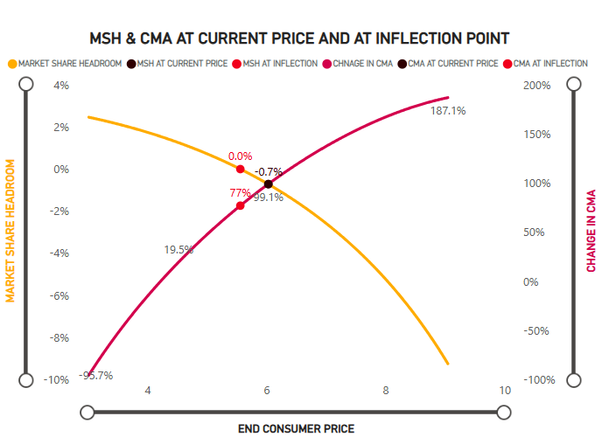
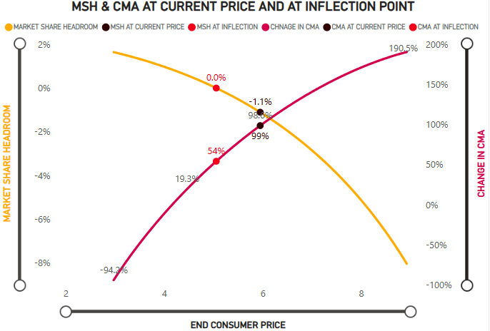
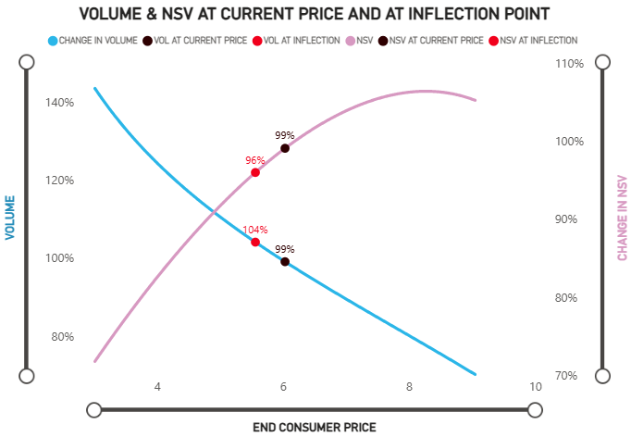
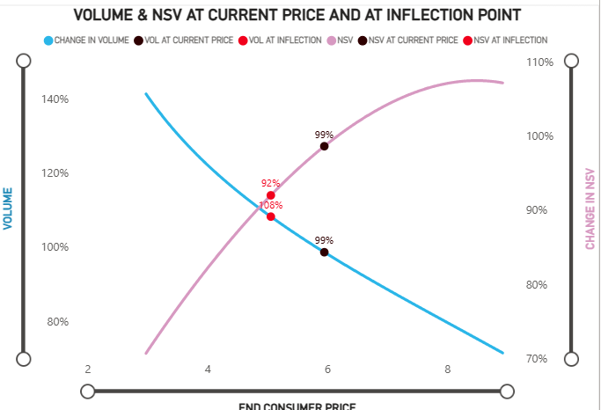
Channel level- RPI Curves
Supermarkets
Tesco
Price: 5.06
RPI PL Std: 191
RPI Cat: 107
Price: 5.56
RPI PL Std: 200
RPI Cat: 116
Price: 6.02
RPI PL : 217
RPI Cat: 126
Price: 5.95
RPI PL : 224
RPI Cat: 126
L12M
Inflection

Slide 19
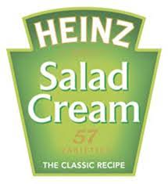
CSF and MCV trends : Both the brands have increasing MCV patterns showing category specific consumers
SUPERMARKET CHANNEL
MCV
Increasing MCV
CSF
Increasing MCV
Price
(Moving 52 Wks)
PRIVATE LABEL
Heinz even after reducing the average prices in the last year found it’s MCV increasing thus giving a better CSF and pricing power at the current price point
Private label has increased prices by ~50% yet has seen its MCV rising and CSF still above that of Heinz inferring it still has a better market share headroom than Heinz
CSF1- Till Mar 23’; CSF2 – Till Mar 24’; CSF3 – Till Mar 25’

Slide 20
Category |  | Self Elas | brown sauce | bbq sauce | salad cream | ketchup | mayo | Cat delta
brown sauce |  | -2.10 | 0 | 0.16 | 0 | 0.21 | 0 | 0.03
bbq sauce |  | -1.97 | 0.27 | 0 | 0.19 | 0.09 | 0.09 | 0.01
salad cream |  | -1.47 | 0 | 0 | 0 | 0 | 0.12 | 0.06
ketchup |  | -2.36 | 0.05 | 0.18 | 0.44 | 0 | 0.89 | 0.47
mayo |  | -2.66 | 0.30 | 0.82 | 1.27 | 1.02 | 0 | 0.57

