Slide 1

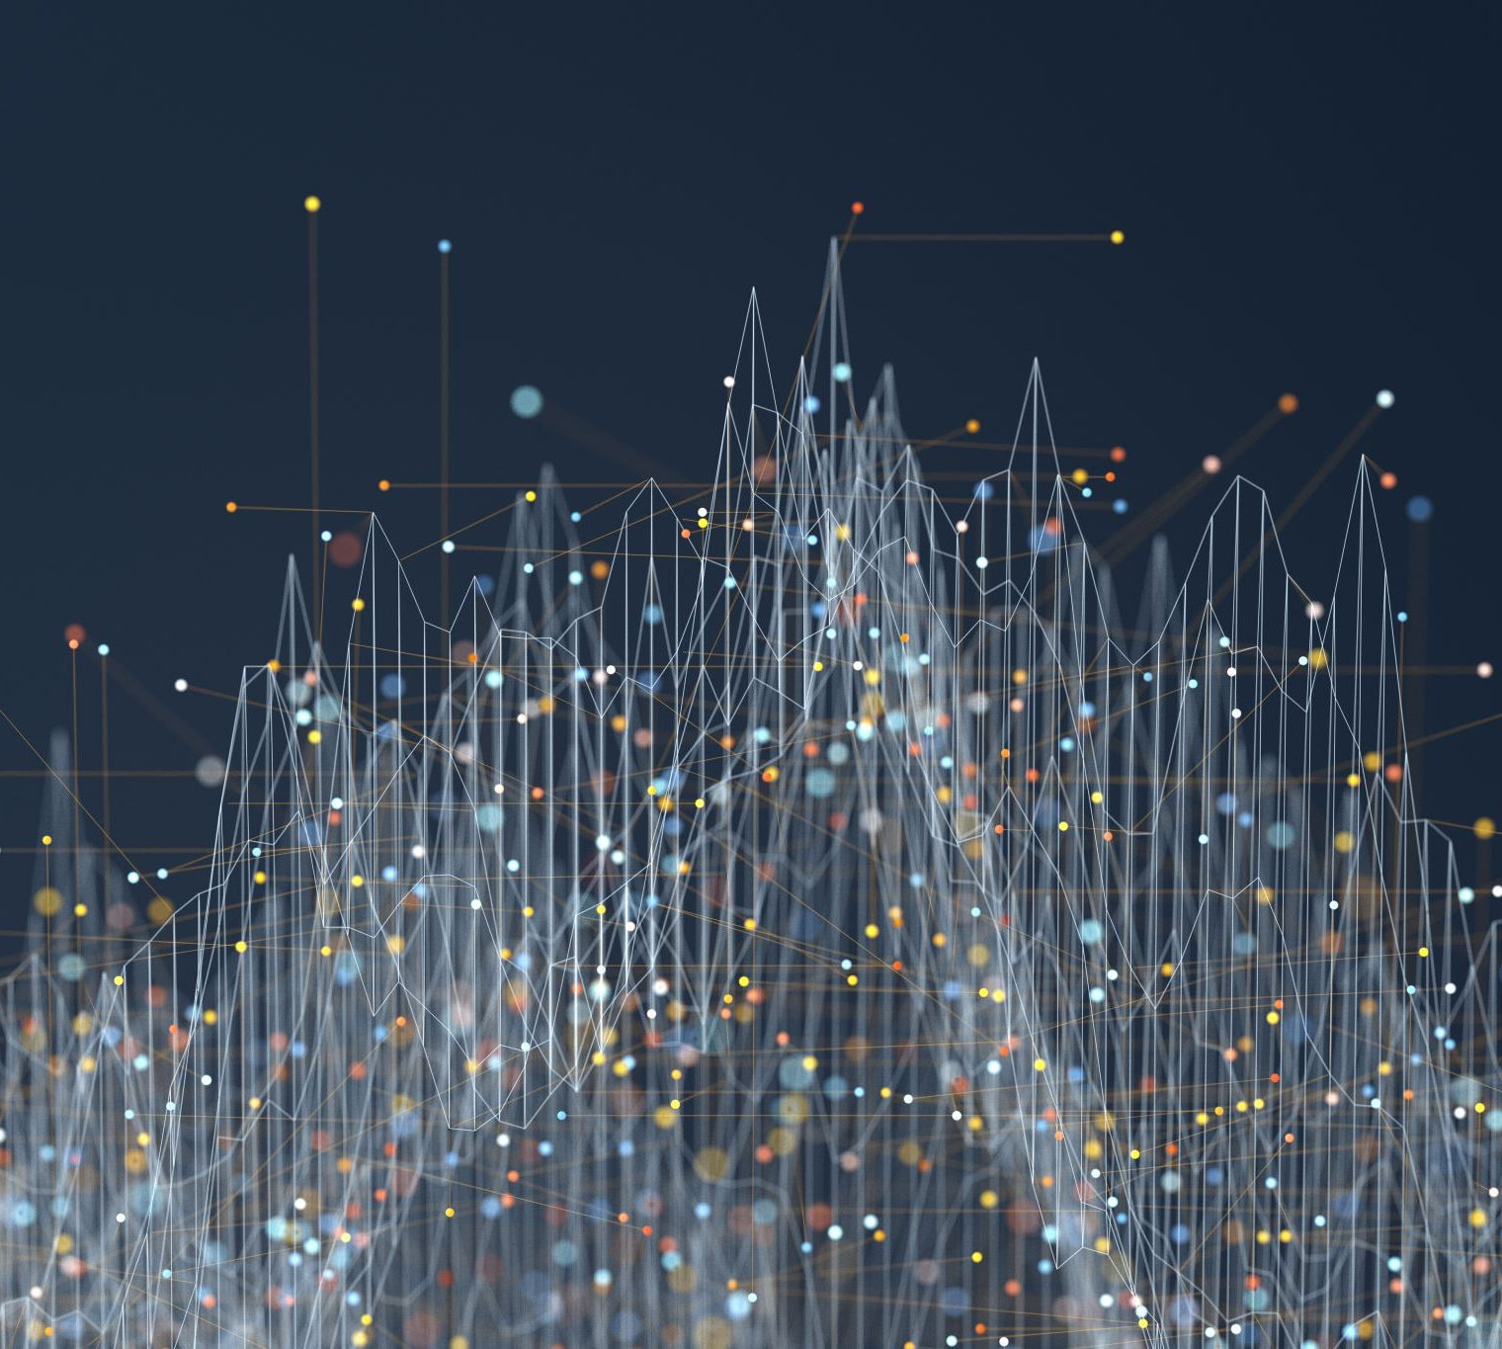
RAG and Agentic AI: Documentation-Based Overview
AI Learnino
Exploring AI systems driven by dynamic document retrieval
Arta Asadi
Notes:
---

Slide 2
Agentic AI and RAG Fundamentals
Notes:
---
This slide references information from the following file: https://qdrant.tech/documentation/agentic-rag-langgraph/,https://docs-v1.agno.com/examples/streamlit/agentic-rag,https://www.leanware.co/insights/langgraph-rag-agentic
Agentic AI, Introduction to RAG

Slide 3

Agentic AI
Evolution of RAG Systems
  Agentic AI builds on traditional RAG by enabling autonomous agents to orchestrate multiple retrieval and reasoning steps dynamically.
Graph-Based Orchestration
  Frameworks like LangGraph enable conditional routing, retries, and adaptive workflows for complex query processing.
Dynamic Data Retrieval
  Agents decide between vector databases, SQL databases, or web searches to gather relevant information for queries.
Improved Accuracy and Flexibility
  Agentic AI offers enhanced query accuracy and context relevance by integrating real-time data and adaptive reasoning.
Notes:
---
This slide references information from the following file: https://qdrant.tech/documentation/agentic-rag-langgraph/,https://docs-v1.agno.com/examples/streamlit/agentic-rag,https://www.leanware.co/insights/langgraph-rag-agentic
Agentic AI represents an evolution of traditional Retrieval-Augmented Generation (RAG) systems by introducing autonomous agents capable of orchestrating multiple retrieval and reasoning steps. Unlike linear RAG workflows that follow a simple query → retrieve → generate pattern, Agentic AI leverages decision-making capabilities to dynamically select the most appropriate tools and data sources for complex queries. This approach is particularly useful when dealing with multi-step reasoning tasks or queries that require combining diverse information types. Agentic AI systems often integrate frameworks like LangGraph, which provides graph-based orchestration, enabling conditional routing, retries, and adaptive workflows. These agents analyze incoming queries, determine whether to retrieve data from vector databases such as Qdrant or Postgres, or perform external web searches, and then synthesize the retrieved information into coherent responses using large language models. The benefits of Agentic AI include improved flexibility, enhanced accuracy for complex queries, and the ability to incorporate real-time data sources. By treating RAG as one component within a broader agentic toolkit, these systems deliver more robust and contextually relevant answers compared to traditional RAG implementations.

Slide 4
Introduction to RAG
Ingestion Stage
  Documents are preprocessed into smaller chunks and converted into vector embeddings stored in vector databases.
Retrieval Stage
  User queries are converted to embeddings to retrieve relevant chunks using similarity metrics or keyword methods.
Generation Stage
  Retrieved context is integrated into prompts to ensure accurate and contextually grounded language model responses.
Applications of RAG
  RAG is used in question answering, document summarization, and knowledge-based chatbots for improved accuracy.
Notes:
---
This slide references information from the following file: https://qdrant.tech/documentation/agentic-rag-langgraph/,https://docs-v1.agno.com/examples/streamlit/agentic-rag,https://www.leanware.co/insights/langgraph-rag-agentic
Retrieval-Augmented Generation (RAG) is a technique that enhances the performance of large language models by grounding their outputs in external knowledge retrieved at query time. The RAG pipeline typically consists of three main stages: ingestion, retrieval, and generation. During ingestion, documents are preprocessed, chunked into smaller segments, and converted into vector embeddings using models such as OpenAI or Hugging Face transformers. These embeddings are stored in vector databases like Qdrant or Postgres with pgvector extension. The retrieval stage involves transforming the user query into an embedding and performing similarity searches to identify the most relevant chunks. Common similarity metrics include cosine similarity, dot product, and Euclidean distance. Additionally, keyword-based methods like BM25 can be used for sparse retrieval, and hybrid approaches combine both dense and sparse techniques for optimal results. Finally, the generation stage integrates the retrieved context into the prompt for the language model, ensuring that responses are accurate and contextually grounded. RAG systems are widely used in applications such as question answering, document summarization, and knowledge-based chatbots, offering improved factual accuracy and reduced hallucination compared to standalone LLMs.

Slide 5
Core Components and Databases
Notes:
---
This slide references information from the following file: https://qdrant.tech/documentation/rag-deepseek/,https://www.enterprisedb.com/docs/edb-postgres-ai/latest/ai-factory/vector-engine/,https://blogs.perficient.com/2025/07/17/postgres-typescript-rag-stack/
Databases for RAG, Embeddings and Their Role

Slide 6
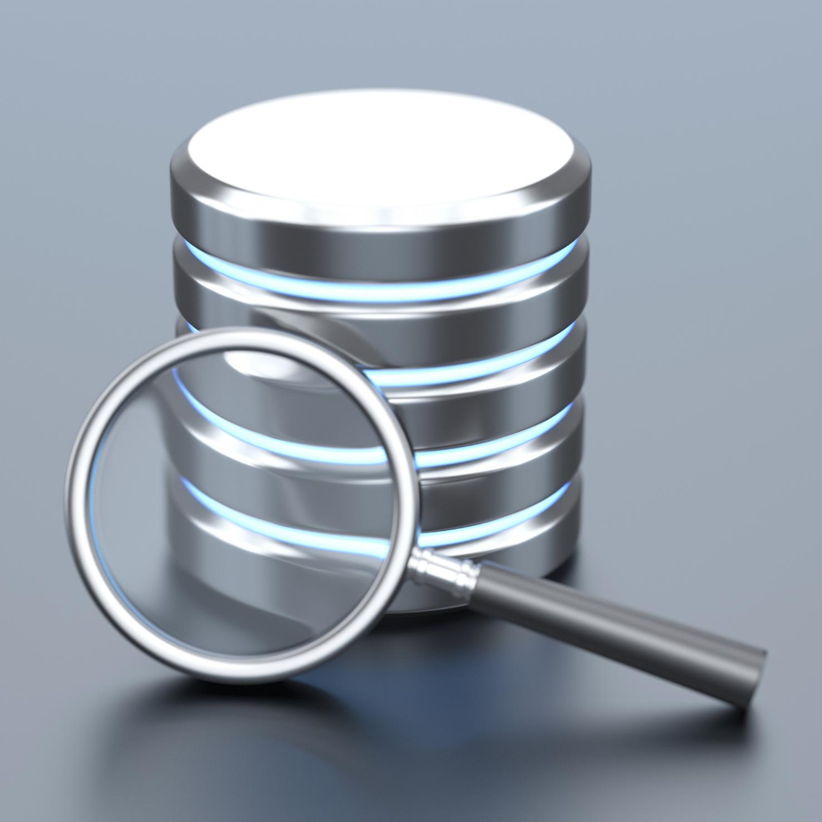
Databases for RAG
Qdrant Vector Database
  Qdrant is a high-performance vector database supporting metadata filtering and hybrid semantic search.
PostgreSQL with pgvector
  PostgreSQL with pgvector integrates vector search into relational databases for combined structured and unstructured data.
Hybrid Search Capability
  Both databases support hybrid search combining semantic and keyword-based retrieval for enhanced accuracy.
Efficient Embedding Storage
  These systems securely store embeddings and metadata, enabling efficient retrieval in RAG pipelines.
Notes:
---
This slide references information from the following file: https://qdrant.tech/documentation/rag-deepseek/,https://www.enterprisedb.com/docs/edb-postgres-ai/latest/ai-factory/vector-engine/,https://blogs.perficient.com/2025/07/17/postgres-typescript-rag-stack/
Databases play a critical role in RAG systems by storing and retrieving embeddings efficiently. Qdrant is a specialized vector database designed for high-performance similarity search. It supports features like metadata filtering, hybrid search, and integration with embedding generation libraries such as FastEmbed. Qdrant enables scalable storage of high-dimensional vectors and provides APIs for managing collections and performing semantic queries. On the other hand, PostgreSQL with the pgvector extension allows developers to incorporate vector search capabilities directly into relational databases. This approach is ideal for organizations that want to maintain structured and unstructured data within a single system. pgvector supports operations like cosine similarity, inner product, and approximate nearest neighbor indexing, making it suitable for production-grade RAG pipelines. Both Qdrant and Postgres facilitate hybrid search strategies, combining semantic and keyword-based retrieval for improved accuracy. These databases ensure that embeddings and associated metadata are stored securely and retrieved efficiently, forming the backbone of any robust RAG implementation.

Slide 7

Embeddings and Their Role
Definition of Embeddings
  Embeddings are numerical vectors that represent text semantics in a high-dimensional space to capture meaning.
Similarity Measures
  Cosine similarity and dot product are common methods to compare semantic closeness between embeddings.
Contextual vs Static Embeddings
  Contextual embeddings adjust word meaning based on context, providing nuanced understanding over static embeddings.
Role in RAG Systems
  High-quality embeddings enable accurate semantic retrieval, making them fundamental in RAG pipelines.
Notes:
---
This slide references information from the following file: https://qdrant.tech/documentation/rag-deepseek/,https://www.enterprisedb.com/docs/edb-postgres-ai/latest/ai-factory/vector-engine/,https://blogs.perficient.com/2025/07/17/postgres-typescript-rag-stack/
Embeddings are numerical representations of text that capture semantic meaning in a high-dimensional space. They are essential for enabling similarity-based retrieval in RAG systems. The process begins by converting text chunks into embeddings using pre-trained models such as BERT, OpenAI embeddings, or other transformer-based architectures. These embeddings allow the system to compare semantic similarity between queries and document chunks mathematically. Common similarity measures include cosine similarity, which evaluates the angle between two vectors, and dot product, which measures their alignment. High-quality embeddings ensure that semantically related texts are positioned close to each other in the vector space, enabling accurate retrieval. Embedding models can be contextual, meaning they account for word meaning based on surrounding text, or static, where each word has a fixed representation. Contextual embeddings are generally preferred for RAG because they provide nuanced understanding of language. The choice of embedding model significantly impacts retrieval performance, making it a critical component of any RAG pipeline.

Slide 8
Search Strategies and Retrieval Types
Notes:
---
This slide references information from the following file: https://learn.microsoft.com/en-us/azure/architecture/ai-ml/guide/rag/rag-chunking-phase,https://langcopilot.com/posts/2025-10-11-document-chunking-for-rag-practical-guide
Chunking Approaches, Similarity and BM25 Search

Slide 9
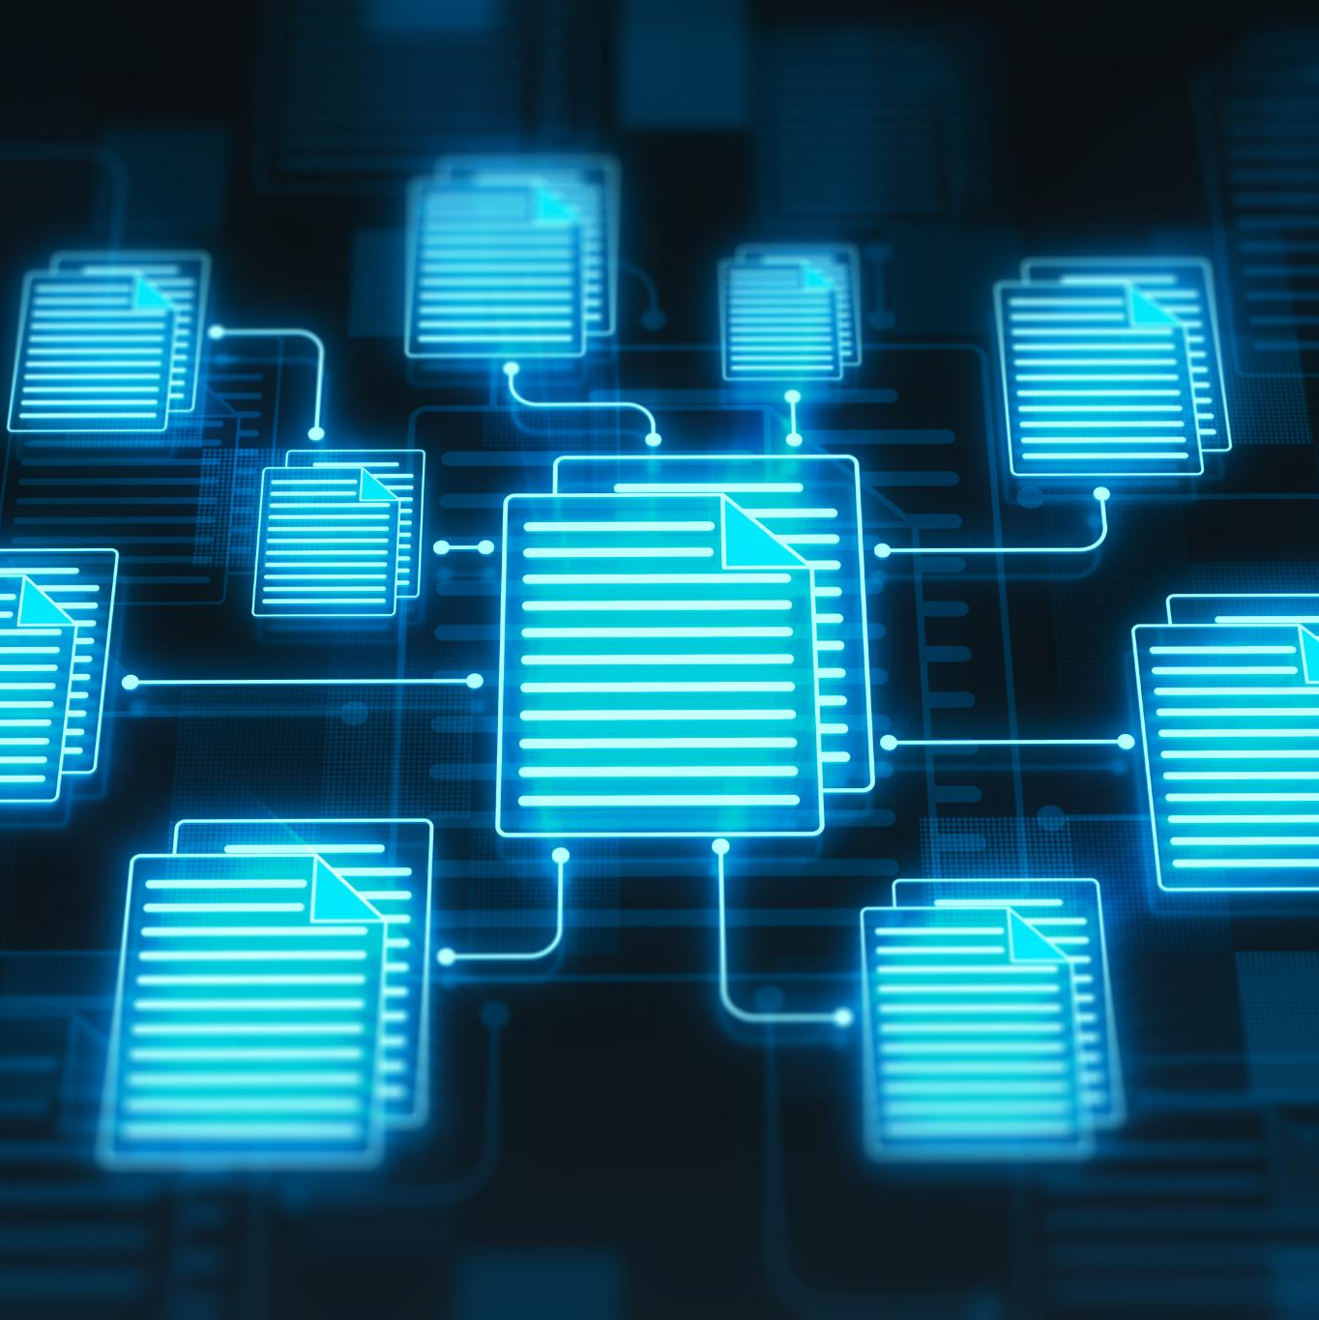
Chunking Approaches
Definition and Purpose
  Chunking divides documents into smaller, coherent segments to optimize retrieval in RAG systems and maintain query accuracy.
Common Chunking Strategies
  Strategies include fixed-size chunking, semantic chunking based on meaning, recursive chunking, and token-based chunking for efficiency.
Performance and Importance
  Semantic chunking improves retrieval accuracy up to 70%, while optimal chunk sizes range between 256 and 512 tokens with overlap.
Choosing the Right Strategy
  Selection depends on document type, application needs, and resources; poor chunking harms context and retrieval quality.
Notes:
---
This slide references information from the following file: https://learn.microsoft.com/en-us/azure/architecture/ai-ml/guide/rag/rag-chunking-phase,https://langcopilot.com/posts/2025-10-11-document-chunking-for-rag-practical-guide
Chunking is the process of dividing documents into smaller, semantically coherent segments to optimize retrieval in RAG systems. Effective chunking ensures that each segment contains enough context to answer queries accurately without exceeding token limits of language models. Common strategies include fixed-size chunking, which splits text into uniform lengths, and semantic chunking, which groups sentences based on meaning for higher accuracy. Recursive chunking preserves document structure by breaking down paragraphs into sentences iteratively, offering a balance between accuracy and efficiency. Token-based chunking aligns with LLM tokenization, making it suitable for cost-sensitive applications. Research indicates that semantic chunking can improve retrieval accuracy by up to 70%, while optimal chunk sizes typically range between 256 and 512 tokens with 10–20% overlap. Choosing the right chunking strategy depends on document type, application requirements, and computational resources. Poor chunking can lead to fragmented context and degraded performance, highlighting its importance in RAG pipelines.

Slide 10
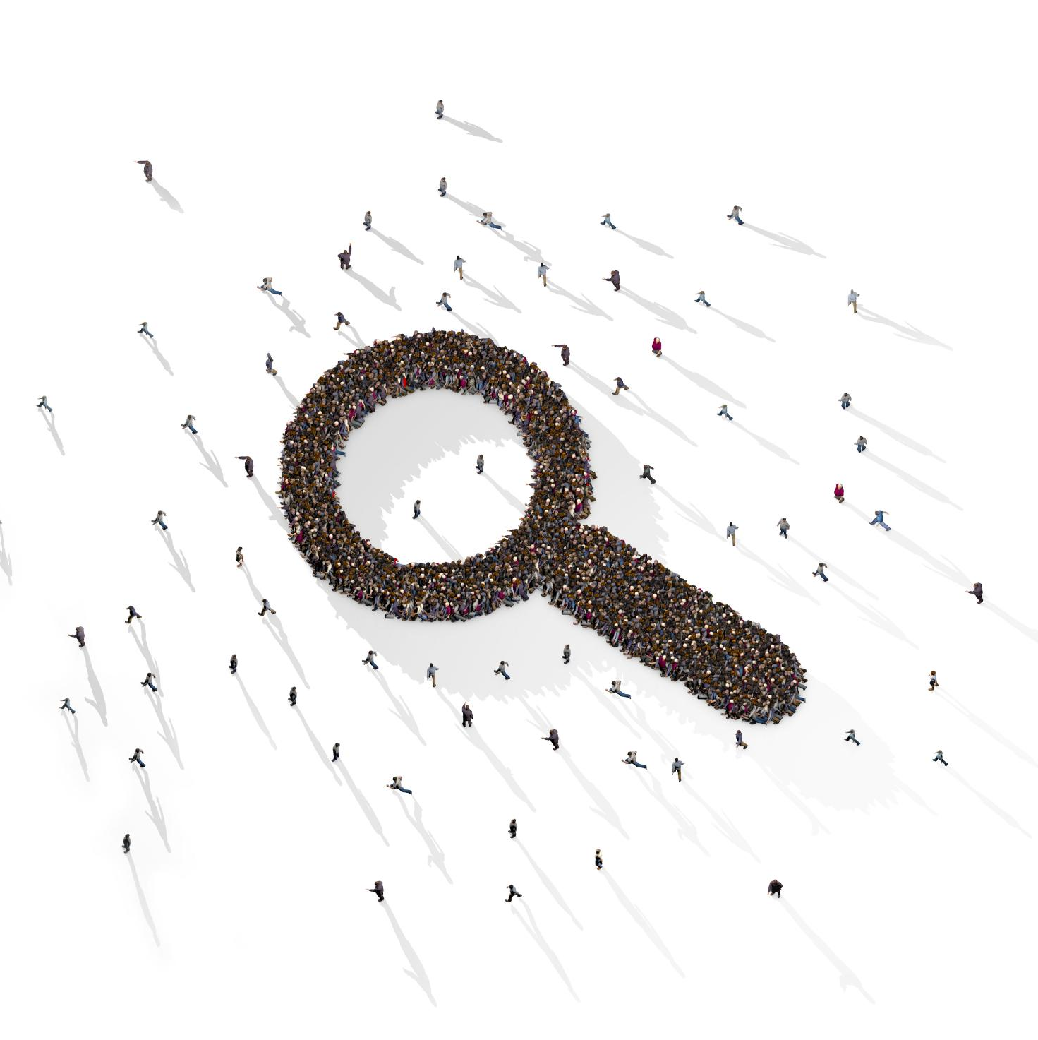
Similarity and BM25 Search
Dense Similarity Search
  Uses embeddings to measure semantic similarity with cosine, dot product, or Euclidean metrics capturing context.
Sparse BM25 Search
  Ranks documents by term frequency and inverse document frequency, effective for exact keyword queries.
Hybrid Retrieval Approach
  Combines BM25 filtering with dense similarity refinement to improve precision and recall in retrieval.
Notes:
---
This slide references information from the following file: https://learn.microsoft.com/en-us/azure/architecture/ai-ml/guide/rag/rag-chunking-phase,https://langcopilot.com/posts/2025-10-11-document-chunking-for-rag-practical-guide
Retrieval in RAG systems relies on two primary approaches: dense similarity search and sparse keyword-based search. Dense retrieval uses embeddings to perform semantic similarity matching, typically measured by cosine similarity, dot product, or Euclidean distance. This method excels at capturing contextual meaning but can be computationally intensive. Sparse retrieval, exemplified by BM25, ranks documents based on term frequency and inverse document frequency, making it effective for keyword-specific queries. Hybrid retrieval combines both methods, using BM25 to filter candidates and dense similarity to refine results, thereby improving precision and recall. BM25 is particularly useful for domains requiring exact keyword matches, while dense retrieval is ideal for nuanced, context-driven queries. Implementing hybrid strategies ensures that RAG systems can handle a wide range of query types, from highly specific to semantically complex, delivering more accurate and relevant responses.

Slide 11
Libraries and Tools for RAG
Notes:
---
This slide references information from the following file: https://docs.langchain.com/oss/python/langgraph/agentic-rag,https://www.leanware.co/insights/langgraph-rag-agentic,https://langchain-tutorials.com/lessons/rag-applications/lesson-13
LangChain and LangGraph, CrewAI and Agno

Slide 12

LangChain and LangGraph
LangChain Framework
  LangChain provides modular components like document ingestion, chunking, and embedding generation for RAG applications.
Vector Database Integration
  It supports multiple vector databases such as Qdrant, Pinecone, and FAISS for efficient data retrieval.
LangGraph Orchestration
  LangGraph extends LangChain with graph-based orchestration enabling conditional logic and adaptive workflows.
Dynamic Decision-Making
  LangGraph supports flexible pipelines for complex query handling and agentic RAG systems with retries.
Notes:
---
This slide references information from the following file: https://docs.langchain.com/oss/python/langgraph/agentic-rag,https://www.leanware.co/insights/langgraph-rag-agentic,https://langchain-tutorials.com/lessons/rag-applications/lesson-13
LangChain is a popular framework for building RAG applications, offering components for document ingestion, chunking, embedding generation, and retrieval orchestration. It supports integration with multiple vector databases, including Qdrant, Pinecone, and FAISS, and provides utilities for creating RAG chains and agents. LangGraph extends LangChain by introducing graph-based orchestration, enabling conditional logic, retries, and adaptive workflows. This approach allows developers to design flexible pipelines where nodes represent tasks such as retrieval or generation, and edges define execution paths based on intermediate results. LangGraph is particularly suited for agentic RAG systems that require dynamic decision-making and complex query handling. Together, these libraries simplify the development of robust, scalable RAG solutions.

Slide 13

CrewAI and Agno
CrewAI RagTool Capabilities
  CrewAI's RagTool builds RAG pipelines ingesting data from PDFs, web pages, and databases dynamically.
Agno Multi-Agent Framework
  Agno supports multi-agent systems with conversation memory, citation tracking, and dynamic knowledge updates.
Advanced RAG Solutions
  Both platforms enable advanced retrieval-augmented generation for richer, accurate AI interactions.
Notes:
---
This slide references information from the following file: https://docs.langchain.com/oss/python/langgraph/agentic-rag,https://www.leanware.co/insights/langgraph-rag-agentic,https://langchain-tutorials.com/lessons/rag-applications/lesson-13
CrewAI provides the RagTool, a versatile component for building RAG pipelines that can ingest data from diverse sources such as PDFs, web pages, and databases. It supports dynamic knowledge base creation and integrates seamlessly with agent frameworks for question answering and contextual reasoning. Agno, on the other hand, is an open-source multi-agent framework designed for building sophisticated agentic RAG systems. It offers features like conversation memory, citation tracking, and dynamic knowledge base updates, making it ideal for applications that require multi-step reasoning and persistent context. Both CrewAI and Agno empower developers to create advanced RAG solutions that go beyond simple retrieval and generation, enabling richer interactions and more accurate responses.

Slide 14
Functions and Query Types in RAG
Notes:
---
This slide references information from the following file: https://www.chitika.com/hybrid-retrieval-rag/,https://apxml.com/courses/getting-started-rag/chapter-2-rag-retrieval-component/similarity-search-basics,https://www.jellyfishtechnologies.com/similarity-scoring-rag-types-implementations/
Retrieval and Query Handling

Slide 15
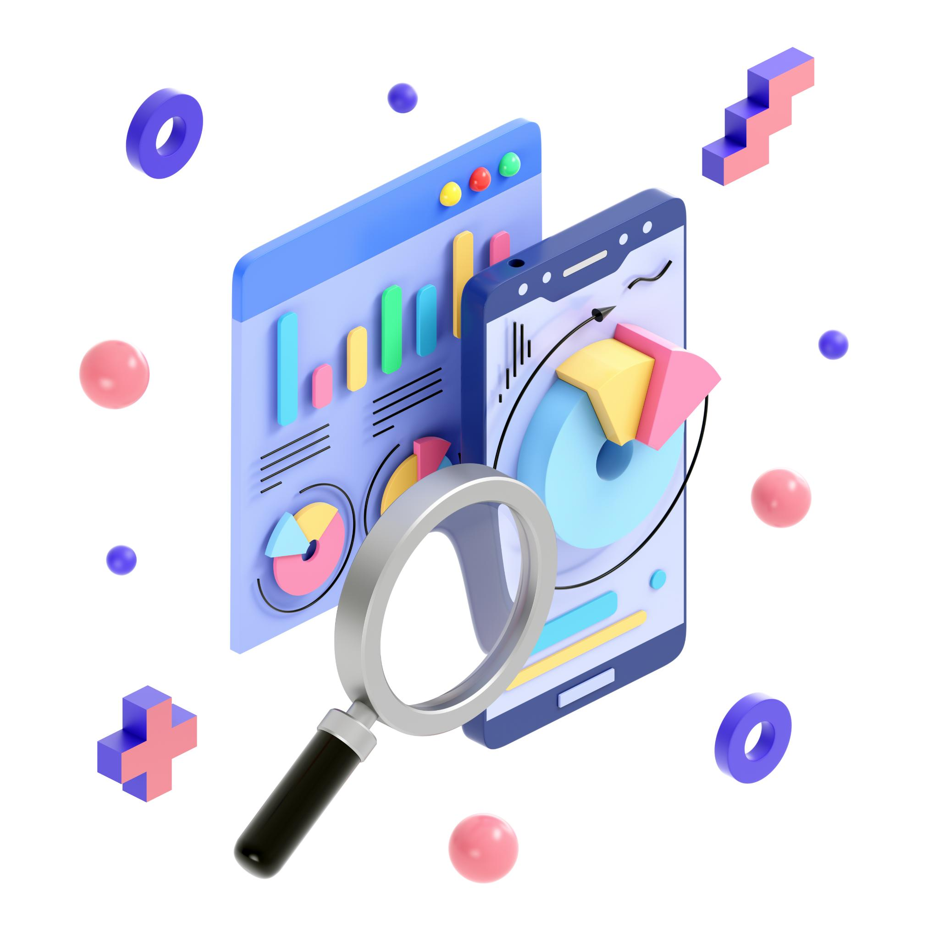
Retrieval and Query Handling
Retrieval Methods
  RAG systems use dense, sparse, or hybrid retrieval methods to select relevant document chunks efficiently.
Query Types
  Queries range from simple keyword searches to complex semantic queries needing multi-step reasoning.
Agentic Query Handling
  Agentic RAG systems dynamically select retrieval strategies based on query complexity for better accuracy.
Tool Integration
  Tool calls invoke APIs and libraries to perform searches and integrate results into text generation pipelines.
Notes:
---
This slide references information from the following file: https://www.chitika.com/hybrid-retrieval-rag/,https://apxml.com/courses/getting-started-rag/chapter-2-rag-retrieval-component/similarity-search-basics,https://www.jellyfishtechnologies.com/similarity-scoring-rag-types-implementations/
Retrieval in RAG systems involves selecting relevant document chunks based on user queries. This process can use dense similarity search, sparse keyword-based search, or hybrid methods. Dense retrieval relies on embedding-based similarity measures such as cosine similarity, while sparse retrieval uses algorithms like BM25. Hybrid retrieval combines both approaches for improved accuracy. Query types in RAG systems vary from simple keyword searches to complex semantic queries requiring multi-step reasoning. Agentic RAG systems enhance query handling by dynamically choosing retrieval strategies based on query complexity. Tool calls orchestrate these processes, invoking APIs or libraries to perform searches and integrate results into the generation pipeline. Effective retrieval and query handling are critical for delivering accurate, contextually relevant responses in RAG applications.

