Slide 1
ANALYSIS OF
INDIAN RAINFALL DATA
FOR
FUTURE PREDICTION
Name: Biswasindhu Mandal
Master of Computer Application(CSE)
Class Roll No.- 001610503028
Exam Roll No.- MCA196024
Registration No.- 137335 of 2016-2017
Jadavpur University

Slide 2
Content
Introduction
Proposed Work
Experiment & Result
Conclusion & Future Work

Slide 3
Introduction: Basic
Difference of weather & climate
weather and climate is a measure of time.
Weather is conditions of the atmosphere are over a short period of time.
Climate is how the atmosphere behaves over relatively long periods of time.
An easy way to remember the difference is that,
weather is like a hot day with pop-up thunderstorms and
climate is what you expect, like a very hot summer, cold winter.2

Slide 4
Introduction : Indian Rainfall
Rainfall is part of climate. It plays an important role in the assessment of climatic water balance of a region.
Importance of Indian Rainfall
India is a riverine country. It falls under the active monsoon region of the world.
The river area holds 81% of our country.
Almost 60%-70% of the total population of this country are directly or indirectly related to agriculture. Hence, rainfall plays a crucial part the economy of India.
Heavy rainfall or low rainfall may affect ecosystems, agriculture, food security, water availability, water quality, health etc.

Slide 5
Introduction: My Work
In general, weather and rainfall are highly non-linear and complex phenomena, which require advanced computer modelling and recreation for their accurate prediction.
So, to predict the future data we using different types of techniques.
In this project presents a methodology for forecasting rainfall of all regions of our country.
Through clustering we update the noise data and next using Artificial Neural Network(ANN) predict the future rainfall.

Slide 6
Background Work: database choice
Why Choose Database:
Weather have 6 major components:
Temperature (ii) Atmospheric Pressure (iii) Rainfall
(iv) Wind (v) Humidity (vi) Cloudiness
In a year for a region total 12 x 6 weather data
So, There are huge amount of data to store in database
Therefore, first problem is what type of database we choose

Slide 7
Background Work: database choice
We know there are two type of database.
SQL & NoSQL
Problem of SQL database:
Forgotten Primary Keys
Forgotten NULL vs. Empty String Values
Poorly Managed Data Redundancy
Dependency on Order of Columns on Result Set
Copying data from one table to other
table-based
fixed or static or predefined schema
Here I use NoSQL database: Mongo dB

Slide 8
Proposed Work: data collection
Monsoon data set has been received from the URL ‘https://data.gov.in’
There is different format of data in xml, csv, JSON
Here I choose csv format as my best →
data

Slide 9
Proposed Work: data processing
We directly do not store data, which directly lies in, excel/csv format.
First, we have to understand how to store this data into database.
Region: LAKSHADWEEP
Year: 2017
Month: JANUARY
Data: 21.3
So, I decided to store data in a specific format
Grouping all data in that format

Slide 10
Proposed Work: data insertion
{
"REGION": "GANGETIC WEST BENGAL",
"YEAR": 1993.0,
"MONTH": "MARCH",
"DATA": 40.8
}
Create object: called json format
Database Insertion find → update/newly insert
Next part is to data filtering to update noise data.

Slide 11
Proposed Work: User Query
Two type user query:
(i) region, year;
ex: expect data of ‘Bihar, 2019’
(ii) region, year, month
ex: expect data of ‘WB, 2019, OCT’

Slide 12
Proposed Work: ANN: introduction
use Artificial Neural Network
Supervised Learning in Machine Learning.
It is a type of system/model where both input and desired output data are provided and with that input-output we train out model/system

Slide 13
Proposed Work: ANN: layers
Input layer:
no of Input set = no of input layer (number of input neurons)
Hidden layer:
set no of hidden layer & height (number of neurons)
set weight, w_{ij} and bias b_{i} of each neurons to each hidden layer
Output layer:
no of output set = no of output layer (number of output neurons)

Slide 14
Proposed Work: ANN : methods
As ANN is a part of Supervised Learning. Therefore, there are some input and output data for learning.
Within learning/training procedure of propagation method, there are two main part of strategy.
(1) Forward Propagation
(2) Backword Propagation.

Slide 15
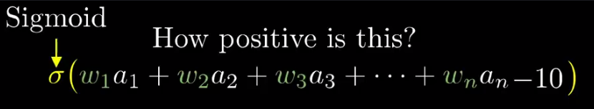

Proposed Work: ANN : methods
Forward Propagation:
The input X provides the initial information.
Set weight, w_{ij} & bias b_{i} for hidden layer weight and additional parameter
Propagate input through network: Y₁ = σ(X●W + B)
continue…..

Slide 16
Proposed Work: ANN : methods
Backword Propagation:
Y provided output ending information
Calculate error: € = Y – Y_{n}; Y_{n} → last hidden layer value
Allows the information to go back from the cost backward through the network in order to compute the gradient. Therefore, loop over the nodes starting at the final node in reverse topological order to compute the derivative of the final node output with respect to each edge’s node tail. The activation function derivatives’ formulas (σ’(𝑥)) will help us write the back-propagate functions.
Similarly do backword process for update weight w_{ij} & bias b_{i} using learning-rate, lr
lr  [0,1]

Slide 17
Proposed Work: ANN : methods

Slide 18
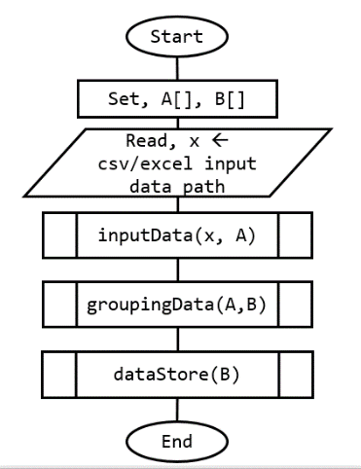
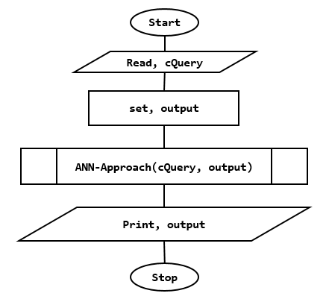
Proposed Work: code structure
Data Insert
Future Data Expect

Slide 19
Experiment & Result: approach -1
ANN-approach-1:
query → [region ,year, month] → [Kerala, 2019, March]
get-data → all data of a month from 1950 to 2017
ANN input
ANN output
1950 | 1951 | 1952 | 1953 | 1954
1951 | 1952 | 1953 | 1954 | 1955
1952 | 1953 | 1954 | 1955 | 1956
1953 | 1954 | 1955 | 1956 | 1957
… | … | … | … | …
2011 | 2012 | 2013 | 2014 | 2015
2012 | 2013 | 2014 | 2015 | 2016
1955
1956
1957
1958
…
2016
2017
Training data
ANN query-Input
ANN query-output
2013 | 2014 | 2015 | 2016 | 2017
2018 ?
2014 | 2015 | 2016 | 2017 | 2018
2019 ?

Slide 20
Experiment & Result: approach -1
ANN-approach-1:
query → [region ,year] → [Kerala, 2020]
get-data → all data of each month from 1950 to 2017

Slide 21
Experiment & Result: approach -2
ANN-approach-2:
query → [region ,year, month]; month → march
get-data → all data of query month and its previous 5 months
from 1950 to 2017
ANN input
ANN output
Oct, ‘50 | Nov, ‘50 | Dec, ‘50 | Jan, ’51 | Feb, ’51
Oct, ‘51 | Nov, ‘51 | Dec, ‘51 | Jan, ’52 | Feb, ‘52
Oct, ’52 | Nov, ’52 | Dec, ’52 | Jan, ’53 | Feb, ’53
Oct, ’53 | Nov, ’53 | Dec, ’53 | Jan, ’54 | Feb, ’54
… | … | … | … | …
Oct, ’16 | Nov, ‘16 | Dec, ’16 | Jan, ’17 | Feb, ‘17
Oct, ‘17 | Nov, ’17 | Dec, ‘17 | Jan, ’18 | Feb, ’18
march, ’51
march, ’52
march, ’53
march, ’54
…
march, ’18
march, ‘19
Training data
ANN query-Input
ANN query-output
Oct, ‘17 | Nov, ’17 | Dec, ‘17 | Jan, ’18 | Feb, ’18
march, ‘18
Problem create…..

Slide 22
Experiment & Result: approach -2
ANN-approach-2:
query → [region ,year]
get-data → all data from 1950 to 2017
now predict Jan, ’18; Feb, ’18; ….. Up to Dec, ‘query-year

Slide 23
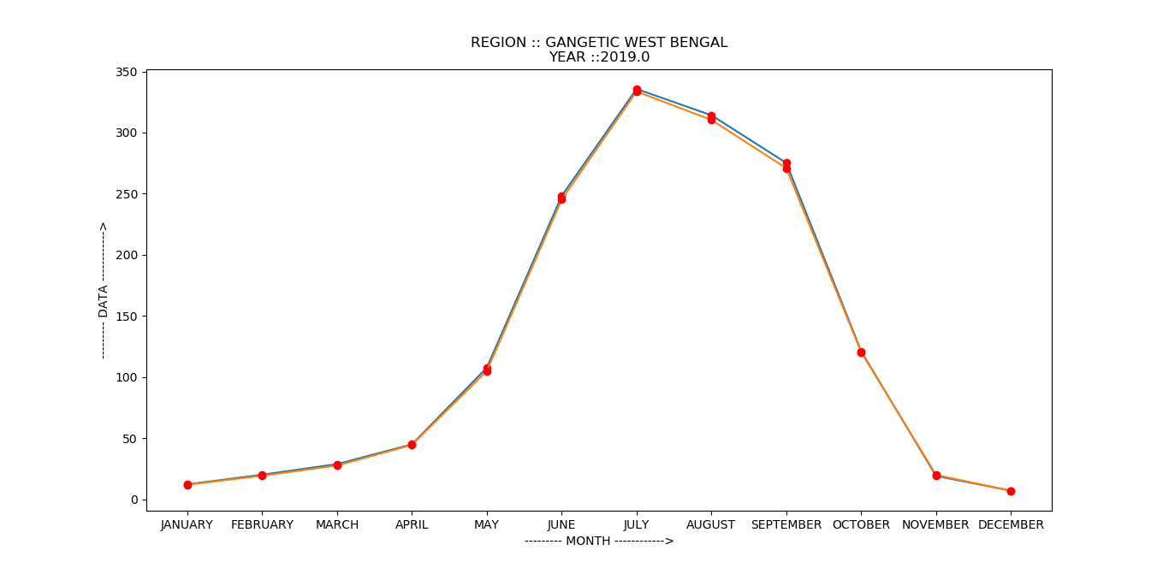
Experiment & Result: results
Red line: approach-1
Blue line: approach-2

Slide 24
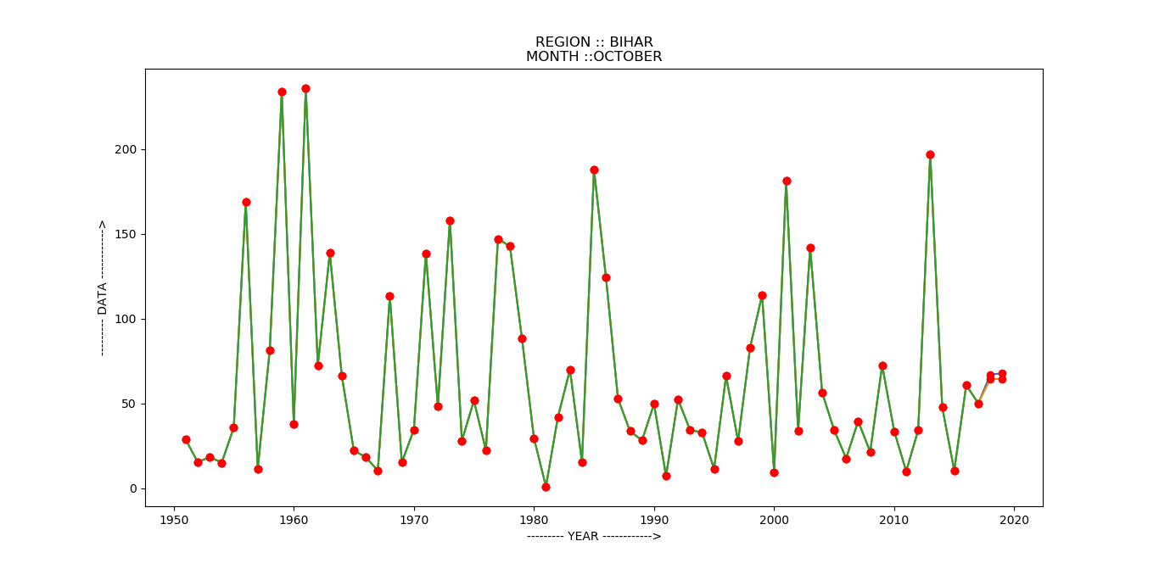
Experiment & Result: results
Red line: approach-1
Blue line: approach-2
Green line: database data

Slide 25
Conclusion & Future Work
Rainfall prediction is a beneficial but challenging task.
Data mining techniques have the ability to predict the rainfall by extracting and using the hidden knowledge from past weather data.
Various models and techniques are available today for effective rainfall prediction. Here, I am using ANN (Artificial Neural Network) to predict the future data. There are another option to predict the rainfall data are SVM (Support Vector Machine), RNN (Recurrent Neural Networks), ANFIS (Adaptive Neuro Fuzzy Inference System) etc. and after that if we comparison all of things then we get a better solution to predict Rainfall data. I start to project with the goal of weather prediction. But, with only rainfall prediction we did not predict the weather data. Therefore, if we add another criterion of the weather data prediction, like temperature, humidity, air-presser etc. then we predict a perfect weather condition.

Slide 26
References
[01]. Administrator, N. C. (2017, august 07). NASA - What's the Difference Between Weather and Climate? Retrieved from nasa.gov: https://www.nasa.gov
[02]. & ISSAC, L. P. (2014, January). SQL vs NoSQL Database Differences Explained with few Example DB. Retrieved from thegeekstuff.com: https://www.thegeekstuff.com
[03]. J. J. (2015, February). Why and when should I use NoSQL instead of SQL? Retrieved from quora.com: https://www.quora.com/Why-and-when-should-I-use-NoSQL-instead-of-SQL
[04]. S. S. (2017, August). Artificial Neural Network (ANN) in Machine Learning. Retrieved from datasciencecentral.com: https://www.datasciencecentral.com/profiles/blogs/artificial-neural-network-ann-inmachine-learning
[05]. J. R. (2019, April 30). Equalizing Seasonal Time Series Using Artificial Neural Networks in Predicting the Euro– Yuan Exchange Rate. 76. Retrieved from mdpi.com: https://doi.org/10.3390/jrfm12020076

Slide 27
References
[06] L S Rathore, S. D. (2013). STATE LEVEL CLIMATE CHANGE TRENDS IN INDIA. Lodi Road, New Delhi- 3 (India): India Meteorological Department. Retrieved from http://www.imd.gov.in/pages/services_climate.php
[07]. P. T. (2007). Sigmoid Functions and Their Usage in. Bahçeşehir University,, Faculty of Engineering and Natural Sciences, Computer Engineering Department. Beşiktaş, İstanbul / TÜRKİYE: -. Retrieved from excel.ucf.edu: https://excel.ucf.edu/classes/2007/Spring/appsII/Chapter1.pdf

