Slide 1

Evaluating Intelligent Voting Strategies
Van Quoc Thinh Vo
Angelo State University
April, 2021
Notes:
Good morning! My name is Van Quoc Thinh Vo and I am currently a senior majoring in Computer Science. Welcome to my presentation about the research that we have been doing for the last semester which is about Evaluating Intelligent Voting Strategies.

Slide 2
Outline
Benefit of intelligent voting strategies
Purposes of the research
Experiment set-up
Results
Future works
Notes:
Today we are going to going through 5 main points of the research which are ….

Slide 3
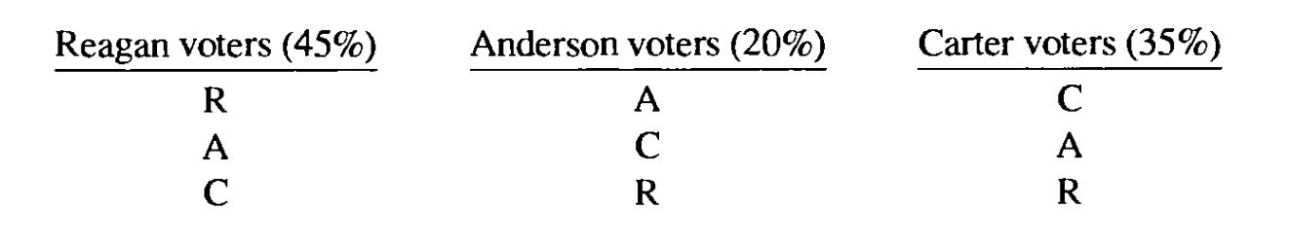
Benefit of Intelligent Voting Strategy?
Produce the best possible outcome for every voter
Increase voter’s satisfaction with the final result
Change the obvious outcome of an election
Example of 1980 United States presidential election
Notes:
As we all know, nowadays, there exists a lot of interesting voting systems. Therefore, acknowledging the benefits of intelligent voting strategy can be extremely important to the voters. So what are the benefits? First and foremost, intelligent voting strategies are used in order to produce the best possible outcome for every voter based on the current vote totals and the voter’s preferences. Secondly, intelligent voting strategies are proved to increase the voter’s satisfaction with the final result significantly. Since they usually suggest voters to vote according to their preference, they ensure the outcome will satisfy most of the voters. Lastly, it could even change the obvious outcome of an election. Historically, intelligent voting strategies have played important parts in deciding the winner of many different elections. One example of such an election is the 1980 United States presidential election. It included three candidates: Democrat Jimmy Carter, Republican Ronald Reagan and Independent John Anderson. According to the summer polls, Ronald Reagan had the highest number of votes. As you can see from this example here, Reagan was the first choice of 45% of the voters, with about 20% favoring Carter and 45% favoring Carter so if everyone votes for their favorite candidate, Ronald Reagan would obviously win the election. However, the result could change if Jimmy Carter and John Anderson’s voters to try different (maybe insincere) voting strategies to keep their least favorite candidates from winning.

Slide 4
Benefit of Intelligent Voting Strategy?
Approval Voting System
  A simple single-winner voting protocol
  Voters are allowed to vote for as many candidates as they wish but cannot cast more than one vote for each candidate
  The winner is whoever has the greatest vote total
Plurality Voting System
  A voting system that allows each voter to only vote for one candidate
  Obliges voters to either choose to vote for their favorites or vote for other candidates
  The winner is the candidate with the highest number of votes
Notes:
- There are many different voting systems that are being used nowadays. In this research, we only focus on two system which are approval voting system and plurality voting system.
- APPROVAL: One of the advantages of approval voting is that it allows voters a larger number of choices in an election

Slide 5
Purposes of the research:
Find the best approval voting strategy
Find the best plurality voting strategy
Analyze which strategies satisfy the voters the most
Compare between approval and plurality voting systems
Notes:
Conduct 10 different approval voting strategies and run an experiment for many different elections to find the best one
Build 4 different plurality voting strategies and run an experiment for many different elections to find the best one
Set up a point system to analyze which strategy is the most efficient and which strategy makes the voters most happy with the results
Compare the effectiveness of every approval voting strategies with every plurality voting strategies and compare the best approval voting strategy with the best plurality voting strategy

Slide 6
Experiment Set-up
Approval Voting Strategies
Plurality Voting Strategies
Election
Effectiveness Rating
Happiness Rating

Slide 7
Approval Voting Strategies
Approval strategies that effectively ignore the candidates’ current vote totals (F, H, and U)
Sophisticated strategies that take into account both the election state and the voter’s preferences (D and Q)
Strategies that look at not just the current leader but also the current second-place candidate (T, Y, and A)
A strategy recommended as most effective by the mathematician Warren Smith (W)
A strategy that acts differently given different parameter inputs (E(x,y))
Notes:
F: favorite, H: favorite half of the candidates out of the voter’s preferences, U: every candidate except least favorite
D: current leader and every candidate that the voter favors more, Q: every candidate that the voter favors more than the current leader
T: favorite of the two currently leading candidates plus all candidates preferred to it, Y: all candidates preferred to either of the two currently leading candidates, A: every candidate preferred to the leader and the leader if (1) > (2)
Ask the audience about the strategies that they would use

Slide 8
Strategy F
Strategy D
Strategy A
Strategy W
Strategy E (x, y)
For each candidate i: Find the voter’s favorite candidate Vote for the candidate
Vote for first place candidate For each candidate i: Vote for candidate i if and only if they are preferred to the current leader
For each candidate i: Vote for candidate i if and only if they are preferred to the current leader Vote for first place candidate if it is preferred to the second placer
Vote only for the favorite of the top two frontrunners For each of the other candidate i: Vote for candidate i if and only the voter’s preference is higher than their average preference for the (previously considered) candidates that currently have more votes
For each candidate i probability of winning = [(number of votes + y) ^ x] / total of the result of every candidate Expected value = each candidate’s estimated probability of winning * the voter’s preference for that candidate For each of the other candidate i: Vote for candidate i if and only their preference value > the expected value
Notes:
Strategy W (moving-average strategy): it arranges the candidates in descending order of votes received
Example for E: if after calculating everything, the expected value is 0.68 then every candidate who has a preference value > 0.68 (like 1, 2,…) will be approved

Slide 9
Plurality Voting Strategies
A simple strategy that only takes the voter’s top preference into consideration (pF)
A strategy that effectively ignores the voter’s preferences and focuses solely on the election state (pD)
A strategy that involves both the election state and the voter’s preferences (pQ)
A strategy that approves the favorite of the currently leading and second-placed candidates (pA)
Notes:
Strategy pF
Strategy pD (vote for highest number of votes)
Strategy pQ (vote for the candidate with the highest number of votes among the candidates preferred to the currently leading candidate)
Strategy pA (vote for the favorite among the first and second-placed candidates)
Ask the audience about the strategies that they would use

Slide 10
Election
Each simulated election in this research uses a multi-round system
Every candidate starts with a vote total of zero and every voter starts voting an empty ballot
All voters vote in a predetermined order in each round
When a voter votes, they replace their previous ballot. The vote totals are also updated after each voter votes; if multiple candidates share a vote total, the tie is broken by candidate number
The election continues until a certain number of rounds is completed
Example (everyone uses strategy A)

Slide 11
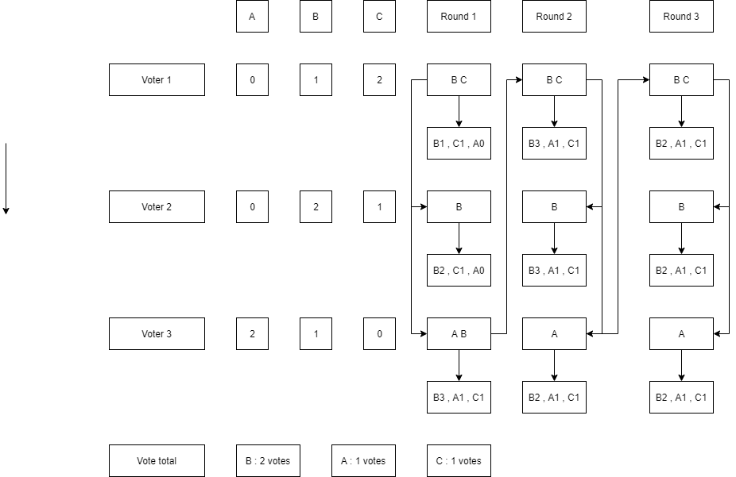
Example
Notes:
Election starts with every candidate has 0 vote and voter starts with an empty ballot
Everyone use strategy A

Slide 12
Effectiveness Rating
Compare two strategies directly
  Assume every voter would use the same particular voting strategy
  Each voter, one at a time, will switch their voting strategy to another strategy
  The same process will be repeated for every other voter
  Example of strategy A and T for 5 voters
Study how the switch changes the winner of the election
Equilibrium for strategy E(x,y)
Notes:
Set random preference ordering for every voter, each candidate in the ordering is assigned with a preference point. The higher the point is, the more favored the candidate is by the voter.
Give an example of 5 voters with strategy A and T
Set y to 1, to find the best x
Set x to the best value just found, find the best y

Slide 13
Results for strategy A
Notes:
- A is closest thing that we can find to the evolutionary strategy

Slide 14
Happiness Rating
Find the strategies that satisfy voters the most when every voter uses the same strategy
Calculate how much the voters like the winner of each election by totaling the preference values for every voter
Notes:
Compare it to the case when the winner of the election is also every voter’s favorite candidate
After many elections, whichever strategy has the highest percentage is the one that satisfies the voters the most

Slide 15
Notes:
- E (7,1), H, T, A, and W do well in making the voters happy with the winner
- Approval voting strategies do much better than plurality voting strategies

Slide 16
Result and Discussion
Strategy A is the best approval voting strategy
Strategy pA is the best plurality voting strategy
Strategy E (7,1) is the equilibrium for the strategy E (x, y)
Overall, approval voting strategies produce much better result than plurality voting strategies
Changing the voting system from plurality to approval will make the voters happier
Notes:
- 20 candidates, 20 voters, and 10 rounds in 10,000 different elections
Strategy H, T, Y, W, and E also do well which concludes that best strategies often vote for more than one candidate
E(7,1) is basically strategy A as x gets large and y gets small

Slide 17
Future Work
Different voting systems
  Borda
  Boehm, Venzke
  Dabagh, antiplurality, Burnitz-Varrentrapp
More kinds of experiments
  Different numbers of voters, candidates, rounds
  Different ways of generating random preferences
  Different ways of comparing effectiveness of strategies
  True genetic algorithms approach (strategies with more parameters)
  Analyze which strategies are best for early voters or later voters
  Decide which voting systems have more stable outcomes when voter use best strategies
Notes:
Describe borda quickly: in an election among three or more candidates, the winner should be the candidate with the largest point total when points are awarded depending on each voter’s relative preferences
All the voting systems give candidates points so we can study them like we study approval and plurality voting systems
Example for stable

Slide 18

Conclusion
Notes:
We have conducted research analyzing the intelligence of some voting strategies under the approval voting and plurality voting systems
Our results demonstrate that strategies that both consider the election state and the voter’s preferences and often vote for more than one candidate perform very well in effectiveness experiment
Overall, if all voters use intelligent voting strategies, approval voting strategies accomplish significantly better results than plurality voting strategies so changing the voting system from plurality to approval will make the voters happier

Slide 19
Reference
Philip D. Straffin. Game Theory and Strategy. The Mathematical Association of America, 1993.
Rob LeGrand. Computational Aspects of Approval Voting and Declared-Strategy Voting. Ph.D. dissertation (WUCSE-2013-43), Department of Computer Science and Engineering, Washington University, St. Louis, Missouri, April 2008.
Steven J. Brams. Game Theory and Politics. Dover Publications, Inc, New York University, Mineola, New York, 2004.
Steven J. Brams and Peter C. Fishburn. Approval Voting. The American Political Science Review, Sep, 1978, pp. 831-847.
Warren D. Smith. Range Voting. December, 2000.

