Slide 1
Project: Dataset Adult
Alla Marokko
Kyrylo Vdovin
July 17, 2022

Slide 2
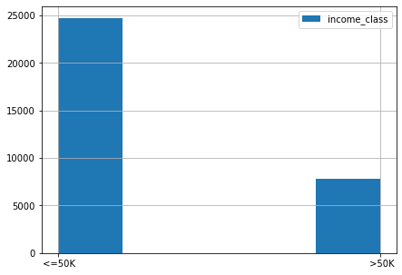
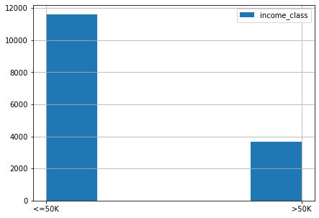
Description
Dataset name: Adult dataset
Dataset characteristics: Multivariate
Attribute characteristics: Categorical, Integer
Number of Instances(Total): 48842
Number of Instances(Train):32561
Number of Instances(Test):16281
Number of Attributes:14
Train
Test

Slide 3
Cleaning
Columns that have value equal to ’?’
workclass 2799
occupation 2809
native_country 857
Duplicates
Training set before removing 32561
Training set after removing 29096
Duplicates removed: 10.64%

Slide 4
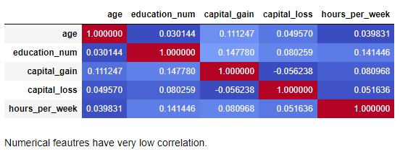
Correlation between numerical columns

Slide 5
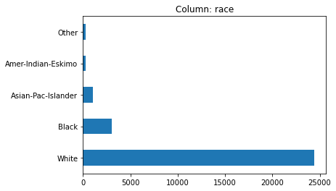
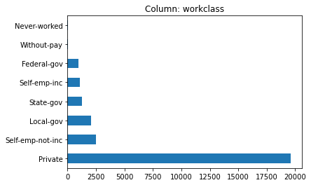
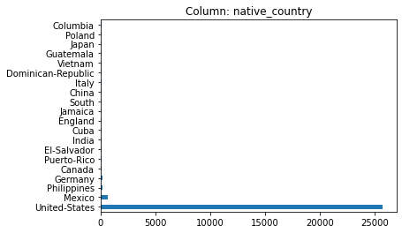
Data analysis

Slide 6
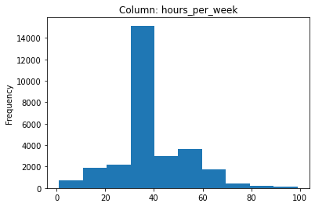
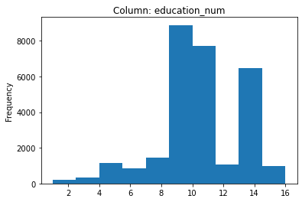
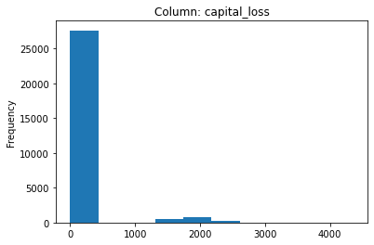
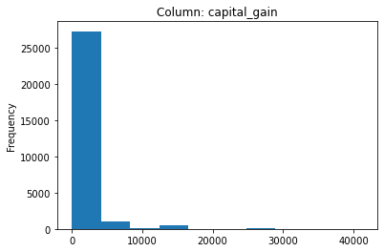
Data analysis

Slide 7
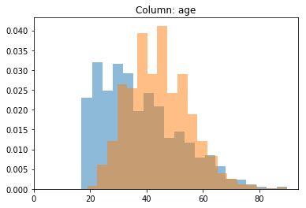
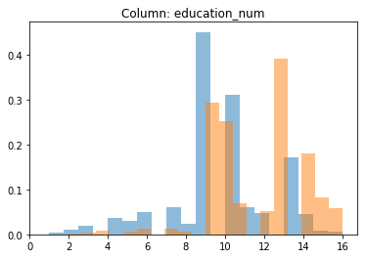
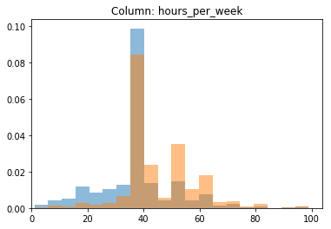
Correlation with the target feature

Slide 8
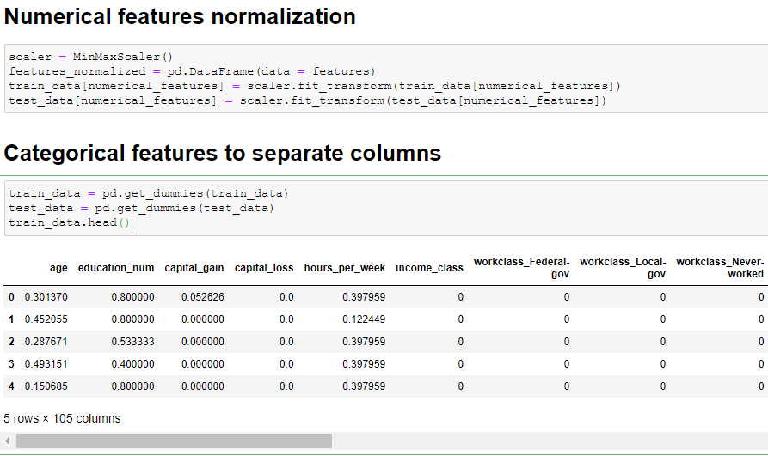

Slide 9
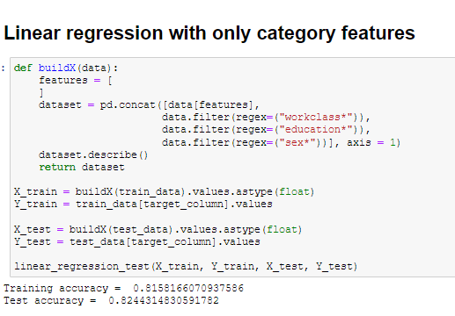

Slide 10
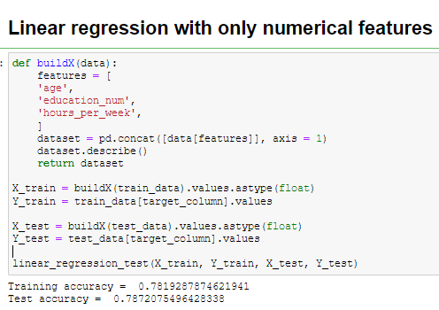

Slide 11
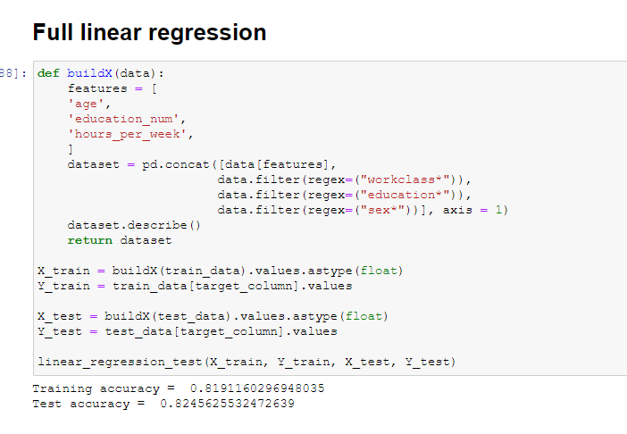

Slide 12
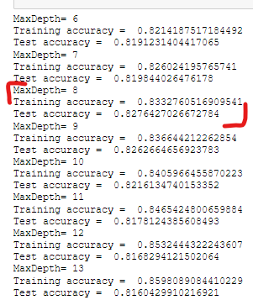
Decision Tree

Slide 13
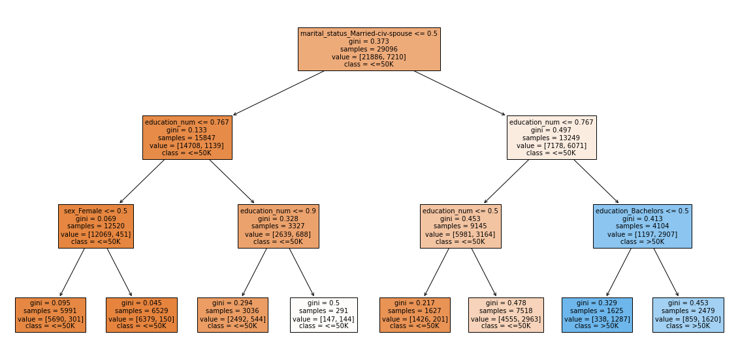
Decision Tree

Slide 14
Conclusions
We have built 2 predictive models (Linear Regression and Decision Tree)
Linear Regression has accuracy around 0.819 on training set and 0.825 on test set, that means that algorithm is not overfitting.
Decision tree has best accuracy around 0.833 on training set and 0.828 on test set with deep of the tree = 8. We can see that with increasing tree height algorithm has more accuracy on training set and less accuracy on test set, that means that the algo is overfitting.
We can see that income correlates the most with the age, education, sex and hours_per_week and workclass.

Slide 15
Thank you for attention!
Github repository of the project

