Slide 1
Hibernate: The Dark and Light Side

Slide 2
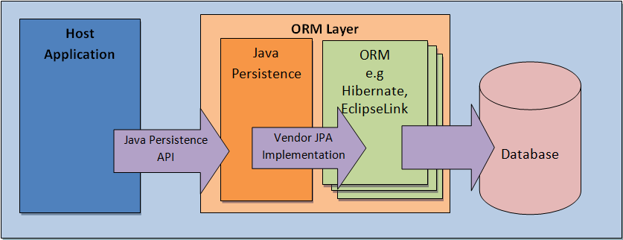
JPA - Java Persistence API

Slide 3
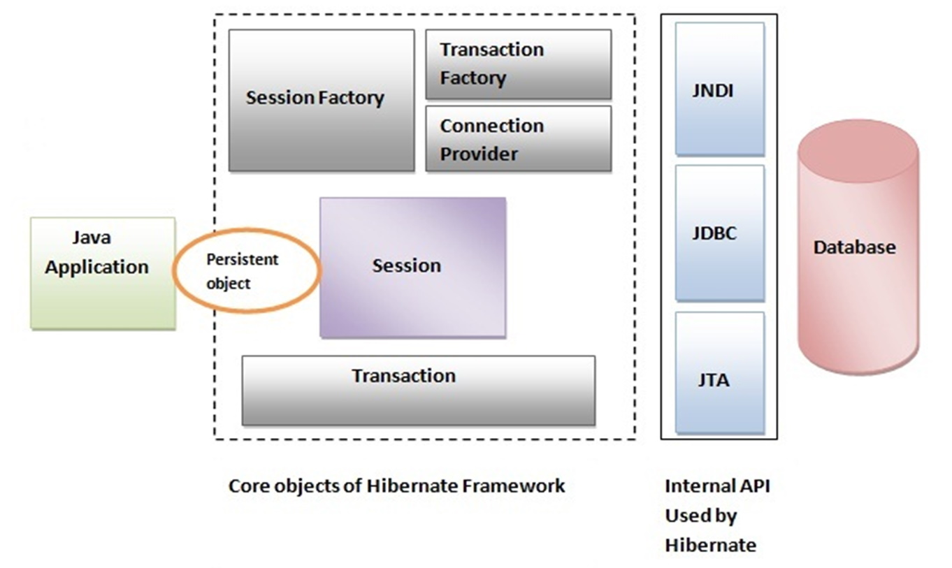
Hibernate

Slide 4
Entities, Proxies & Bytecode Providers
Entity Proxies (Lazy, Dirty checking)
Collection Proxies (Persistent Bag)
hibernate.bytecode.provider
(CGLIB, Javassist, ByteBuddy)

Slide 5
SQL Order Execution
Inserts, in the order they were performed
Updates
Deletion of collection elements
Insertion of collection elements
Deletes, in the order they were performed
*AbstractFlushingEventListener#performExecutions

Slide 6
Dirty Checking
Default approach – ALWAYS CHECK
@Transactional(readOnly = true)
@Immutable on Entity
Read only Queries
Stateless Session
Hibernate Enhancer
CustomEntityDirtinessStrategy

Slide 7
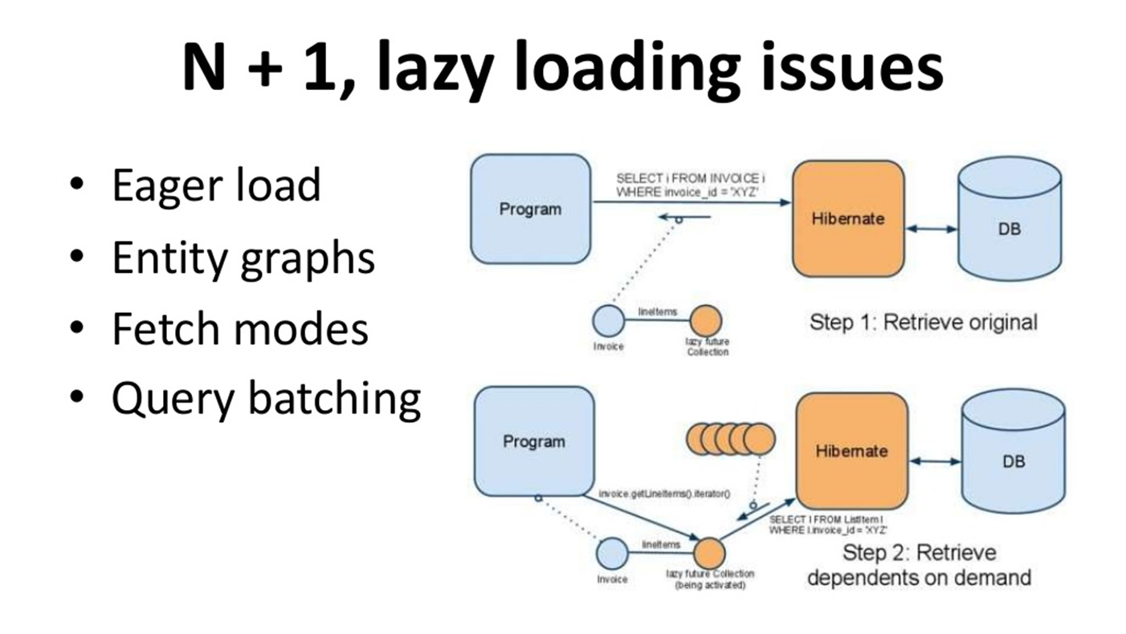

Slide 8
Query Optimizations
@SQLInsert / @SQLUpdate / @SQLDelete
@DynamicInsert / @DynamicUpdate
Native queries
Child mappings (@OneToXXX / @ManyToXXX)
Queries with DTO projections
Fetching & Batching
JDBC Tuning

Slide 9
DTO Projections
Tuple
Constructor Expression
@SqlResultSetMappings
Transformers.aliasToBean

Slide 10
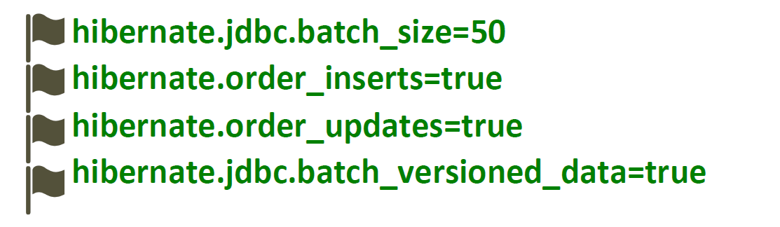
Batch Processing
Hibernate Batch processing is an easy way to add multiple statements into a batch and execute that batch by making a single round trip to the database.

Slide 11

Result Fetching
Fetch size is a number of records read from DB into memory in one round trip for a query.

Slide 12

JDBC Tuning (*PostgreSQL)
preparedStatementCacheQueries = 256
preparedStatementCacheSizeMiB = 5
prepareThreshold = 5

Slide 13
Thank You

