Slide 1
Plan outline (memo 18.09.2025)
Suggestion: Make uncertainty quantification (UQ) the primary contribution of the conference submission. This is less explored in ML for geoscience compared with yet another classifier with small accuracy gain.
Problem: Facies prediction from well logs with explicit uncertainty, acknowledging limited labels, heterogeneity, and interpretational ambiguity.
Approaches:
Multi-scenario (many models) aggregation (as seen in Halotel, Demyanov, Gardiner, 2016)
Train many models, each on a different training/validation well combination.
Calibrate Random Forest outputs on a held-out calibration split of the blind-well
Run all of them on the same test well.
At each depth, they count how often each facies is predicted across those models.
That count, converted to proportions, becomes a “facies proportion log”
+ do on different feature subsets (i.e. 7 vs 11 features) uncertainty reduction (i.e. discriminative context added) can be shown
+explore calibration and scaling (https://www.sciencedirect.com/science/article/pii/S0920410520310500)
2. Bayesian angle as an alternative paradigm for UQ (Vasily suggestion)
https://www.sciencedirect.com/science/article/pii/S0920410521004770
Build one small neural net with dropout.
At test time, dropout is ON and net is ran many times.
Each run is like asking a slightly different model.
Average their probabilities → final prediction.
Spread between runs → uncertainty.

Slide 2
Approach 1. Multi-scenario aggregation

Slide 3
The idea
Turn facies prediction into probabilities (not just hard labels) by ensembling many models trained on different well combinations.
Use model agreement as a proxy for confidence and map it along depth to highlight where the model is sure vs unsure.
Deliver facies-proportion logs + uncertainty metrics to guide interpretation and decisions

Slide 4
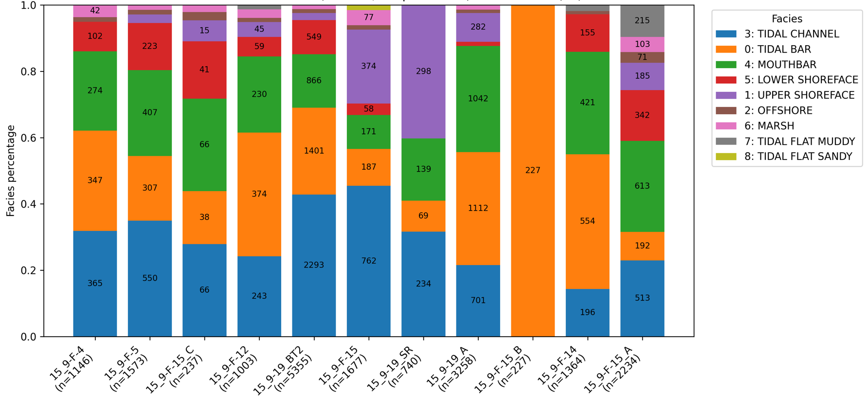
wells selection for experiments
Test
Training
Training
Training
Training

Slide 5
Experiment 1. how it works for 5 wells a,b,c,d,E
Start from a normalized dataset with logs + engineered features and known facies labels.
Take well E as a test (blind) well
Out of 4 remaining wells A,B,C,D generate all possible training combinations, i.e. 4 models of 3 wells in each model
Train each of 4 models and predict in each depth sample of well E
For each depth sample in Well E, get 4 different predictions
Calculate Facies Proportions (Voting)
Quantify Uncertainty
Confidence = max vote % (or max soft probability)
Uncertainty = 1 − max vote (+ entropy as optional normalized measure)
8. Produce facies-proportion logs + uncertainty logs by depth and well.
9. Produce visual diagnostics: model-accuracy distribution; uncertainty histogram; vote-agreement histogram; ranked model accuracies with ensemble line; uncertainty vs depth per well; confusion matrix.

Slide 6
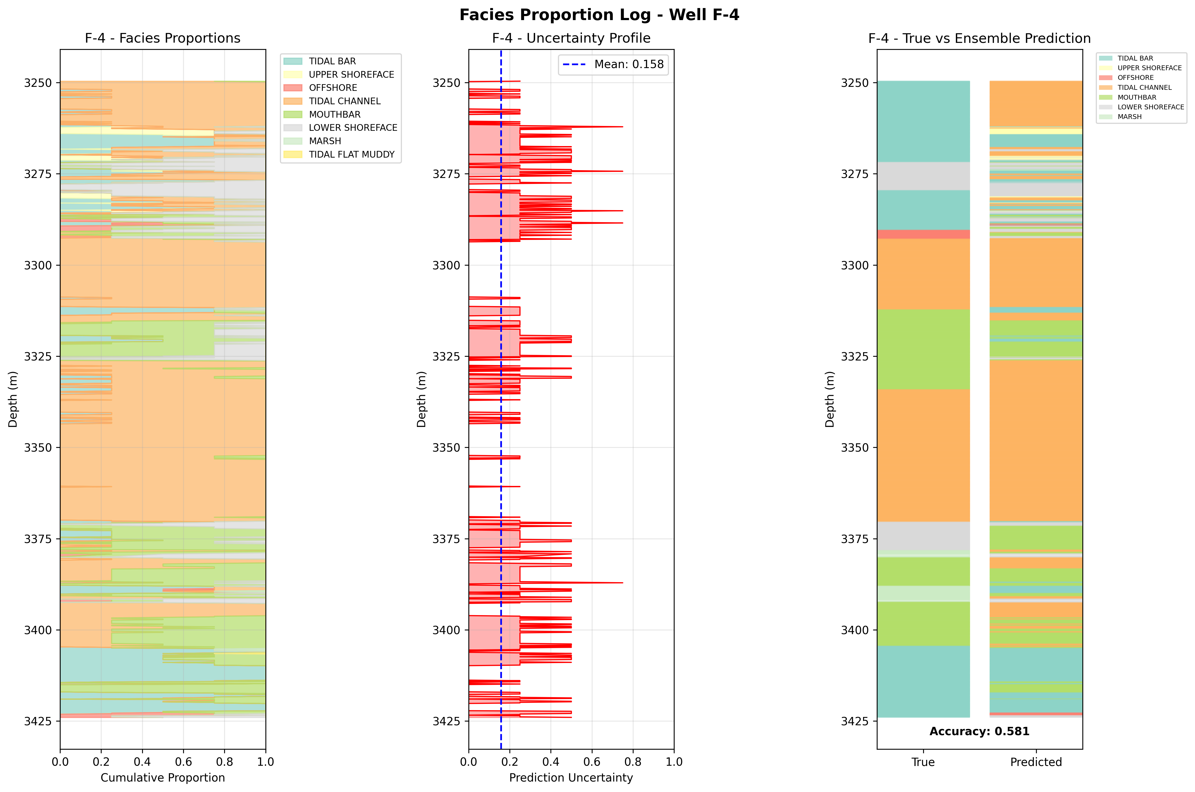
Experiment 1. UQ results

