Slide 1
Project Plan. Memo of 18.09.2025
Suggestion: Make uncertainty quantification (UQ) the primary contribution of the conference submission. This is less explored in ML for geoscience compared with yet another classifier with small accuracy gain.
Problem: Facies prediction from well logs with explicit uncertainty, acknowledging limited labels, heterogeneity, and interpretational ambiguity.
Approach 1.Multi-scenario (many models) aggregation (as seen in Halotel, Demyanov, Gardiner, 2016)
Train many models, each on a different training/validation well combination.
Calibrate Random Forest outputs on a held-out calibration split of the blind-well
Run all of them on the same test well.
At each depth, they count how often each facies is predicted across those models.
That count, converted to proportions, becomes a “facies proportion log”
+ do on different feature subsets (i.e. 7 vs 11 features) uncertainty reduction (i.e. discriminative context added) can be shown
+explore calibration and scaling (https://www.sciencedirect.com/science/article/pii/S0920410520310500)
Approach 2. Bayesian angle as an alternative paradigm for UQ (Vasily suggestion)
https://www.sciencedirect.com/science/article/pii/S0920410521004770
Build one small neural net with dropout.
At test time, dropout is ON and net is ran many times.
Each run is like asking a slightly different model.
Average their probabilities → final prediction.
Spread between runs → uncertainty.

Slide 2
Approach 1. Multi-scenario aggregation

Slide 3
The idea
Turn facies prediction into probabilities (not just hard labels) by ensembling many models trained on different well combinations.
Use model agreement as a proxy for confidence and map it along depth to highlight where the model is sure vs unsure.
Deliver facies-proportion logs + uncertainty metrics to guide interpretation and decisions

Slide 4
Experiment 1: generate all possible training combinations
How it works for 5 wells A,B,C,D,E:
Start from a normalized dataset with logs + engineered features and known facies labels.
Take well E as a test well
Out of 4 remaining wells A,B,C,D generate all possible training combinations, i.e. 4 models of 3 wells in each model
Train each of 4 models and predict in each depth sample of well E
For each depth sample in Well E, get 4 different predictions
Calculate Facies Proportions (Voting)
Quantify Uncertainty
Confidence = max vote % (or max soft probability)
Uncertainty = 1 − max vote (+ entropy as optional normalized measure)
8. Produce facies-proportion logs + uncertainty logs by depth and well.
9. Produce visual diagnostics: model-accuracy distribution; uncertainty histogram; vote-agreement histogram; ranked model accuracies with ensemble line; uncertainty vs depth per well; confusion matrix.

Slide 5
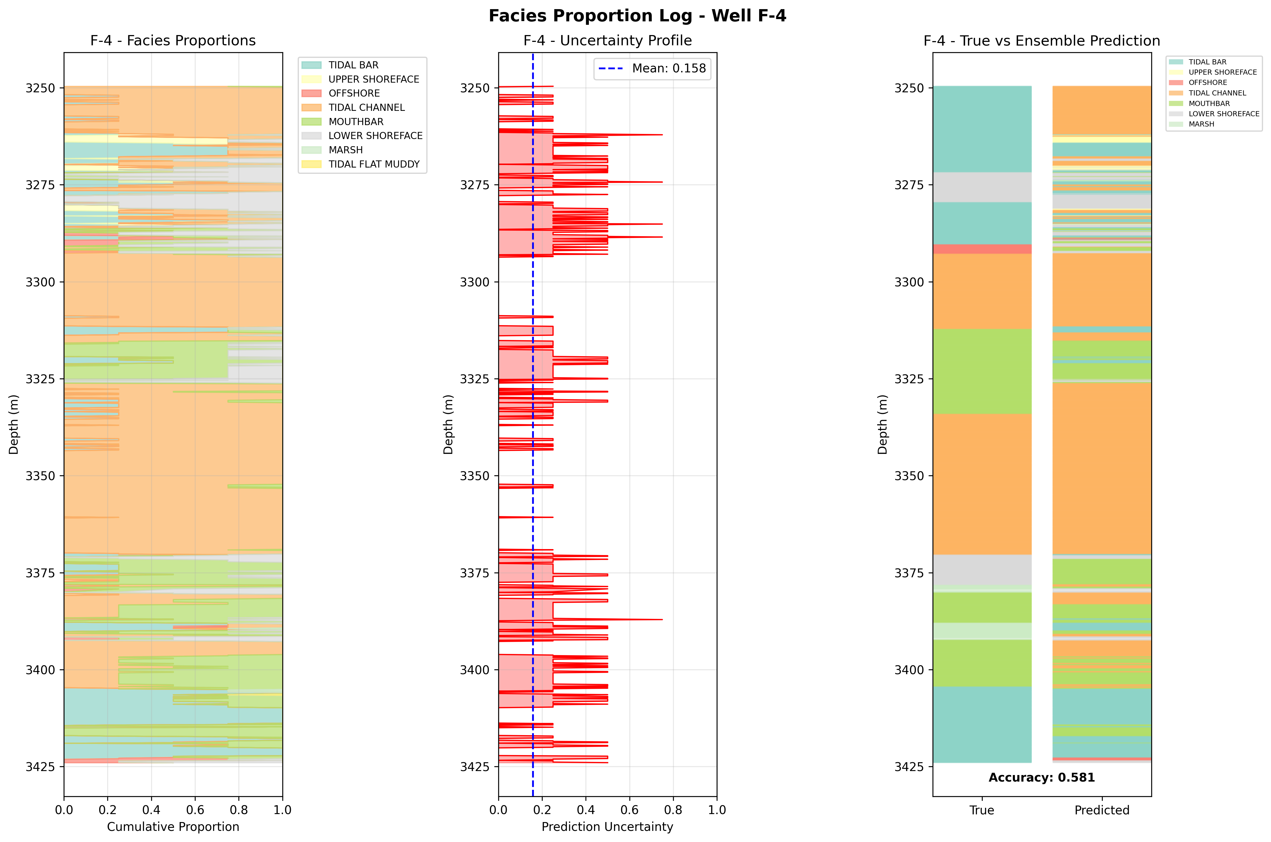
Experiment 1 results

Slide 6
Experiment 2: make 4 training/validation splits
How it works for 5 wells A,B,C,D,E:
Start from a normalized dataset with logs + engineered features and known facies labels.
Take well E as a test well, out of 4 remaining wells A,B,C,D generate 4 training/validation splits
For each split:
  Train initial model on training wells only (3 wells)
  Evaluate on validation well to get F1 score (tuning of hyperparameters)
  Combine train+validation data (now 4 wells total)
  Retrain final model on combined data
  Predict on test well E
For each depth sample in Well E, get 4 different predictions
Calculate Facies Proportions (Voting)
Quantify Uncertainty
8. Produce facies-proportion logs + uncertainty logs by depth and well.
9. Produce visual diagnostics
Check retrain step
Think of doing tuning with cross-validation

Slide 7
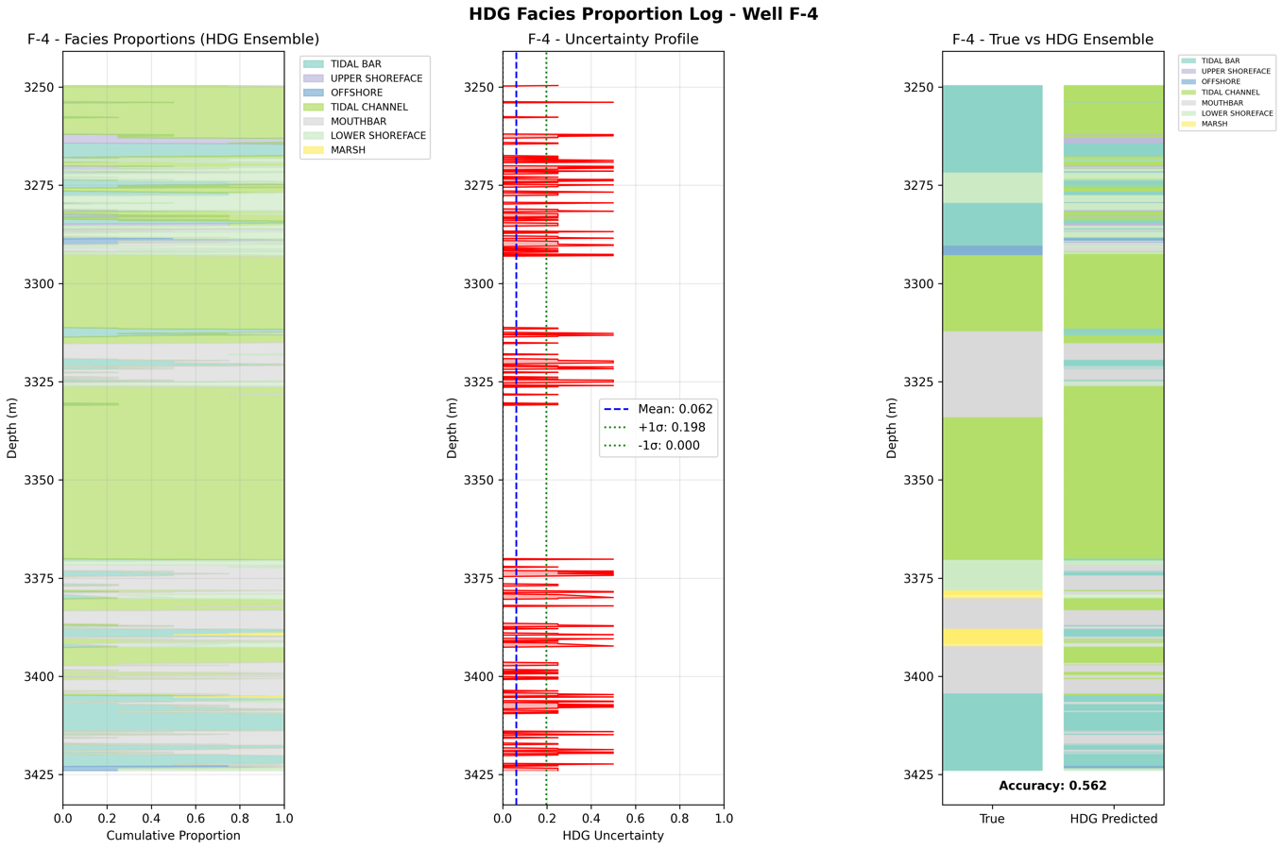
Experiment 2 results
Less uncertainty

Slide 8
Approach 2. neural net with dropout

Slide 9
The idea
Approximate an ensemble with a single Bayesian-style neural network by using Monte Carlo dropout: run many stochastic forward passes to get per-depth class probabilities (not just hard labels).
Use the spread across passes (variance/entropy/“agreement”) as a confidence proxy and map it along depth to show where the model is sure vs unsure, with well-based splits to avoid leakage.
Deliver facies-probability logs + uncertainty tracks

Slide 10
Experiment 3
How it works for 5 wells A,B,C,D,E:
1. Start from a normalized dataset with logs + engineered features and known facies labels.
Split wells into Train/Val/Test (no overlap allowed)
  Training: Wells A,B,C
  Validation: Well D (for monitoring during training)
  Test: Well E (kept blind for final evaluation)
Build Bayesian Neural Network with Monte Carlo (MC) Dropout
Train the neural network: a) train on wells A,B,C; b) monitor performance on well D (validation); c) use early stopping if validation loss stops improving; d) save best model based on validation performance
Make predictions with uncertainty (Monte Carlo Dropout). For each depth sample in well E: a) run 100 forward passes through the network; b) each pass has different dropout (random neurons turned off); c) get 100 different predictions per sample
Calculate Facies Proportions (from 100 MC samples): a) count how many times each facies was predicted; b) convert to proportions (similar to voting in RF ensemble); c) Most common prediction = final facies
Quantify Uncertainty
Produce facies-proportion logs + uncertainty logs by depth
Visual diagnostics

Slide 11
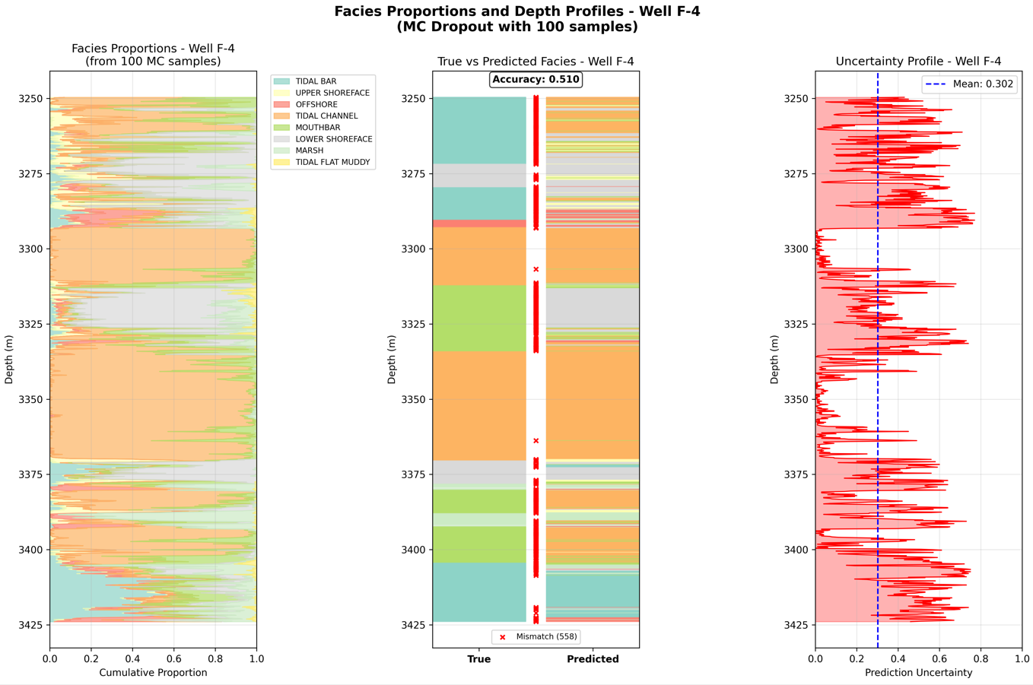
Experiment 3. UQ results

Slide 12
Additional slides

Slide 13
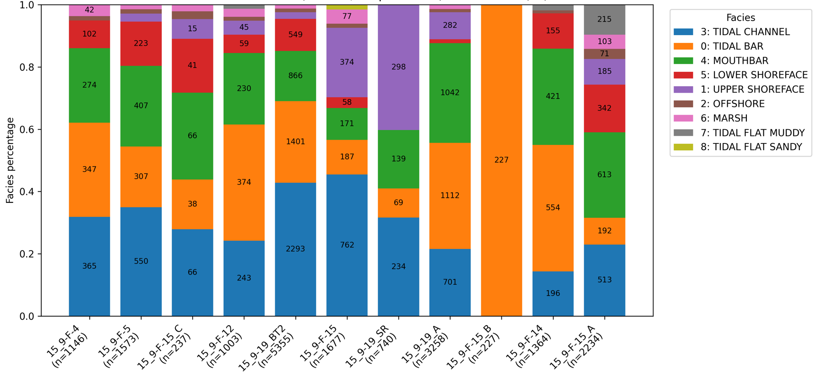
wells selection for experiments
Test
Training
Training
Training
Training

