Slide 1

Studying Swiss products (How are Swiss products perceived throughout the world?)

Slide 2
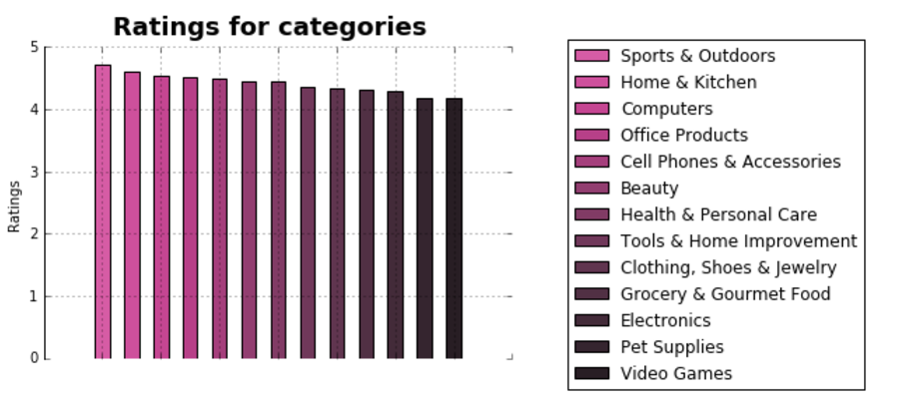
Important question to ask: How did we estimate ratings?
Categories stats

Slide 3
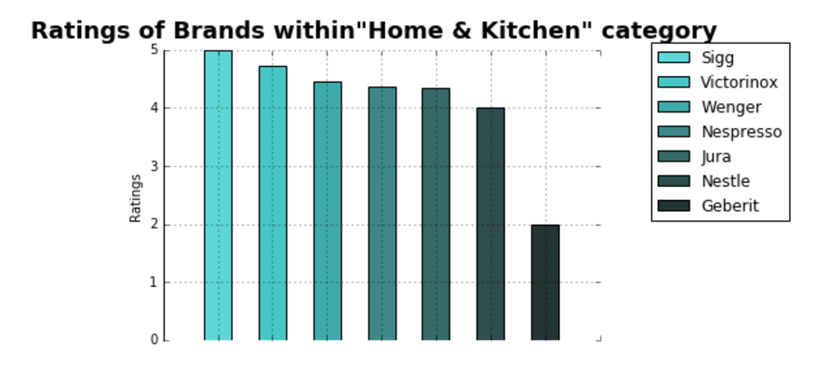
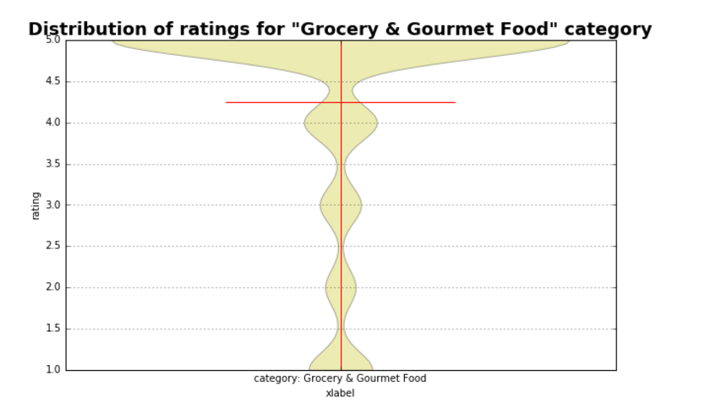
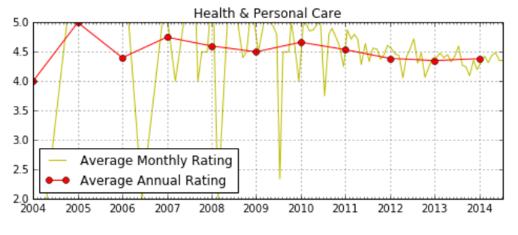

Slide 4
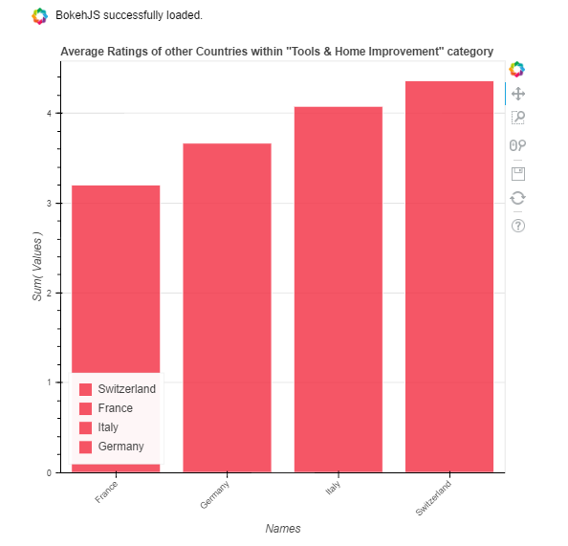

Note: Review with helpful score 0/1 and review with helpful score 0/10 cannot be taken into consideration equaly!

Slide 5
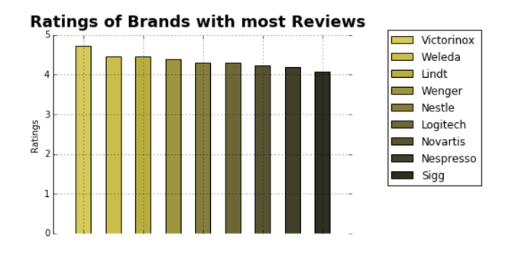
Brands stats
Fun fact: In our dataset there is a product which has review 1 with helpful score 18/19. Rating of that product now on amazon.com is 4.3, even though the same review is on the top of review list as one of the most helpful!

Slide 6
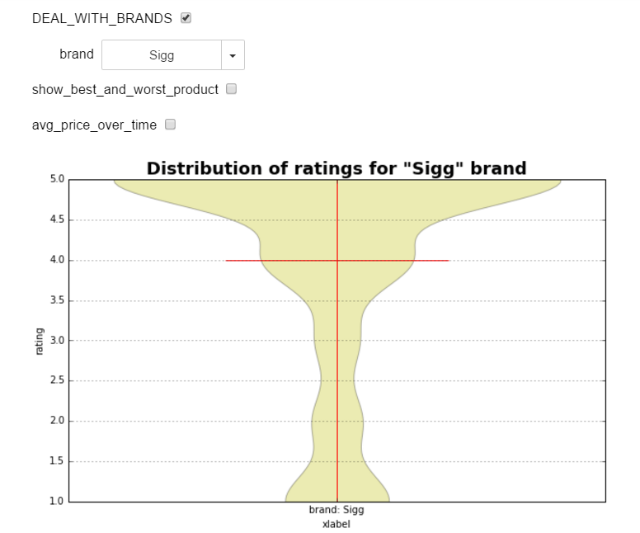
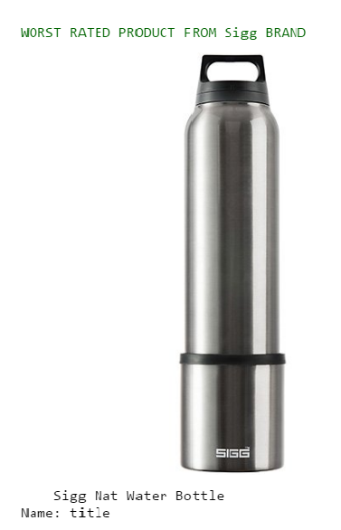
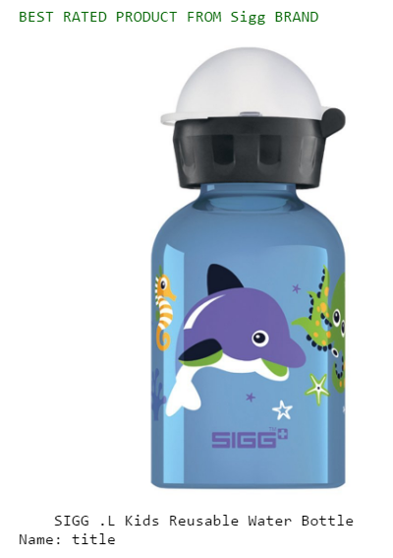
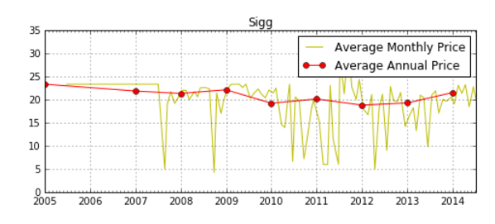
SIGG
BEST
WORST

Slide 7

(future) IDEA: Find mean rating of each user. Are there any haters? YES: Take their ratings with smaller weight.
POTENTIAL PROBLEM: Not many users has reviewed significant amount of product.

