Slide 1

A wheeled autonomous robot with all-terrain capability for patrolling and inspecting forested areas.
Student
Sannikov Artem Konstantinovich
СМ7-21М
Scientific supervisor: Gulyaev I. A.

Slide 2

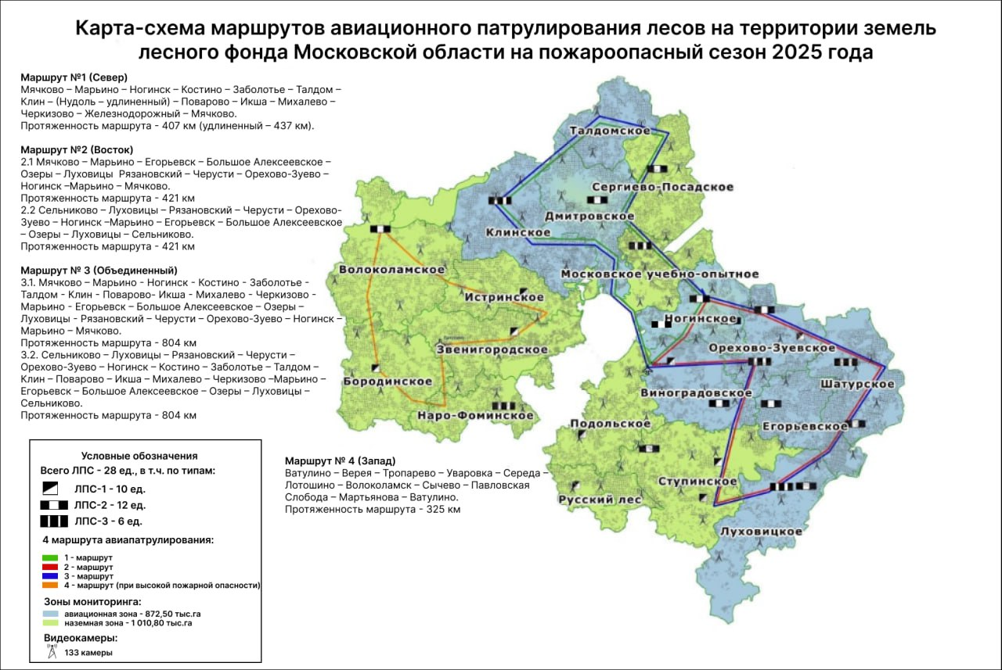
Relevance
The forest area of ​​the Moscow region is
1,883,329 hectares.
Length of forest protection routes:
400-800 km.
Forests are exposed to threats every year:
Pest and disease outbreaks
Landfills
Defoliation
Environmental pollution
Hundreds of man-hours are spent on forest inventory surveys.
Fig. 1. Map of forest protection routes provided by the State Autonomous Institution of the Ministry of Forestry “Mosoblles”

Slide 3
Goal and Objectives
Goal: Development of kinematics of a wheeled walking platform in accordance with cross-country capability requirements, development of a control system.
Objectives:
Supplement the overview section and determine the feasibility of using a UAV in the system.
Develop a kinematic diagram of the platform;
Conduct an energy calculation and engine selection;
Create a platform control system structure;
Create a functional diagram of the platform for developing a control unit.
Evaluate the resulting control system structure and cross-country performance parameters.
Refine the work plan for the following semesters.

Slide 4
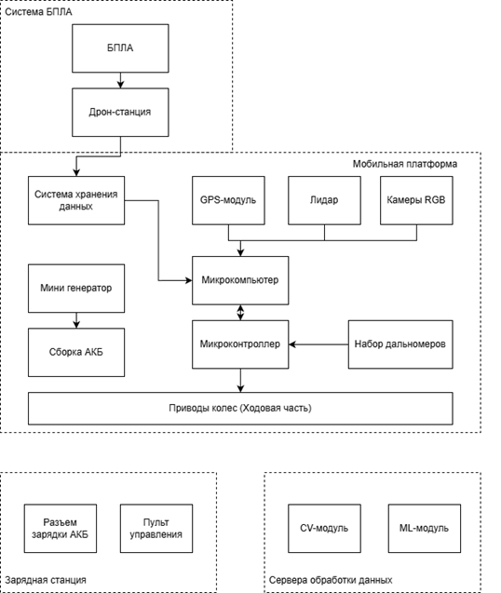
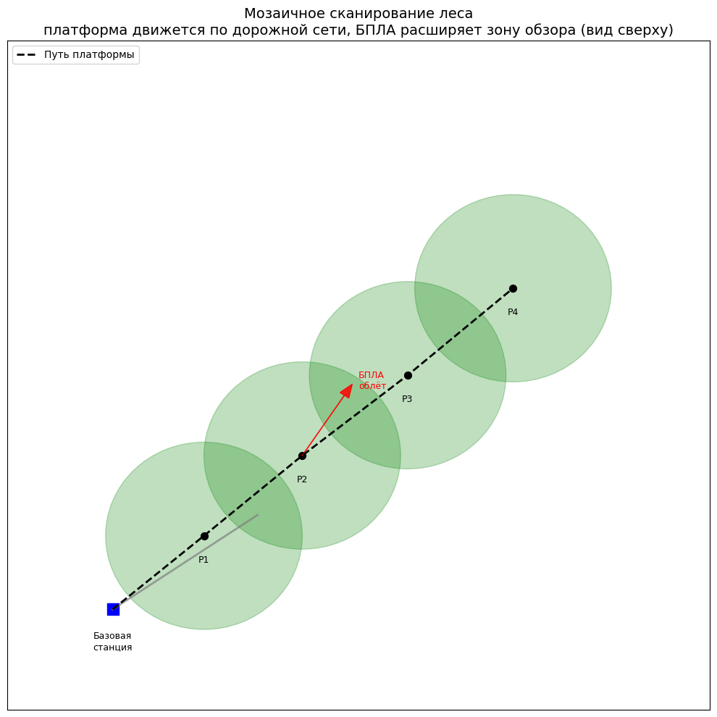
FUNCTIONAL DIAGRAM OF THE SYSTEM
The system is designed to navigate unpaved roads and difficult terrain, including windfalls. However, based on forest condition assessments, 100% coverage will not be achieved. To achieve this, it is proposed to deploy a UAV for overflights as a backup system.
Fig. 3. Scheme of movement and scanning of the area using UAVs
Fig. 2 Functional diagram

Slide 5
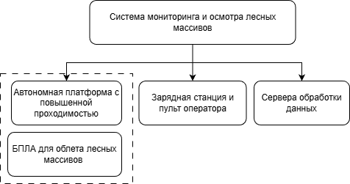
GENERAL STRUCTURE OF THE SYSTEM
The customer provided a specification with a list of the required functionality and requirements for the system, which was divided into several parts.
The system's tasks include:
Autonomous movement and territory survey
Navigation, localization, and mapping
Tree inventory and identification
Data collection and reporting
My Goal:
Development of an autonomous wheeled platform
Fig. 4 System structure
*UAV and drone station are used as a finished product

Slide 6
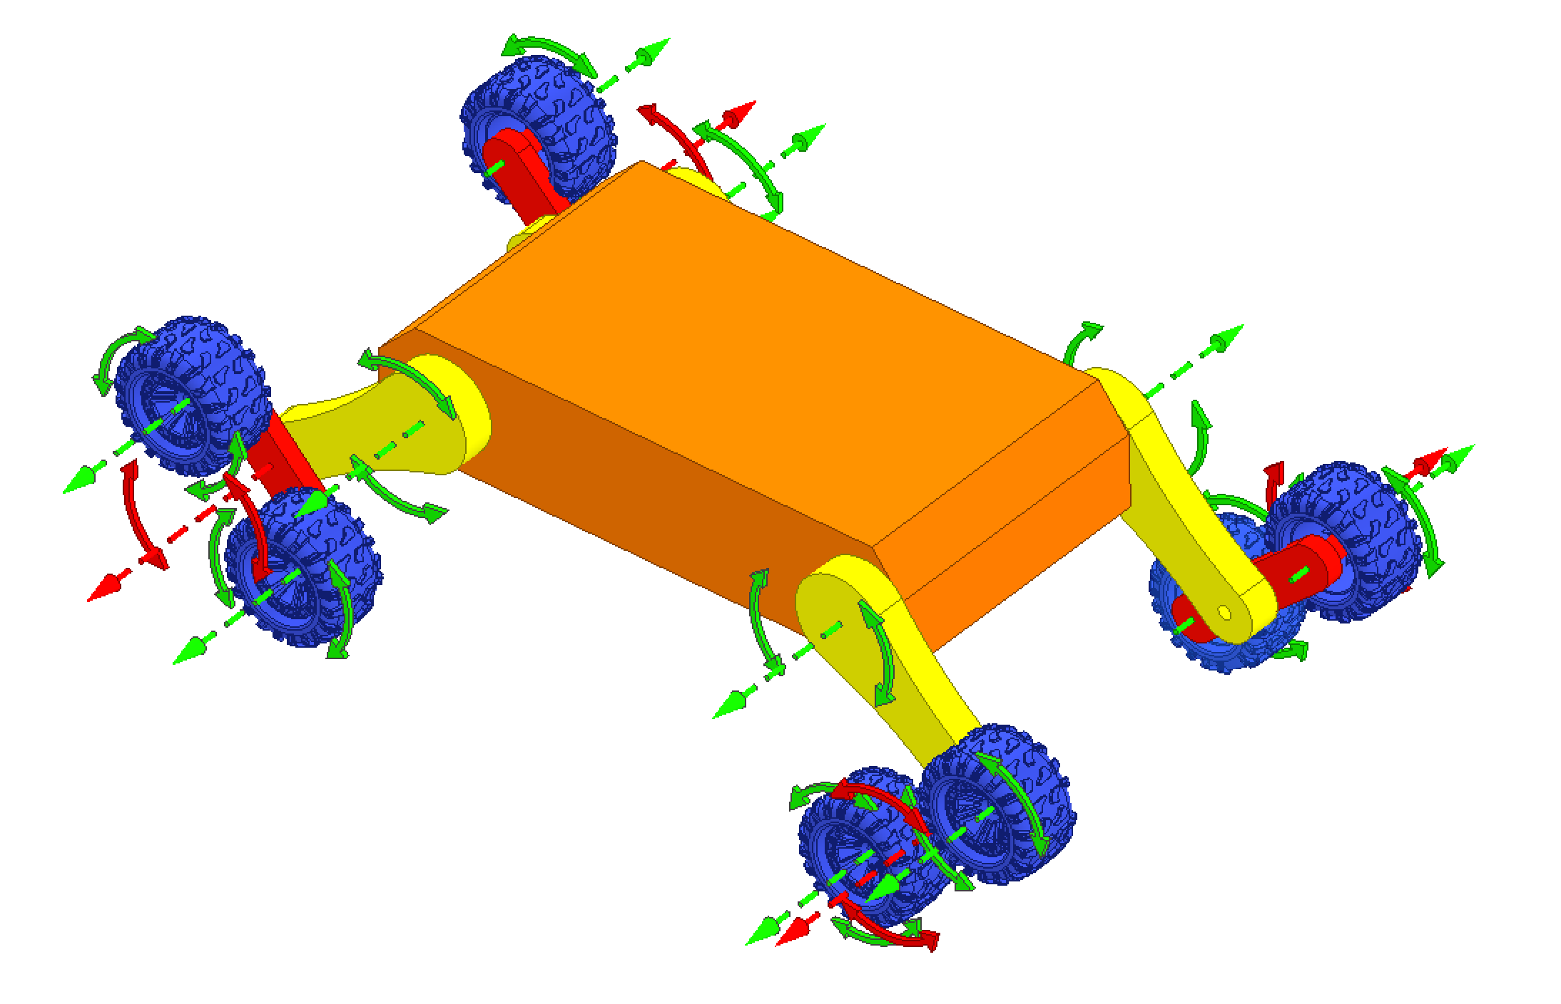
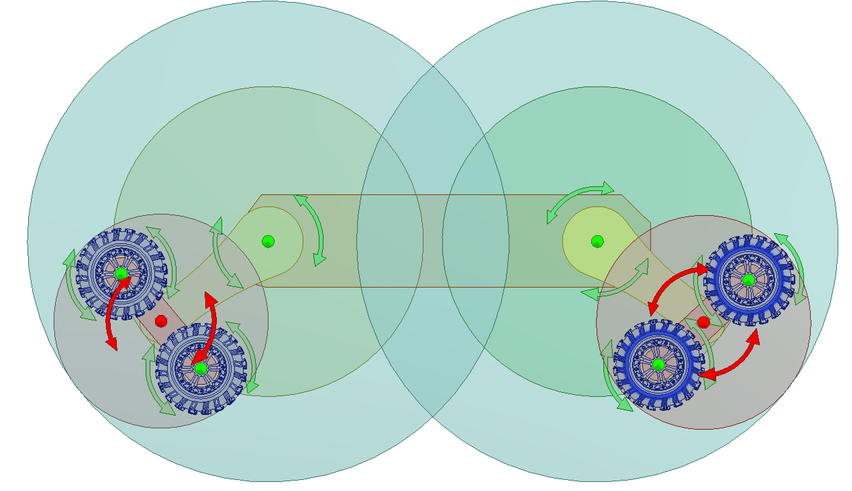
Transport platform model
Wheel
Platform
Joint 1
Joint 2
Fig. 5 Kinematics model, 16 axes of rotation
Fig. 6 Working area of ​​each link

Slide 7
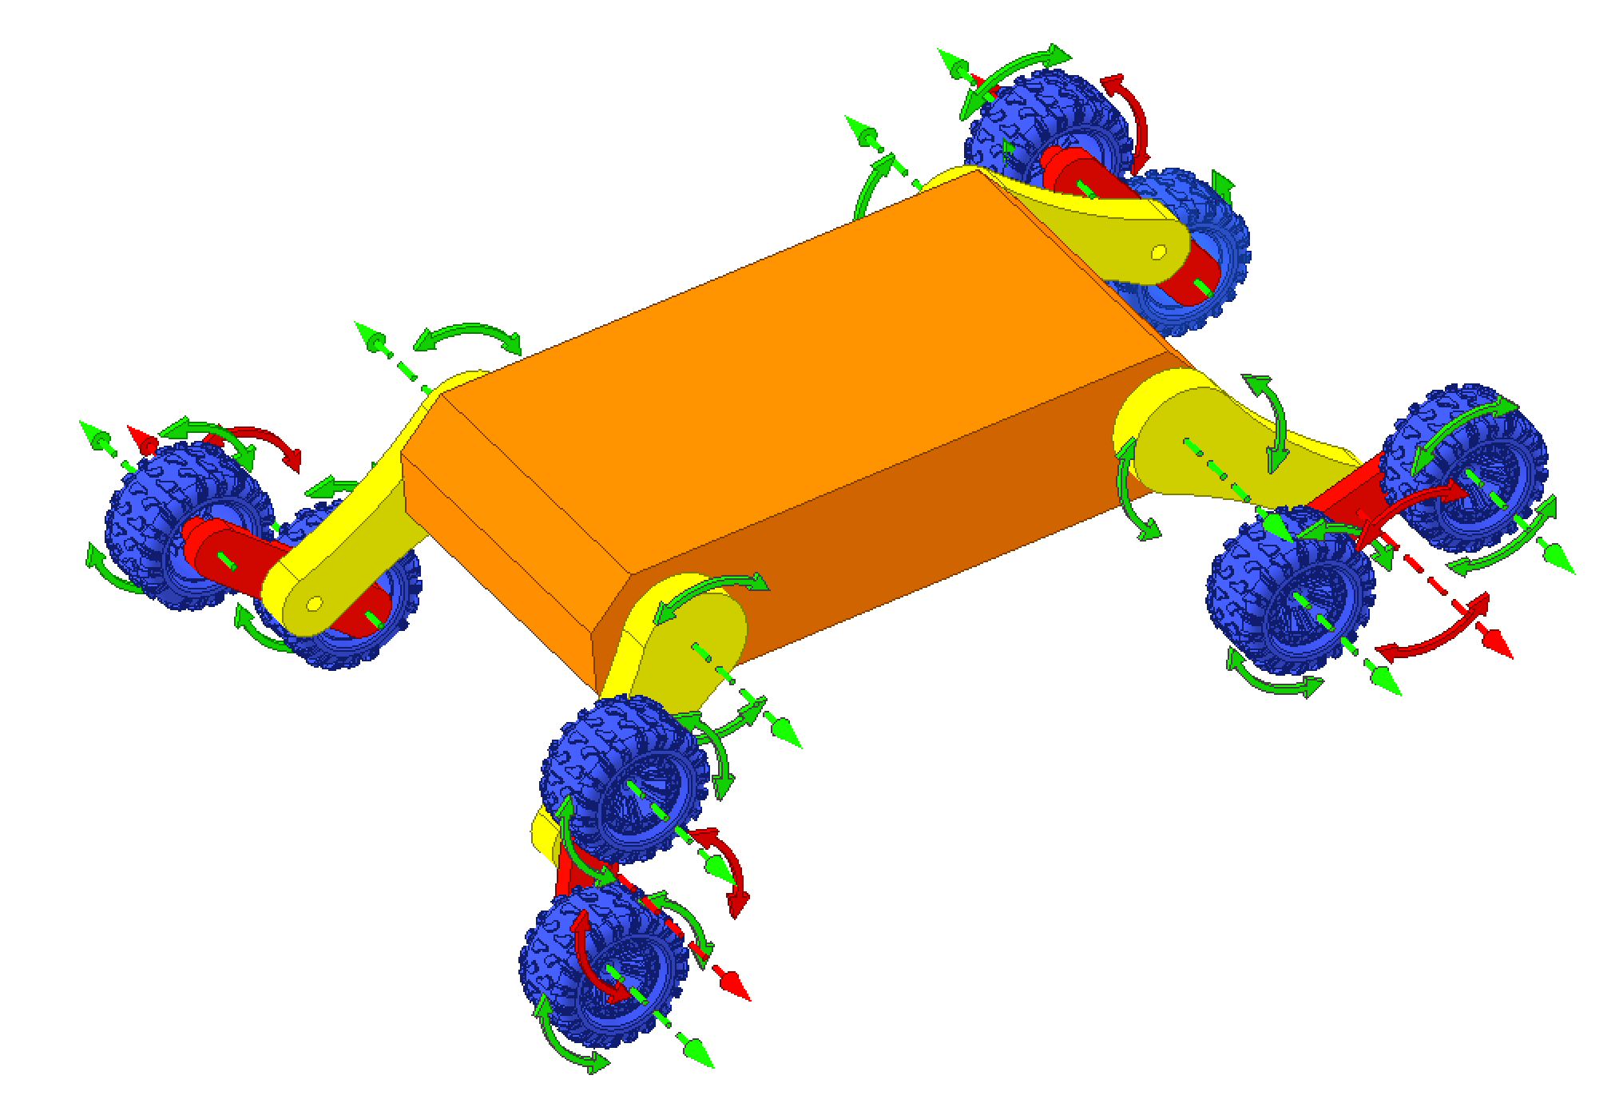
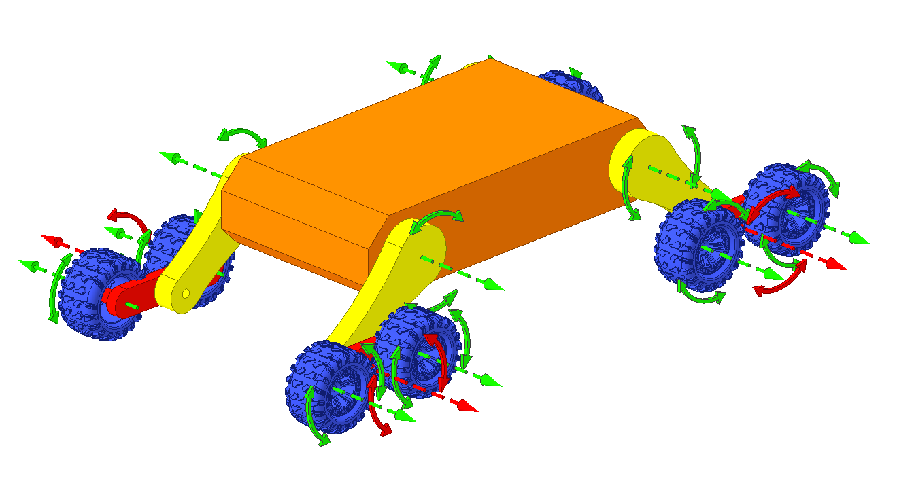
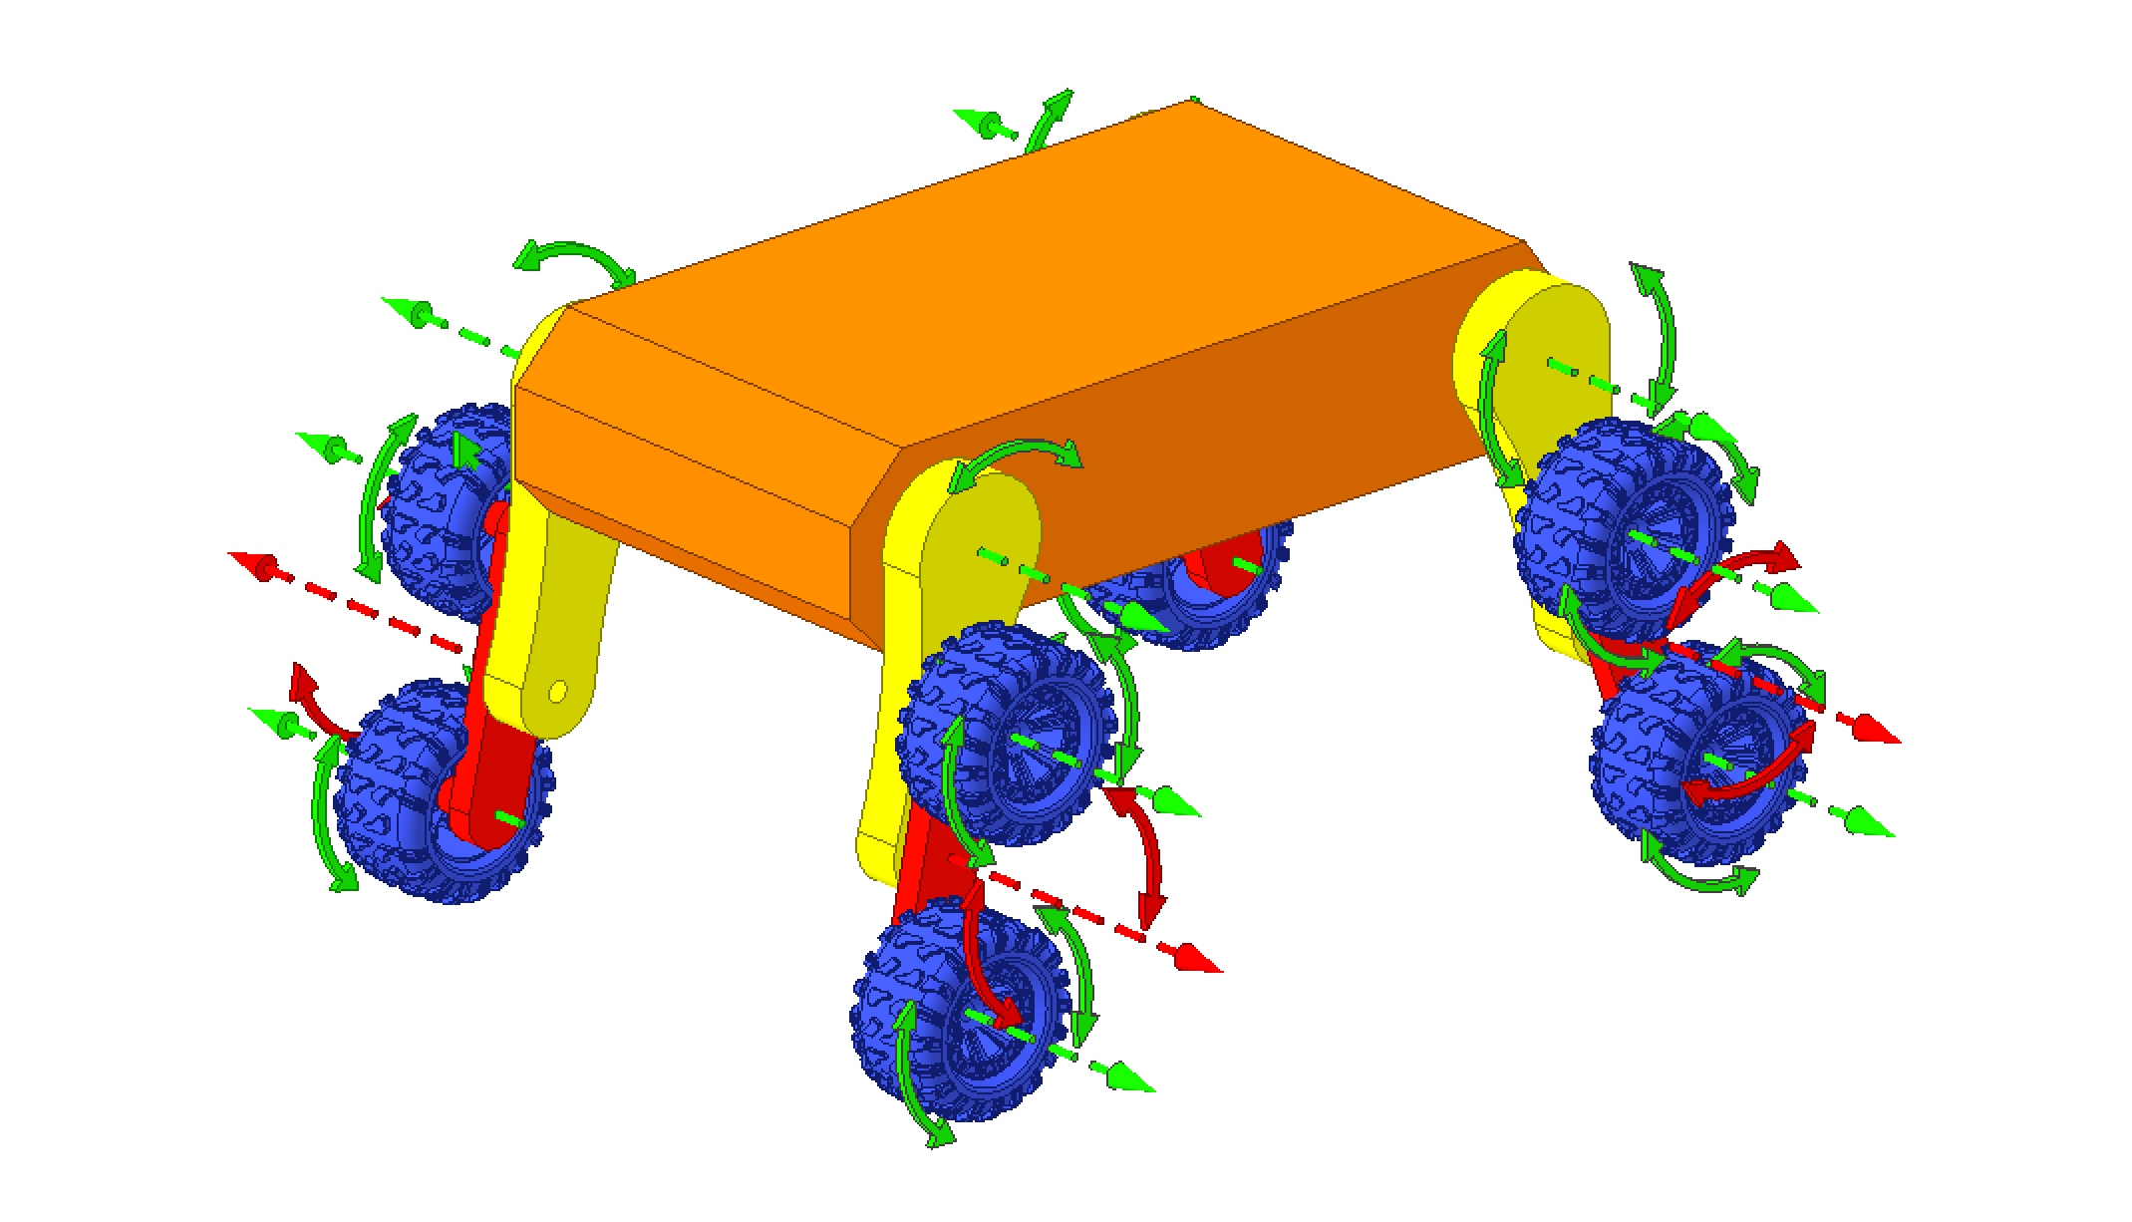
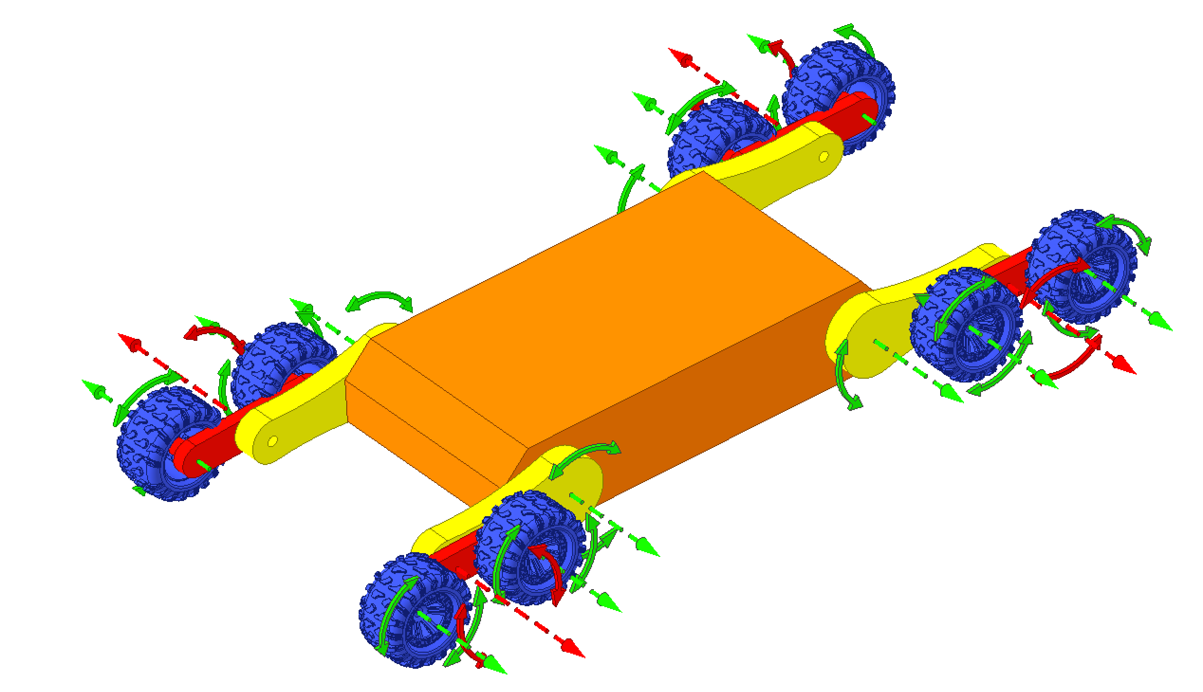
Different states of motion
Fig. 9 Accelerated movement on a flat area
Fig. 10 Using joints and wheel rotation to overcome obstacles
Fig. 7 Maximum ground clearance
Fig. 8. Stable position
"On the belly"

Slide 8
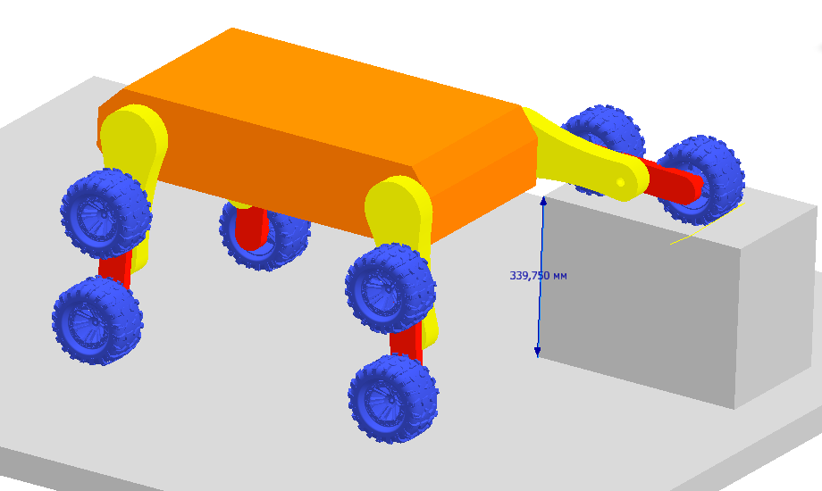
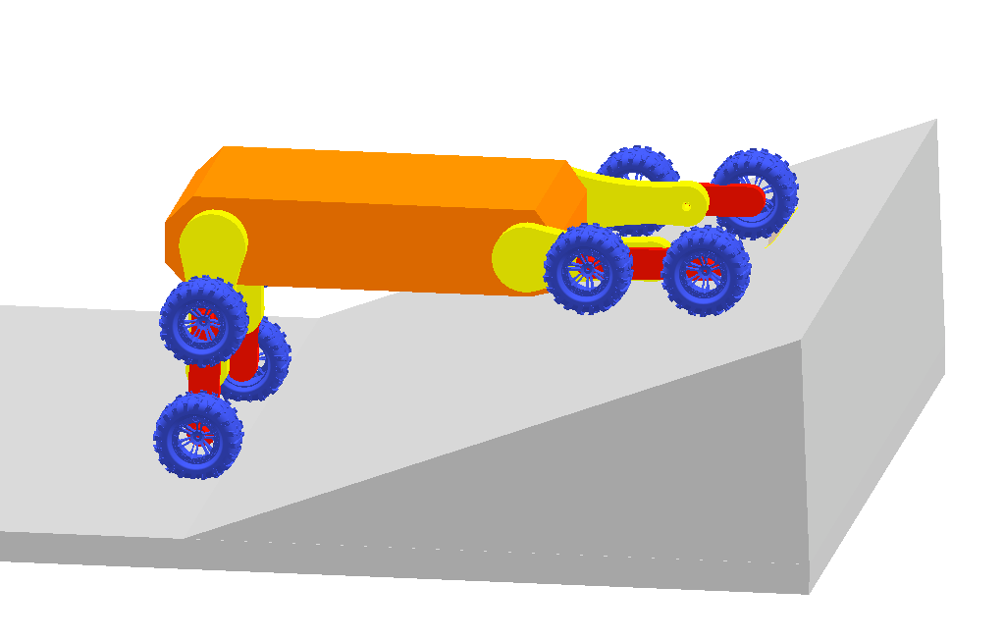
Evaluation of the obtained passability
Ground pressure of 0.29 kg/cm² with a robot weight of 170 kg and 8 wheels in contact simultaneously – reducing the pressure in the chambers reduces ground pressure.
Maximum cross-country ability (theoretical): 339 mm
Minimum slope capability (including stabilization): 22°
Fig. 12 Slope assessment
Fig. 11. Assessment of profile cross-country ability

Slide 9
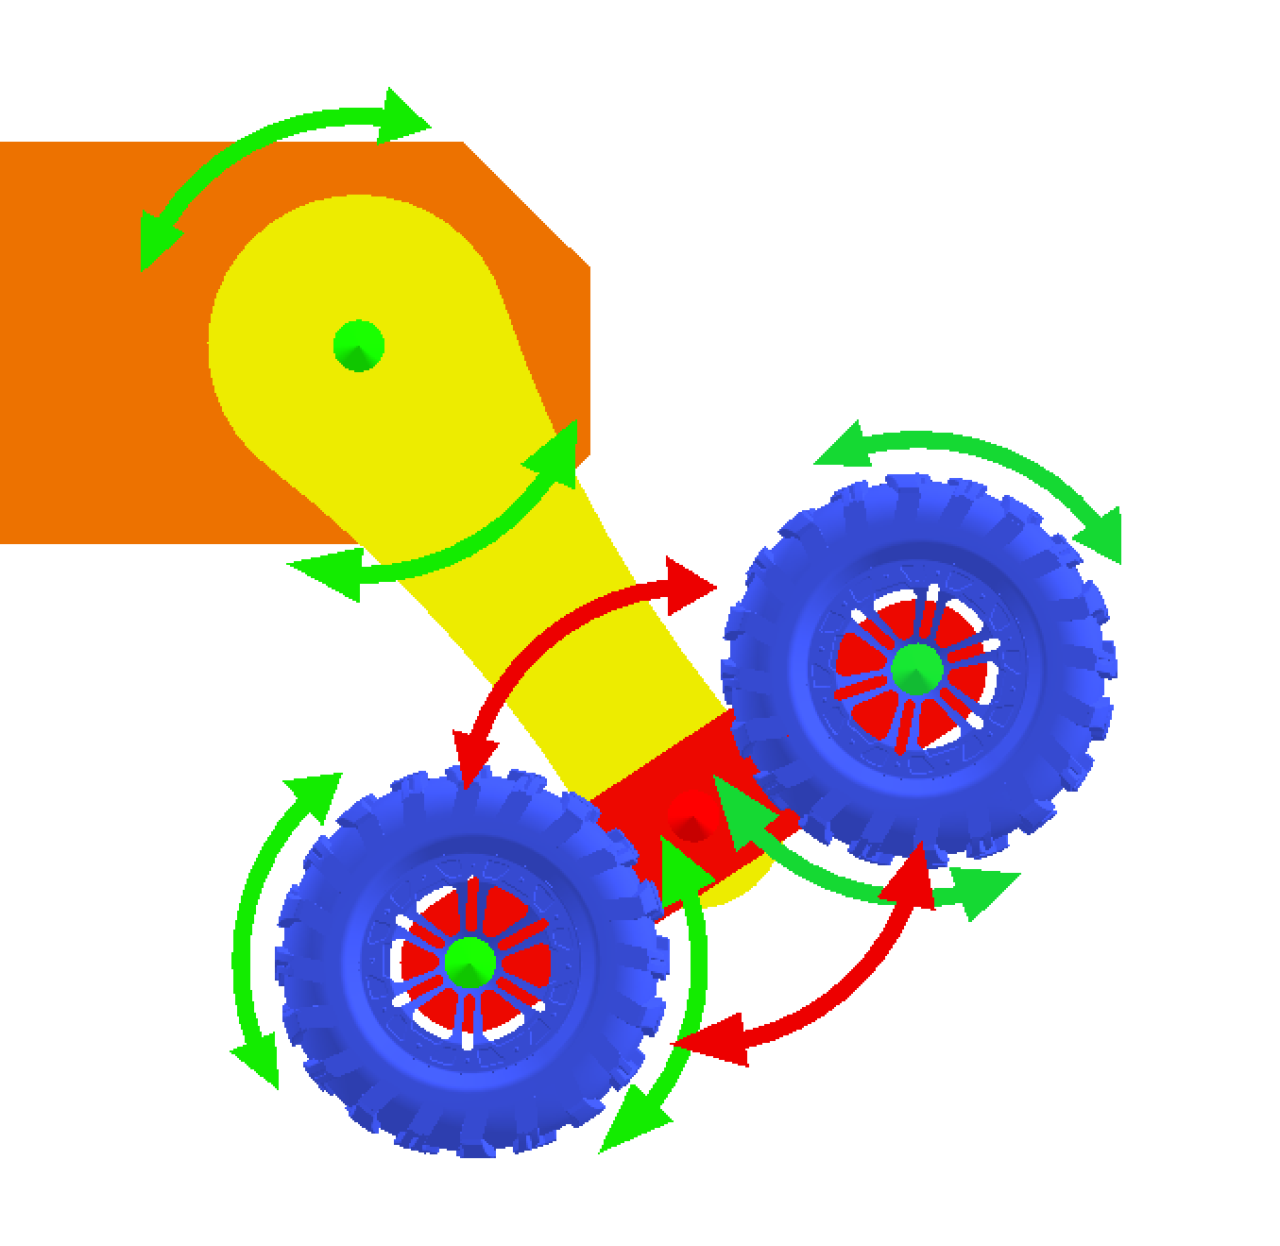
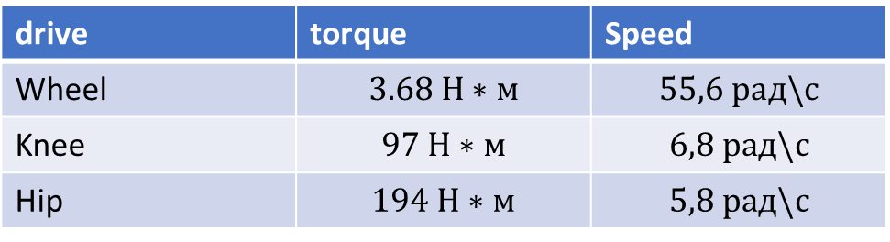
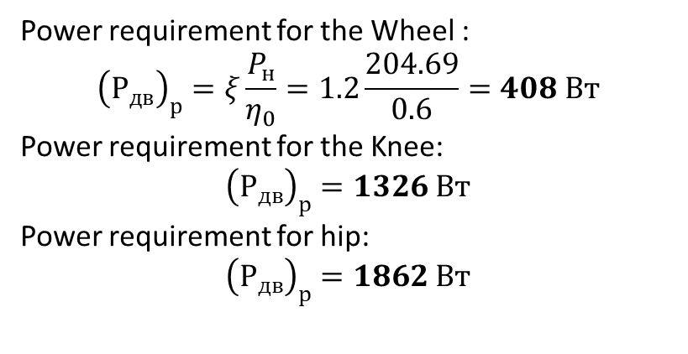
Energy calculation: finding drive capacities
Let's calculate the drive power for the hip, knee and wheel joints
Power requirement for the Wheel :
$${\left(Р_{дв}\right)}_{р}=ξ\frac{P_{н}}{η_{0}}=1.2\frac{204.69}{0.6}=408 Вт$$
Power requirement for the Knee:
$${\left(Р_{дв}\right)}_{р}=1326 Вт$$
Power requirement for hip:
$${\left(Р_{дв}\right)}_{р}=1862 Вт$$
Hip
Wheel
drive | torque | Speed
Wheel | $$3.68 Н∗м$$ | $$55,6 рад\backslash с$$
Knee | $$97 Н∗м$$ | $$6,8 рад\backslash с$$
Hip | $$194 Н∗м$$ | $$5,8 рад\backslash с$$
500мм
Knee
250мм
Fig. 13 Axes Designation

Slide 10
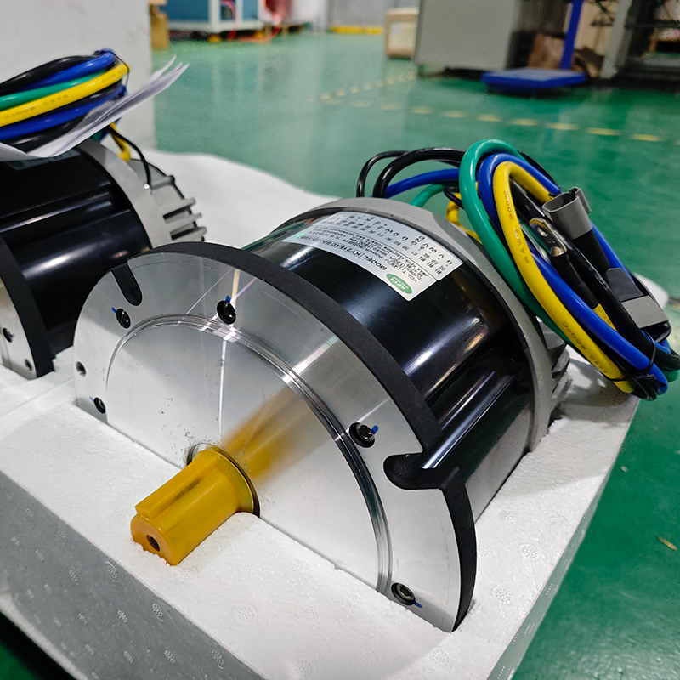
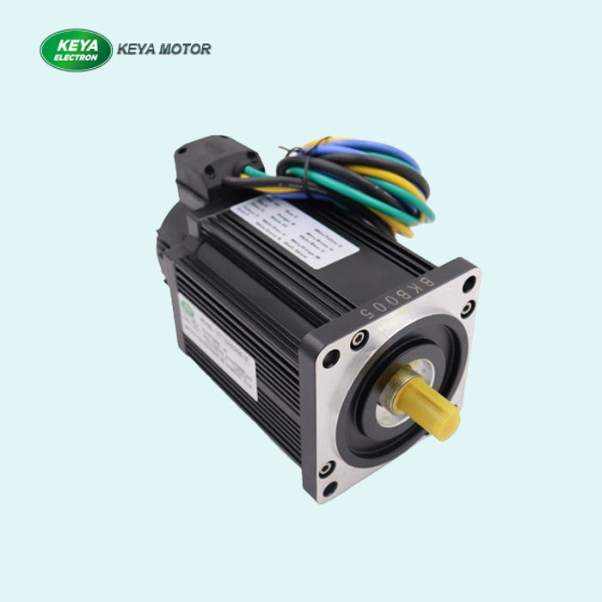
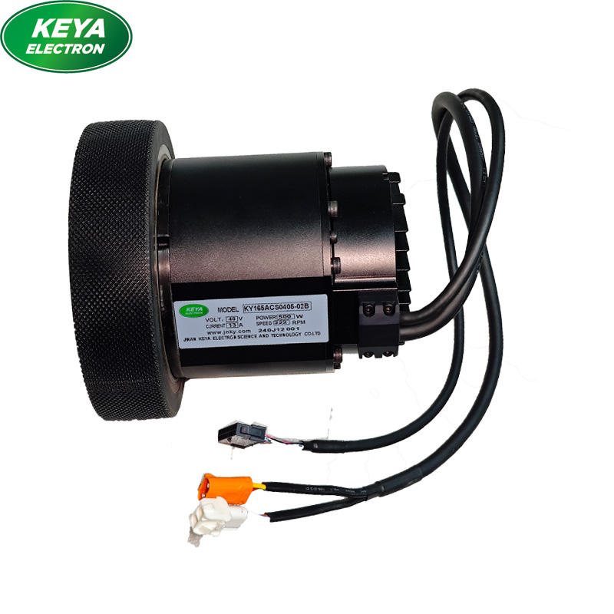
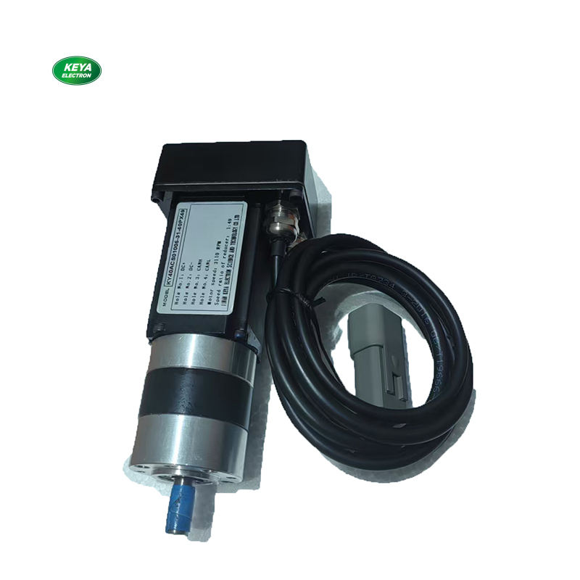
SELECTION of engines
KY215ACS0450-15 Servomotor for Hip Drive
KY110AS0420-25 servo motor for knee drive
KY165ACS0405-02B Wheel Servo Motor for Wheel Drive
KY40AS0105-12 Axis Locking Servo Motor
Power | 4000 Вт | 1500 Вт | 500 Вт | 70 Вт
Speed | 1500 об/мин | 1500 об/мин | 250 об/мин | 63 об\мин ()
troque | 31.8 Н*м | 9.5 Н*м | 4.2 Н*м | 4 Н*м
voltage | 48 В | 48 В | 48 В | 12 В
Mass | 12 кг | 4 кг | 3 кг | 0.6 кг
encoder | Yes | Yes. | Yes | Yes

Slide 11
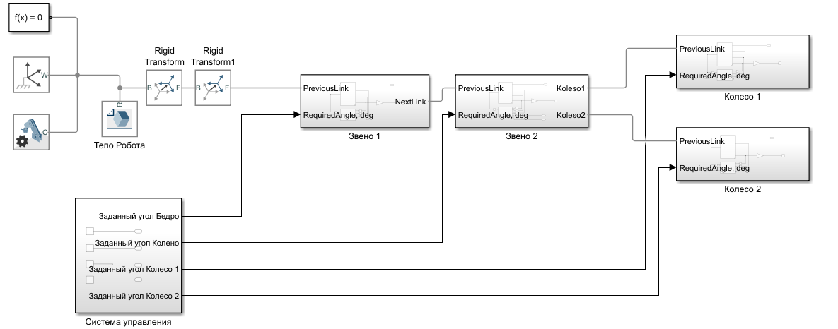
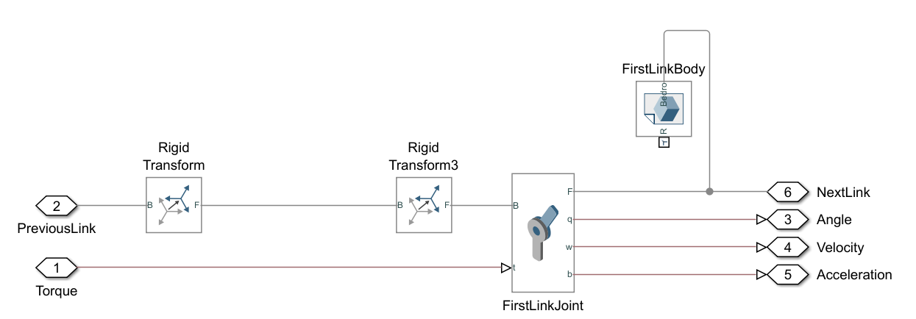
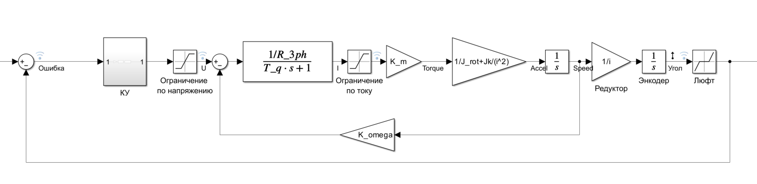
SIMSCAPE ROBOT CONTROL SYSTEM
Fig. 14 Assembling the robot leg model in Simulink Simscape and the drive model
The KY110AS0420-25 drive with gearbox I = 23 was used.

Slide 12
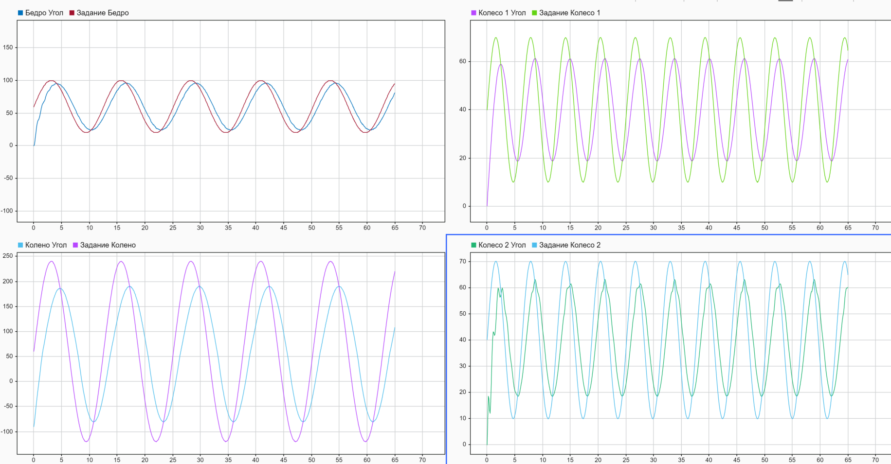
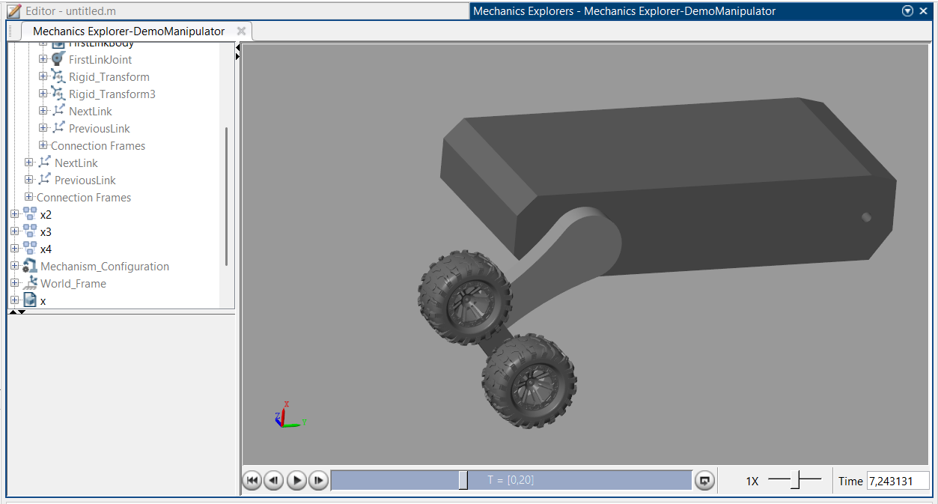
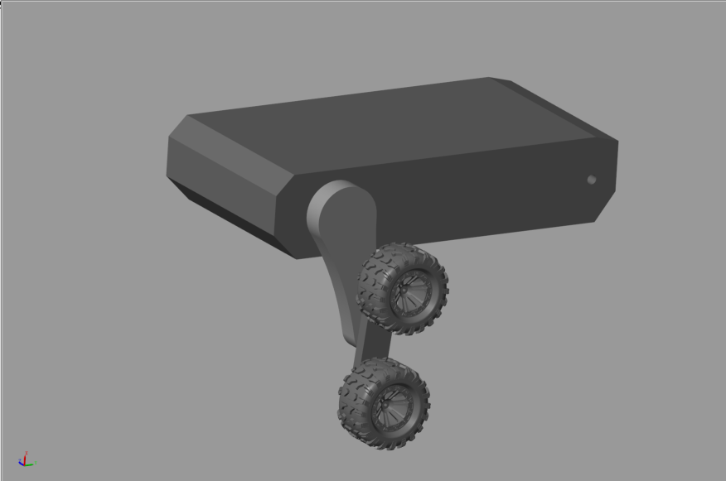
Simscape Multibody Modeling
Fig. 15. The reference action and the resulting angles and animation of the robot in Mechanics Explorer

Slide 13
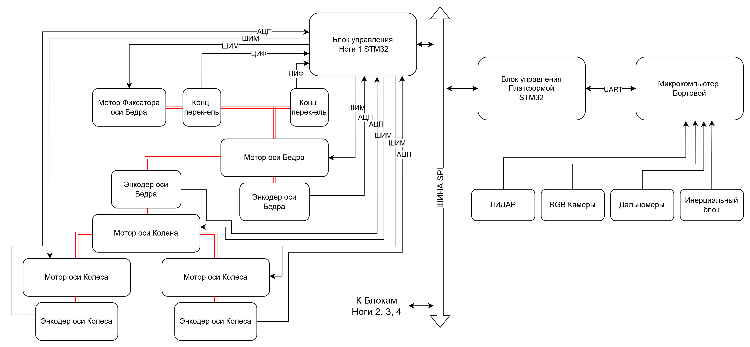
Functional diagram of the transport platform
Fig. 16. Functional diagram of the platform control

Slide 14

CONCLUSION
As part of this semester's R&D work:
The following tasks were completed:
The overview section was expanded, the feasibility of using the UAV was confirmed, and the requirements were adjusted.
A platform kinematics model was developed;
An energy calculation was conducted, and engines were selected;
The platform control system structure was created;
A functional diagram of the platform was created for developing the control unit.
The cross-country performance parameters were assessed and meet the technical specifications.
The work plan for the following semesters was updated.

Slide 15
References
1) Hong, Shaozun & Wu, Meiping & Xiao, Junhao & Xu, Xiaohong & Lu, Huimin. (2017). Kylin: A transformable track-wheel hybrid robot. 10.1109/ICAMechS.2017.8316541.
2) Jay D., Hackett J.E., Bosscher P., Hubicki C.M., Clark J.E., 2025. "WaLTER: A Wheel and Leg Tumbling Expedition Robot." IEEE International Conference on Robotics and Automation (ICRA).
3) Brian D. Harrington* and Chris Voorhees The Challenges of Designing the Rocker-Bogie Suspension for the Mars Exploration Rover 2004
4) Paillat, Jean-Luc & Com, Jlpaillat@gmail & Lucidarme, Philippe & Hardouin, Laurent. Variable Geometry Tracked Vehicle (VGTV) prototype: conception, capability, and problems. 2008
6) Jörg Mämpel1,*, Sebastian Köhring1, Robert Koopmann1, Kristian Langguth1, Roy Lichtenfeld1, and Hartmut Witte ROLV – A Hybrid Wheel Robot Using Compliant Mechanisms for Locomotion
7) A. I. Eremeev et al.; Ed. O. F. Tishchenko. A 1. Class of Designs of Instrument Elements: Textbook. Handbook for Students of Instrument-Making Specialties at Universities / A. A. Butsev, Moscow: Mashinostroenie, 1982. 116 p.
8) DJI DOCK 2 User Manual

Slide 16
Thank you for your attention!

