Slide 1

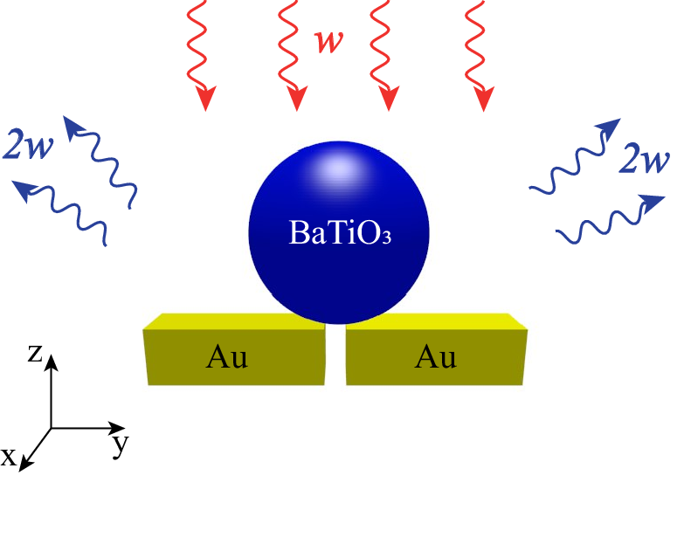


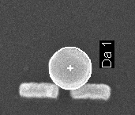
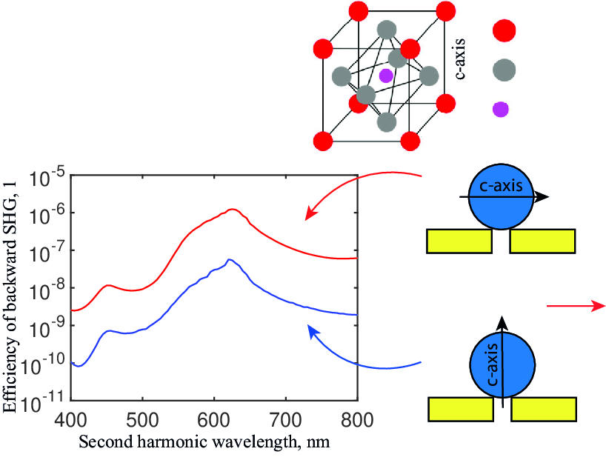
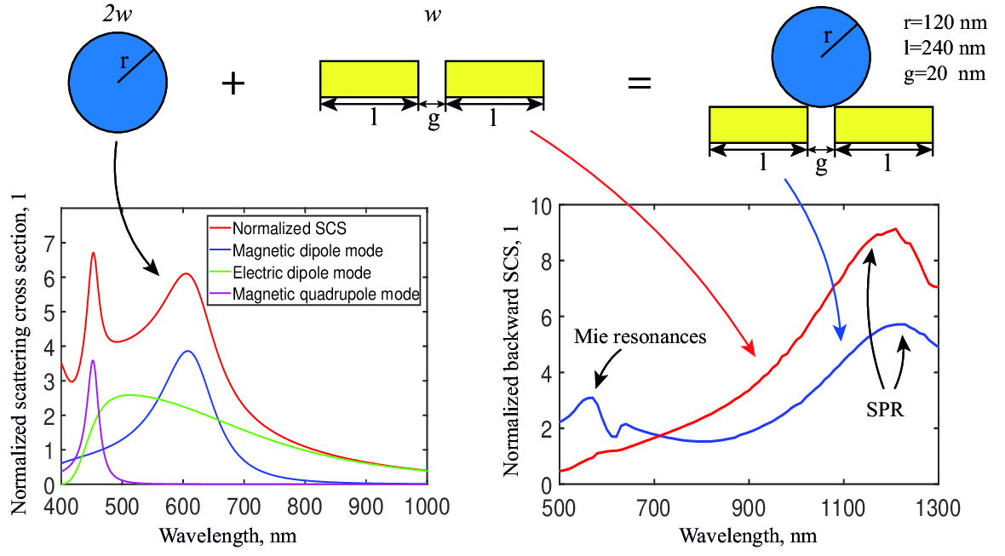
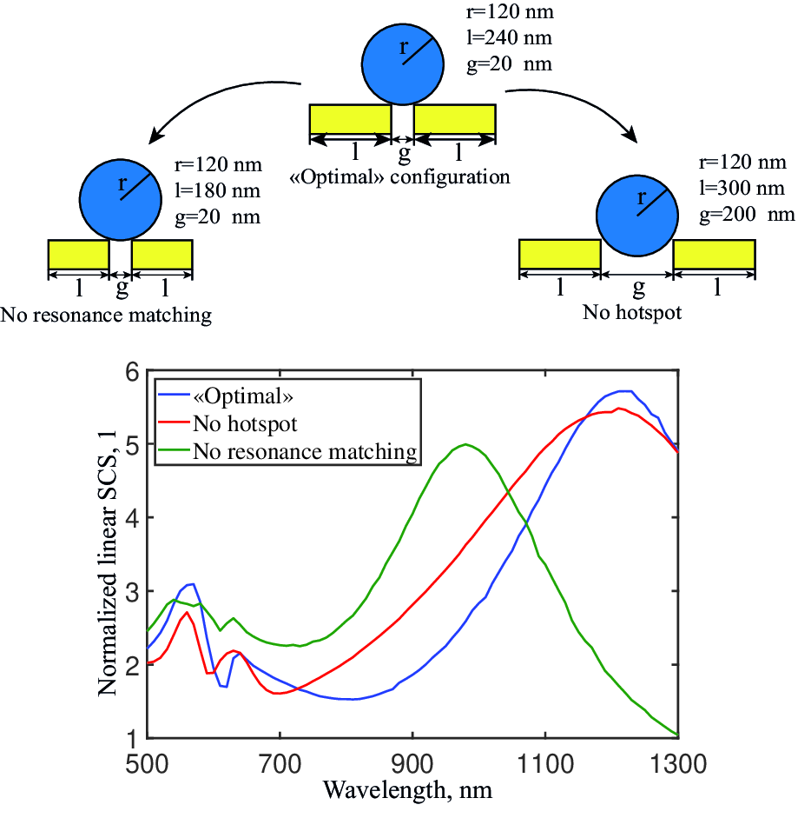
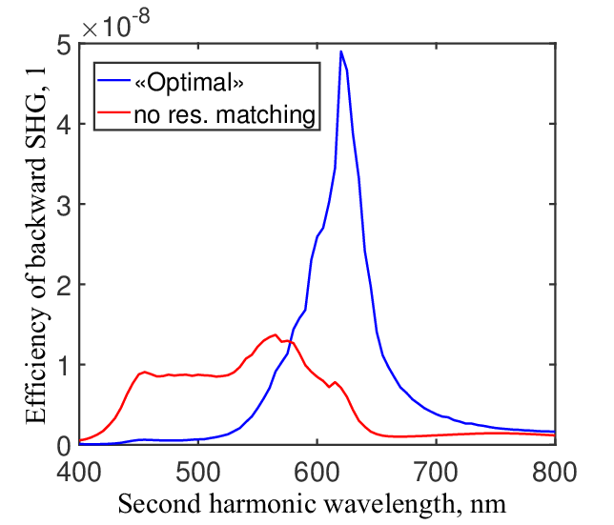
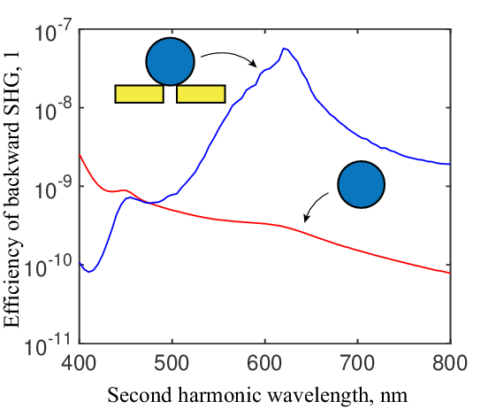
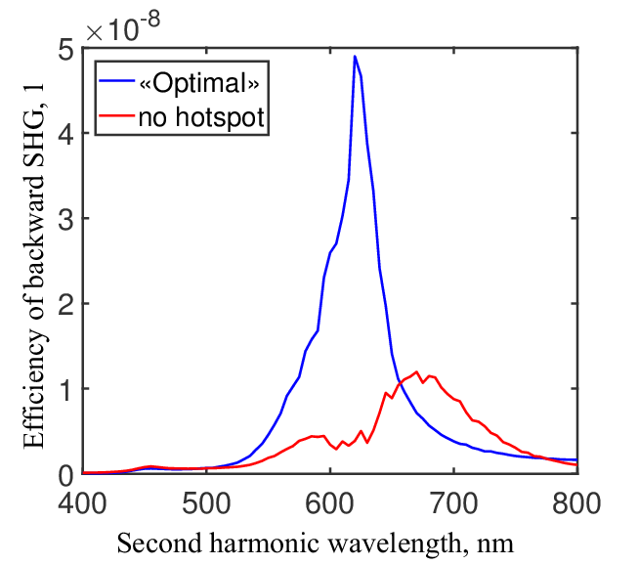
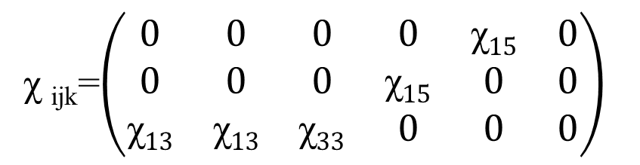
Numerical simulation of second harmonic generation by hybrid bi-resonant nanoantenna
A. Goncharov¹, M. Petrov^{1,2}
¹ Department of Condensed matter physics, St. Petersburg Academic University RAS, St. Petersburg 194021, Russia
² Department of Nanophotonics and Metamaterials, ITMO university, St. Petersburg 199034, Russia
Introduction
Second harmonic generation microscopy(SHGM) is an emerging bioimaging technique based on labeling biological objects with dielectric nonlinear nanoparticles(NNPs)[1,2]. However, one of the disadvantage of SHGM is that the second harmonic generation(SHG) efficiency is very weak due to nanoscale size of employed particles[1]. To improve frequency conversion efficiency NNP can be placed in a hot spot of a plasmonic nanoantenna [3].
In this work, we numerically simulate a bi-resonant hybrid nanoantenna (HN), combined of a a plasmonic nanoantenna with a plasmon resonance(PR) at the incident field wavelength, and BaTiO₃ particle with a Mie resonance at second harmonic wavelength (Figure 1). We demonstrate 150-fold SHG efficiency enhancement with respect to a bare BaTiO₃ particle. We also modify HN configuration to analyze the impact of it’s parameters on SHG efficiency.
)
(a)
(b)
200 nm
Figure 1. (a) Schematic of investigated hybrid bi-resonant nanoantenna, (b) Designed hybrid bi-resonant nanoantenna
Simulation and results
We aimed at SHG resonance at 600 nm, so we employed Mie theory to adjust BaTiO3 NNP radius to have scattering cross section (SCS) resonance at abovementioned wavelength. Varying the size of BaTiO₃ we found out the optimal radius equal to 120 nm (Fig. 2(a)).
BaTiO₃ has anisotropic tetrahonal crystal structure, consequently SHG depends on crystal orientation. We compared SHG for two different orientations:
Figure 4. (a) BaTiO3 crystal structure; (b) Calculated efficiency of backward SHG for two perpendicular orientations of BaTiO₃
(a)
Ba²⁺
O²⁻
Ti⁴⁻
(b)
E_{inc}
Figure 2. Scattering cross section for BaTiO₃ particle with 120 nm radius (left graph) and normalized (by geometric cross section) backward SCS for plasmonic and bi-resonant hybrid nanoantennas (right graph)
Finally, we analyzed impact of a hotspot and optimal matching between double BaTiO3 resonant wavelength and PR wavelength on SHG efficiency(Fig. 5).
We applied Comsol Multiphysics environment to adjust the whole hybrid system to have SCS resonance at 1200 nm. SCS spectrum was calculated for incident field wavelengths between 500 nm and 1300 nm with a 10 nm step. To find field distribution the Helmholtz equation was numerically solved for each wavelength (Fig. 2(b)).
(a)
(b)
Further, we introduced quadratic nonlinear susceptibility tensor for BaTiO₃ to simulate SHG :
χ _{ijk}=$\left(\begin{matrix}0 & 0 & 0 & 0 & \text{χ}15 & 0 \\ 0 & 0 & 0 & \text{χ}15 & 0 & 0 \\ \text{χ}13 & \text{χ}13 & \text{χ}33 & 0 & 0 & 0\end{matrix}\right)$
We calculated efficiency of SHG (SCS divided by geometric cross section) and compared it with one of a bare BaTiO3 nanosphere (Fig. 3).
(c)
Figure 5. (a) Calculated linear SCS for configurations without a hotspot and resonance matching; (b) SHG efficiency of configuration with no resonance matching (c) SHG efficiency of configuration with no hotspot
Figure 3. Cross section of backward SHG for bare BaTiO₃ particle(red line) and hybrid nanoantenna (blue line)
Conclusion
In this work we have numerically simulated SHG by hybrid bi-resonant nanoantenna composed of gold and BaTiO3 particles. We have demonstrated 150-fold SHG efficiency enhancement with respect to bare BaTiO3 nanoparticle. Therefore studied nanoantenna is a promising candidate for efficient nanoscale SHG source that can be employed in SHGM.
[1] Staedler D.; et. al. 2012 ACS Nano, 2542–2549.
[2] Bonacina L.; et. al. 2007 Appl. Phys. B: Laser Opt., 87, 399–403
[3] Timpu F.; et. al. 2017 Nano Lett.

