Slide 1




Slide 2
VARIABLES

Slide 3
var quantity;
DECLARING A VARIABLE
KEYWORD
VARIABLE NAME

Slide 4
quantity = 3;
VARIABLE NAME

Slide 5
DATA TYPES

Slide 6
1

Slide 7
1
NUMBERS
0.75
NO QUOTES

Slide 8
2
1
NUMBERS
0.75
NO QUOTES

Slide 9
2
1
NUMBERS
0.75
NO QUOTES
STRINGS
‘Hi Ivy!’
ENCLOSED IN QUOTES
WHICH CAN BE SINGLE OR DOUBLE QUOTES, BUT MUST MATCH

Slide 10
3
1
2
NUMBERS
0.75
NO QUOTES
STRINGS
‘Hi Ivy!’
ENCLOSED IN QUOTES
WHICH CAN BE SINGLE OR DOUBLE QUOTES, BUT MUST MATCH

Slide 11
1
2
3
NUMBERS
0.75
NO QUOTES
STRINGS
‘Hi Ivy!’
ENCLOSED IN QUOTES
WHICH CAN BE SINGLE OR DOUBLE QUOTES, BUT MUST MATCH
BOOLEAN
true
EITHER TRUE OR FALSE

Slide 12
ARRAYS

Slide 13
Declare and Initialize an Array
Array Literals: var colors = [‘pink’,‘yellow’,‘green’];
Array Object: var colors = new Array(3);

Slide 14
colors = [‘pink’,‘yellow’,‘green’];
colors[ ];

Slide 15
colors = [‘pink’,‘yellow’,‘green’];
colors[0];

Slide 16
colors = [‘pink’,‘yellow’,‘green’];
colors[1];

Slide 17
colors = [‘pink’,‘yellow’,‘green’];
colors[2];

Slide 18
ARITHMETIC OPERATORS

Slide 19
var width = 3;

Slide 20
var width = 3; var height = 2;

Slide 21
var width = 3; var height = 2; area = width * height;

Slide 22
CONCATENATING STRINGS

Slide 23
var fullname = ‘Howdy ‘;

Slide 24
var greeting = ‘Howdy ‘; var name = ‘Molly’;

Slide 25
var greeting = ‘Howdy ‘; var name = ‘Molly’; var message = greeting + name;

Slide 26
var name = ‘John ‘; var familyname = ‘Doe’; var message = name + familyname;
John Doe

Slide 27
OBJECTS

Slide 28
Each property or method consists of a name (also known as a key) and its corresponding value.

Slide 29
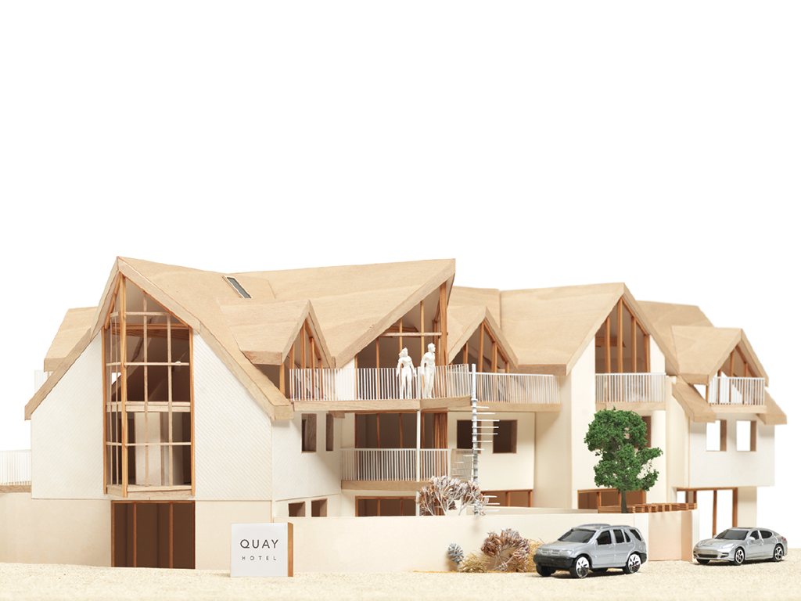
var hotel = {
name: ‘Quay’,
rooms: 40,
booked: 25,
gym: true,
roomTypes: [‘twin’, ‘double’, ‘suite’],
checkAvailability: function() {
return this.rooms - this.booked;
}
};

Slide 30
var hotel = {
name: ‘Quay’,
rooms: 40,
booked: 25,
gym: true,
roomTypes: [‘twin’, ‘double’, ‘suite’],
checkAvailability: function() {
return this.rooms - this.booked;
}
};

Slide 31
NAMES (KEYS)
var hotel = {
name: ‘Quay’,
rooms: 40,
booked: 25,
gym: true,
roomTypes: [‘twin’, ‘double’, ‘suite’],
checkAvailability: function() {
return this.rooms - this.booked;
}
};

Slide 32
VALUES
var hotel = {
name: ‘Quay’,
rooms: 40,
booked: 25,
gym: true,
roomTypes: [‘twin’, ‘double’, ‘suite’],
checkAvailability: function() {
return this.rooms - this.booked;
}
};

Slide 33
PROPERTIES
var hotel = {
name: ‘Quay’,
rooms: 40,
booked: 25,
gym: true,
roomTypes: [‘twin’, ‘double’, ‘suite’],
checkAvailability: function() {
return this.rooms - this.booked;
}
};

Slide 34
METHOD
var hotel = {
name: ‘Quay’,
rooms: 40,
booked: 25,
gym: true,
roomTypes: [‘twin’, ‘double’, ‘suite’],
checkAvailability: function() {
return this.rooms - this.booked;
}
};

Slide 35
ACCESSING OBJECTS

Slide 36
var hotelName = hotel.name;

Slide 37
var hotelName = hotel.name;
OBJECT

Slide 38
var hotelName = hotel.name;
PROPERTY

Slide 39
var hotelName = hotel[‘name’];

Slide 40
var hotelName = hotel[‘name’];
OBJECT

Slide 41
var hotelName = hotel[‘name’];
PROPERTY

Slide 42
UPDATING OBJECTS

Slide 43
hotel.name = ‘Park’;

Slide 44
hotel.name = ‘Park’;
OBJECT

Slide 45
hotel.name = ‘Park’;
PROPERTY

Slide 46
hotel.name = ‘Park’;
NEW VALUE

Slide 47
hotel[‘name’] = ‘Park’;

Slide 48
hotel[‘name’] = ‘Park’;
OBJECT

Slide 49
hotel[‘name’] = ‘Park’;
PROPERTY

Slide 50
hotel[‘name’] = ‘Park’;
NEW VALUE

Slide 51
BUILT-IN OBJECTS

Slide 52
1

Slide 53
1
Browser Object Model
THE WEB BROWSER

Slide 54
BROWSER OBJECT MODEL
PROPERTIES INCLUDE: window.innerHeight window.innerWidth
METHODS INCLUDE: window.alert() window.open()

Slide 55
2
1
Browser Object Model
THE WEB BROWSER

Slide 56
2
1
Browser Object Model
THE WEB BROWSER
Document Object Model
THE PAGE LOADED IN THE WEB BROWSER (OR TAB)

Slide 57
DOCUMENT OBJECT MODEL
PROPERTIES INCLUDE: document.title document.lastModified
METHODS INCLUDE: document.write() document.getElementById()

Slide 58
3
1
2
Browser Object Model
THE WEB BROWSER
Document Object Model
THE PAGE LOADED IN THE WEB BROWSER (OR TAB)

Slide 59
1
2
3
Browser Object Model
THE WEB BROWSER
Document Object Model
THE PAGE LOADED IN THE WEB BROWSER (OR TAB)
Global JavaScript Objects
GENERAL PURPOSE OBJECTS JAVASCRIPT NEEDS TO WORK

Slide 60
GLOBAL OBJECTS: STRING OBJECT
PROPERTIES INCLUDE: var saying=‘Home Sweet Home’; saying.length
METHODS INCLUDE: saying.toUpperCase() saying.toLowerCase() saying.charAt(3)

Slide 61
GLOBAL OBJECTS: NUMBER OBJECT
METHODS INCLUDE: isNaN(): checks if the value is not a number toFixed() toPrecision() toExponential()

Slide 62
DECISIONS & LOOPS

Slide 63
if (score > 50) { document.write(‘You passed!’);
} else { document.write(‘Try again…’);
}

Slide 64
COMPARISON OPERATORS

Slide 65
= =
IS EQUAL TO

Slide 66
= =
IS EQUAL TO
! =
IS NOT EQUAL TO

Slide 67
= =
IS EQUAL TO
! =
IS NOT EQUAL TO
= = =
STRICT EQUAL TO

Slide 68
= =
IS EQUAL TO
! =
IS NOT EQUAL TO
= = =
STRICT EQUAL TO
! = =
STRICT NOT EQUAL TO

Slide 69
>
GREATER THAN

Slide 70
>
GREATER THAN
<
LESS THAN

Slide 71
>
GREATER THAN
<
LESS THAN
> =
GREATER THAN
OR EQUAL TO

Slide 72
>
GREATER THAN
<
LESS THAN
> =
GREATER THAN
OR EQUAL TO
< =
LESS THAN
OR EQUAL TO

Slide 73
LOGICAL OPERATORS

Slide 74
if (score > 75)&&(score < 95) { document.write(‘Very good!’);
}

Slide 75
if (score > 75)&&(score < 95) { document.write(‘Very good!’);
}

Slide 76
& &
LOGICAL AND

Slide 77
& &
LOGICAL AND
| |
LOGICAL OR

Slide 78
& &
LOGICAL AND
| |
LOGICAL OR
!
LOGICAL NOT

Slide 79
SWITCH STATEMENTS

Slide 80
switch (level) { case ‘One’: title = ‘Level 1’; break; case ‘Two’: title = ‘Level 2’; break; case ‘Three’: title = ‘Level 3’; break; default: title = ‘Test’; break;
}

Slide 81
LOOPS

Slide 82
for (var i = 0; i < 3; i++) { document.write(i);
}

Slide 83
for (var i = 0; i < 3; i++) { document.write(i);
}
KEYWORD

Slide 84
for (var i = 0; i < 3; i++) { document.write(i);
}
CONDITION (COUNTER)

Slide 85
for (var i = 0; i < 3; i++) { document.write(i);
}
The variable i is declared and set a value of 0
INITIALIZATION

Slide 86
for (var i = 0; i < 3; i++) { document.write(i);
}
Every time the loop is run, the condition is checked to see if i is less than 3
CONDITION

Slide 87
for (var i = 0; i < 3; i++) { document.write(i);
}
If i is less than 3, the code block is run

Slide 88
for (var i = 0; i < 3; i++) { document.write(i);
}
When the code inside the curly braces has been executed, the variable i is incremented by 1
UPDATE

Slide 89
var scores=[24, 32, 17] var arrayLength=scores.length; var roundNumber=0; var msg=‘’; var i; for (var i = 0; i < arrayLength; i++) { roundNumber =i+1; msg+=‘Round ’+ roundNumber+’: ’+scores[i]; window.alert(msg);
}

Slide 90
while Statements
Syntax
  while (conditional expression) {
  statement(s);
  }
Iteration
  Each repetition of a looping statement
JavaScript, Fourth Edition

Slide 91
Counter
  Variable that increments or decrements with each iteration of a loop statement
  var count = 10;
  while (count > 0) {
  document.write(count + "<br />");
  --count;
  }
  document.write("<p>We have liftoff.</p>");

Slide 92
Counter
  Variable that increments or decrements with each iteration of a loop statement
  var count = 10;
  do {
  document.write(count + "<br />");
  --count;
  } while (count<1)
  document.write("<p>We have liftoff.</p>");

