Slide 1
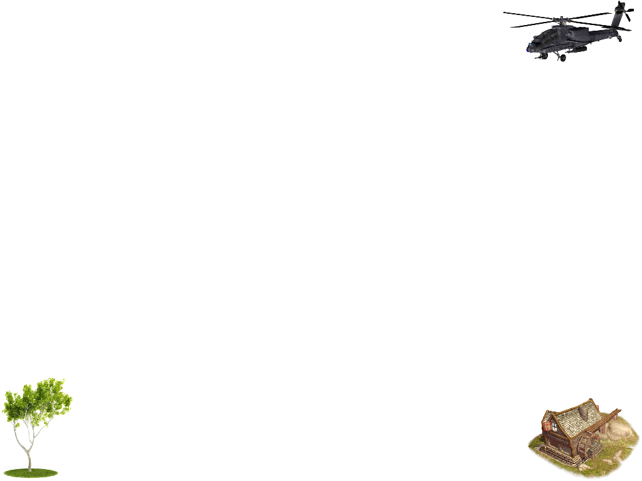
MFC Framework for OpenGL
任课教师：区士颀
Email：smart_vr@21cn.com

Slide 2
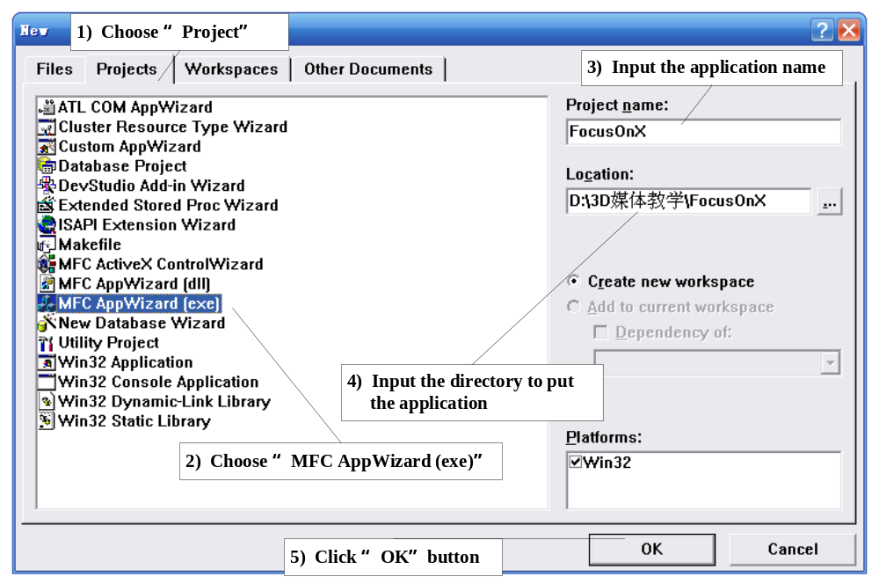
A MFC Project for OpenGL
Create a new Project

Slide 3
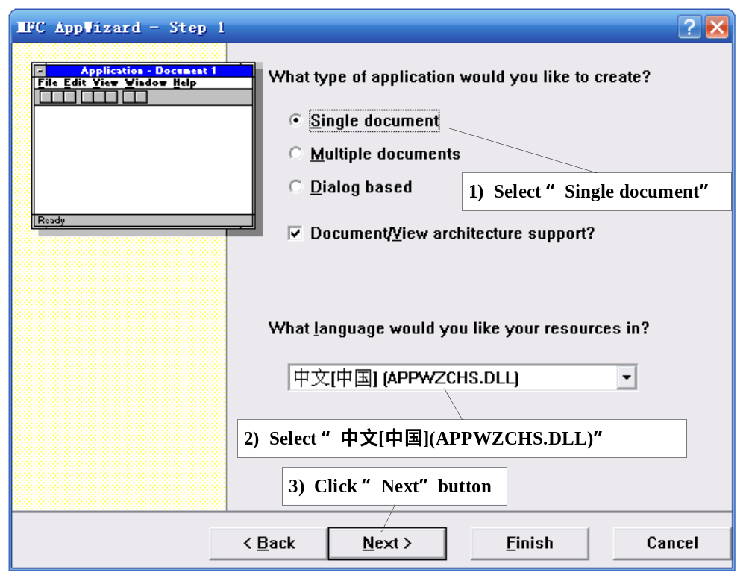
Configure the Step 1

Slide 4
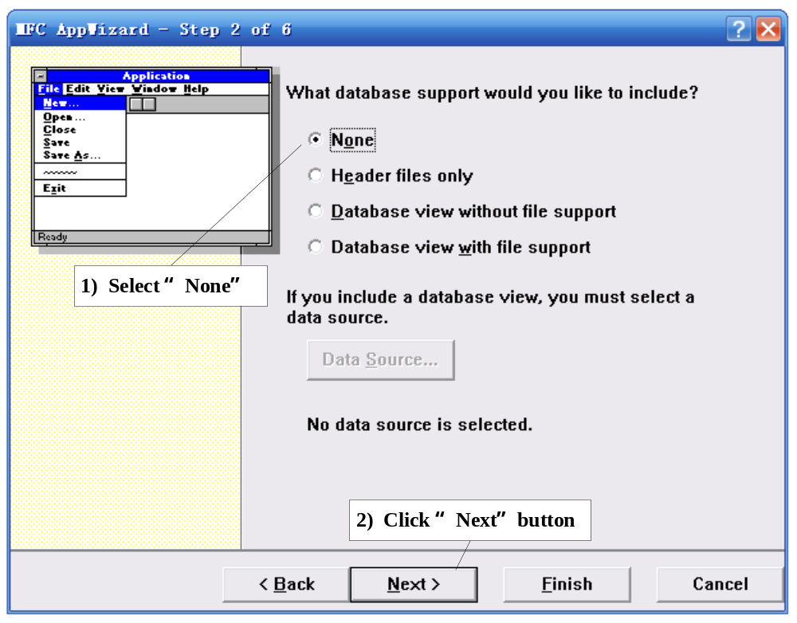
Configure the Step 2

Slide 5
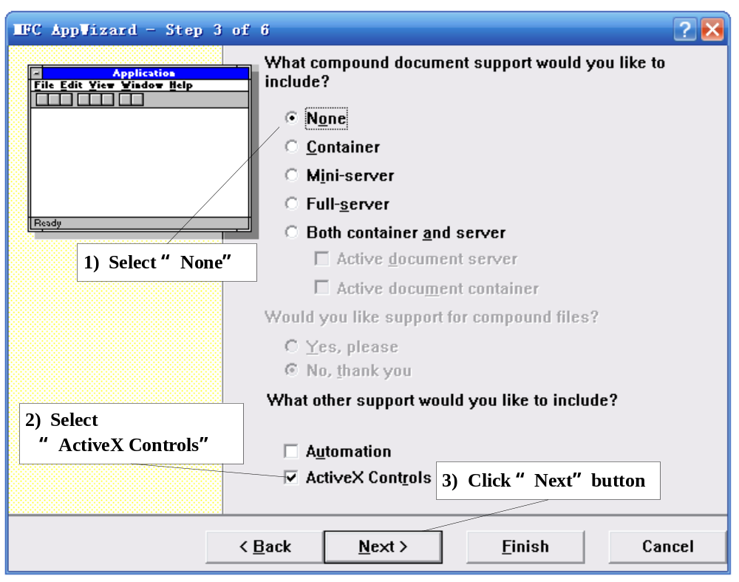
Configure the Step 3

Slide 6
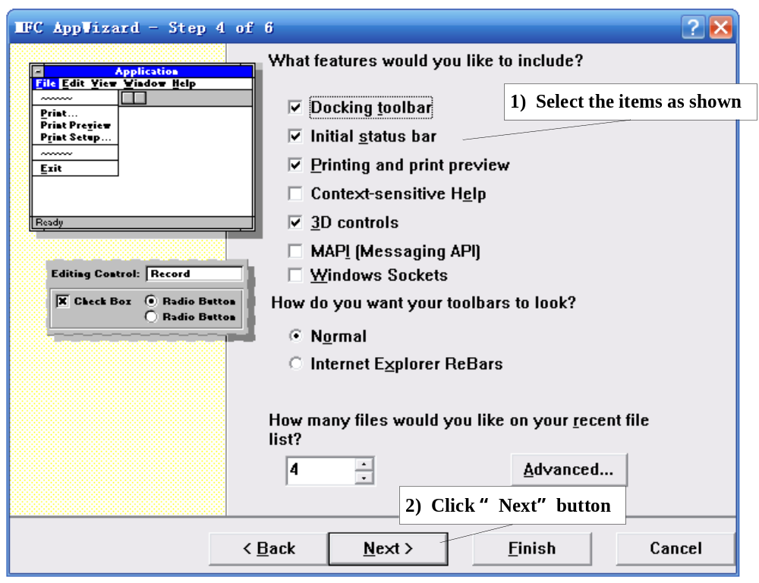
Configure the Step 4

Slide 7
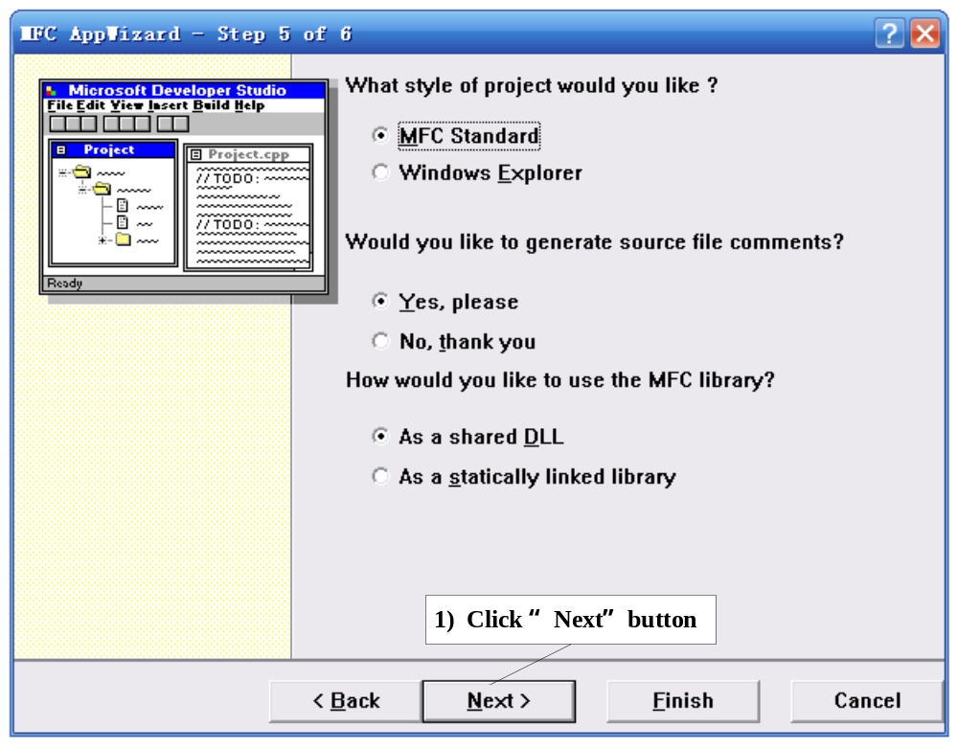
Configure the Step 5

Slide 8
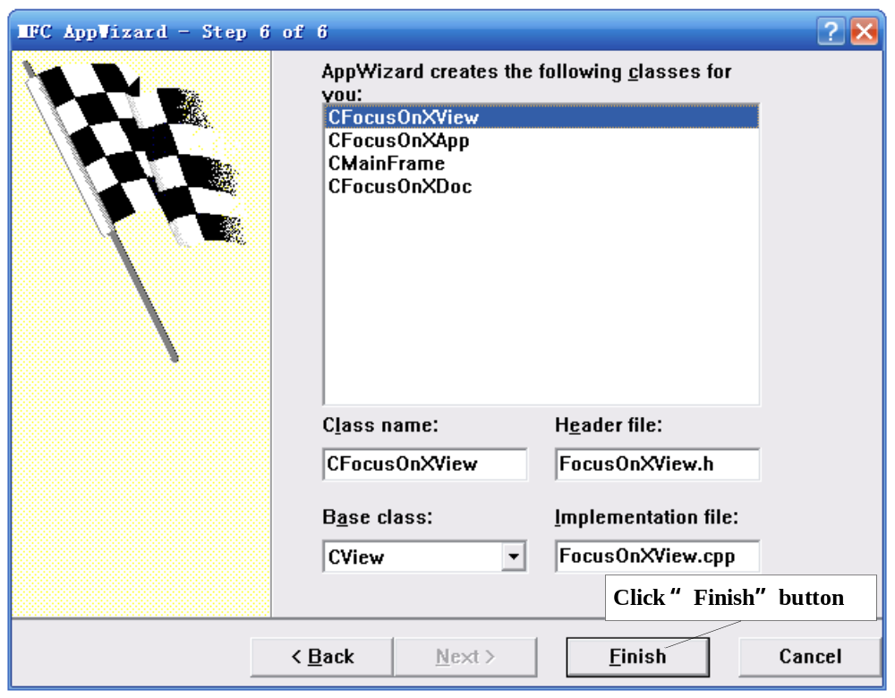
Configure the Step 6

Slide 9
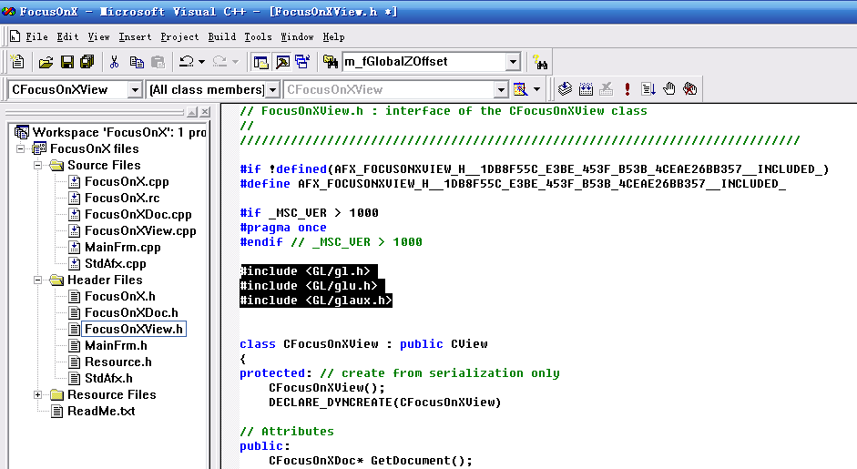
Add Something Special for OpenGL
Add head files

Slide 10
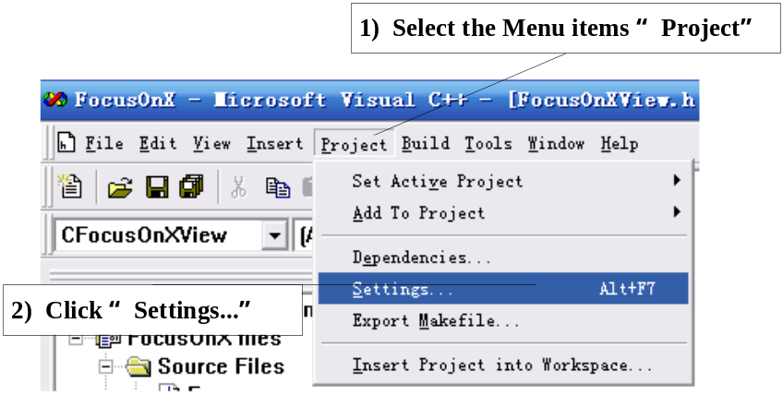
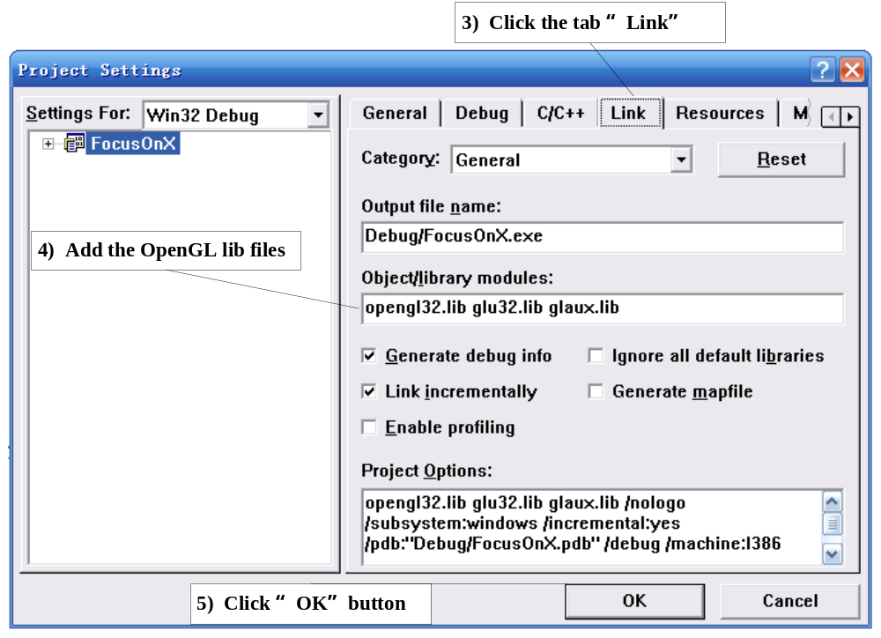
Change the Settings

Slide 11
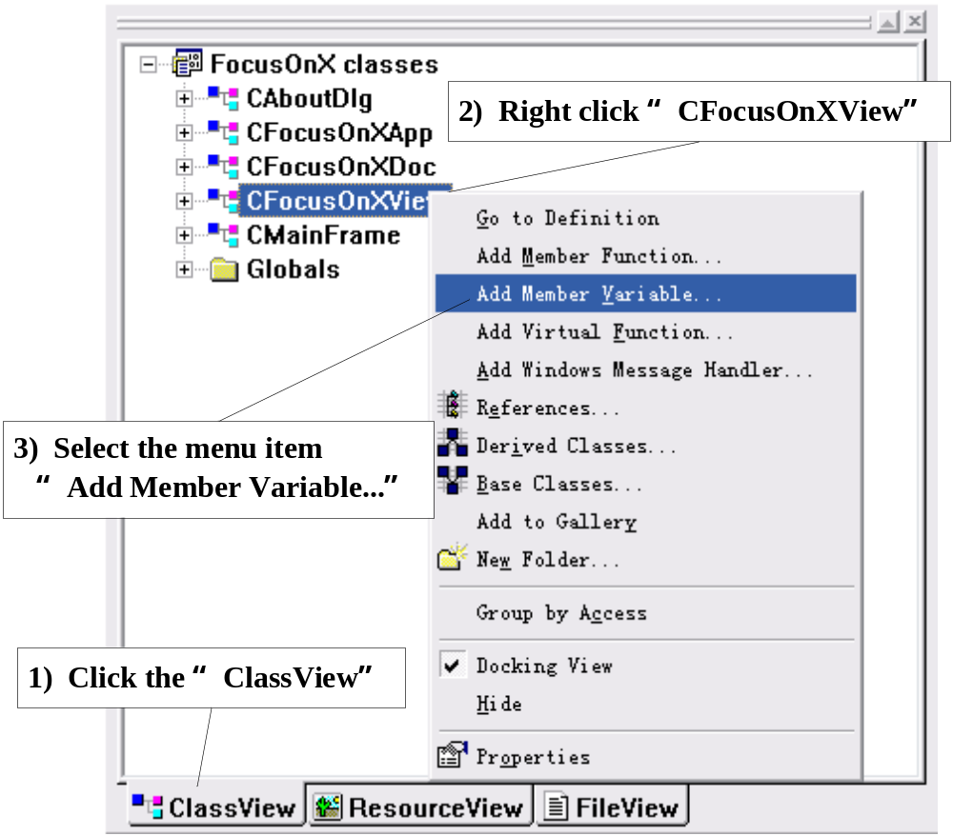
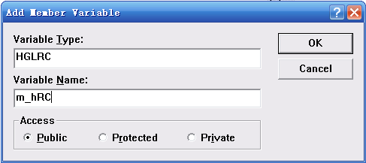
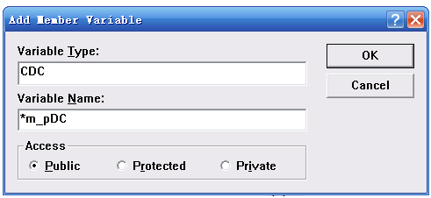
Add the variable of the handle to OpenGL
Rendering context, and the point to the CDC

Slide 12
Add the member function of the view:
OnCreate( )
int CFocusOnXView::OnCreate(LPCREATESTRUCT lpCreateStruct)
{
if( -1==CView::OnCreate(lpCreateStruct) )
return -1;
// TODO: Add your specialized creation code here
m_pDC=new CClientDC(this);
// Initial OpenGL with the CClientDC
InitializeOpenGL(m_pDC);
// Release the resource with the OpenGL rendering context handle
wglMakeCurrent( NULL, NULL );
return 0;
}

Slide 13
Add the member function of the view:
OnCreate( ) (cont.)
// Initial OpenGL
BOOL CFocusOnXView::InitializeOpenGL( CDC* pDC )
{
m_pDC=pDC;
// Set up the PIXELFORMATDESCRIPTOR for the OpenGL
SetupPixelFormat( );
// Create a OpenGL rendering context which is suitable for drawing on the
// device context related with the m_pDC
m_hRC=::wglCreateContext( m_pDC->GetSafeHdc( ) );
// Makes the OpenGL rendering context m_hRC the calling thread's current
// rendering context, which is related with the m_pDC
::wglMakeCurrent( m_pDC->GetSafeHdc(), m_hRC );
return TRUE;
}

Slide 14
Add the member function of the view:
OnCreate( ) (cont.)
BOOL CFocusOnXView::SetupPixelFormat( )
{
PIXELFORMATDESCRIPTOR pfd;
memset( &pfd, 0, sizeof(PIXELFORMATDESCRIPTOR) );
pfd.nSize = sizeof(PIXELFORMATDESCRIPTOR);
pfd.nVersion = 1;
pfd.dwFlags = PFD_DRAW_TO_WINDOW | // draw to window PFD_SUPPORT_OPENGL | // support OpenGL
PFD_DOUBLEBUFFER; // support double buffer swap
pfd.iPixelType = PFD_TYPE_RGBA; // color type is (R, G, B, alpha)
pfd.cColorBits = 24; // color bits, no alpha bits
pfd.cDepthBits = 32; // bits of z-buffer
// Match the device context pixel format to a given specification
int pixelFormat = ChoosePixelFormat( m_pDC->GetSafeHdc( ), &pfd );
// Sets the pixel format of the device context
SetPixelFormat( m_pDC->GetSafeHdc( ), pixelFormat, &pfd );
return TRUE;
}

Slide 15
Add the member function of the view:
PreCreateWindow(CREATESTRUCT& cs)
BOOL FocusOnXView::PreCreateWindow( CREATESTRUCT& cs )
{
// OpenGL only supports the window with these styles
cs.style |= WS_CLIPSIBLINGS | WS_CLIPCHILDREN;
// Create the only device context (DC) for the view
cs.lpszClass=AfxRegisterWndClass( CS_OWNDC, NULL,
(HBRUSH)(COLOR_WINDOW+1) );
return CView::PreCreateWindow(cs);
}

Slide 16
Add the member function of the view:
OnDestroy( )
void CFocusOnXView::OnDestroy( )
{
// Release the OpenGL rendering context
wglMakeCurrent( NULL, NULL );
// Delete the OpenGL rendering context
if( m_hRC!=NULL )
wglDeleteContext( m_hRC );
// Release the Windows device context
if( m_pDC )
delete m_pDC;
CView::OnDestroy( );
}

Slide 17
Add the member function of the view:
OnEraseBkgnd( CDC *pDC )
int CFocusOnXView:OnEraseBkgnd(CDC* pDC)
{
// Do nothing at all!
return TRUE;
}

Slide 18
Add the member function of the view:
OnSize( )
void CFocusOnXView::OnSize(UINT nType, int cx, int cy)
{
CView::OnSize(nType, cx, cy);
// TODO: Add your message handler code here
m_nWinWidth=cx;
m_nWinHeight=cy;
if( m_nWinHeight!=0 )
m_dAspectRatio=(GLdouble)m_nWinWidth/(GLdouble)m_nWinHeight;
else
m_dAspectRatio=1;
// Makes m_hRC related with m_pDC
wglMakeCurrent( m_pDC->GetSafeHdc(), m_hRC );
// Applies subsequent matrix operations to the projection matrix stack and
// load identity matrix
glMatrixMode( GL_PROJECTION );
glLoadIdentity( );

Slide 19
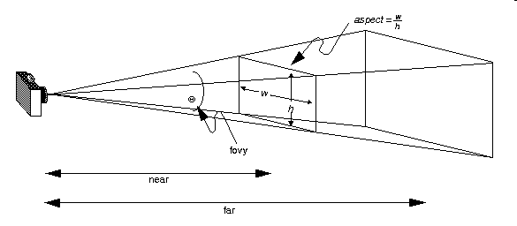
Add the member function of the view:
OnSize( ) (cont.)
// Sets up a perspective projection matrix
gluPerspective( m_dFov, m_dAspectRatio, m_dNearPlane, m_dFarPlane );
// Sets the viewport
glViewport( 0, 0, m_nWinWidth, m_nWinHeight );
// Applies subsequent matrix operations to the modelview matrix stack
glMatrixMode( GL_MODELVIEW );
// load identity matrix
glLoadIdentity( );
// Release the OpenGL rendering context
wglMakeCurrent( NULL, NULL );
}

Slide 20
Override the member function of the view:
OnDraw( )
void CFocusOnXView::OnDraw(CDC* pDC)
{
// Makes m_hRC related with m_pDC
wglMakeCurrent( m_pDC->GetSafeHdc( ), m_hRC );
// Sets background color and clear the depth initial value
glClearColor( 1.0f, 1.0f, 1.0f, 1.0f );
glClearDepth( 1.0 );
// call the key function to render the scene
OnDrawGL( );
// finish the OpenGL rendering operations
glFinish( );
// exchanges the front and back buffers so we can see the new scene
SwapBuffers( m_pDC->GetSafeHdc( ) );
// Release the OpenGL rendering context
wglMakeCurrent( NULL, NULL );
}

Slide 21
Override the member function of the view:
OnDraw( ) (cont.)
// The key function to operate the penGL drawing job
void CFocusOnXView::OnDrawGL( )
{
// Specifies the value used for depth-buffer comparisons
glDepthFunc( GL_LEQUAL );
glClearColor( 0.0f, 0.0f, 0.0f, 0.5f ); // We use a black background
// Clears the color buffer and the depth buffer
glClear( GL_COLOR_BUFFER_BIT | GL_DEPTH_BUFFER_BIT );
glEnable( GL_DEPTH_TEST );
// Enables the lighting
glEnable( GL_LIGHTING );
// 使用OpenGL系统自身提供的第0号光源
glEnable( GL_LIGHT0 );

Slide 22
Override the member function of the view:
OnDraw( ) (cont.)
GLfloat mat_solid[] = { 0.75, 0.75, 0.0, 0.8 }; // Sets the diffuse color
GLfloat mat_zero[] = { 0.0, 0.0, 0.0, 0.8 }; // Sets the emission color
glLightModeli( GL_LIGHT_MODEL_TWO_SIDE, GL_FALSE );
// Push the current matrix stack
glPushMatrix ();
glTranslatef ( -0.15, -0.15, -3 ); // Translates the object to the visible position
glRotated( 15, 1, 0, 0 ); // Rotates the object so it looks stereoscopic
glRotated( 25, 0, 1, 0 );
glRotated( 5, 0, 0, 1 );
// Sets the diffuse color and emission color of the object
glMaterialfv(GL_FRONT, GL_EMISSION, mat_zero);
glMaterialfv(GL_FRONT, GL_DIFFUSE, mat_solid);
// Draws a solid cube of the size 0.5
auxSolidCube( 0.5 );
// Pop the current matrix stack
glPopMatrix ();
}

Slide 23
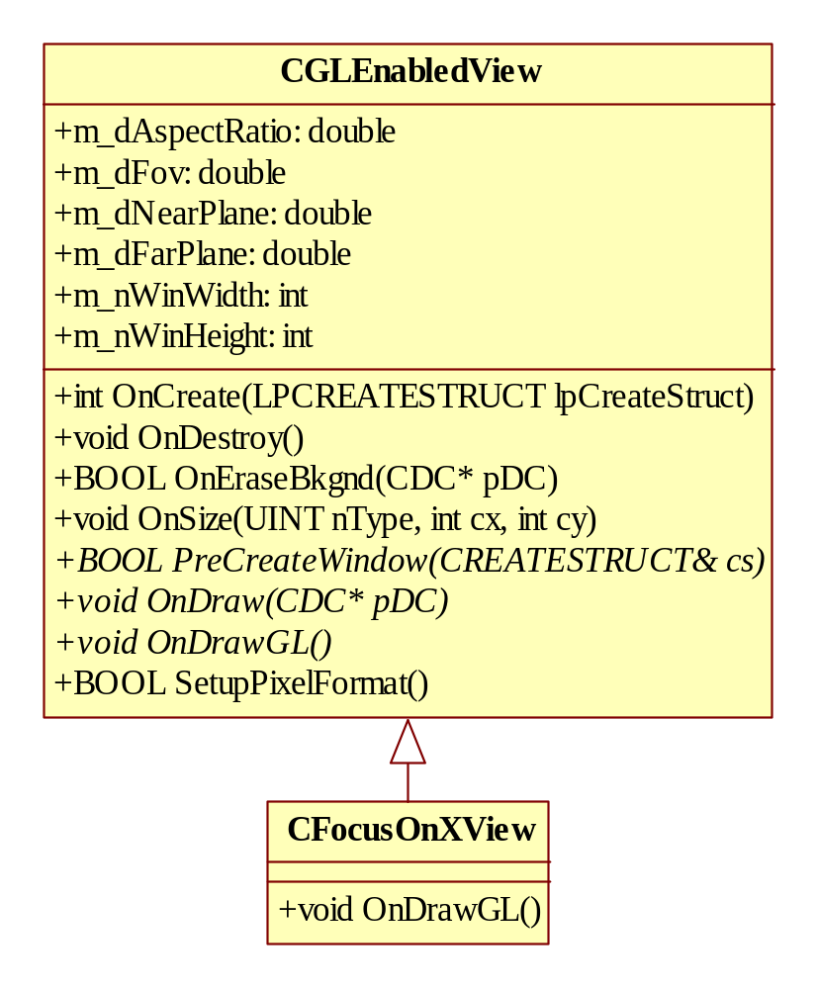
Optimize the OpenGL view hierarchy

