Slide 1
Influence of full-scale russian invasion on language habits of Ukrainians
Moskovets Artem, SMD-2

Slide 2
Goals of this study:
To investigate the impact of the full-scale invasion on the use of the Russian language among Ukrainian citizens.
To examine the relationship between language usage and personal factors such as gender, age, and region of origin
Try to proof the “latitude pattern”.
To analyze changes in language preferences in different aspects of life, such as daily communication, watching movies/series, and consuming content from russian authors, etc.

Slide 3
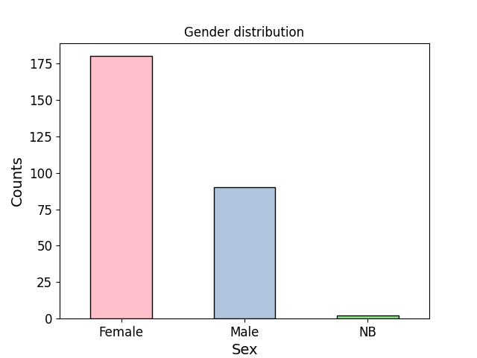

Slide 4
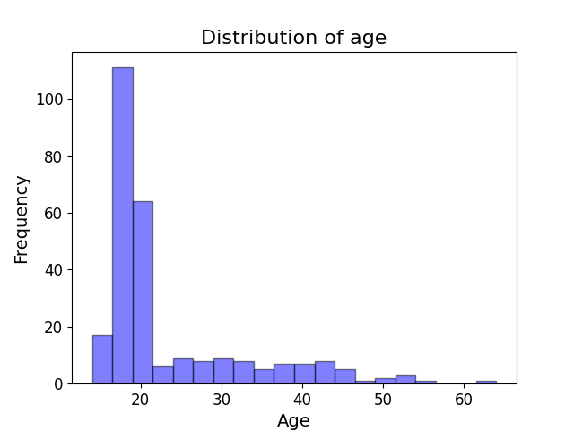

Slide 5
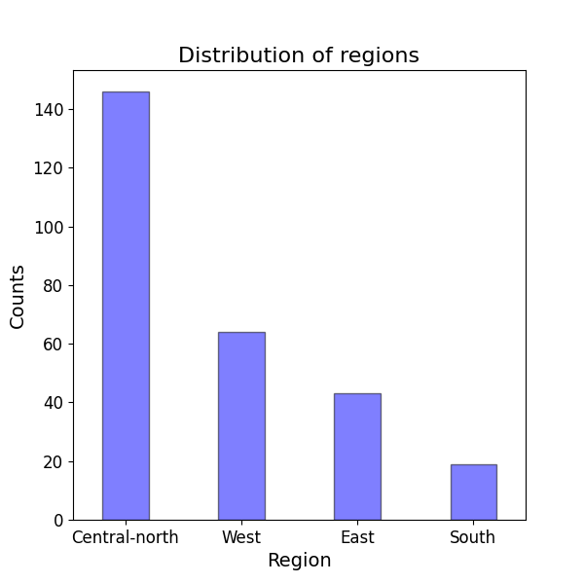

Slide 6
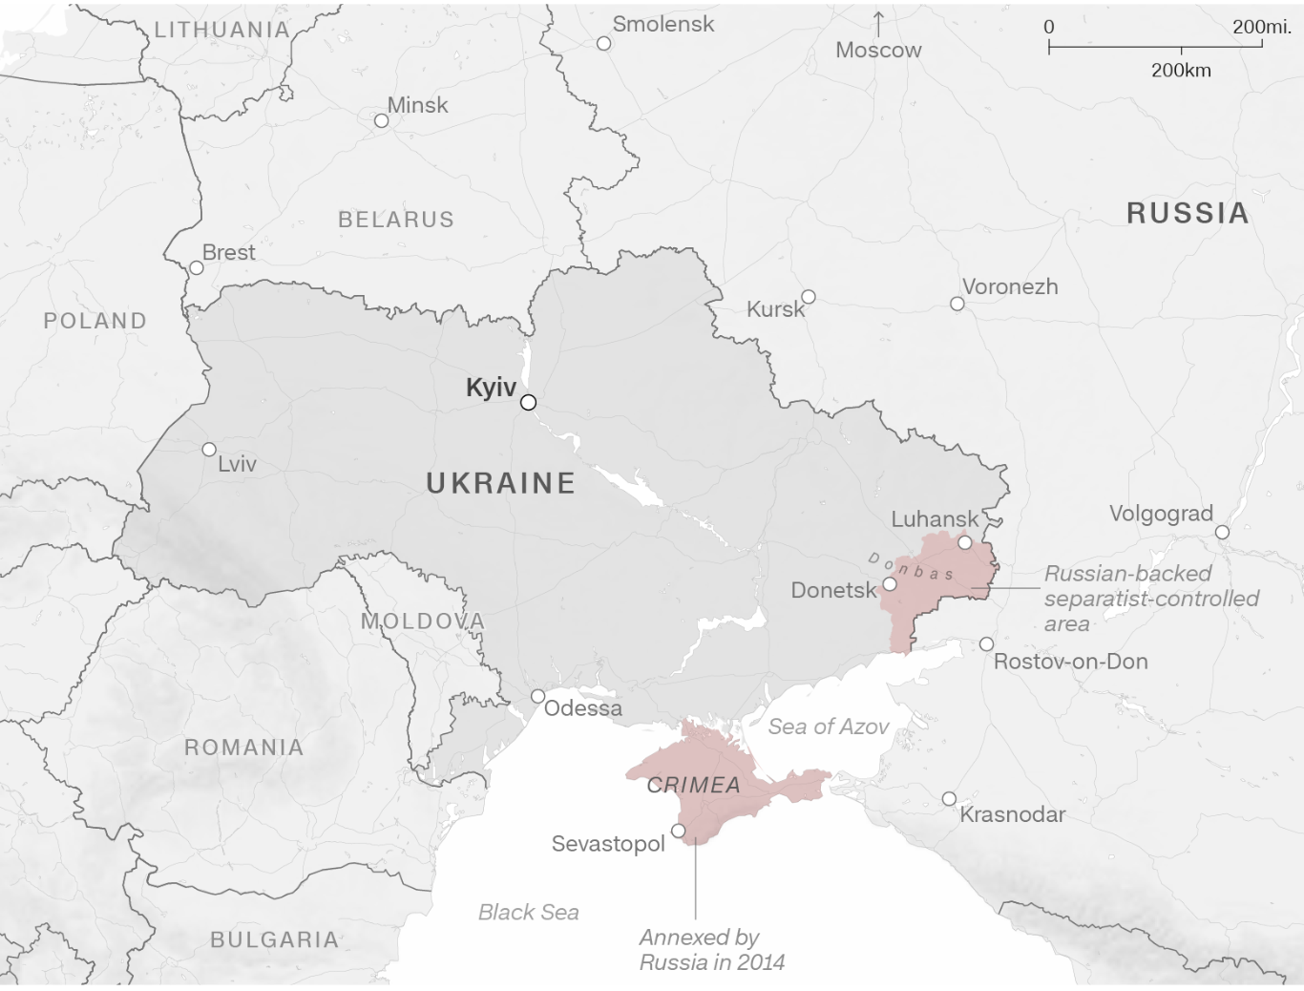

Slide 7
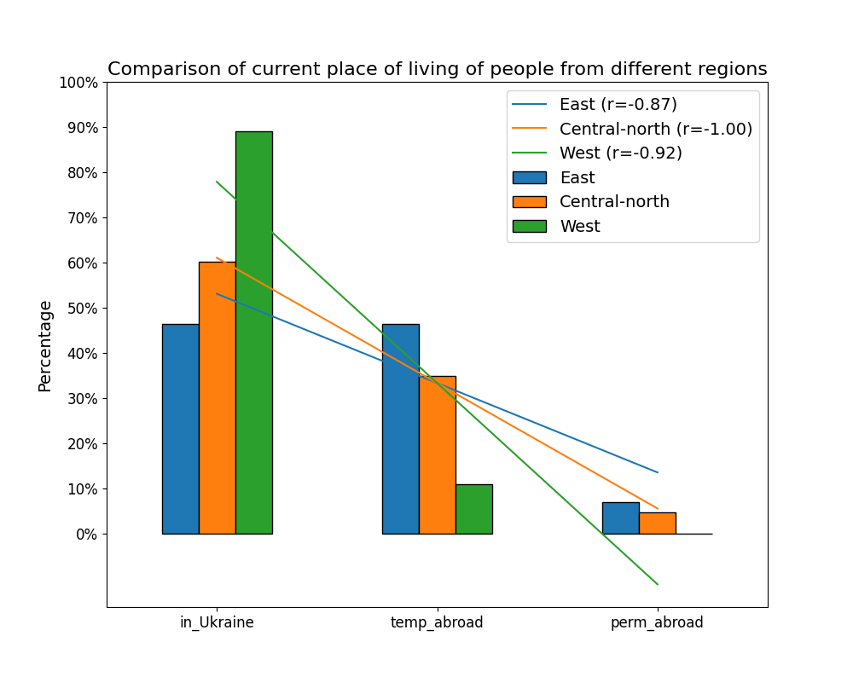

Slide 8
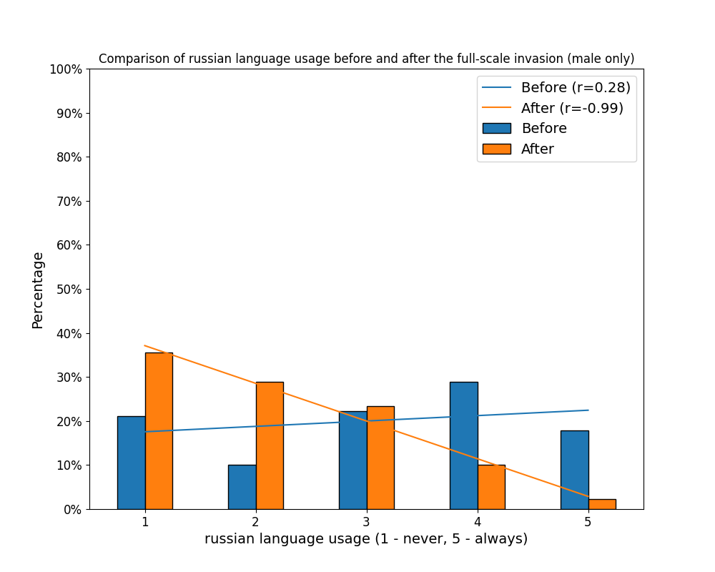

Slide 9
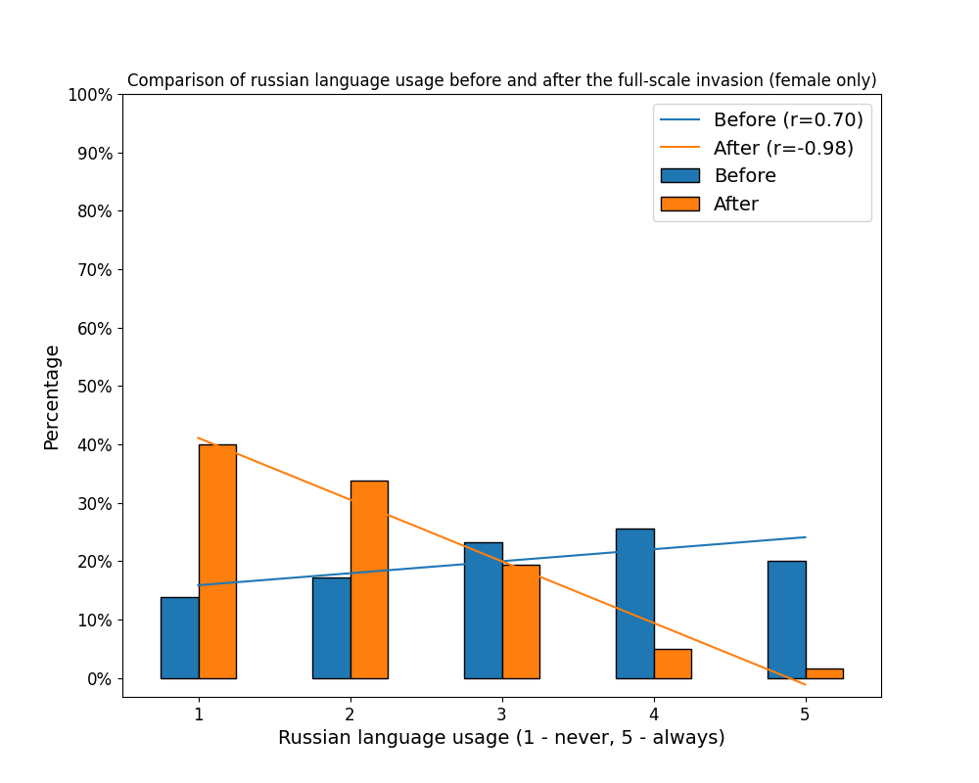

Slide 10
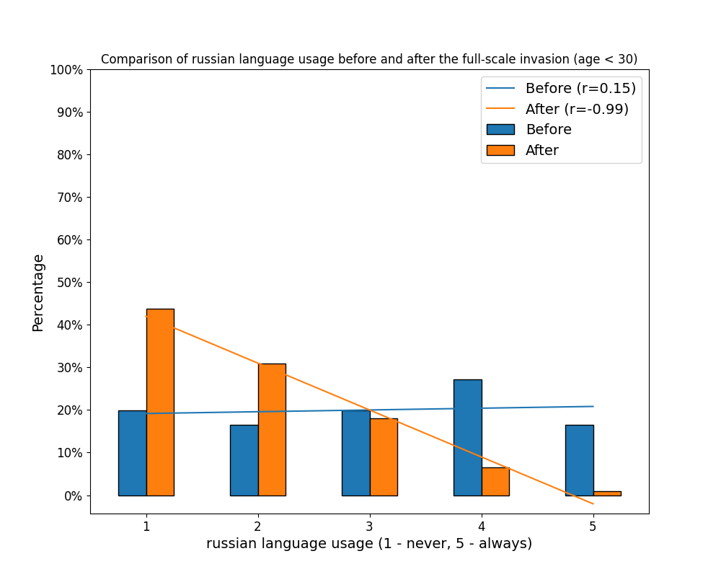

Slide 11
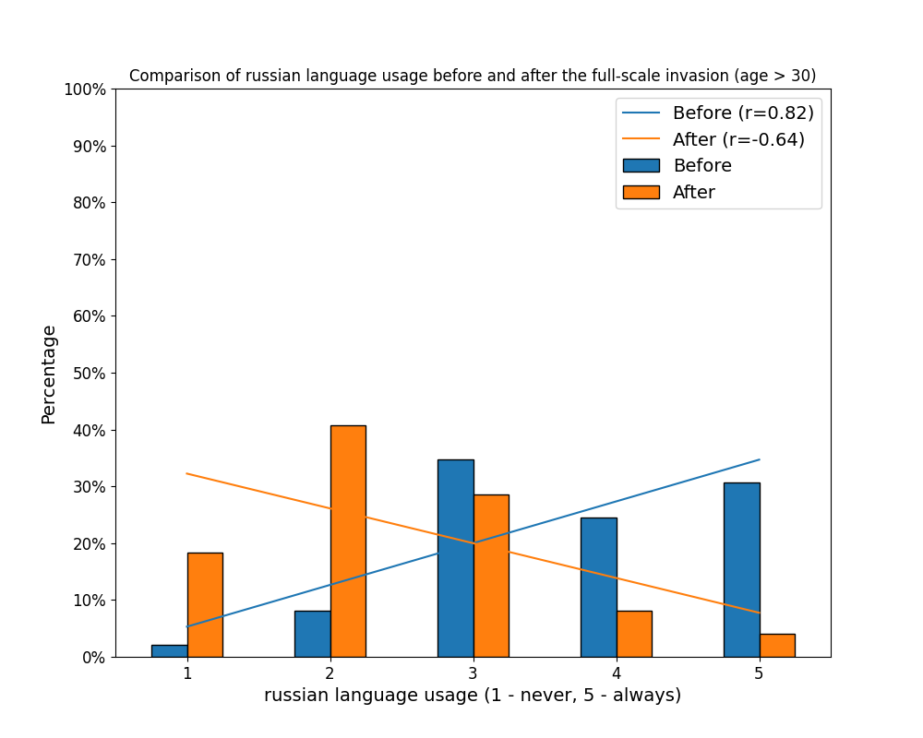

Slide 12
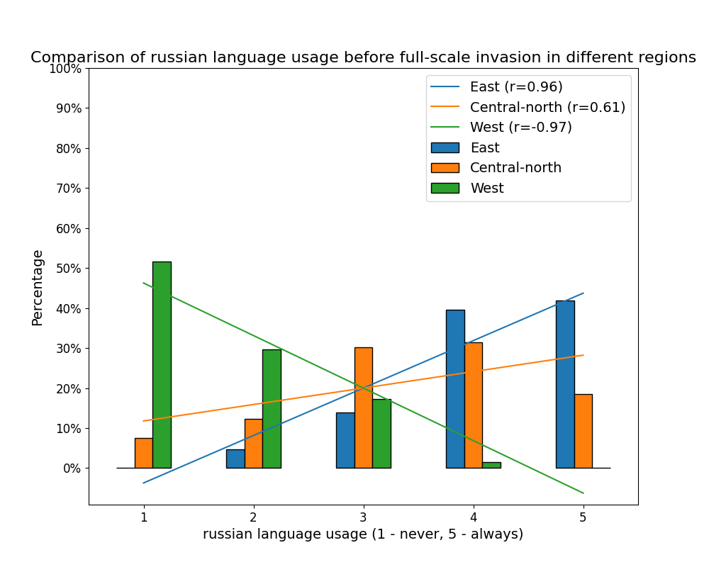

Slide 13
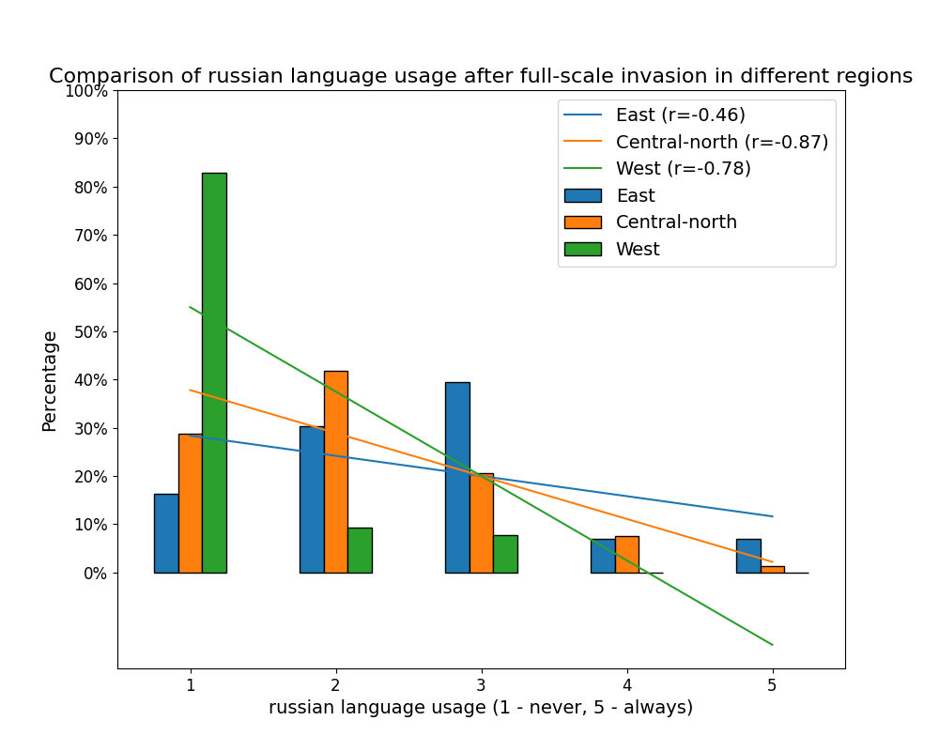

Slide 14
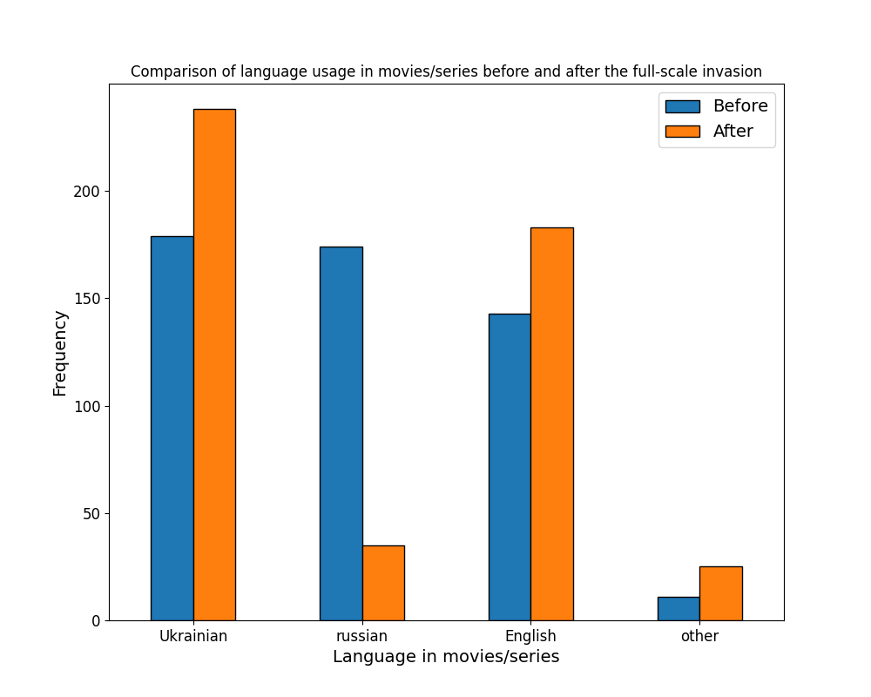

Slide 15
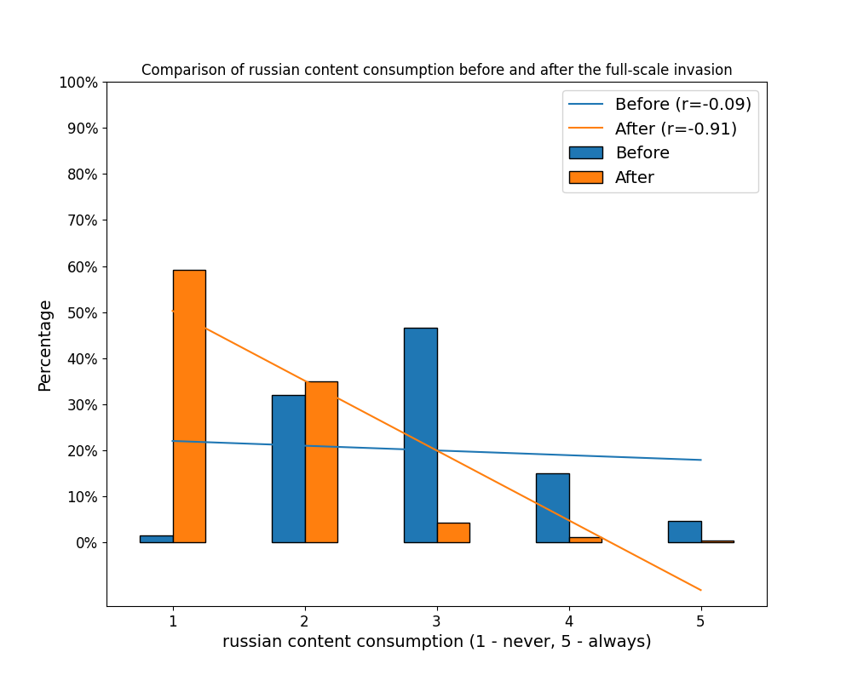

Slide 16
Conclusion
In conclusion, the study provides compelling evidence that the full-scale invasion has resulted in a significant reduction in the use of the Russian language among Ukrainian citizens. This shift in language usage appears to be a natural response to the external threat and underscores the resilience of the Ukrainian people in preserving their cultural identity and independence.

Slide 17

Thank you for attention!

