Slide 1
Effect of ESP operating regime on failure rate. Analysis for Vt
ESP operating-life model · dependence on regime and contractor · v3.1

Slide 2
Glossary
• TTF — time to failure / operating life: how long a pump runs before it fails (days).
• Median — the age by which half the pumps have failed.
• Full mean life (in statistics MRL — Mean Residual Life) — the mean time to failure in full, including the whole tail.
• Mean life over a horizon (in statistics RMST — Restricted Mean Survival Time) — how long a pump works on average over a fixed near-term window (e.g. 730 days), without looking into the far tail.
• Ql — liquid rate; Kpod — pump loading (fraction of nominal); GLF — gas-liquid factor.
• Contractors: brt / slb / other (oth).

Slide 3
1 — Conclusions
• Question: how does pump operating life (TTF) on the Vt field depend on the operating regime — liquid rate (Ql), frequency, loading (Kpod), gas (GLF) — and what formula should the life forecast use?
• Data: empirical survival curves across 6 groups (H₂S class: sour / nonsour × contractor brt / slb / other). ~530 nonsour + ~136 sour runs in total.
• Headline:
– Liquid rate is the only operating factor that matters for nonsour: higher rate — shorter life. Frequency and Kpod reflect the same rate (pump affinity law).
– Sour wells are a separate world: ~3–4× shorter life, and the regime does not affect it — H₂S corrosion drives everything.
– Gas (GLF) — no effect, excluded.
– The 2× brt/slb difference is mostly rate (slb runs at higher rates); a small unexplained residual reproduces on another field — kept as an empirical adjustment.

Slide 4
Part I. Results: model, parameters and calculation

Slide 5
2 — Final life-forecast formula
Meaning: a group baseline life, adjusted for rate and for the contractor. The model is log-linear: life is multiplied by exp(coefficient × Δ), where Δ is the parameter's deviation from its reference value (for rate — on the log scale).
TTF = TTF0 · contractor_mult · exp( γ · Δ ), Δ = ln( Ql_{clip} / Ql_{ref})
clip = winsorize Ql to the bounds Ql_{min}, Ql_{max} held at the boundary and grows no further (no extrapolation)
class | curve shape β | TTF0 | Ql_{ref} | Ql bounds | coefficient γ (per Δln Ql) | Brt (Борец) | slb | other
Vt_nonsour | 1.15 | 571 | 250 | 47–823 | −0.305 | ×1.00 | ×0.79 | ×0.54
Vt_sour | 1.37 | 149 | 346 | 73–779 | ≈0 (no effect) | ×1.00 | ×1.05 | ×0.65
Brt (Борец) is the reference contractor, its multiplier = 1.00 (the others are relative to brt).
• Reference value — the point where the adjustment = 1 (exp(0)=1); TTF0 is the baseline life at Ql = reference and contractor brt. exp(γ·Δ) is equivalent to (Ql/Ql_{ref})^γ.
• Curve shape β ≈ 1 means: failure risk hardly grows with age (not "wear-out").
• Relationships are observational (not an experiment). For sour the rate coefficient ≈0 → in practice life = TTF0 · contractor multiplier (converted to the median).
Ql is the strongest signal. Kpod and frequency are considerably correlated with Ql, the split into (Ql, Kpod, frequency) is mostly indicative (much weaker signal from individual Kpod and frequency)

Slide 6
3 — Coefficients: all three parameters (log-linear model)
Life is multiplied by exp(γ · Δ), where Δ is the parameter's deviation from its reference value (for rate — on the log scale). Coefficients γ (nonsour, from the data; significant in bold):
known | γ Ql (per Δln Ql) | γ frequency (1/Hz) | γ Kpod (per 1.0) | case
Ql + frequency + Kpod | −0.130 | −0.0142 | −0.729 | all three (split)
Ql + Kpod | −0.191 | — | −0.597 | two parameters
Ql + frequency | −0.190 | −0.0161 | — | two parameters
frequency + Kpod | — | −0.0171 | −0.812 | two parameters
Ql only | −0.240 | — | — | one (fallback)
frequency only | — | −0.0222 | — | one (fallback)
Kpod only | — | — | −0.729 | one (fallback)
Reference values (where all adjustments = 1): Ql 250 m³/d, frequency 50 Hz, Kpod 0.70; baseline life η_ref = 570 d (brt). Contractor: brt = 1.00 (reference), slb ≈0.73, other ≈0.64. Applicability range (q05–q95, do not extrapolate beyond): Ql 47–823, frequency 31–56 Hz, Kpod 0.2–1.2.
TTF = TTF0· contractor_ mult · exp( γ · ln( Ql_{clip} / Ql_{ref}) + γ_freq·(freq − 50) + γ_Kpod·(Kpod − 0.70))
How to apply — for each known parameter compute exp(γ · Δ):
• frequency 55 Hz = +5 from 50 → exp(−0.0142·5) = ×0.93 (−7 %);
• Kpod 0.90 = +0.20 from 0.70 → exp(−0.729·0.20) = ×0.86;
• Ql 400 vs 250 → exp(−0.130·ln(400/250)) = ×0.94.
Then multiply the adjustments of the known parameters × contractor × η_ref (drop missing ones, do not impute). For sour all γ ≈ 0 → contractor only. Median / life — slide 5.

Slide 7
4 — Worked example
Well W: nonsour, contractor slb, Ql 400 m³/d, frequency 52 Hz, Kpod 0.90. All three known → the "all three" set (β=1.28, η_ref=570; references 250 m³/d / 50 Hz / 0.70):
Δ Ql = ln(400/250) = +0.470 → contribution = −0.130·0.470 = −0.061 (400 within 47–823)
Δ frequency = 52 − 50 = +2 Hz → contribution = −0.0142·2 = −0.028
Δ Kpod = 0.90 − 0.70 = +0.20 → contribution = −0.729·0.20 = −0.146
sum of contributions = −0.235 → exp(−0.235) = 0.790
contractor multiplier (slb) = 0.728
characteristic life η = 570 · 0.790 · 0.728 = 328 d
quantity | what it is | value
Median | half the pumps have failed by this age | 247 d
Full mean life (MRL) | mean time to failure in full | 304 d
Mean life over 2 years (RMST, 730 d) | how long it runs on average over the next 730 d | 292 d
If only Ql is known → the baseline formula (β=1.15, η_ref=571, Ql reference 250): multiplier 0.79 · exp(−0.305·ln(400/250)) = 0.686, η=392 → Median 285 / mean life 373 / 2-year life 335 d. (Fewer parameters used — a more conservative estimate, so the life comes out longer.)
▍ This calculation ports 1:1 to Excel: the parameters (η, β, references, adjustments, contractor) on a separate sheet, functions compute the four quantities. (The Excel workbook is a separate task.)

Slide 8
5 — Which quantity to report as TTF
The same forecast can be expressed three ways:
• Median — the age by which half the pumps have failed. Simple, but only speaks to the "middle" and ignores the spread.
• Full mean life (MRL) — the mean time to failure in full. An honest mean, but it partly relies on the far "tail", which the data observe only weakly.
• Mean life over a horizon (RMST over 730 d) — how long a pump runs on average over the next 2 years. It invents nothing beyond the data and is always computable.
Recommendation: report "mean life over 2 years" (RMST) as the primary quantity, with "full mean life" beside it, and the median for reference only. Values by group:
class | contractor | multiplier | Median, d | Full mean life, d | 2-year life, d
nonsour | brt | 1.00 | 415 | 544 | 424
nonsour | slb | 0.79 | 329 | 431 | 369
nonsour | other | 0.54 | 224 | 294 | 278
sour | brt | 1.00 | 114 | 136 | 136
sour | slb | 1.05 | 119 | 143 | 143
sour | other | 0.65 | 74 | 88 | 88
▍ For nonsour "full mean life" is noticeably larger than "2-year life" — because some pumps live longer than 2 years (long tail). For sour the lives are short, both quantities coincide. The remaining life of a running pump is measured from its current age.

Slide 9
6 — Limitations (what to keep in mind)
• Ql sets the overall trend, but it predicts the life of a single pump weakly — the model is good for planning by group / fleet, not for the exact date of one pump.
• The contractor multiplier is observational; the cause is only partly understood (about a third of the difference is runs cut short by planned workovers (GTM), not failures).
• All relationships are observational, not from an experiment.
• Frequency and Kpod are not in the TM-06 plan — shown for understanding; the forecast is computed from Ql.
• For sour the regime has no effect — do not add regime adjustments without new H₂S data.
• Deprecated: the previously deployed "penalty for high Kpod loading" is not supported by this analysis (see slide 12).

Slide 10
Part II. Analysis — model justification

Slide 11
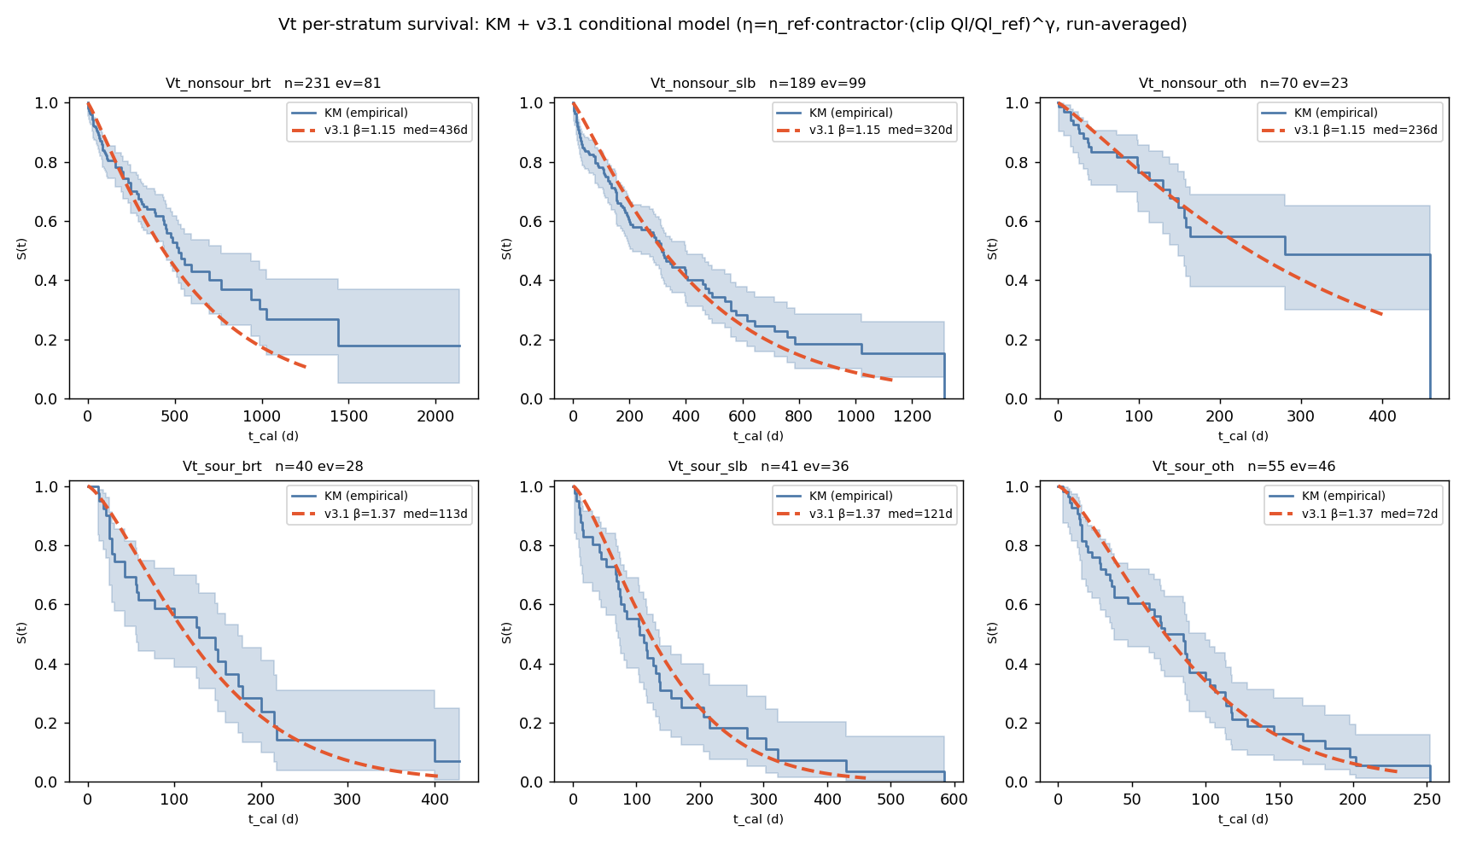
7 — Groups and overall picture
Empirical survival curves (share of running pumps over time, from the data) across the 6 groups + the fitted model overlay:
group | runs | failures | shape β | model median, d
Vt_nonsour_brt | 231 | 81 | 1.15 | 436
Vt_nonsour_slb | 189 | 99 | 1.15 | 320
Vt_nonsour_other | 70 | 23 | 1.15 | 236
Vt_sour_brt | 40 | 28 | 1.37 | 113
Vt_sour_slb | 41 | 36 | 1.37 | 121
Vt_sour_other | 55 | 46 | 1.37 | 72
▍ The model sits inside the confidence band of each group. Full parameters (characteristic life, reference Ql, bounds, adjustments, fallbacks) — slides 2–3.

Slide 12
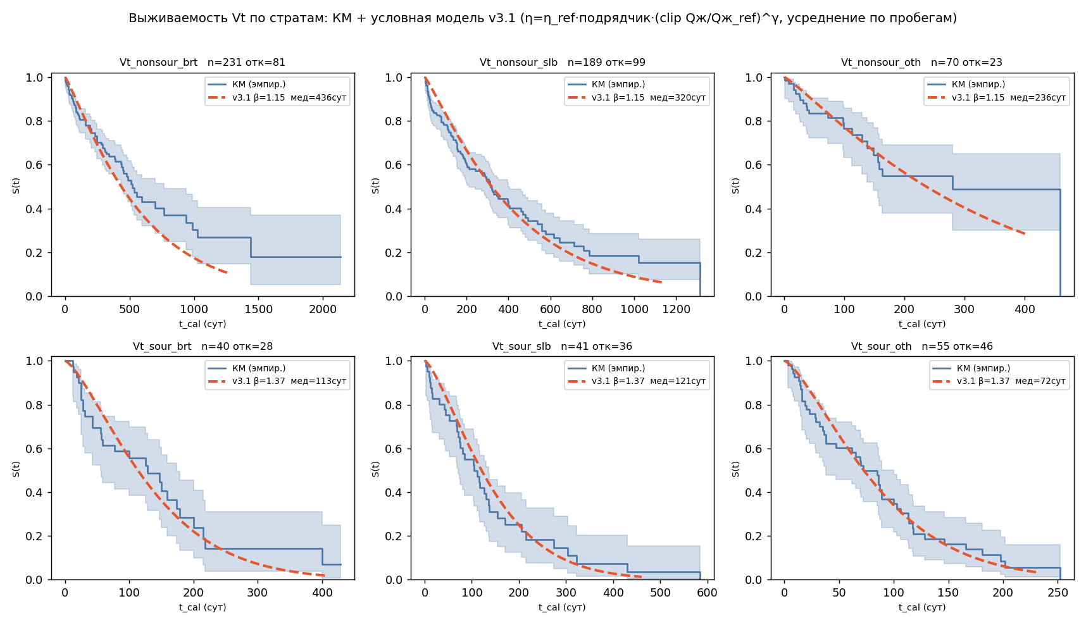
8 — Nonsour wells: life and model
(top row of the figure, slide 7)
• Nonsour lives long and is rate-driven: model median 436 / 320 / 236 d (brt / slb / other); shape β ≈ 1.15 — failure risk hardly grows with age.
• The model (Ql + contractor) reproduces each contractor's empirical curve.
• The brt↔slb difference is mostly a rate difference (discussed on slide 14).

Slide 13
9 — Sour wells: life and model
(bottom row of the figure, slide 7)
• Life is ~3–4× shorter than nonsour: median 113 / 121 / 72 d (brt / slb / other).
• Shape β ≈ 1.37 — mild wear from day one (the nonsour curve is flatter).
• The order other < brt ≈ slb is set by H₂S corrosion; the regime does not affect life, so for sour the model = baseline life · contractor multiplier (slides 2, 16).

Slide 14
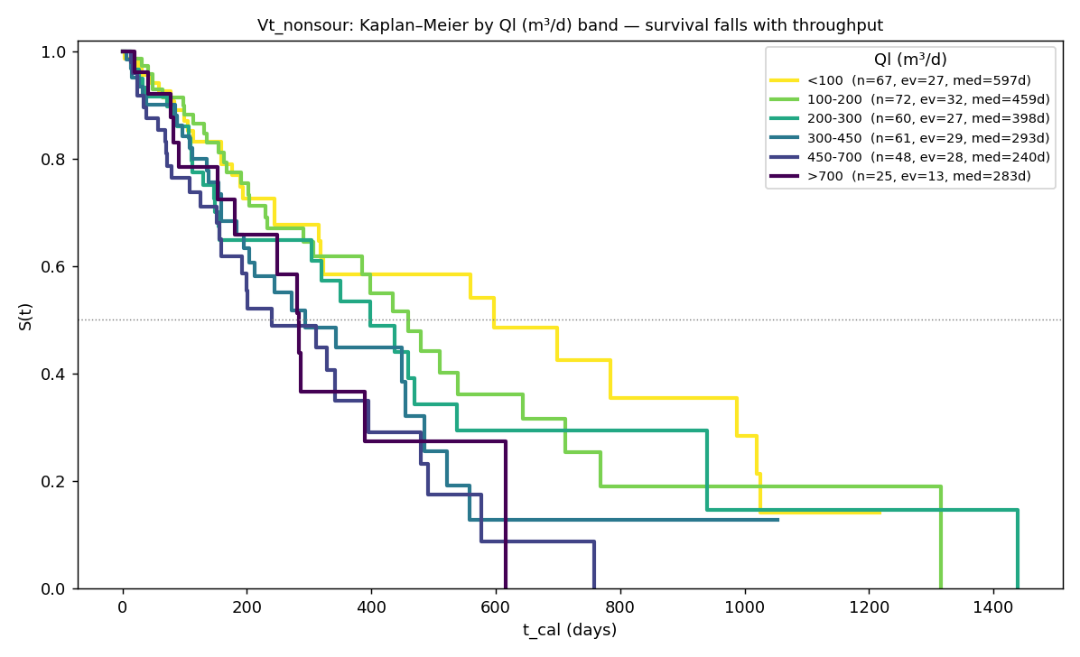
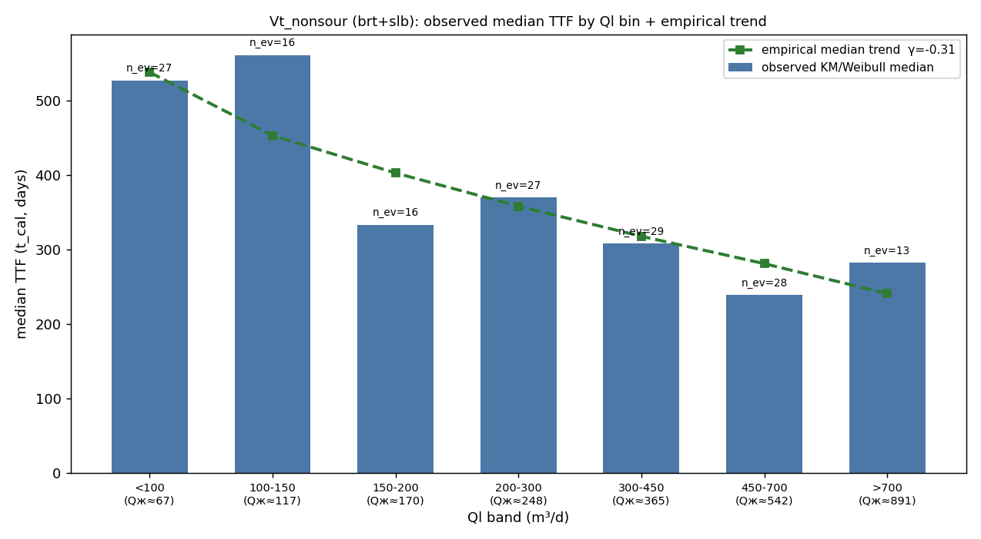
10 — The main factor: liquid rate
• Life steadily decreases with rising Ql (the higher the Ql band, the lower the curve).
• The shape was chosen from the data: log of Ql with the extreme 5% clipped top and bottom (beyond the working bounds the adjustment is not increased).
• The Ql effect is statistically significant (p<0.001): life ×0.74 for a ~2.7× rise in Ql.
• Reproduces on another field (Ya) — the same effect, so the relationship is not by chance.

Slide 15
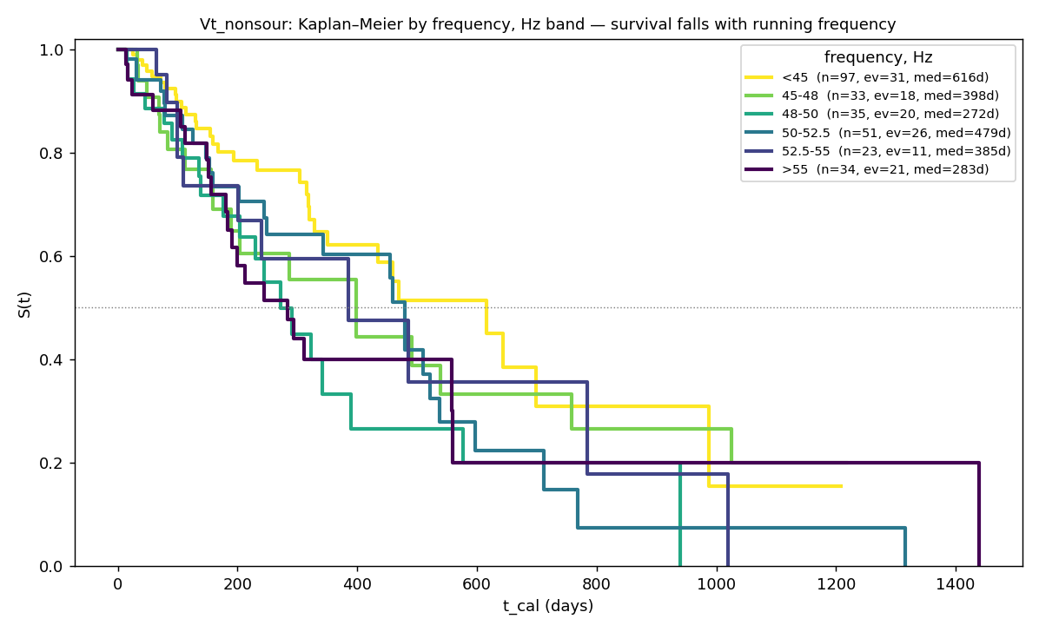
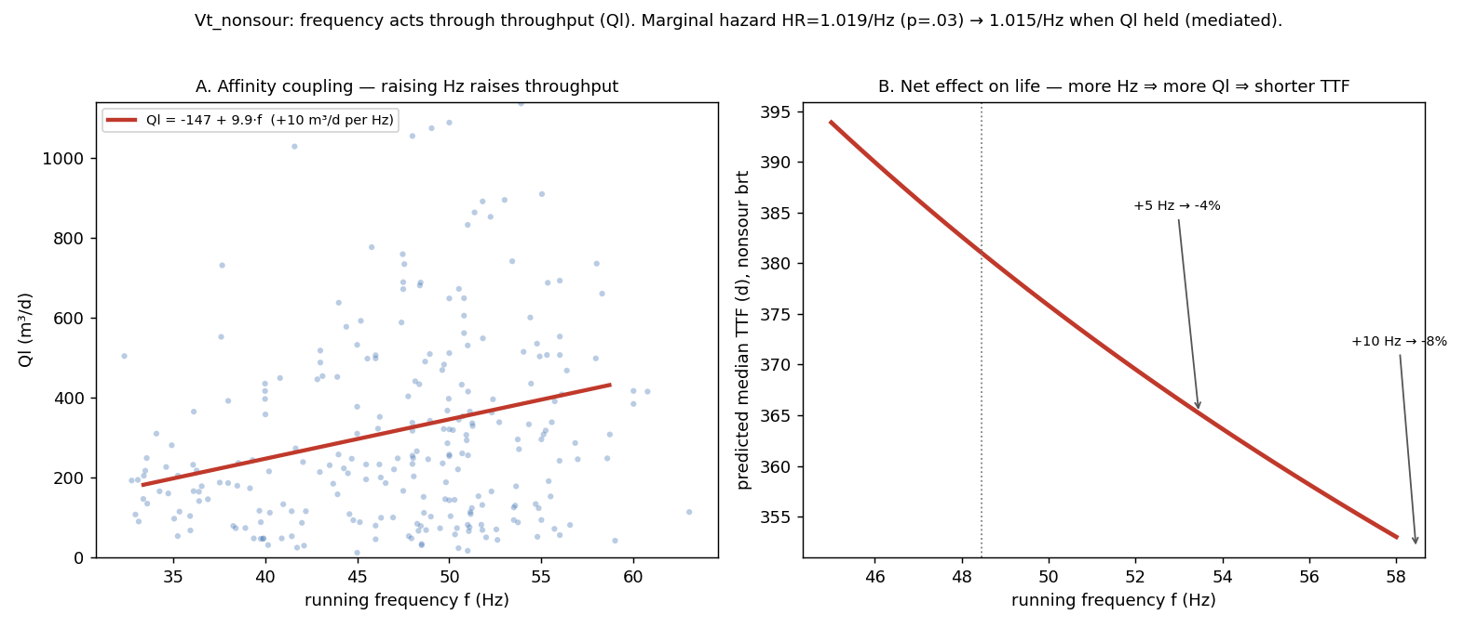
11 — Frequency: the same physics through rate
• Raising frequency raises rate (affinity law): roughly +10 m³/d per Hz.
• Frequency is the clearest single signal: failure risk +1.9% per Hz (significant), but with Ql held fixed the effect nearly vanishes — frequency acts precisely through rate.
• Net along the frequency→rate chain: +5 Hz ≈ −4 %, +10 Hz ≈ −8 % of life.
• For deployment: frequency and Kpod are not in the TM-06 plan, so the forecast is computed from Ql — frequency/Kpod are the same physics, shown for understanding.

Slide 16
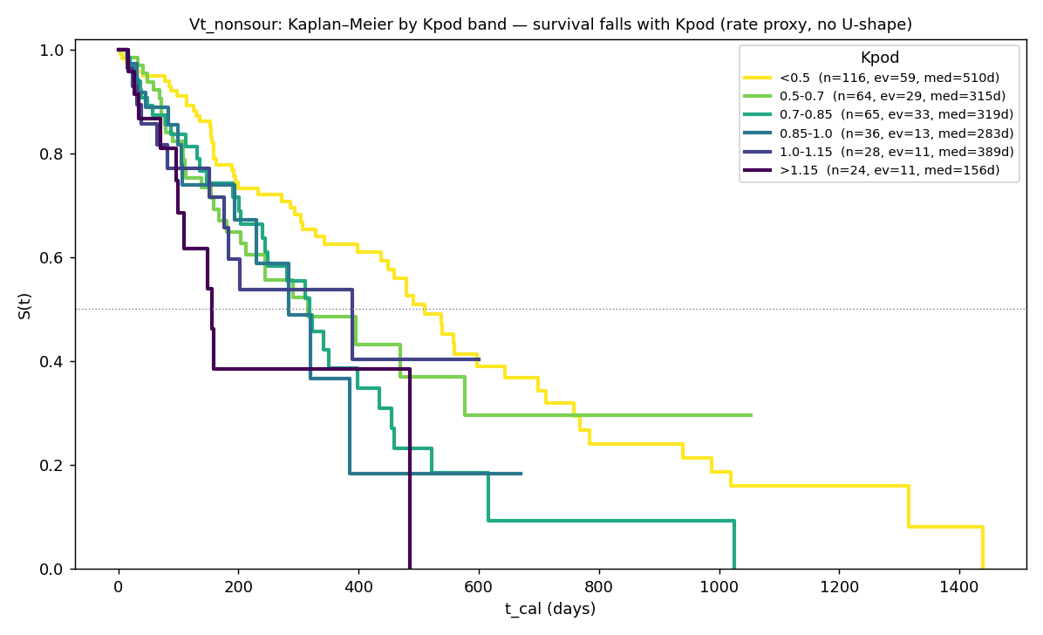
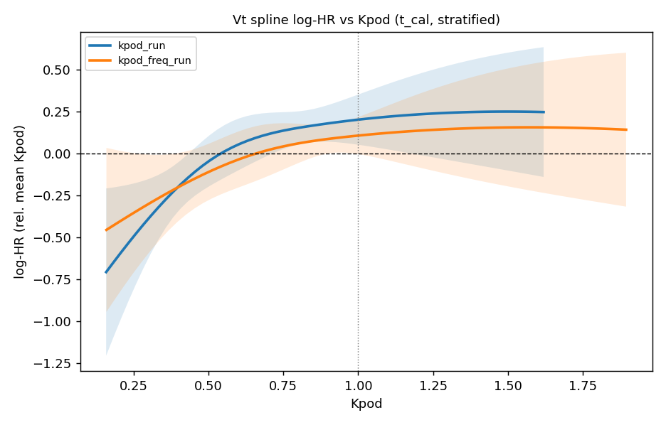
12 — Loading (Kpod): checking the "safe zone"
Is there a "safe zone" at nominal (the previously deployed high-loading penalty)? — No.
• The flexible risk curve (right figure) shows: no protective valley at nominal.
• Risk rises monotonically with loading across the whole working range; the minimum is at the low edge.
• Direct check: low loading is not harmful (robust to how it is counted).
• ⇒ A penalty for exceeding nominal is not justified; loading is the same rate, in other words.

Slide 17
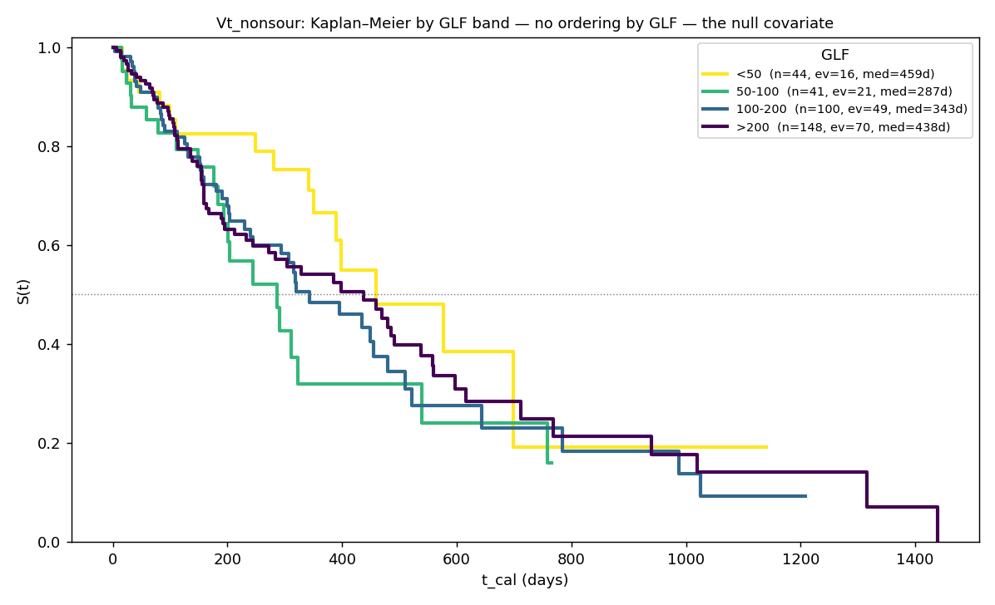
13 — Gas (GLF): no effect — excluded
• Survival curves by GLF band cross — no ordering (medians 459 / 287 / 343 / 438 d mixed up), unlike the clear ordering by Ql (slide 10).
• No effect on either risk or life (not significant).
• Free-gas rate is also not significant (a single spike in one group does not repeat).
• Why excluded: no signal, and gas rate is also confounded with well productivity. Vt is the gassiest field, so this is an honest zero, not a lack of data.

Slide 18
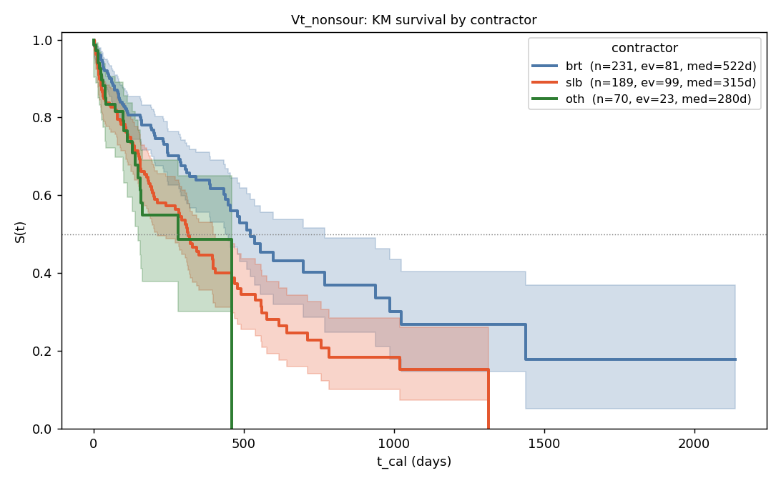
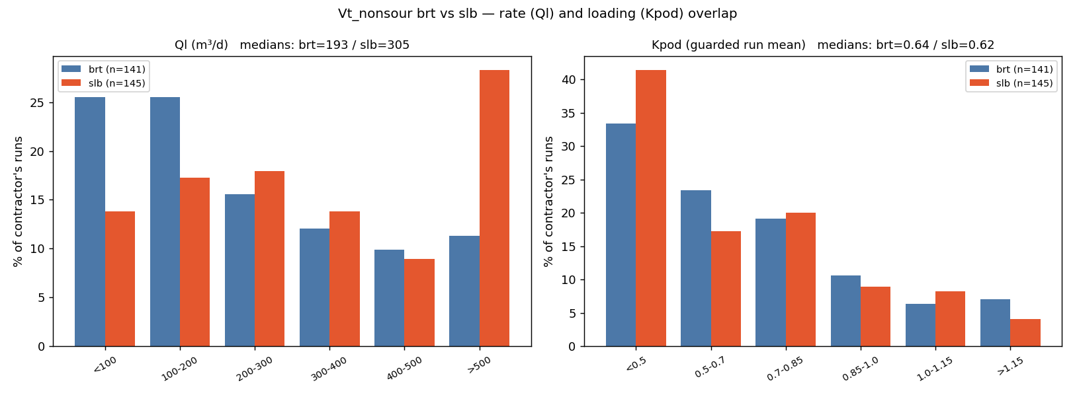
14 — brt vs slb, nonsour — the "lesson" explained
Parameters by contractor (a separate Weibull fit per stratum, no adjustments):
contractor | runs | failures | shape β | char. life η, d | median, d | mean, d
brt | 231 | 81 | 0.82 | 897 | 573 | 1001
slb | 189 | 99 | 0.81 | 482 | 306 | 542
other | 70 | 23 | 0.87 | 429 | 282 | 460
These are raw per-stratum fits; β<1 reflects the spread between wells, not wear-out. In the final model (slide 2) the contractor is a multiplier on a common baseline, and the shape is β≈1.15.
Empirical survival curves by contractor (the raw picture — brt clearly above slb):
• At first glance — a 2× contractor advantage (median brt 573 vs slb 306 d), but slb runs at noticeably higher rates: median 305 vs 193 m³/d (the ranges overlap, they are not just different).
• Match the rate (range 193–305): the gap disappears — brt 403 d vs slb 440 d. So the 2× is mostly rate.
• A small residual (slb ×0.79) persists and repeats on another field (Ya) — i.e. it is real. If we account for runs cut short by planned GTM (not failures), about a third of the residual is explained by this; the rest is unattributed (make/service).
• Verdict: the contractor is kept as an observational adjustment, the cause marked "not established".

Slide 19
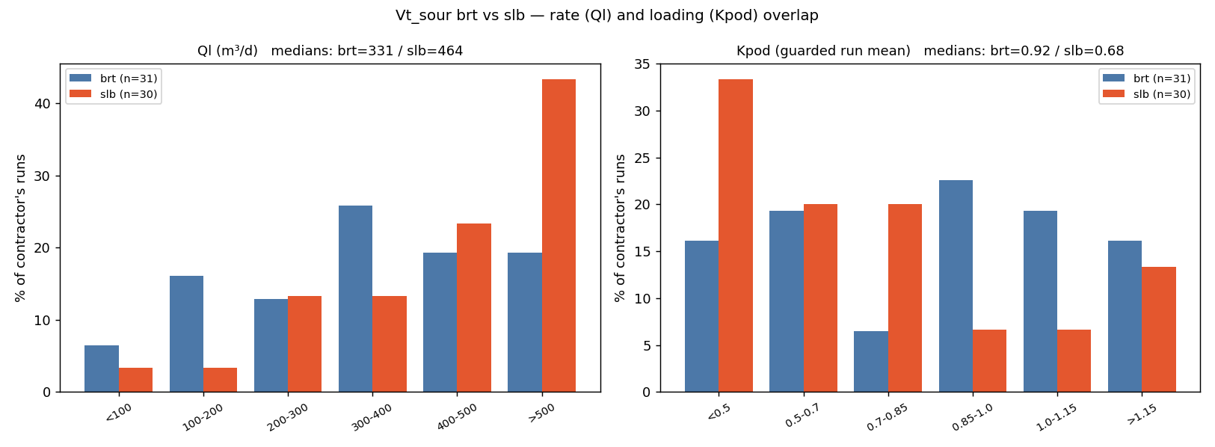
15 — brt vs slb, sour
• The same rate pattern: slb runs at higher rates (median 464 vs brt 331).
• But for sour the regime does not affect life (slide 16), so here the contractor multiplier is not a rate artefact: it reflects a real shortfall of the "other" group (life ×0.65, significant). brt ≈ slb (difference not significant).

Slide 20
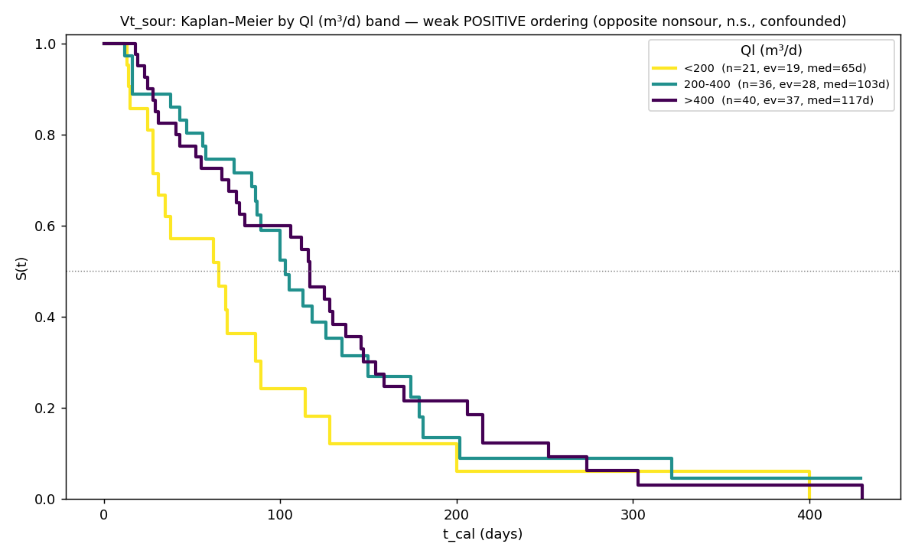
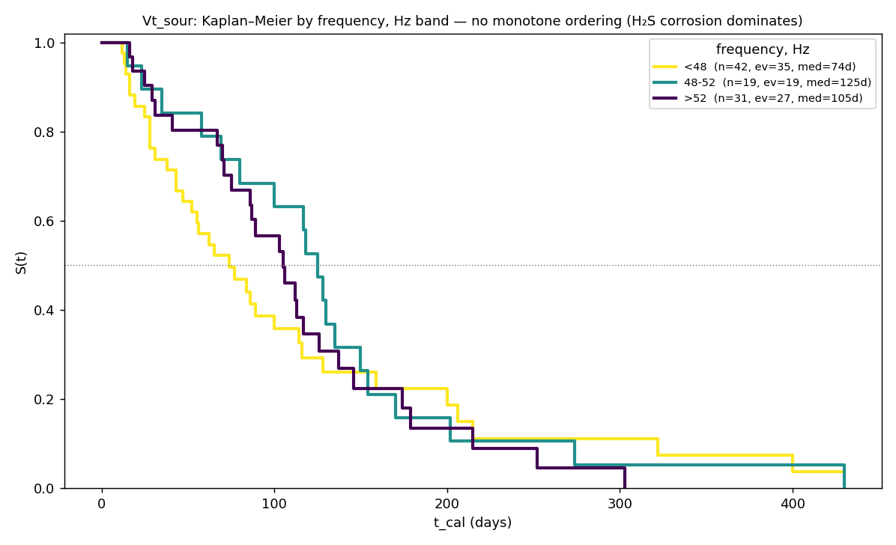
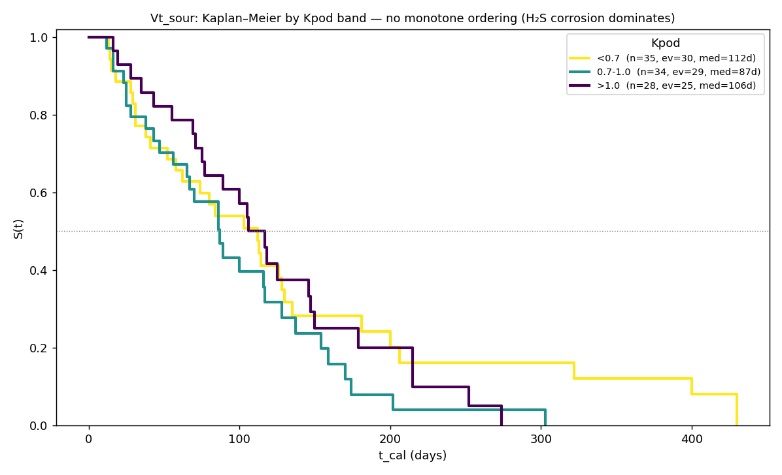
16 — Why the regime is excluded for sour
Why the regime parameters are removed from the sour formula:
• Ql: no effect, and the order is even reversed vs nonsour (low-rate sour wells die faster, 65 vs 117 d) — this is confounding (the worst wells run quietly), not a rate law.
• Frequency / Kpod: no ordering (frequency 74/125/105 d; Kpod 112/87/106 d).
• Cause: H₂S corrosion is a threshold (~120 mg/l) that overrides everything else; once a well is sour, the regime barely changes its life.
• ⇒ The sour formula = baseline life + contractor; the regime parameters are set aside (no effect).

Slide 21
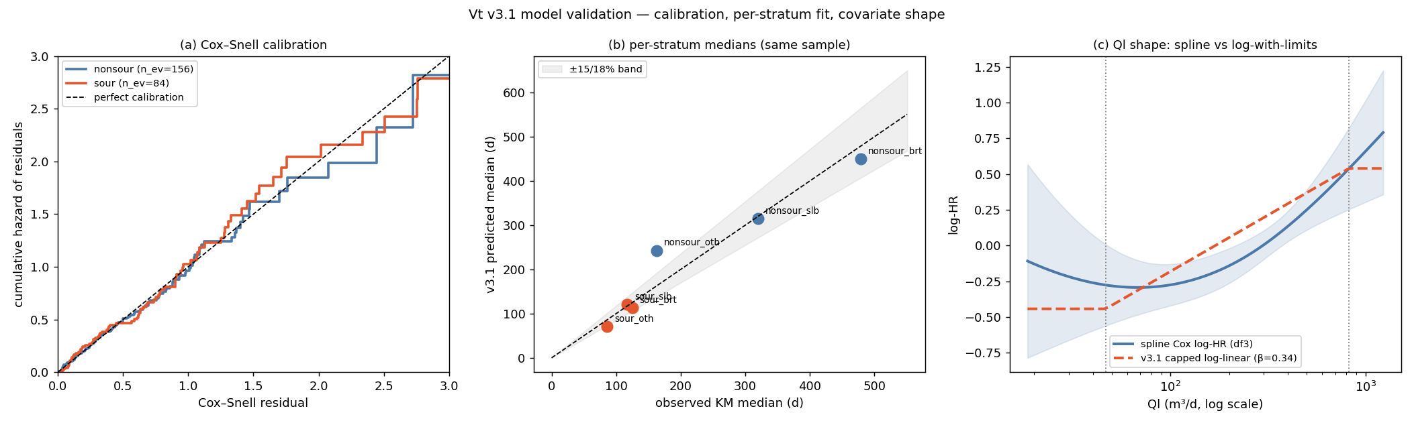
17 — Validation
• Agreement with fact: predicted median within ±10 % for 4 of 6 groups (thin "other" groups flagged); on the left figure the points fall on the diagonal.
• Another field: the rate dependence and the slb multiplier repeat on the Ya field.
• Out-of-sample: trained on installs before 2024, tested on 2024+ — the rate dependence transfers; the baseline level "drifts" ~20–30 % with install vintage (a recalibration knob, not a model error).
• Robustness: 200 recomputes on a resampled dataset — the confidence bounds cover the fact in 5 of 6 groups.

Slide 22
18 — Agent prompt: implementing the calculation (dependencies + MRL/RMST formulas)
A copy-paste prompt: how to write the calculation itself of operating life from ready-made parameters — the dependence on contractor/covariates and the four quantities (median, mean life, horizon life, remaining life). Any language; VBA and Python examples below. The model is NOT re-fit.
GOAL. Implement functions that compute ESP operating life from READY-MADE parameters (do not
re-fit). Four quantities: MEDIAN, MEAN LIFE (MRL at 0), HORIZON LIFE (RMST over tau),
REMAINING LIFE (MRL at age t). Any language (VBA/Python/…). Keep the parameters on a separate
sheet/table; the functions read them.
INPUT (sheet "Parameters", per H₂S class nonsour/sour):
beta (curve shape), eta_ref (baseline life at the reference values, days),
references X_ref: Ql_ref=250, freq_ref=50, Kpod_ref=0.70,
coefficients g (log-linear): g_Ql (per Δln Ql), g_freq (1/Hz), g_Kpod (per 1.0)
— from the row of the availability pattern (which covariates are known; DROP the missing),
contractor multipliers (brt=1, slb, oth),
applicability range (nonsour, q05–q95): Ql 47..823, freq 31..56, Kpod 0.2..1.2,
horizon tau (default 730).
STEP 1 — multiplier phi via exp-log over DEVIATIONS Δ from references (known covariates only):
clamp parameters to the applicability range (do NOT extrapolate beyond), e.g.
q = min(max(Ql, 47), 823);
s = g_Ql · (ln(q) − ln(Ql_ref)) // Ql: deviation on the LOG scale
+ g_freq · (freq − freq_ref) // DROP the term if frequency is unknown
+ g_Kpod · (Kpod − Kpod_ref) // DROP if Kpod is unknown
phi = contractor_multiplier · exp(s)
eta = eta_ref · phi
STEP 2 — quantities from (eta, beta). Survival curve S(t)=exp(−(t/eta)^beta):
MEDIAN = eta · ln(2)^(1/beta)
MEAN LIFE MRL(0) = eta · Γ(1 + 1/beta)
HORIZON LIFE = eta · Γ(1 + 1/beta) · P(1/beta, (tau/eta)^beta) // = RMST(0,tau)
REMAINING LIFE(t) = eta · Γ(1 + 1/beta) · Q(1/beta, (t/eta)^beta) / exp(−(t/eta)^beta)
where Γ is the gamma function; P(s,x) is the regularized LOWER incomplete gamma; Q(s,x)=1−P(s,x).
SPECIAL FUNCTIONS (the only nontrivial part) — how to get them:
Γ(z): Python math.gamma(z)
VBA Exp(WorksheetFunction.GammaLn(z))
P(s,x): Python scipy.special.gammainc(s, x) // already the regularized lower one
VBA WorksheetFunction.Gamma_Dist(x, s, 1, True) // = P(s,x)
no library: lower incomplete gamma(s,x) by series gamma(s,x)=x^s·e^−x·Σ_{k≥0} x^k/(s·(s+1)…(s+k)),
then P = gamma(s,x)/Γ(s); converges fast for x≲s+1 (else via Q).
Q(s,x) = 1 − P(s,x)
CHECK VALUES (nonsour/slb, Ql=400, freq=52, Kpod=0.90, pattern "all three":
beta=1.28, eta_ref=570, references 250/50/0.70, g = −0.130/−0.0142/−0.729, slb=0.728):
Δ: ln(400/250)=+0.470, freq +2, Kpod +0.20; s=−0.235; exp(s)=0.790; phi=0.576; eta=328
→ MEDIAN 247, MEAN LIFE 304, HORIZON LIFE over 730 d = 292.
Fallback "Ql only" (beta=1.15, eta_ref=571, ref 250, g_Ql=−0.305, slb=0.792):
phi = 0.792·exp(−0.305·ln(400/250)) = 0.686, eta=392 → 285 / 373 / 335.
NOTES. Median and mean life scale linearly with phi; horizon life scales sub-linearly (tau
fixed). Report "horizon life" as primary, the median for reference. For sour the regime
coefficients g = 0 (contractor only).
▍ This is a calculation spec (not a re-fit). It is also the basis of a separate task: an Excel workbook with the parameters on a sheet and functions TTF_Median / TTF_Mean / TTF_RMST / TTF_MRL.

