Slide 1
Effect of ESP operating regime on failure rate. Analysis for Vt
ESP operating-life model · dependence on regime and contractor · v3.1

Slide 2
Glossary
• TTF — time to failure / operating life: how long a pump runs before it fails (days).
• Median — the age by which half the pumps have failed.
• Full mean life (in statistics MRL — Mean Residual Life) — the mean time to failure in full, including the whole tail.
• Mean life over a horizon (in statistics RMST — Restricted Mean Survival Time) — how long a pump works on average over a fixed near-term window (e.g. 730 days), without looking into the far tail.
• Ql — liquid rate; Kpod — pump loading (fraction of nominal); GLF — gas-liquid factor.
• Contractors: brt / slb / other (oth).

Slide 3
1 — Conclusions
• Question: how does pump operating life (TTF) on the Vt field depend on the operating regime — liquid rate (Ql), frequency, loading (Kpod), gas (GLF) — and what formula should the life forecast use?
• Data: empirical survival curves across 6 groups (H₂S class: sour / nonsour × contractor brt / slb / other). ~530 nonsour + ~136 sour runs in total.
• Headline:
– Liquid rate is the only operating factor that matters for nonsour: higher rate — shorter life. Frequency and Kpod reflect the same rate (pump affinity law).
– Sour wells are a separate world: ~3–4× shorter life, and the regime does not affect it — H₂S corrosion drives everything.
– Gas (GLF) — no effect, excluded.
– The 2× brt/slb difference is mostly rate (slb runs at higher rates); a small unexplained residual reproduces on another field — kept as an empirical adjustment.

Slide 4
Part I. Results: model, parameters and calculation

Slide 5
2 — Final life-forecast formula
Meaning: a group baseline life, adjusted for rate and for the contractor. The model is log-linear: life is multiplied by exp(coefficient × Δ), where Δ is the parameter's deviation from its reference value (for rate — on the log scale).
Life(well) = η_ref · contractor_mult · exp( γ · Δ ), Δ = ln( clip(Ql, 47, 823) ) − ln(250)
clip = winsorize Ql to the bounds 47–823: below 47 or above 823 the adjustment is
held at the boundary and grows no further (no extrapolation)
class | curve shape β | characteristic life η_ref, d | Ql_ref | Ql bounds | coefficient γ (per Δln Ql) | brt | slb | other
nonsour | 1.15 | 571 | 250 | 47–823 | −0.305 | ×1.00 | ×0.79 | ×0.54
sour | 1.37 | 149 | 346 | 73–779 | ≈0 (no effect) | ×1.00 | ×1.05 | ×0.65
brt is the reference contractor, its multiplier = 1.00 (the others are relative to brt).
• Reference value — the point where the adjustment = 1 (exp(0)=1); η_ref is the baseline life at Ql = reference and contractor brt. exp(γ·Δ) is equivalent to (Ql/ref)^γ.
• Curve shape β ≈ 1 means: failure risk hardly grows with age (not "wear-out").
• Relationships are observational (not an experiment). For sour the rate coefficient ≈0 → in practice life = η_ref · contractor multiplier (converted to the median).

Slide 6
3 — Coefficients: all three parameters (log-linear model)
Life is multiplied by exp(γ · Δ), where Δ is the parameter's deviation from its reference value (for rate — on the log scale). Coefficients γ (nonsour, from the data; significant in bold):
known | γ Ql (per Δln Ql) | γ frequency (1/Hz) | γ Kpod (per 1.0) | case
Ql + frequency + Kpod | −0.130 | −0.0142 | −0.729 | all three (split)
Ql + Kpod | −0.191 | — | −0.597 | two parameters
Ql + frequency | −0.190 | −0.0161 | — | two parameters
frequency + Kpod | — | −0.0171 | −0.812 | two parameters
Ql only | −0.240 | — | — | one (fallback)
frequency only | — | −0.0222 | — | one (fallback)
Kpod only | — | — | −0.729 | one (fallback)
Reference values (where all adjustments = 1): Ql 250 m³/d, frequency 50 Hz, Kpod 0.70; baseline life η_ref = 570 d (brt). Contractor: brt = 1.00 (reference), slb ≈0.73, other ≈0.64. Applicability range (q05–q95, do not extrapolate beyond): Ql 47–823, frequency 31–56 Hz, Kpod 0.2–1.2.
Life = η_ref · contractor · exp( γ_Ql·(ln clip(Ql,47,823) − ln 250) + γ_freq·(freq − 50) + γ_Kpod·(Kpod − 0.70) )
How to apply — for each known parameter compute exp(γ · Δ):
• frequency 55 Hz = +5 from 50 → exp(−0.0142·5) = ×0.93 (−7 %);
• Kpod 0.90 = +0.20 from 0.70 → exp(−0.729·0.20) = ×0.86;
• Ql 400 vs 250 → exp(−0.130·ln(400/250)) = ×0.94.
Then multiply the adjustments of the known parameters × contractor × η_ref (drop missing ones, do not impute). For sour all γ ≈ 0 → contractor only. Median / life — slide 5.

Slide 7
4 — Worked example
Well W: nonsour, contractor slb, Ql 400 m³/d, frequency 52 Hz, Kpod 0.90. All three known → the "all three" set (β=1.28, η_ref=570; references 250 m³/d / 50 Hz / 0.70):
Δ Ql = ln(400/250) = +0.470 → contribution = −0.130·0.470 = −0.061 (400 within 47–823)
Δ frequency = 52 − 50 = +2 Hz → contribution = −0.0142·2 = −0.028
Δ Kpod = 0.90 − 0.70 = +0.20 → contribution = −0.729·0.20 = −0.146
sum of contributions = −0.235 → exp(−0.235) = 0.790
contractor multiplier (slb) = 0.728
characteristic life η = 570 · 0.790 · 0.728 = 328 d
quantity | what it is | value
Median | half the pumps have failed by this age | 247 d
Full mean life (MRL) | mean time to failure in full | 304 d
Mean life over 2 years (RMST, 730 d) | how long it runs on average over the next 730 d | 292 d
If only Ql is known → the baseline formula (β=1.15, η_ref=571, Ql reference 250): multiplier 0.79 · exp(−0.305·ln(400/250)) = 0.686, η=392 → Median 285 / mean life 373 / 2-year life 335 d. (Fewer parameters used — a more conservative estimate, so the life comes out longer.)
▍ This calculation ports 1:1 to Excel: the parameters (η, β, references, adjustments, contractor) on a separate sheet, functions compute the four quantities. (The Excel workbook is a separate task.)

Slide 8
5 — Which quantity to report as TTF
The same forecast can be expressed three ways:
• Median — the age by which half the pumps have failed. Simple, but only speaks to the "middle" and ignores the spread.
• Full mean life (MRL) — the mean time to failure in full. An honest mean, but it partly relies on the far "tail", which the data observe only weakly.
• Mean life over a horizon (RMST over 730 d) — how long a pump runs on average over the next 2 years. It invents nothing beyond the data and is always computable.
Recommendation: report "mean life over 2 years" (RMST) as the primary quantity, with "full mean life" beside it, and the median for reference only. Values by group:
class | contractor | multiplier | Median, d | Full mean life, d | 2-year life, d
nonsour | brt | 1.00 | 415 | 544 | 424
nonsour | slb | 0.79 | 329 | 431 | 369
nonsour | other | 0.54 | 224 | 294 | 278
sour | brt | 1.00 | 114 | 136 | 136
sour | slb | 1.05 | 119 | 143 | 143
sour | other | 0.65 | 74 | 88 | 88
▍ For nonsour "full mean life" is noticeably larger than "2-year life" — because some pumps live longer than 2 years (long tail). For sour the lives are short, both quantities coincide. The remaining life of a running pump is measured from its current age.

Slide 9
6 — Limitations (what to keep in mind)
• Ql sets the overall trend, but it predicts the life of a single pump weakly — the model is good for planning by group / fleet, not for the exact date of one pump.
• The contractor multiplier is observational; the cause is only partly understood (about a third of the difference is runs cut short by planned workovers (GTM), not failures).
• All relationships are observational, not from an experiment.
• Frequency and Kpod are not in the TM-06 plan — shown for understanding; the forecast is computed from Ql.
• For sour the regime has no effect — do not add regime adjustments without new H₂S data.
• Deprecated: the previously deployed "penalty for high Kpod loading" is not supported by this analysis (see slide 12).

Slide 10
Part II. Analysis — model justification

Slide 11
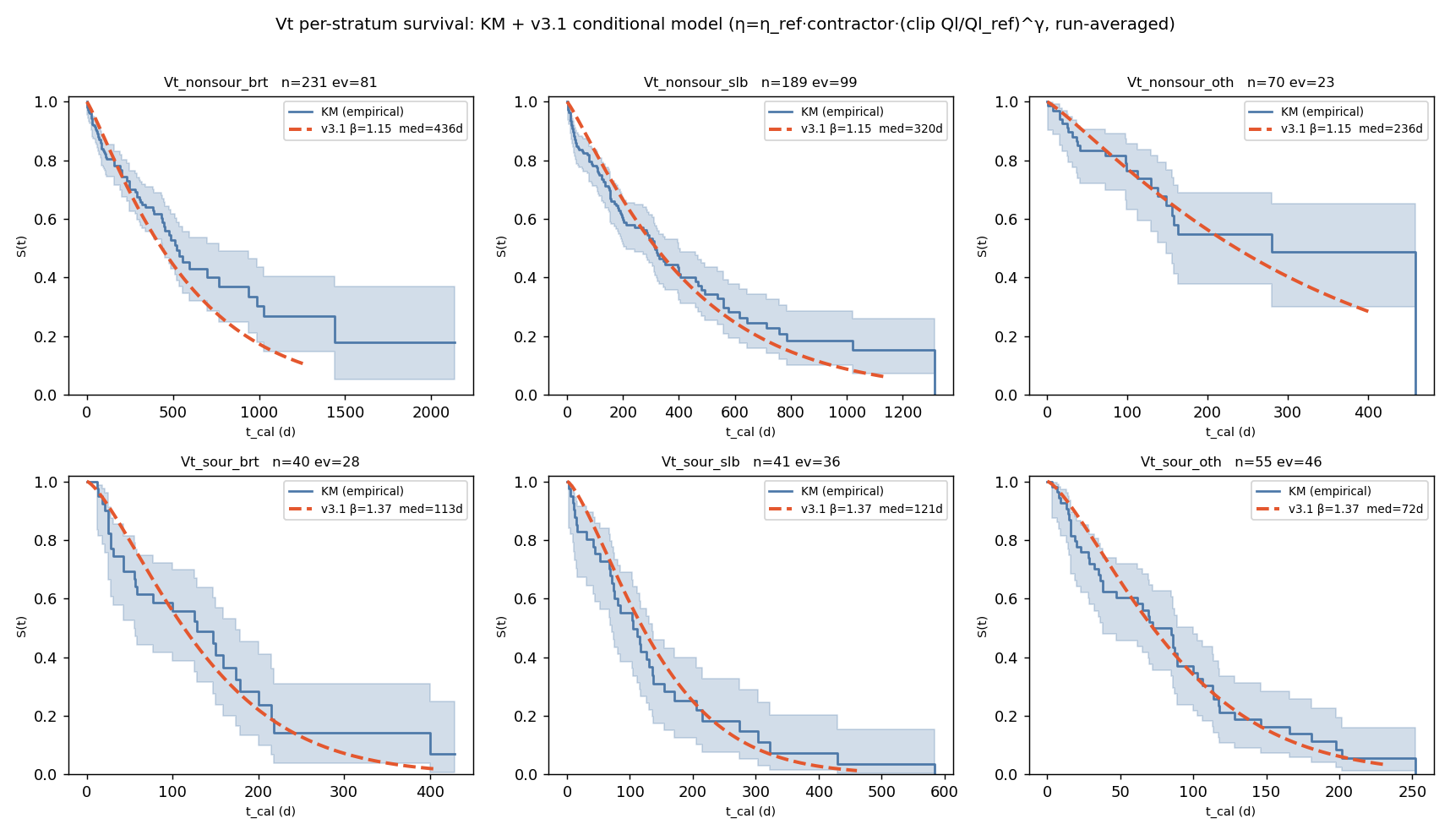
7 — Groups and overall picture
Empirical survival curves (share of running pumps over time, from the data) across the 6 groups + the fitted model overlay:
group | runs | failures | shape β | model median, d
Vt_nonsour_brt | 231 | 81 | 1.15 | 436
Vt_nonsour_slb | 189 | 99 | 1.15 | 320
Vt_nonsour_other | 70 | 23 | 1.15 | 236
Vt_sour_brt | 40 | 28 | 1.37 | 113
Vt_sour_slb | 41 | 36 | 1.37 | 121
Vt_sour_other | 55 | 46 | 1.37 | 72
▍ The model sits inside the confidence band of each group. Full parameters (characteristic life, reference Ql, bounds, adjustments, fallbacks) — slides 2–3.

Slide 12
8 — Nonsour wells: life and model
(top row of the figure, slide 7)
• Nonsour lives long and is rate-driven: model median 436 / 320 / 236 d (brt / slb / other); shape β ≈ 1.15 — failure risk hardly grows with age.
• The model (Ql + contractor) reproduces each contractor's empirical curve.
• The brt↔slb difference is mostly a rate difference (discussed on slide 14).

Slide 13
9 — Sour wells: life and model
(bottom row of the figure, slide 7)
• Life is ~3–4× shorter than nonsour: median 113 / 121 / 72 d (brt / slb / other).
• Shape β ≈ 1.37 — mild wear from day one (the nonsour curve is flatter).
• The order other < brt ≈ slb is set by H₂S corrosion; the regime does not affect life, so for sour the model = baseline life · contractor multiplier (slides 2, 16).

Slide 14
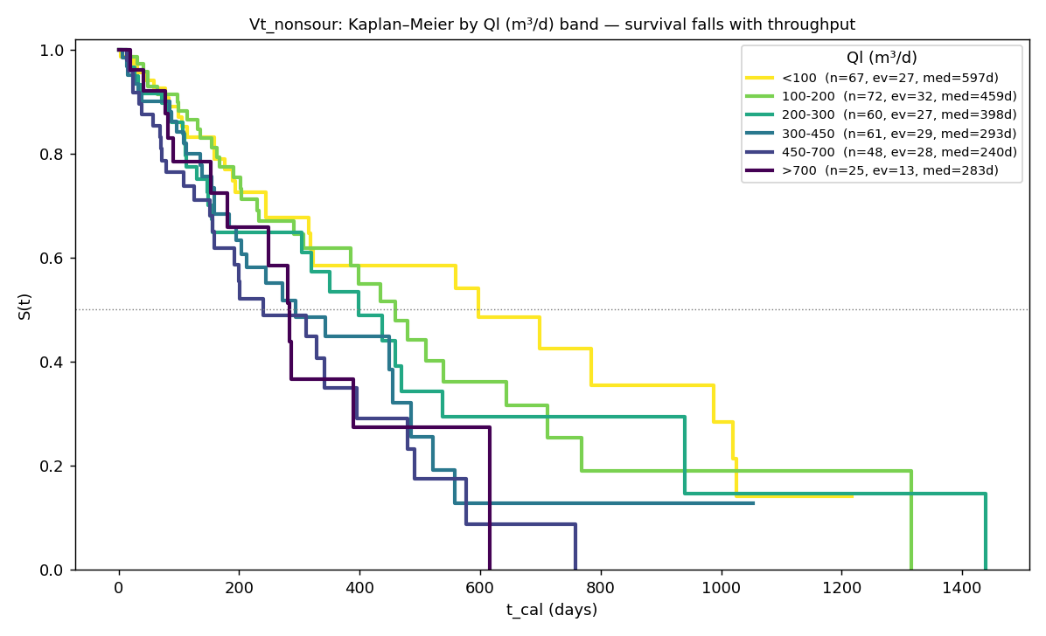
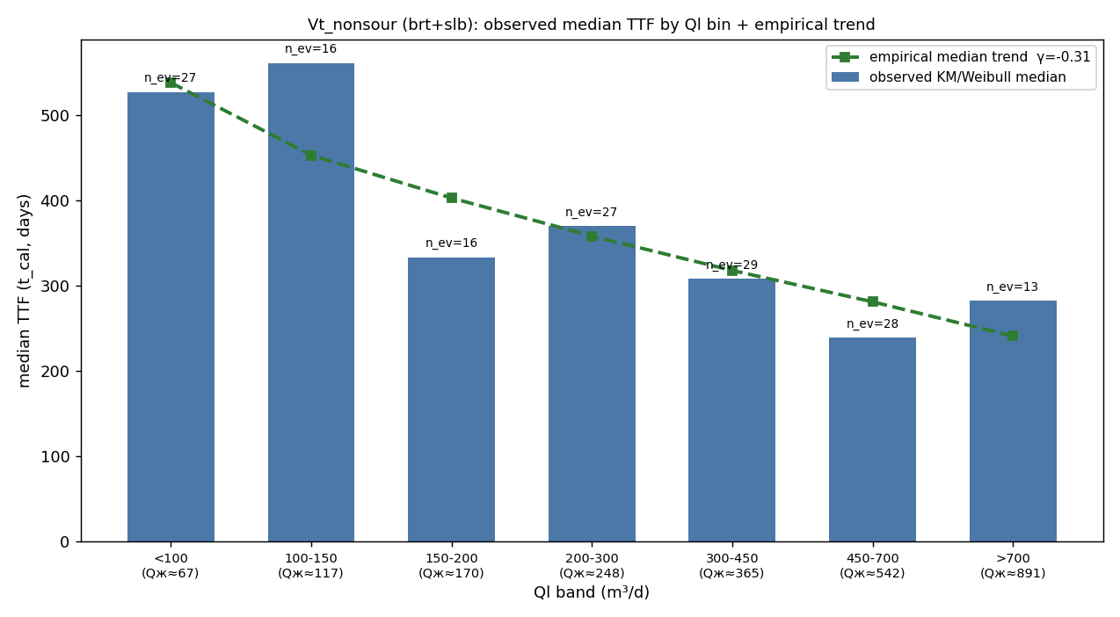
10 — The main factor: liquid rate
• Life steadily decreases with rising Ql (the higher the Ql band, the lower the curve).
• The shape was chosen from the data: log of Ql with the extreme 5% clipped top and bottom (beyond the working bounds the adjustment is not increased).
• The Ql effect is statistically significant (p<0.001): life ×0.74 for a ~2.7× rise in Ql.
• Reproduces on another field (Ya) — the same effect, so the relationship is not by chance.

Slide 15
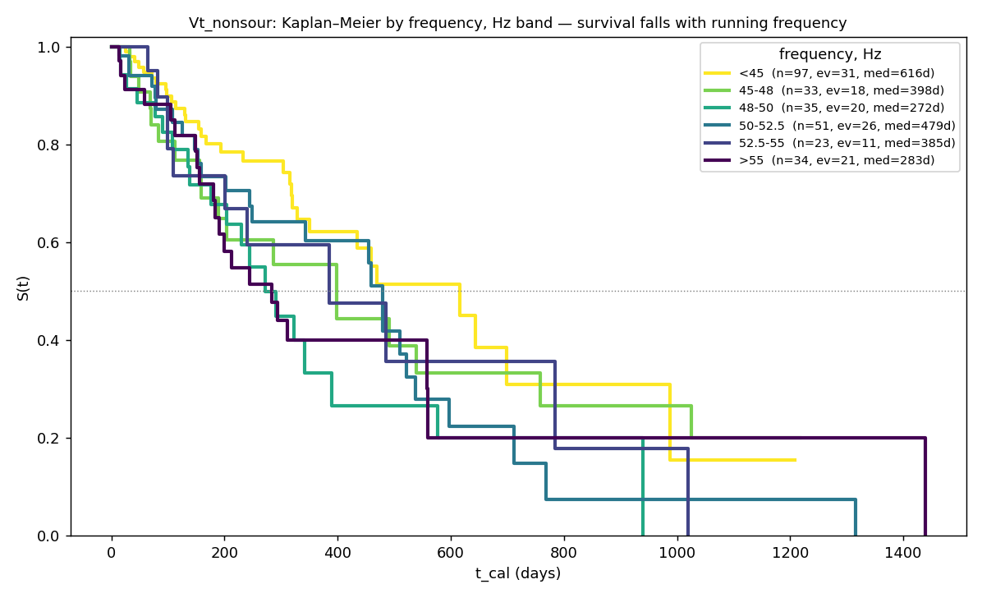
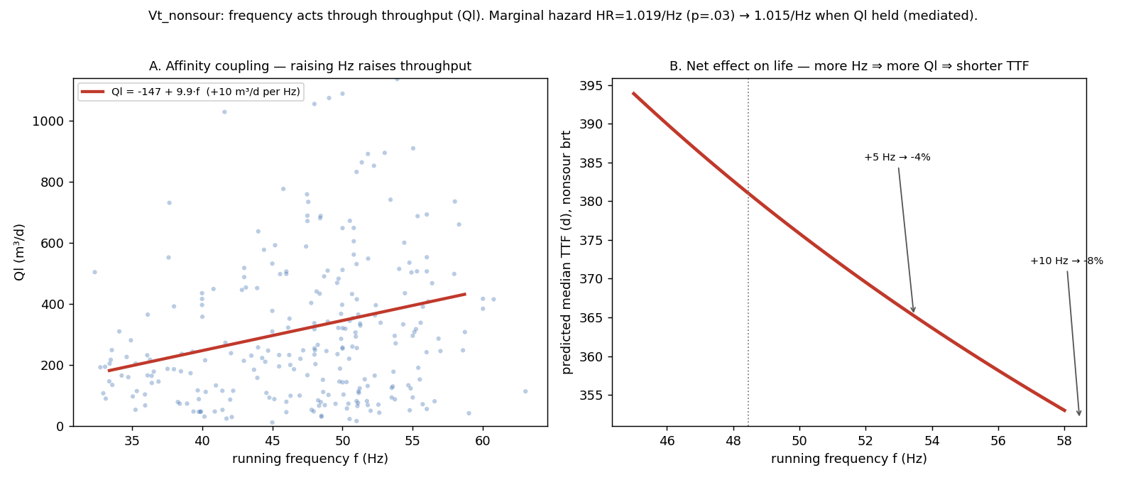
11 — Frequency: the same physics through rate
• Raising frequency raises rate (affinity law): roughly +10 m³/d per Hz.
• Frequency is the clearest single signal: failure risk +1.9% per Hz (significant), but with Ql held fixed the effect nearly vanishes — frequency acts precisely through rate.
• Net along the frequency→rate chain: +5 Hz ≈ −4 %, +10 Hz ≈ −8 % of life.
• For deployment: frequency and Kpod are not in the TM-06 plan, so the forecast is computed from Ql — frequency/Kpod are the same physics, shown for understanding.

Slide 16
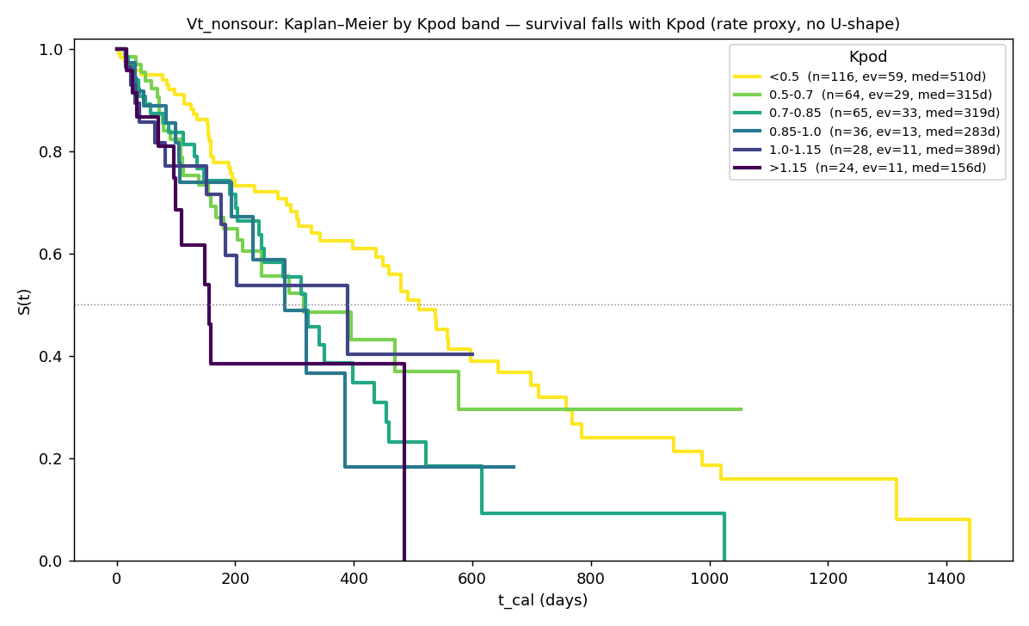
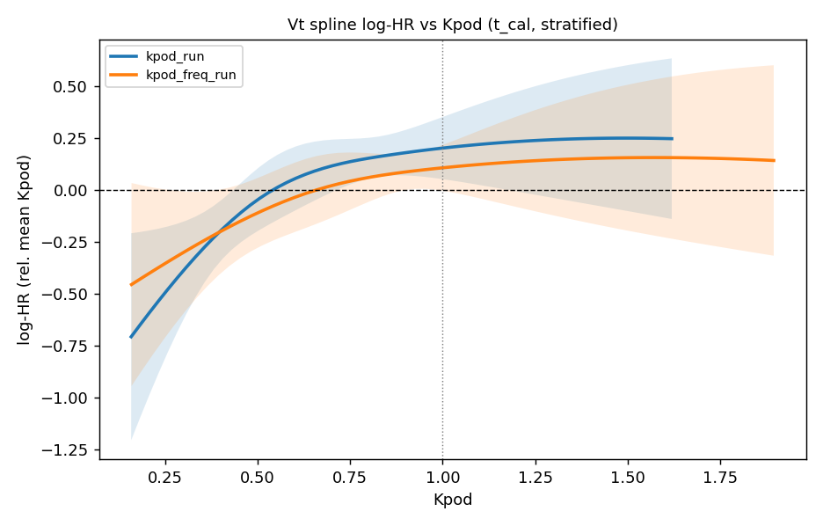
12 — Loading (Kpod): checking the "safe zone"
Is there a "safe zone" at nominal (the previously deployed high-loading penalty)? — No.
• The flexible risk curve (right figure) shows: no protective valley at nominal.
• Risk rises monotonically with loading across the whole working range; the minimum is at the low edge.
• Direct check: low loading is not harmful (robust to how it is counted).
• ⇒ A penalty for exceeding nominal is not justified; loading is the same rate, in other words.

Slide 17
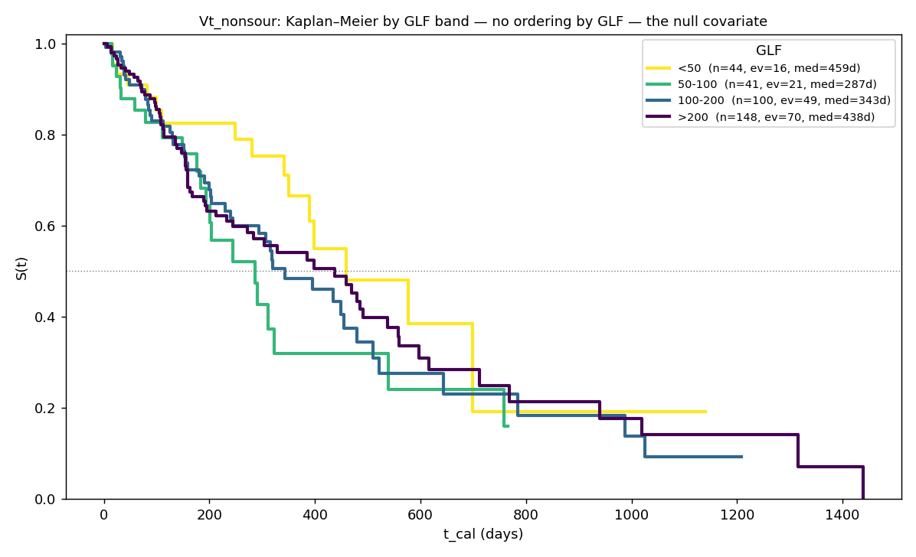
13 — Gas (GLF): no effect — excluded
• Survival curves by GLF band cross — no ordering (medians 459 / 287 / 343 / 438 d mixed up), unlike the clear ordering by Ql (slide 10).
• No effect on either risk or life (not significant).
• Free-gas rate is also not significant (a single spike in one group does not repeat).
• Why excluded: no signal, and gas rate is also confounded with well productivity. Vt is the gassiest field, so this is an honest zero, not a lack of data.

Slide 18
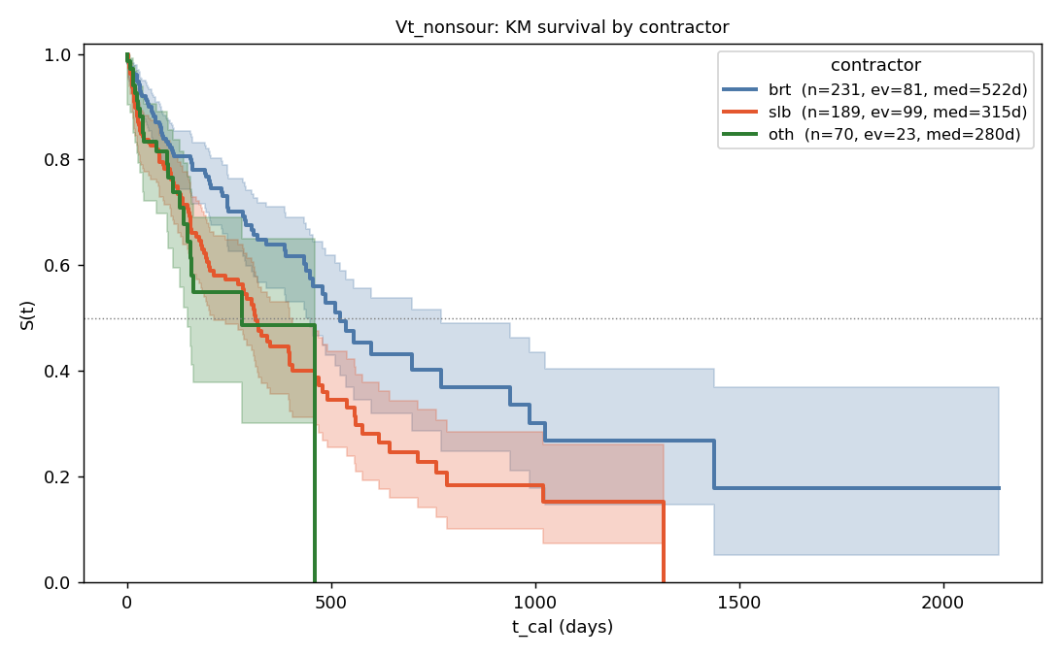
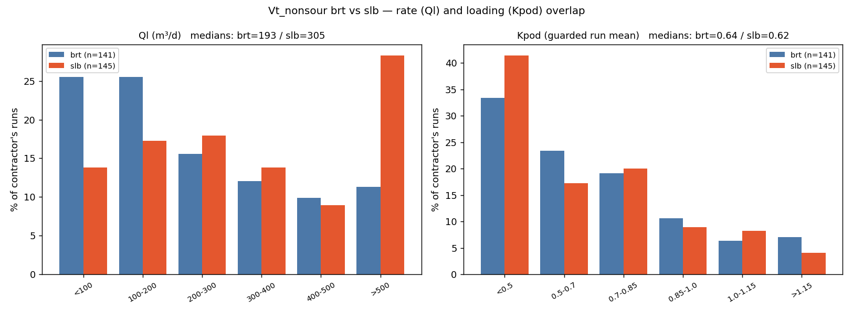
14 — brt vs slb, nonsour — the "lesson" explained
Parameters by contractor (a separate Weibull fit per stratum, no adjustments):
contractor | runs | failures | shape β | char. life η, d | median, d | mean, d
brt | 231 | 81 | 0.82 | 897 | 573 | 1001
slb | 189 | 99 | 0.81 | 482 | 306 | 542
other | 70 | 23 | 0.87 | 429 | 282 | 460
These are raw per-stratum fits; β<1 reflects the spread between wells, not wear-out. In the final model (slide 2) the contractor is a multiplier on a common baseline, and the shape is β≈1.15.
Empirical survival curves by contractor (the raw picture — brt clearly above slb):
• At first glance — a 2× contractor advantage (median brt 573 vs slb 306 d), but slb runs at noticeably higher rates: median 305 vs 193 m³/d (the ranges overlap, they are not just different).
• Match the rate (range 193–305): the gap disappears — brt 403 d vs slb 440 d. So the 2× is mostly rate.
• A small residual (slb ×0.79) persists and repeats on another field (Ya) — i.e. it is real. If we account for runs cut short by planned GTM (not failures), about a third of the residual is explained by this; the rest is unattributed (make/service).
• Verdict: the contractor is kept as an observational adjustment, the cause marked "not established".

Slide 19
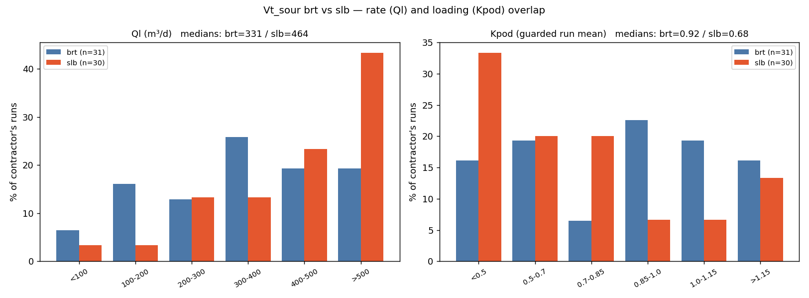
15 — brt vs slb, sour
• The same rate pattern: slb runs at higher rates (median 464 vs brt 331).
• But for sour the regime does not affect life (slide 16), so here the contractor multiplier is not a rate artefact: it reflects a real shortfall of the "other" group (life ×0.65, significant). brt ≈ slb (difference not significant).

Slide 20
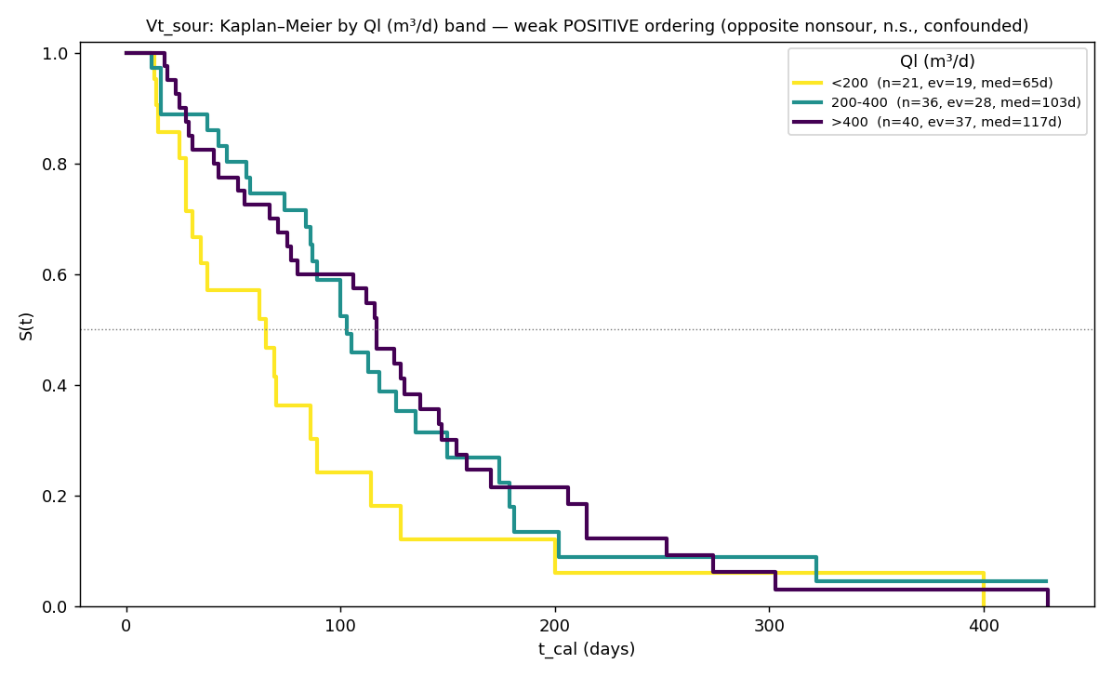
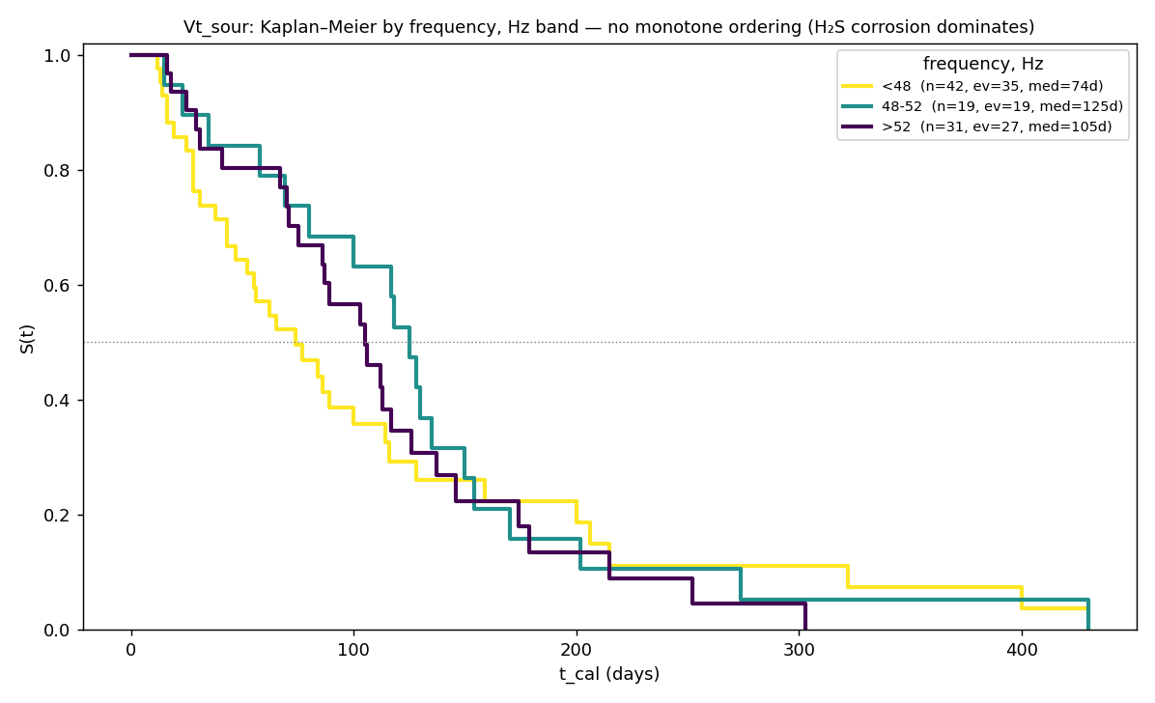
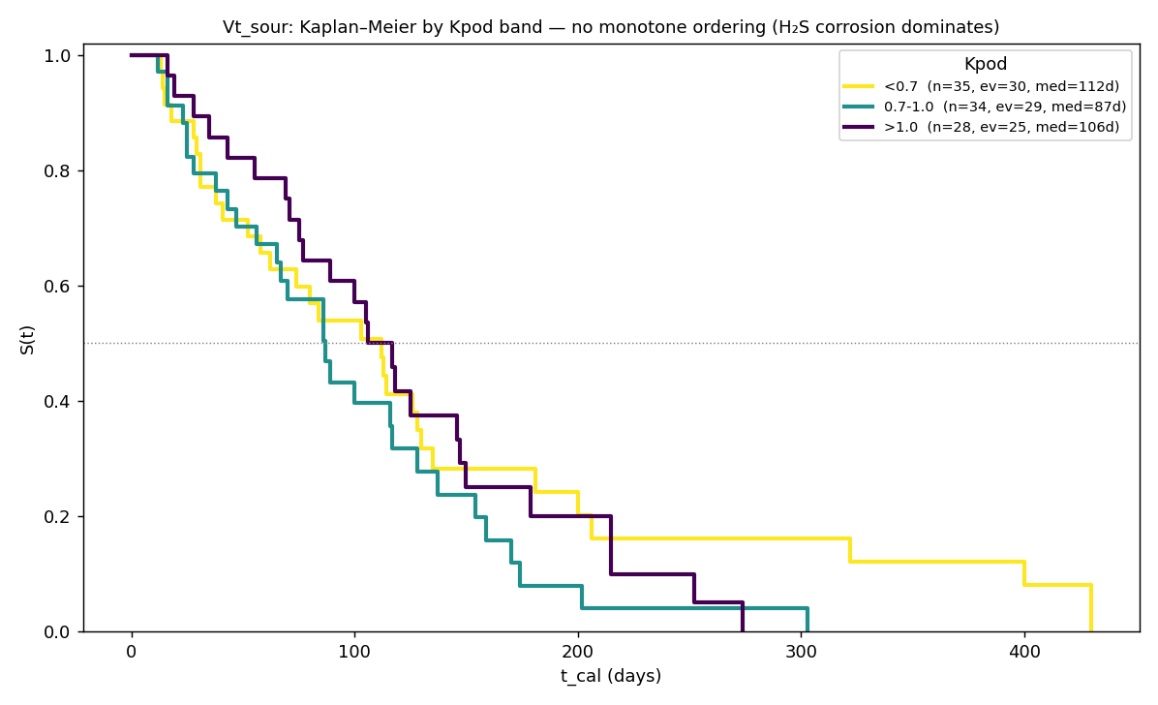
16 — Why the regime is excluded for sour
Why the regime parameters are removed from the sour formula:
• Ql: no effect, and the order is even reversed vs nonsour (low-rate sour wells die faster, 65 vs 117 d) — this is confounding (the worst wells run quietly), not a rate law.
• Frequency / Kpod: no ordering (frequency 74/125/105 d; Kpod 112/87/106 d).
• Cause: H₂S corrosion is a threshold (~120 mg/l) that overrides everything else; once a well is sour, the regime barely changes its life.
• ⇒ The sour formula = baseline life + contractor; the regime parameters are set aside (no effect).

Slide 21
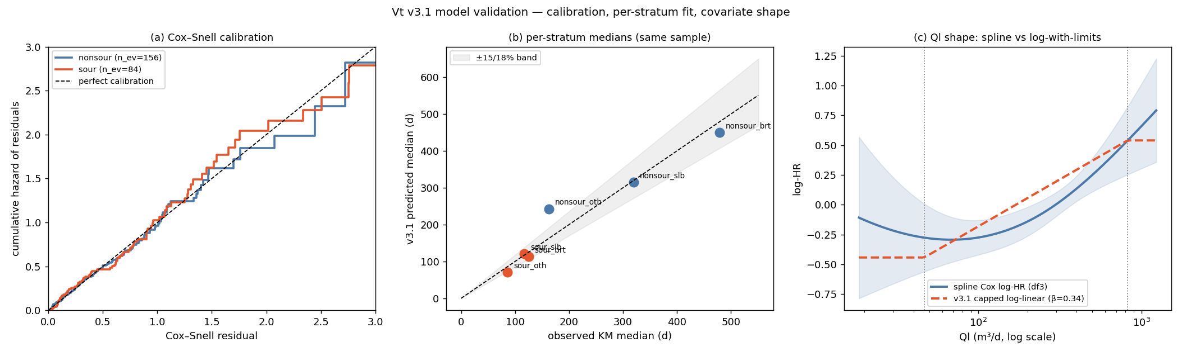
17 — Validation
• Agreement with fact: predicted median within ±10 % for 4 of 6 groups (thin "other" groups flagged); on the left figure the points fall on the diagonal.
• Another field: the rate dependence and the slb multiplier repeat on the Ya field.
• Out-of-sample: trained on installs before 2024, tested on 2024+ — the rate dependence transfers; the baseline level "drifts" ~20–30 % with install vintage (a recalibration knob, not a model error).
• Robustness: 200 recomputes on a resampled dataset — the confidence bounds cover the fact in 5 of 6 groups.

Slide 22
Appendix — files and tables
• Equation: TTF_ADJUSTMENT_EQUATION.md (parameters, survival curve, computation of median / mean life / horizon life + table).
• Full reports: docs/notes/vt_ttf_operating_covariates_findings.md (EN) / _ru.md (RU).
• Key tables: revised_operating_model_v2.csv, availability_life_multipliers.csv, model_consistency_checks.csv, replicate_v31_on_ya.csv, temporal_holdout_validation.csv, bootstrap_model_cis.csv, informative_censoring_test.csv, contractor_rate_matched_cohorts.csv, kpod_quadratic_cox.csv / kpod_spline_meta.csv / kpod_risk_min.csv.

Slide 23
18 — Agent prompt: implementing the calculation (dependencies + MRL/RMST formulas)
A copy-paste prompt: how to write the calculation itself of operating life from ready-made parameters — the dependence on contractor/covariates and the four quantities (median, mean life, horizon life, remaining life). Any language; VBA and Python examples below. The model is NOT re-fit.
GOAL. Implement functions that compute ESP operating life from READY-MADE parameters (do not
re-fit). Four quantities: MEDIAN, MEAN LIFE (MRL at 0), HORIZON LIFE (RMST over tau),
REMAINING LIFE (MRL at age t). Any language (VBA/Python/…). Keep the parameters on a separate
sheet/table; the functions read them.
INPUT (sheet "Parameters", per H₂S class nonsour/sour):
beta (curve shape), eta_ref (baseline life at the reference values, days),
references X_ref: Ql_ref=250, freq_ref=50, Kpod_ref=0.70,
coefficients g (log-linear): g_Ql (per Δln Ql), g_freq (1/Hz), g_Kpod (per 1.0)
— from the row of the availability pattern (which covariates are known; DROP the missing),
contractor multipliers (brt=1, slb, oth),
applicability range (nonsour, q05–q95): Ql 47..823, freq 31..56, Kpod 0.2..1.2,
horizon tau (default 730).
STEP 1 — multiplier phi via exp-log over DEVIATIONS Δ from references (known covariates only):
clamp parameters to the applicability range (do NOT extrapolate beyond), e.g.
q = min(max(Ql, 47), 823);
s = g_Ql · (ln(q) − ln(Ql_ref)) // Ql: deviation on the LOG scale
+ g_freq · (freq − freq_ref) // DROP the term if frequency is unknown
+ g_Kpod · (Kpod − Kpod_ref) // DROP if Kpod is unknown
phi = contractor_multiplier · exp(s)
eta = eta_ref · phi
STEP 2 — quantities from (eta, beta). Survival curve S(t)=exp(−(t/eta)^beta):
MEDIAN = eta · ln(2)^(1/beta)
MEAN LIFE MRL(0) = eta · Γ(1 + 1/beta)
HORIZON LIFE = eta · Γ(1 + 1/beta) · P(1/beta, (tau/eta)^beta) // = RMST(0,tau)
REMAINING LIFE(t) = eta · Γ(1 + 1/beta) · Q(1/beta, (t/eta)^beta) / exp(−(t/eta)^beta)
where Γ is the gamma function; P(s,x) is the regularized LOWER incomplete gamma; Q(s,x)=1−P(s,x).
SPECIAL FUNCTIONS (the only nontrivial part) — how to get them:
Γ(z): Python math.gamma(z)
VBA Exp(WorksheetFunction.GammaLn(z))
P(s,x): Python scipy.special.gammainc(s, x) // already the regularized lower one
VBA WorksheetFunction.Gamma_Dist(x, s, 1, True) // = P(s,x)
no library: lower incomplete gamma(s,x) by series gamma(s,x)=x^s·e^−x·Σ_{k≥0} x^k/(s·(s+1)…(s+k)),
then P = gamma(s,x)/Γ(s); converges fast for x≲s+1 (else via Q).
Q(s,x) = 1 − P(s,x)
CHECK VALUES (nonsour/slb, Ql=400, freq=52, Kpod=0.90, pattern "all three":
beta=1.28, eta_ref=570, references 250/50/0.70, g = −0.130/−0.0142/−0.729, slb=0.728):
Δ: ln(400/250)=+0.470, freq +2, Kpod +0.20; s=−0.235; exp(s)=0.790; phi=0.576; eta=328
→ MEDIAN 247, MEAN LIFE 304, HORIZON LIFE over 730 d = 292.
Fallback "Ql only" (beta=1.15, eta_ref=571, ref 250, g_Ql=−0.305, slb=0.792):
phi = 0.792·exp(−0.305·ln(400/250)) = 0.686, eta=392 → 285 / 373 / 335.
NOTES. Median and mean life scale linearly with phi; horizon life scales sub-linearly (tau
fixed). Report "horizon life" as primary, the median for reference. For sour the regime
coefficients g = 0 (contractor only).
▍ This is a calculation spec (not a re-fit). It is also the basis of a separate task: an Excel workbook with the parameters on a sheet and functions TTF_Median / TTF_Mean / TTF_RMST / TTF_MRL.

