Slide 1
TamuBot — Problem Statement
Choosing Courses Takes Time
• Searching for, reading, and understanding each syllabus is slow
• Comparing courses to find the best personal fit takes effort
• Easy to miss good courses you didn't know to look for
Planning Around Constraints
• Fitting courses to your specific program requirements
• Aligning class schedules across multiple courses
• Tracking prerequisites and registration windows term-to-term
Advisor Time Is Limited
• Advisors are a great resource, but appointments are short and scheduled
• Students get more out of meetings when they come prepared
• Self-research is the bottleneck before that conversation can start
AI Without Grounding Falls Short
• LLMs make broad knowledge easy to access
• Generic LLM answers are often not grounded in real documents
• Hallucinations make answers unreliable for high-stakes decisions
• Students need answers tied to actual TAMU syllabi they can verify
Texas A&M graduate course/policy assistant — RAG-grounded, citation-first

Slide 2
TamuBot — Current Status
RAG Pipeline (live)
• 3-stage LangGraph: Router → Retrieval → Generator
• Gemini 2.5 Flash for routing, generation, PDF parsing
• Hybrid retrieval: vector + BM25 (RRF) + Voyage rerank-2
• 8-function routing matrix (metadata/hybrid/semantic/compare)
• Recursive discovery: from an anchor course, find related ones
• Conversation memory via mem0 + SQLite checkpoints
Data & Ingestion (7-step pipeline)
• 1. Scrape — Howdy Portal + Simple Syllabus PDFs
• 2. Convert — Docling parses PDFs to markdown
• 3. Strip boilerplate — repeated headers/footers/policies
• 4. Normalize hierarchy — headings, sections, lists
• 5. Recover images & tables — Gemini multimodal
• 6. Validate — LLM + false-positive (bronze→silver→gold)
• 7. Chunk & embed — Voyage voyage-3 → MongoDB Atlas
Frontend & Ops
• Streamlit chat UI w/ hot-reload for RAG modules
• Citation on every factual claim, linked to its source
• Inline links to the syllabus for each cited course
• Course comparison: tables with per-cell citations
• Docker + API proxy: TAMU/Voyage per-session budgets
Observability & Eval
• Langfuse per-node traces: cost, latency, tokens, errors
• Drill into any graph node for troubleshooting
• RAGAS answer quality: Faithfulness + Answer Relevancy
• RAGAS retrieval quality: Context Precision + Recall
• Golden-set benchmarks + chunking-eval harness
• pytest + mypy + ruff in CI loop
Branch: main • Recent: course comparison revamp, Docling v4, image_recovery filter

Slide 3
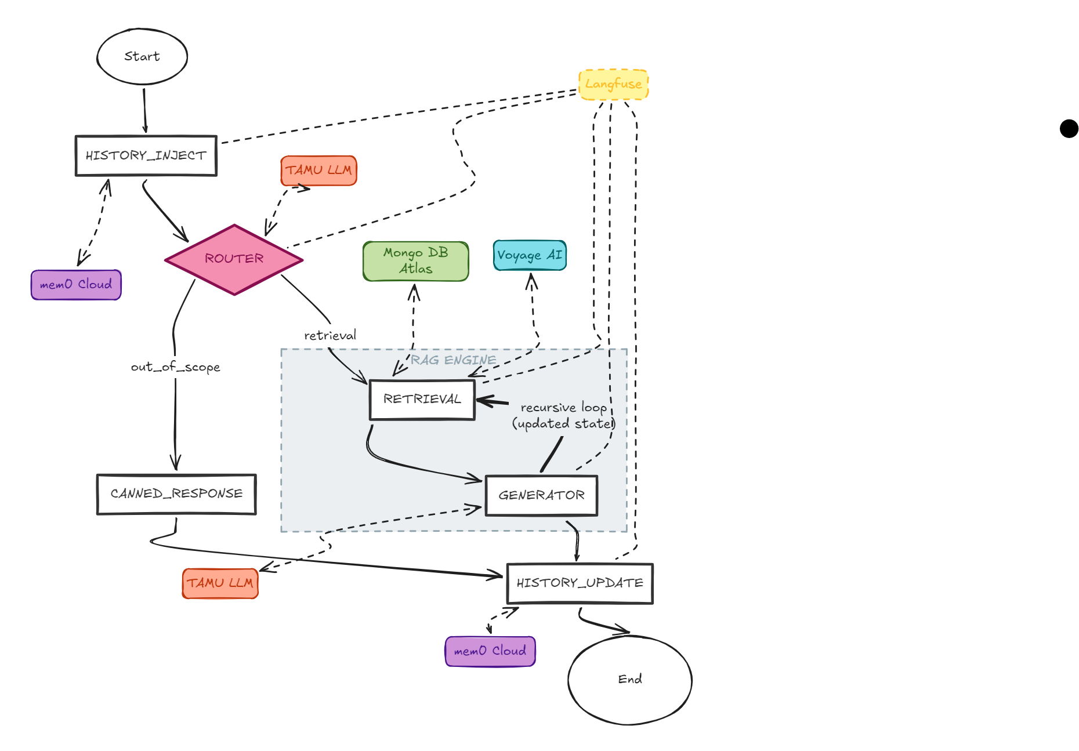
RAG Pipeline — Flow
How a query flows
• HISTORY_INJECT — pulls prior turns from mem0 Cloud
• ROUTER — TAMU LLM extracts variables, picks function
• Out-of-scope → CANNED_RESPONSE (early exit)
• RETRIEVAL — MongoDB Atlas (vector + BM25) + Voyage rerank
• GENERATOR — TAMU LLM produces cited answer
• Recursive loop — Generator can re-trigger Retrieval w/ updated state
• HISTORY_UPDATE — writes turn back to mem0
• Langfuse traces every node end-to-end
LangGraph state machine — Router → Retrieval → Generator with recursive refinement

Slide 4
TamuBot — Future Goals
Data Coverage
• Add catalog.tamu.edu (course descriptions, degree plans, certificates)
• Switch from fixed-size to semantic chunking by syllabus category
• Close syllabus gaps across Howdy Portal + Simple Syllabus
• Expand beyond ISEN/CSCE to all graduate departments
• Promote silver → gold for the full corpus via iterative QA
• Refresh cadence: scheduled re-scrape per term
Retrieval Quality
• Per-stage LLMs (router/retrieval/generator) for speed + quality
• Optimize semantic search: embeddings, top-k, thresholds
• Multi-step / multi-hop query evaluation in the eval harness
• Schema-aware diffing for multi-course comparisons
• Recursive discovery: broaden anchor strategies
• Out-of-scope rejection: fewer false positives
Product & UX
• Polish frontend UX: layout, readability, response display
• Feedback loop: thumbs / ratings on each response
• Smoother, more reliable conversational flow
• Auth + persistent per-student memory across sessions
• Advisor mode: planning, prerequisites, degree-plan overlays
• Source preview pane: jump from citation → chunk
Reliability & Deployment
• Red-team the pipeline: prompt injection + data leakage tests
• Cost management: caching, budgets, quotas
• Load-balancing gateway in front of LLM calls
• Cloud deployment for production hosting
• Quality alerting: notify on regressions and drift
• Grow golden set; track regression on every PR
Targets shaped by current backlog and recent ingestion-pipeline iterations

Slide 5
Related Work — Similar Systems at Other Universities
RAG-Based Academic Systems
Broad AI Student Support Systems
Aurora — Florida International University
Neuro-symbolic advising agent — RAG + Prolog logic engine for policy-compliant course advising. 0.93 semantic alignment, 0.71s latency.
arXiv:2602.17999
Jill Watson — Georgia Tech
Oldest university AI assistant (2016); rebuilt on RAG + GPT-4o. Ingests syllabi and course Q&A; integrates via Canvas / Blackboard LTI.
dilab.gatech.edu/jill-watson
BarkPlug V.2 — Mississippi State University
RAG pipeline over 42 university resource documents using GPT-3.5-turbo. Evaluated with RAGAS (score 0.96) — same framework as TamuBot.
arXiv:2405.08120
Maizey / Go Blue — University of Michigan
First institution-wide LLM deployment in U.S. higher ed (2023). 3,500+ RAG instances across courses, dining, events, campus services.
its.umich.edu/computing/ai/go-blue-ai
URAG — Ho Chi Minh City University of Technology
Hybrid two-tier RAG (FAQ gate + vector retrieval) for admissions advising. Only live-deployed system of all six — running at ura.hcmut.edu.vn.
arXiv:2501.16276
Smart Plan — Purdue University
AI-driven degree planning engine ("GPS for graduation"). Enforces prerequisites, models what-if major changes, integrates with SIS/registrar in real time.
Purdue Registrar
Six representative academic RAG / AI systems — context for TamuBot's positioning

