Slide 1
Coors Lib Rust library for symmetric coroutines Foster’s Home: Kevin Chang, Dylan Johnson, Artem Minyaylov,
The Problem: A Rust coroutine library has already been created, but contributors have stopped development and symmetric coroutines remain unimplemented. We want to add an extension to this library to aid in hardware emulation.

Slide 2
Domain Analysis
Programs we want to write:
hardware emulation (QEMU)
game emulator programs
modular discrete event driven computer system simulator platforms
Ex. Gem5
How they are written today:
Gem5 is single-threaded and uses function calls to context switch between hardware components
Lots of spaghetti code

Slide 3
Language Constructs
Coors Object Methods:
Coors::new()
creates a new Coors object which controls switching between coroutines
Coors::set_coroutines(Vec<Coroutines>)
gives the Coors object a vector of coroutines use for context switching
Coors::yield_to(Coroutine, Arg)
yields to given coroutine with an argument
Coors::start(Coroutine, Arg)
starts the the passed-in coroutine
Coors::stop(Arg)
returns the arg back to the start call
Coroutine::spawn(Closure)
creates a coroutine that will execute the given closure
Coroutine argument: index of coroutine
Constants:
FIRST: selects the first coroutine
NEXT: selects the next coroutine

Slide 4
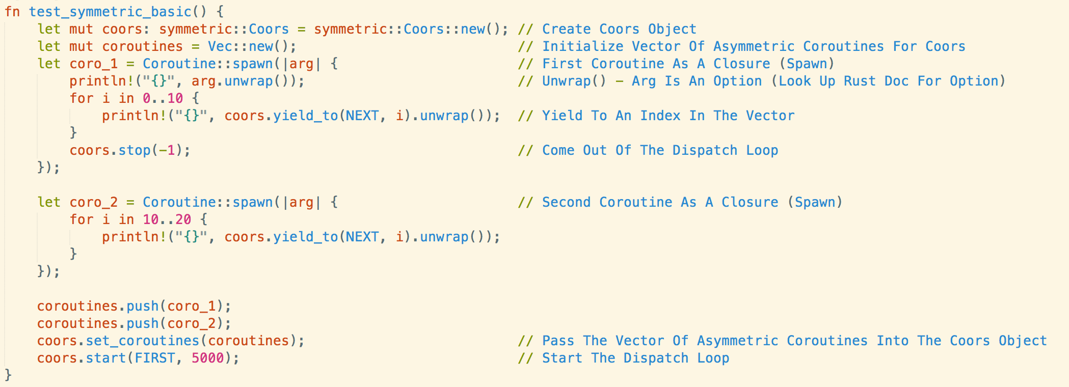
Demo: Basic Use Case

Slide 5
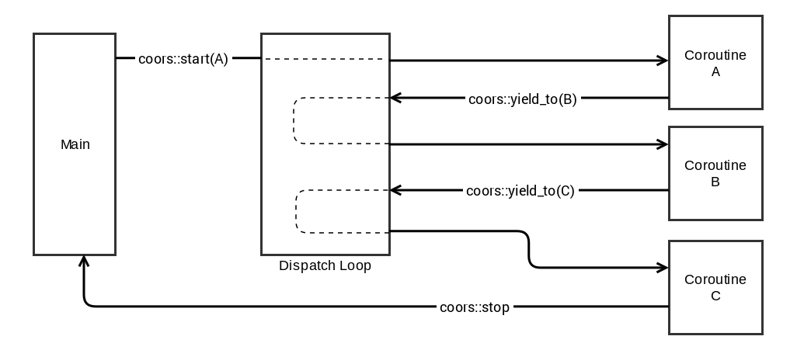
Implementation
Built on top of coroutine-rs, an asymmetric coroutine library
Coors object starts a dispatch loop, which calls the first coroutine
Subsequent yield_to calls tell the dispatch loop which coroutine to run next
Includes parameter passing

Slide 6
What you are proud of?
We conquered the strict typing of the Rust language.
The dispatch loop is a clever trick to flatten symmetric coroutine calls.
Mistakes
Rust has a lot of rules to maintain its safety guarantees. The syntax and strict typing will be the biggest hurdle for newcomer developers using our library. Also, our library was written in the same version as coroutine_rs (09-29-2015-nightly) and does not run on newer versions.
What we would do differently
We would start from scratch to develop a coroutine library that is compatible with newer versions of Rust.

