Slide 1

MyKlinik.id System Quality Analysis Using ISO/IEC 25000 (SQuaRE)
972025007

Slide 2


Contents
01
Introduction
02
Research GAP
03
Research methodology
04
Results and Discussion
05
Conclusion and Suggestions
06
Appendix

Slide 3

01
Introduction

Slide 4
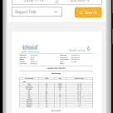
Background
Technological integration in healthcare
1
The use of information technology in clinics like IsawaBeauty Clinic Tangerang is essential to ensure speedy, effective, and accurate medical and administrative processes.
Role of MyKlinik.id
2
MyKlinik.id serves as the primary information system for patient registration, medical record management, billing, and operational reporting, making it a strategic component in maintaining service quality.
Need for standardized evaluation
3
To ensure the application meets operational demands, a standardized quality evaluation using ISO/IEC 25000 (SQuaRE) is imperative, focusing on software quality attributes like functionality, reliability, usability, and security.

Slide 5
Background
Comprehensive quality framework
ISO 25010 embedded within SQuaRE offers a defined model emphasizing eight software quality characteristics, facilitating systematic assessment and enabling continuous development of the MyKlinik.id system.
Objective approach for evaluation
By adopting ISO/IEC 25000's structured methodology, this research supports comprehensive evaluation and generates actionable recommendations aligning with international practices to enhance system usability and organizational credibility.

Slide 6

Problem Formulation
System quality concerns
Issues such as page load delays, mobile interface inconsistency, and minor system errors impact user perception and operational smoothness.
User perception divergence
Admins, nurses, and doctors have varying opinions on system navigation, reliability, error mitigation, and data quality within MyKlinik.id.
Need for a structured evaluation
Ensuring systematic analysis, as supported by ISO 25010, to address gaps in usability, performance efficiency, and security.

Slide 7
Research purposes
Detailed quality assessment
Evaluating MyKlinik.id using ISO 25010 to analyze functional suitability, reliability, and data portability to provide insights into improvement areas.
User feedback analysis
Obtaining user perspectives across different roles to better understand system performance challenges and enhancement requirements.
Strategic recommendations
Generating improvement strategies based on findings to ensure the system evolves to meet clinical demands effectively.

Slide 8
Contribution to software quality literature
Adds practical insights on implementing ISO/IEC 25000 standards for system evaluation, encouraging broader adoption of quality benchmarks.
Benefits of research
Operational enhancement
Supports clinics in implementing tailored improvements to MyKlinik.id, ensuring the system aligns effectively with user needs and operational processes.
Framework adaptation
Demonstrates the applicability of ISO standards like ISO 25010 in assessing technical and functional aspects, fostering credibility in healthcare software solutions.

Slide 9
Research Gap
Limited comprehensive evaluation
01
Previous studies often lack integration of all eight characteristics from the ISO 25010 model in assessing clinical systems' quality, particularly in real-world environments.
Mobile and browser compatibility concerns
02
Current research does not fully address usability challenges related to mobile responsiveness and browser inconsistencies within clinical information systems.
Automation deficits in data validation
03
Existing evaluations rarely focus on the effectiveness of automated mechanisms in managing duplicate records, which is critical for preserving patient data integrity.

Slide 10
03
Research methodology

Slide 11



Types of research
Overview of quantitative descriptive research
Quantitative descriptive research aims to quantify specific features of interest, employing data derived from structured instruments like questionnaires.
Utilization of survey tools
User surveys based on ISO 25010 were employed to measure predefined software quality metrics.
Importance in system quality studies
This method is apt for systematically analyzing diverse user perceptions and deriving actionable insights.

Slide 12

Research Object
01
Presence in clinical operations
The research focuses on MyKlinik.id, an application integral to multiple aspects of Isawa Beauty Clinic's operations.
02
Roles in operational management
MyKlinik.id oversees patient registration, medical record-keeping, transaction management, and operational reporting.
03
Requirement for quality assessment
Analyzing MyKlinik.id’s alignment with ISO/IEC 25000 standards ensures compliance with operational and strategic clinical needs.

Slide 13

Research Sample
Broad inclusion of stakeholders
The sample includes admin staff (2 participants), clinic nurses (1 participant), and aesthetic physicians (2 participants).
Criteria for participant selection
The participants were chosen due to their consistent usage and familiarity with MyKlinik.id functionalities.
Diversity in perspectives
This sample aids in capturing perspectives across different user roles, ensuring comprehensive feedback.

Slide 14
Research Instruments
Basis in the ISO 25010 model
The evaluation was conducted using a Likert-scale questionnaire covering eight ISO 25010-defined software quality characteristics.
Quantitative data expression
Responses were numerically gauged across a range from 1 (strongly disagree) to 5 (strongly agree), facilitating straightforward aggregation.
Standardized assessment approach
By employing ISO standards, the instrument ensures reliability and relevance in measuring complex system features.

Slide 15
04
Results and Discussion

Slide 16
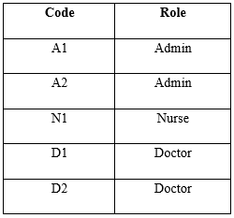
Respondent Profile
Diverse organizational roles
The study involved a mix of respondents, including two administrative staff, one nurse, and two aesthetic doctors, ensuring insights from different operational levels of MyKlinik.id users.
Importance of respondent roles
Each respondent played a critical part in providing feedback on the system's functional utility, operational efficiency, and reliability in their respective areas of responsibility.
Representative sample size
Although the study surveyed five individuals, their roles cover key operational workflows, thereby offering a comprehensive understanding of system performance.

Slide 17
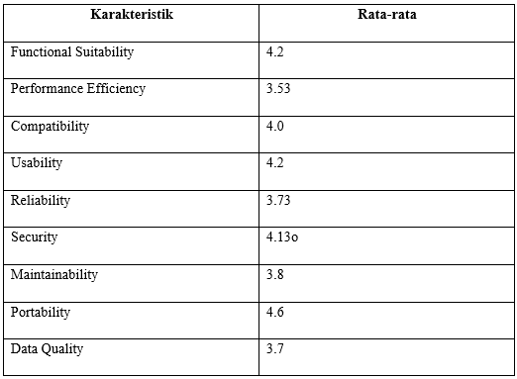
Summary of Assessments per Characteristic

Slide 18
05
Conclusion and Suggestions

Slide 19
Conclusion
System quality rated at 3.97/5
The MyKlinik.id system demonstrated "good" overall quality, aligning with user needs and other ISO 25010 indicators.
Performance efficiency optimization needed
Delayed loading times during peak hours and intensive module access show performance bottlenecks requiring server configuration upgrades and database query optimization.
Improvements in maintenance and data validation
Lack of comprehensive technical documentation and duplicate patient records indicate the need for enhanced maintainability processes and data integrity protocols.

Slide 20
Suggestion
Enhance system performance
01
Conduct server optimization and refine database queries to reduce response time during peak usage and improve operational reliability.
Implement stricter data validation mechanisms
02
Introduce automated checks during data entry to mitigate duplication risks and ensure the accuracy of patient medical records.
Strengthen technical documentation
03
Provide detailed onboarding and technical guides for new staff to improve system familiarity and minimize training inefficiencies.

Slide 21
Suggestion
Improve user interface responsiveness
Optimize mobile interface designs and browser compatibility to facilitate seamless access across devices.
Educate staff on data security protocols
Develop comprehensive training programs to instill best practices for patient data protection and system hygiene.

Slide 22

Thank you

