Slide 1

ARTexceptionals
Basic Prototype

Slide 2
Requirements
The gathered requirements have been analyzed and categorized as Essential, Necessary and Desirable Requirements.
Essential Requirements:
Customizable category, deleting option.
Payment method of income and expenditure.
Free text note.
Date
Security feature(Pin for the app)
Statistics
Necessary Requirements:
Security question to retrieve forgotten password. Take the answer for security question while setting the pin.
The data needs to be filtered based on time, type of payment, category, range of money.
Currency change support.

Slide 3
Requirements I
Desirable Requirements:
Sharing expense with other users
Summarize monthly expenses in mail
Store data on server/firebase
Sync at particular time with firebase serve
Estimated Time:
Divided our User stories into four Epics
Each Epic is categorized into Stories and Stories are further categorized into multiple tasks
Have provided three sprints for each Epic, one and a half sprints for each story
For fast and smooth purpose of our work, we have divided our development teams into two groups, each working on one Epic
The time estimation of two other Epics will be re-calculated depending on first two Epics

Slide 4
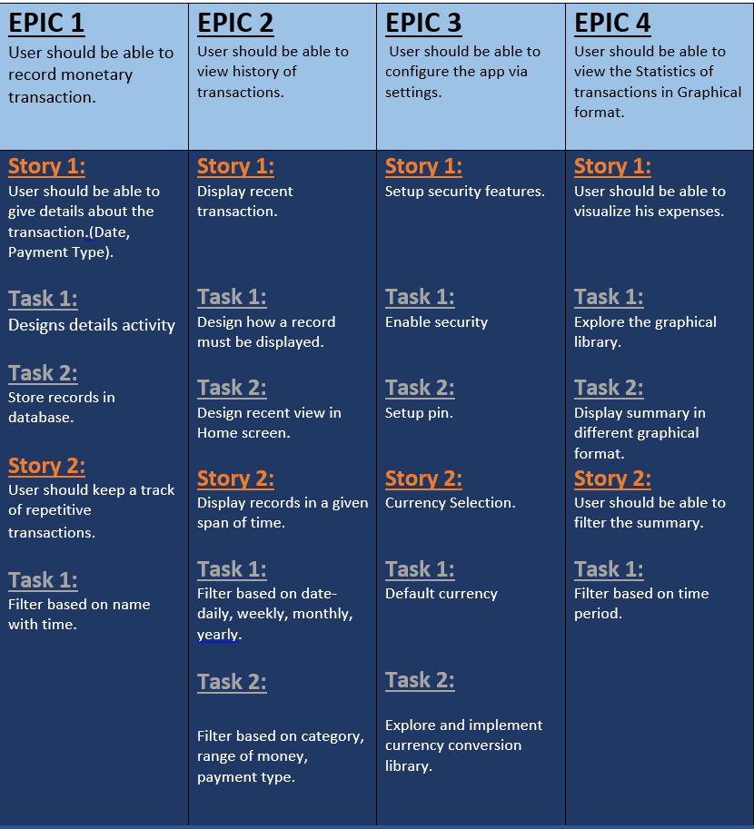
User Story

Slide 5
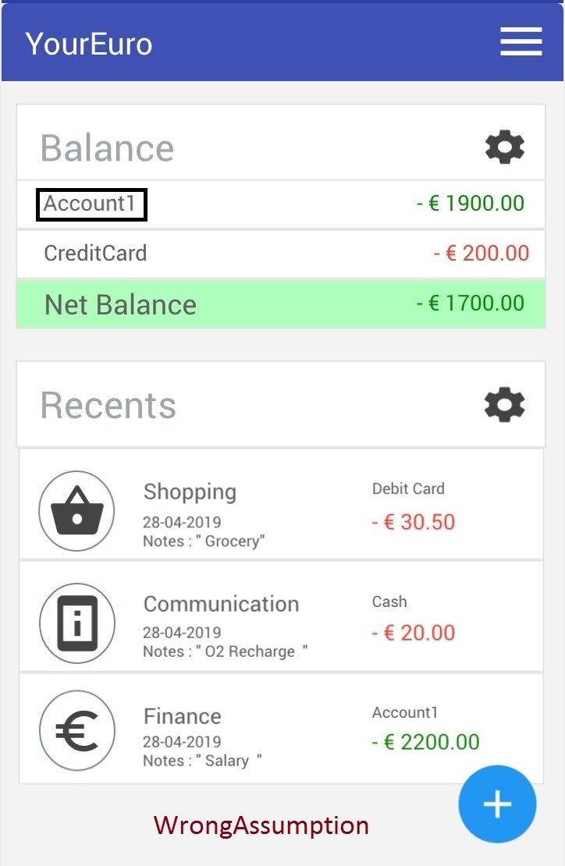
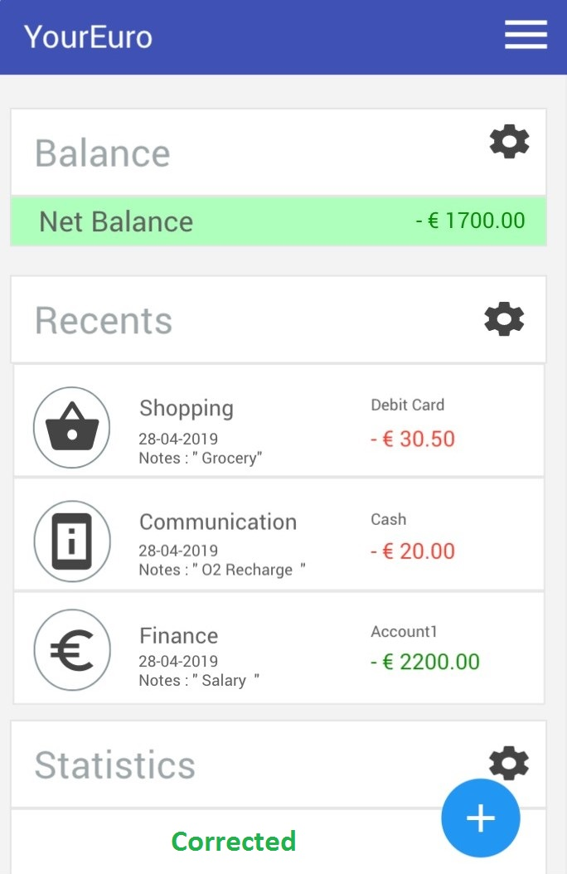
Wrong Assumptions
Barcode scanning is not required
We assumed that Login authentication should be given using Google, Facebook or email whereas the client requirement is just pin authentication
We got to know filtering the expenses based on Payment type, Range of money and category is required along with just date (initial assumption)
Our assumption was to include multiple bank accounts in the app but the requirement is to monitor transactions of only one account as shown below.

Slide 6
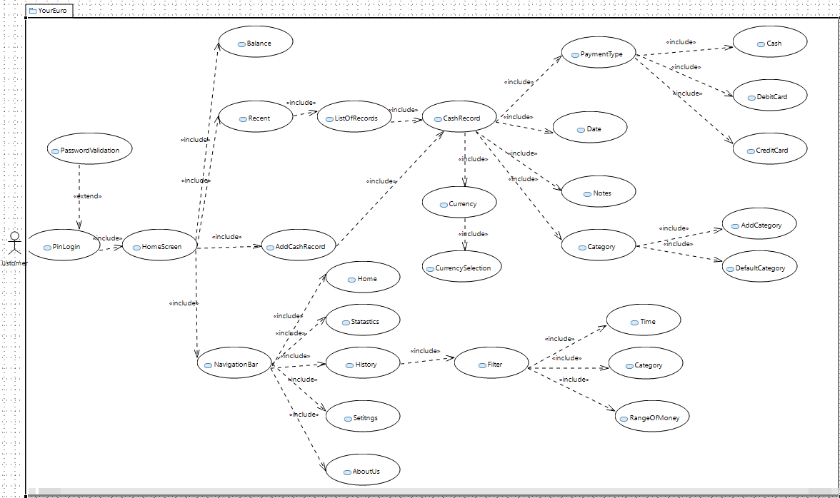
Use Case Diagram

Slide 7
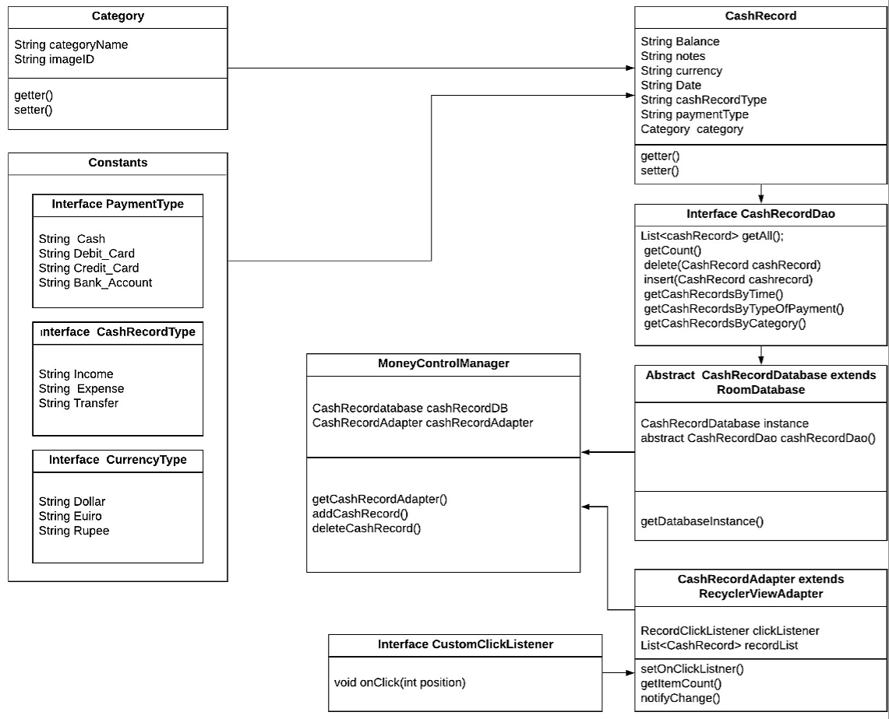
Class Diagram

Slide 8
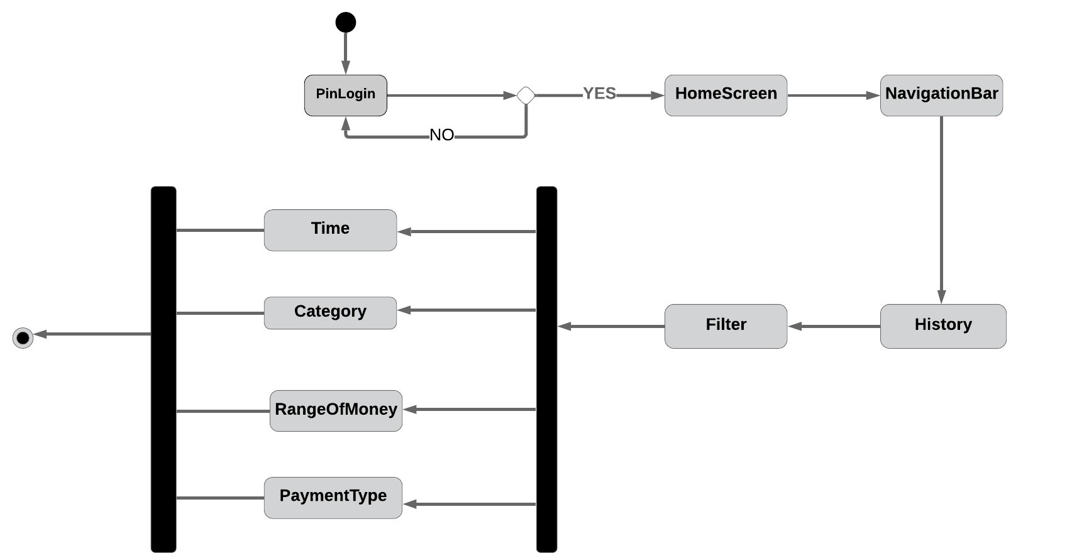
Activity Diagram- Navigation Bar

Slide 9
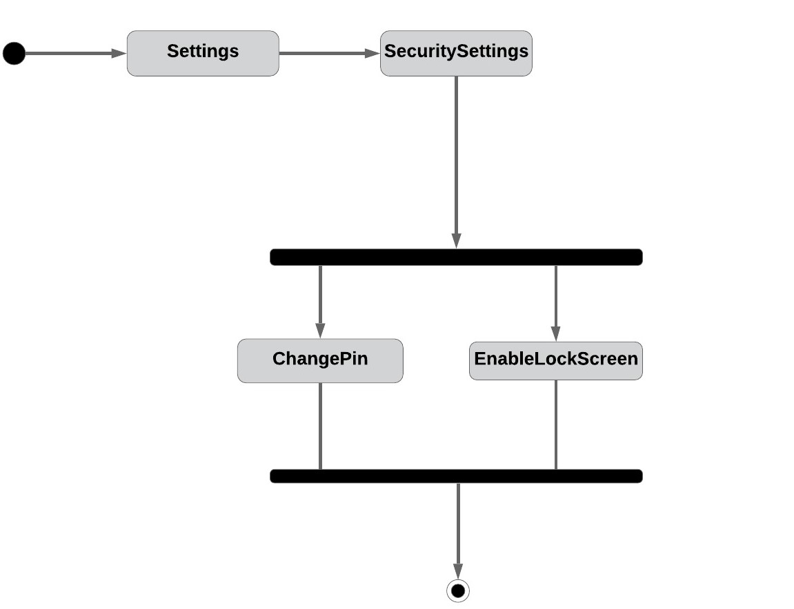
Activity Diagram- Settings Page

Slide 10
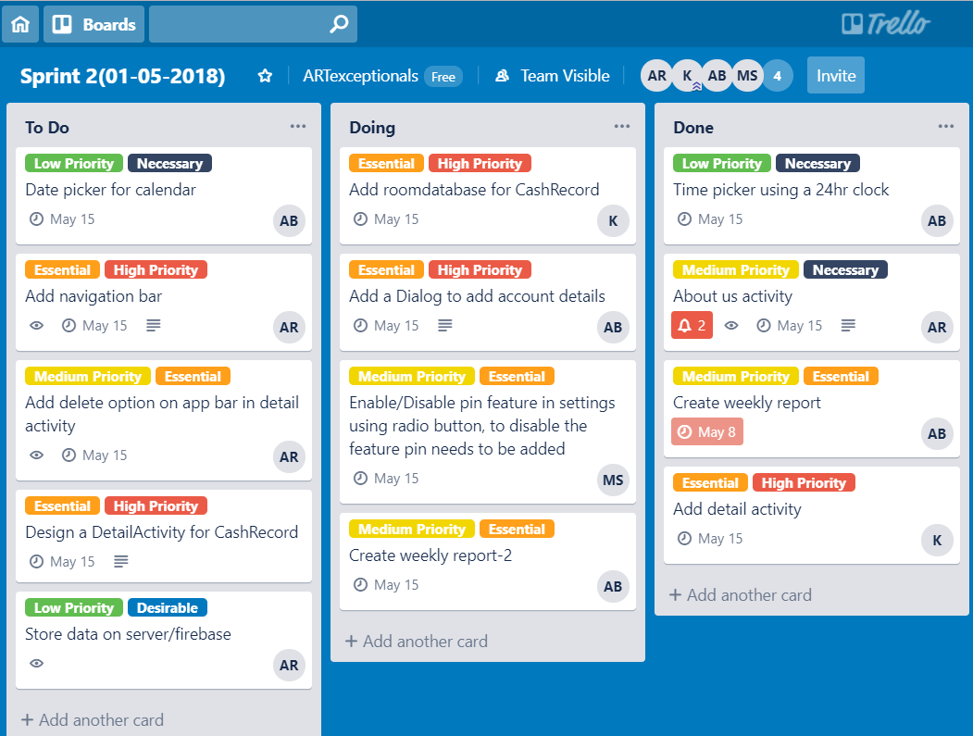
Development Strategy

Slide 11
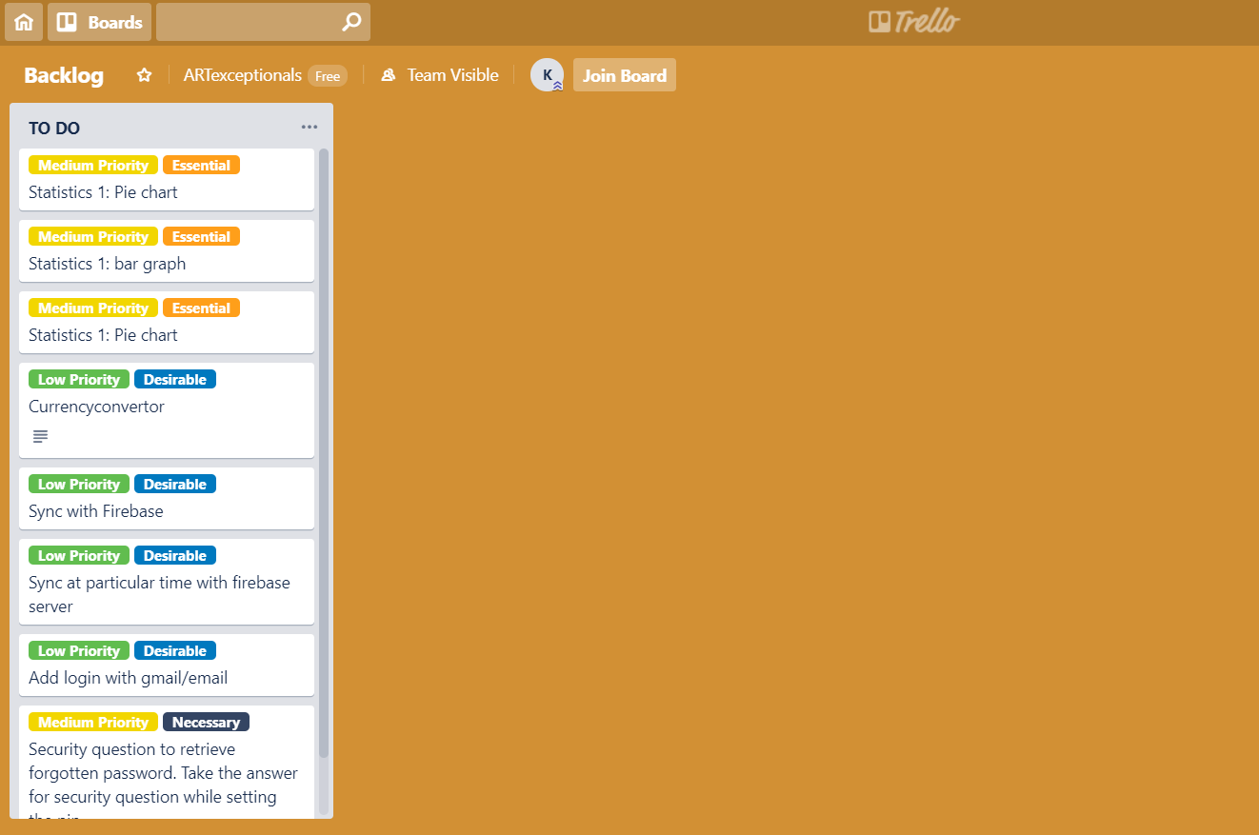
Development Strategy I

Slide 12
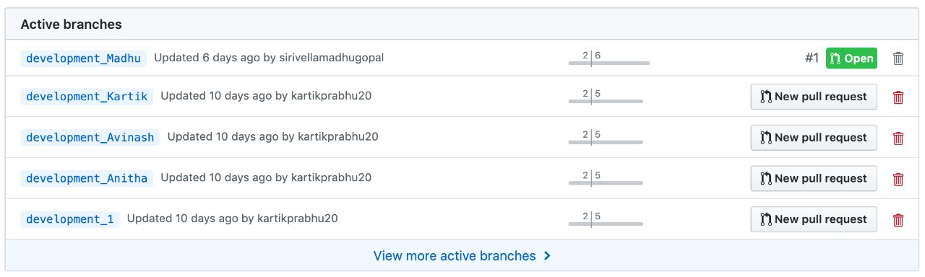
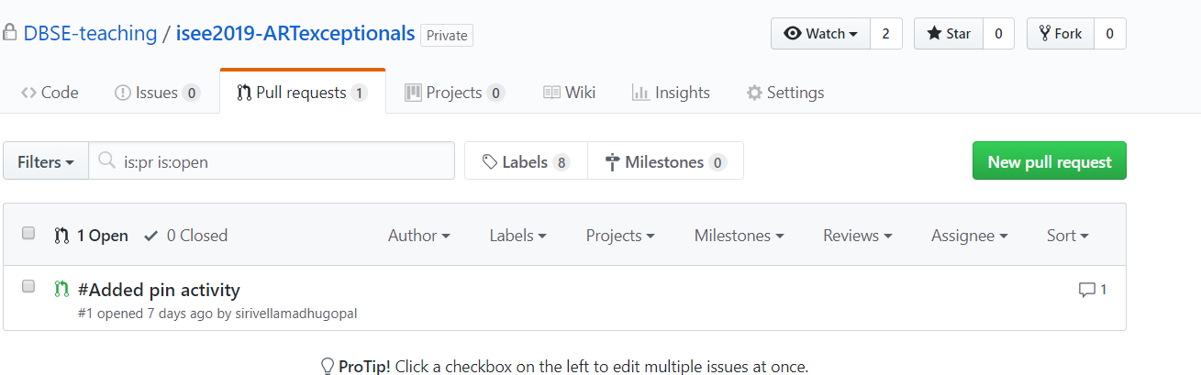
Development Strategy II

Slide 13
Questionnaire
Please answer In Yes/No:
Are libraries any allowed?
Can we use barcode scanning used as input?
Is Enabling of sharing the expenses with others required?
App must support the currency change?
Do we need to provide the Ads feature in our App?
Check the following based on the requirement:
Login Authentication using
Locally
Google and Facebook
Others
How does the data need to be stored?
Locally
Server/firebase
Others

Slide 14
Questionnaire I
What is the duration of history needs to be saved?
One day
One week
One month or more
How the statistics of the expenses must be displayed?
Pie chart
Bar graph
Designer choice
Make the working prototype available as
Downloadable ask file
As a separate release branch in the git repo
other
Fill the answers:
Please specify the minimum version of android that our app must support.
Do we need to handle tab design.

Slide 15
Thank You

