Slide 1
Fundamentals of Ornamental Horticulture & Landscaping
सजावटी बागवानी और लैंडस्केपिंग के मूल सिद्धांत
For BSc Agriculture Students
Taught by Professor Gaurav
Notes:
Introduction to the core concepts of ornamental horticulture and landscaping designed for agriculture students.

Slide 2
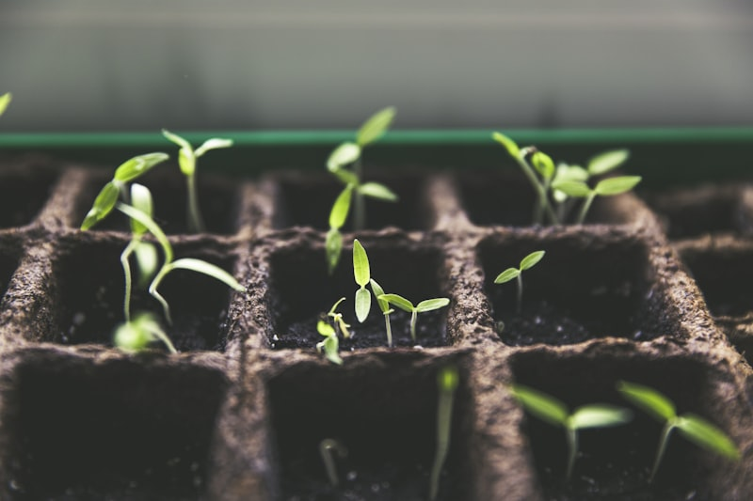
What are Ornamental Crops? / सजावटी फसलें क्या हैं?
Definition / परिभाषा
Grown for aesthetic beauty and environmental enhancement.
सुंदरता और पर्यावरण के लिए उगाए गए पौधे।
Scope / क्षेत्र
• Floriculture industry (cut/loose flowers)
• Enhances property value
• Reduces pollution
Notes:
Emphasize that ornamental crops are not just about beauty—they have significant economic value in the floriculture industry.

Slide 3
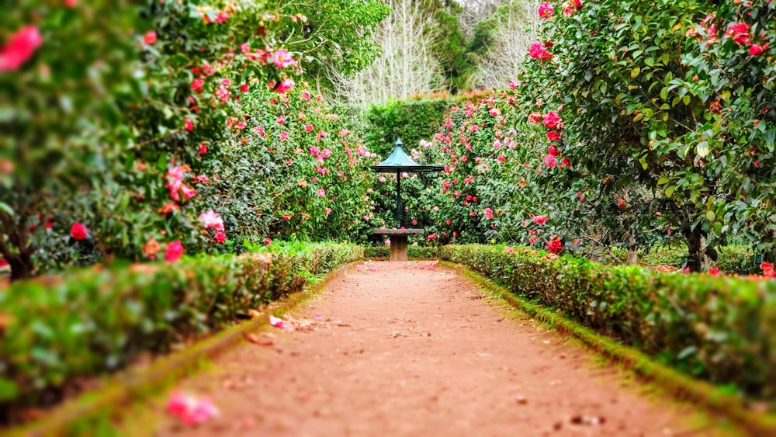
Medicinal and Aromatic Plants (MAPs)
Medicinal / औषधीय:
Therapeutic healing compounds.
Aromatic / सुगंधित:
Essential oils for perfumes.
Examples: Aloe Vera, Tulsi, Neem, Lavender, Mint
Notes:
Highlight the dual benefits of MAPs—therapeutic value and economic potential through export markets.

Slide 4
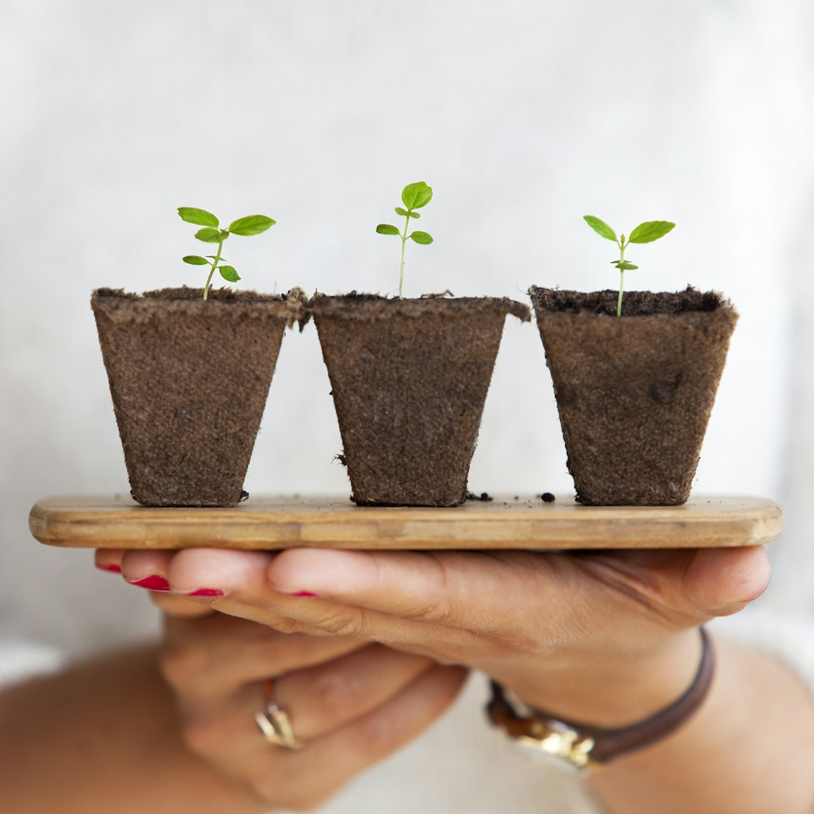
Landscaping - Definition and Scope
Art & Science of designing land to be aesthetically pleasing and functional.
भूमि को सुंदर और उपयोगी बनाने की कला और विज्ञान।
Notes:
Explain that landscaping combines both artistic vision and scientific knowledge of plants, soil, and climate.

Slide 5
Principles of Landscaping / लैंडस्केपिंग के सिद्धांत
Principle | Meaning (English & Hindi)
Balance / संतुलन | Equal visual weight on both sides (दोनों ओर समान भार)
Proportion / अनुपात | Correct sizing relative to surroundings (सही आकार)
Rhythm / लय | Repetition to create movement (पुनरावृत्ति)
Focal Point / मुख्य बिंदु | A feature that draws the eye (ध्यान आकर्षित करना)
Harmony / सामंजस्य | Blending parts together uniformly (एक साथ मिलना)
Notes:
These five principles work together to create visually appealing landscapes.

Slide 6
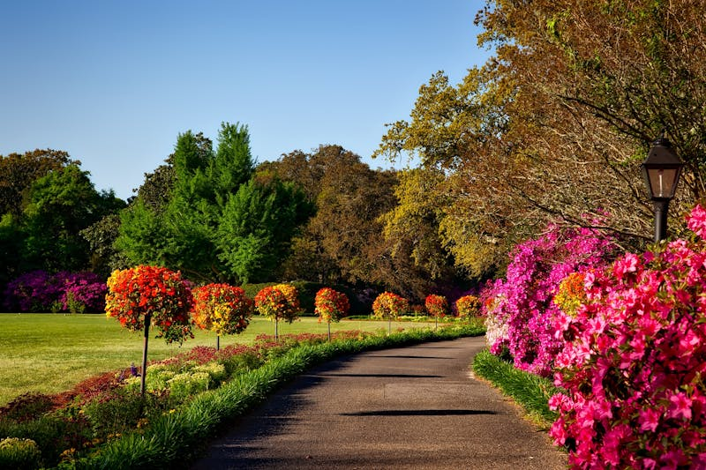
Uses of Trees, Shrubs & Climbers
• Providing Shade (छाया)
• Physical Boundaries (सीमाएँ)
• Soil Erosion Control (मृदा संरक्षण)
• Blocking Unwanted Views (स्क्रीनिंग)
• Aesthetic Beauty (सुंदरता)
Notes:
Explain how different plant types serve different functional purposes in landscape design.

Slide 7
Examples of Trees / पेड़ों के उदाहरण
Flowering / फूलों वाले:
Gulmohar (गुलमोहर), Amaltas (अमलतास), Kachnar (कचनार)
Foliage / पत्तियों वाले:
False Ashoka (अशोक), Banyan (बरगद), Rubber Tree (रबर)
Notes:
Identify common Indian trees categorized by their flowers or their architectural foliage.

Slide 8
Examples of Shrubs / झाड़ियों के उदाहरण
Flowering / फूलों वाली:
Hibiscus (गुड़हल), Chandni (चांदनी), Bougainvillea
Foliage / पत्तियों वाली:
Croton (क्रोटन), Coleus (कोलियस), Aralia (अरालिया)
Notes:
Shrubs are versatile plants that can be used for hedges, borders, or as standalone features.

Slide 9
Examples of Climbers / लताओं के उदाहरण
Flowering / फूलों वाली:
Rangoon Creeper (मधुमालती), Passion Flower
Foliage / पत्तियों वाली:
Money Plant (मनी प्लांट), English Ivy (इंग्लिश आइवी)
Notes:
Climbers maximize vertical space and add dimension to landscapes.

Slide 10
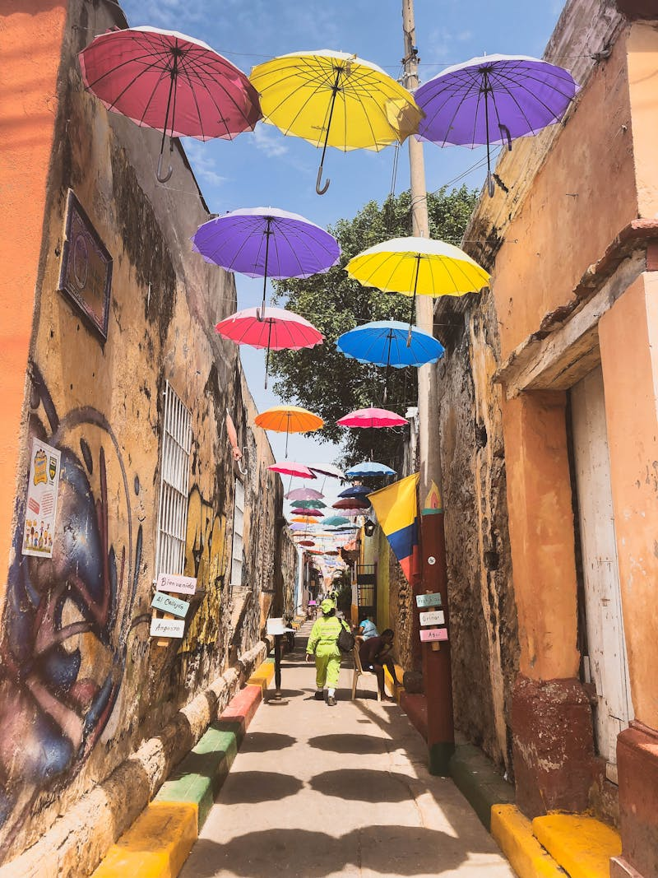
Conclusion / निष्कर्ष
Ornamental horticulture is vital for sustainability, human well-being, and commercial agriculture.
Questions & Answers (प्रश्न और उत्तर)

