Slide 1
Final Project
the truth is out there…

Slide 2
The Problem?

Slide 3
Text meaning
simplify?
Text #hashtags ?
Key phrases!

Slide 4

Idea

Slide 5
Approach

Slide 6
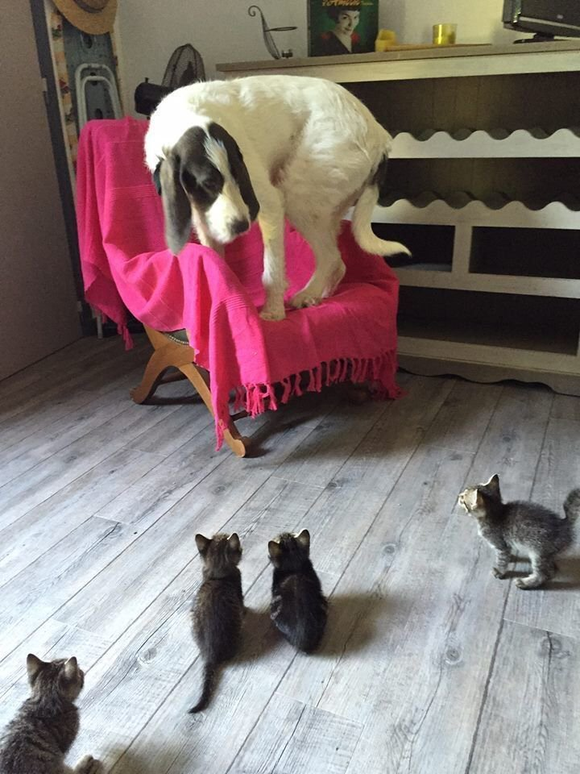
Attack from different angles

Slide 7
Noun Phrase Chunking
Trained model to chunk sentences into NP parts
Get list of mostly used chunks

Slide 8
Rachel
Fill in

Slide 9
Words vectorisation
Fill in description

Slide 10
Solution?

Slide 11

Mix it all

Slide 12
Results?

Slide 13
Phase 1 Results
Show the output

Slide 14
Future Plans

Slide 15
Future Plans
Apply vectorization
Replace his/it/etc. with meaningful nouns
SVO split to understand the meaning of each sentence
…and much more…

Slide 16


Slide 17
Thank you ☺

Slide 18
Q & A

