Slide 1
What is sales shipment and Inventory management
Sales Shipment and Inventory Management refers to the process of efficiently handling and tracking the movement of goods from the point of sale to the customer, while also managing the stock levels of products within a business.

Slide 2
Advantages:
Enhanced customer satisfaction
Cost reduction
Increased efficiency
Better inventory control
Improved profitability
Informed decision-making
Enhanced forecasting accuracy
Improved supplier relationships
Scalability
Compliance and risk management

Slide 3
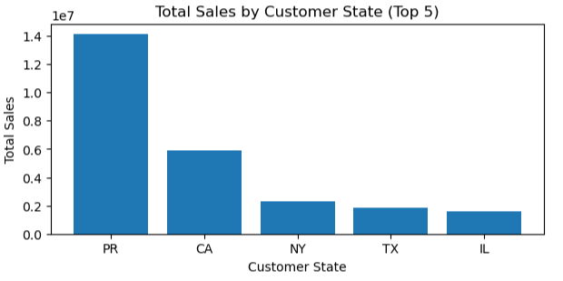
Insights:
PR , CA state is giving Maximum sales

Slide 4
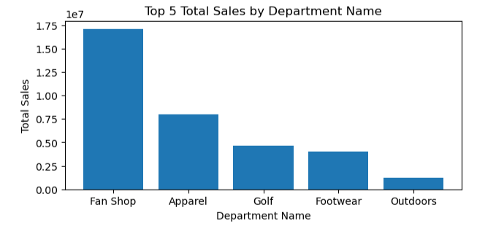
Insights:
Fan shop , Apprel departments is giving Maximum sales

Slide 5
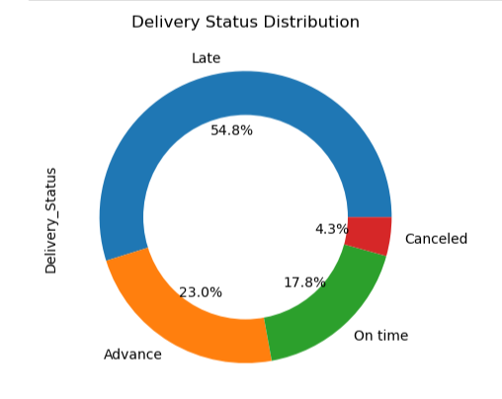
Insights:
From the donut chart we can see maximum orders are delivering late. So we need to work on that and improve delivery status.

Slide 6
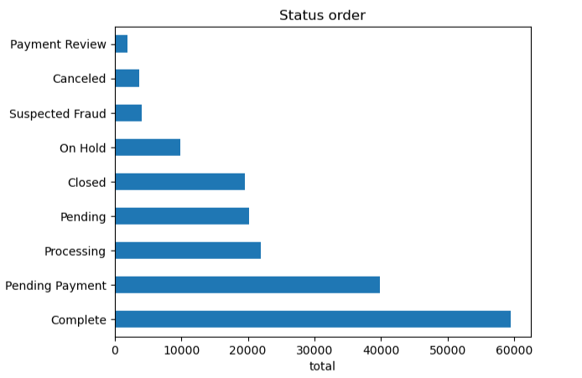
Insights:
From the bar chart we can see payment is pending for about 40000 orders. So we can target those customers by giving them some special discount.

Slide 7
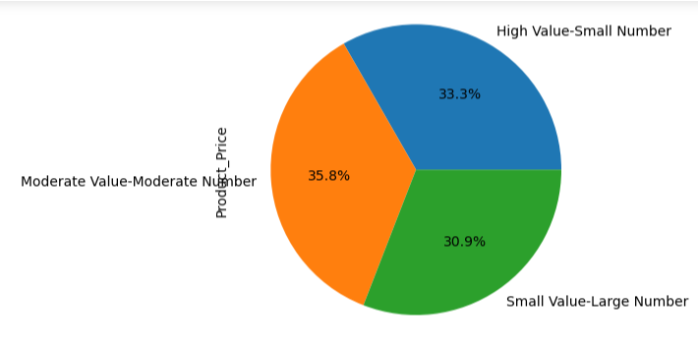
Insights:
There is no significant difference between classes for revenue.

Slide 8
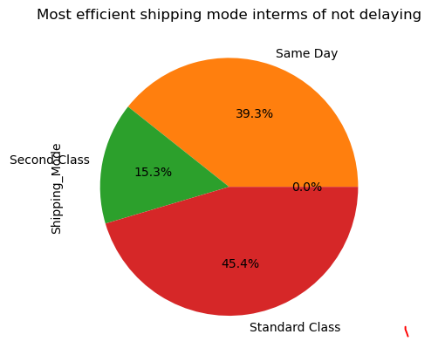
Insights:
From the pie chart we can see that standard class and same day shipping mode doing better than same class mode. So we can improve our Second class shipping mode

Slide 9
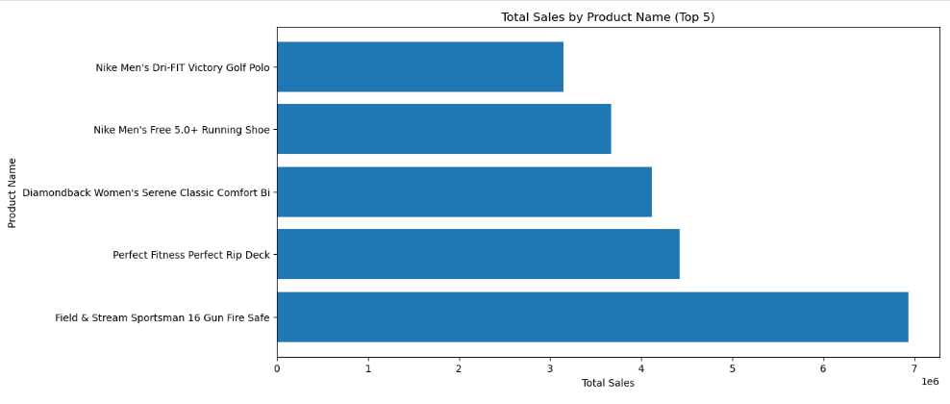
Insights:
From the bar chart we can see that Field & Stream Sportsman 16 Gun Fire Safe is giving is maximum sales

Slide 10
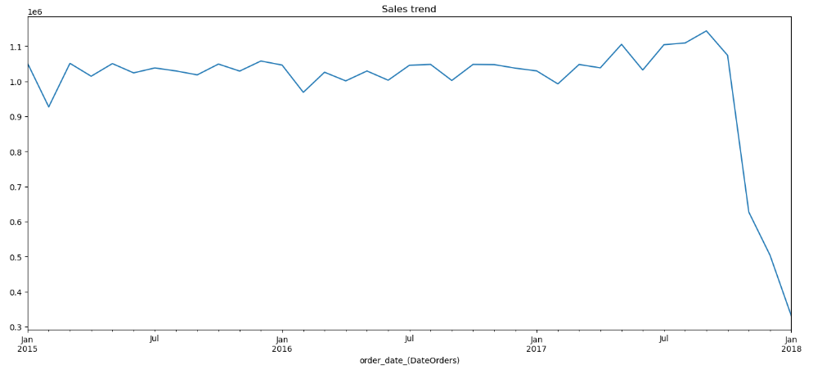
Insights:
For this we cannot draw any conclusion as data is only available till jan 2018

Slide 11
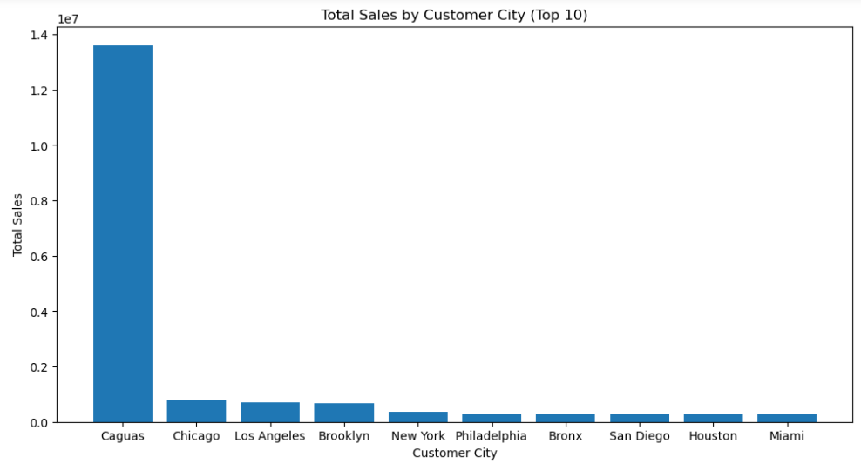
Insights:
Caguas city is giving maximum sales

Slide 12
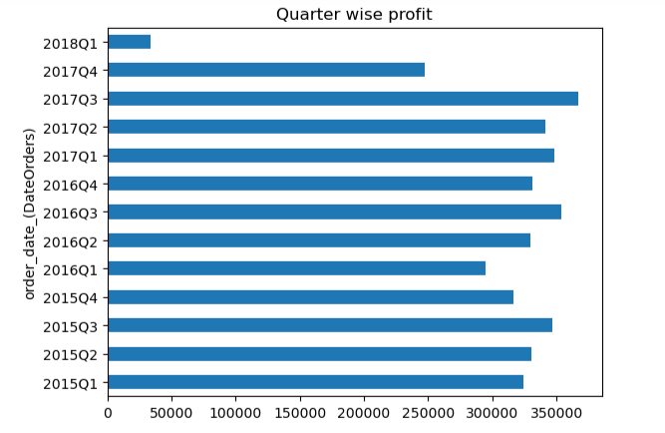
Insights:
Quarter 3 of 2017 giving maximum profit.

Slide 13
Thank you

