Slide 1
HOME STATE
Let us guide you HOME

Slide 2
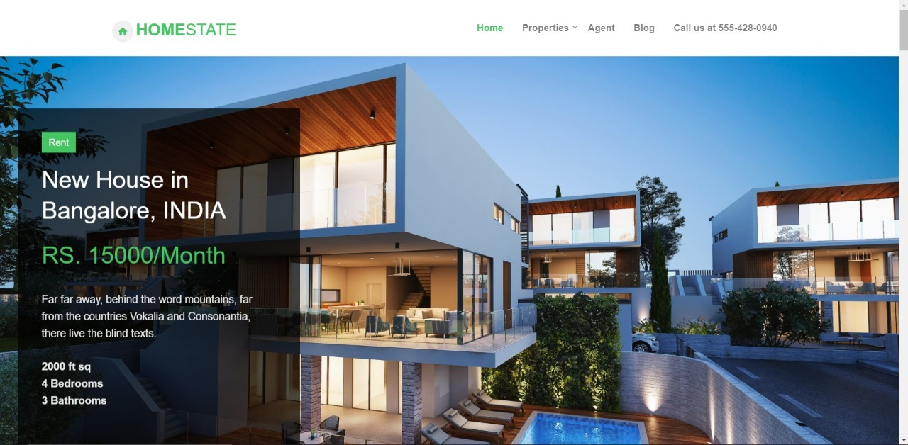
About
Home State is a web application for buying and selling the property and for estimating the price of the property.
Currently it is developed for the city of Bangalore.

Slide 3
Tools and technology:
Frontend: HTML, CSS, Javascript
Backend: Python
Framework: Django
Database: Postgresql

Slide 4

Why this tools and technology:
We have used Django as the framework because it will help our website scalable in future.
PostgreSQL is a powerful relational database to handle our relational data.
Python3 supports various library for machine learning and web development.

Slide 5
Model for Software Development
Waterfall Model

Slide 6
Why Waterfall Model?
The project was short.
Requirements are very well known, clear and fixed.
We can divide whole project into phases and work accordingly.
In this model phases do not overlap as they are completed one at a time.

Slide 7
Features:
Price Prediction
Buy property
Sell Property
Direct contact to owner and buyer

Slide 8
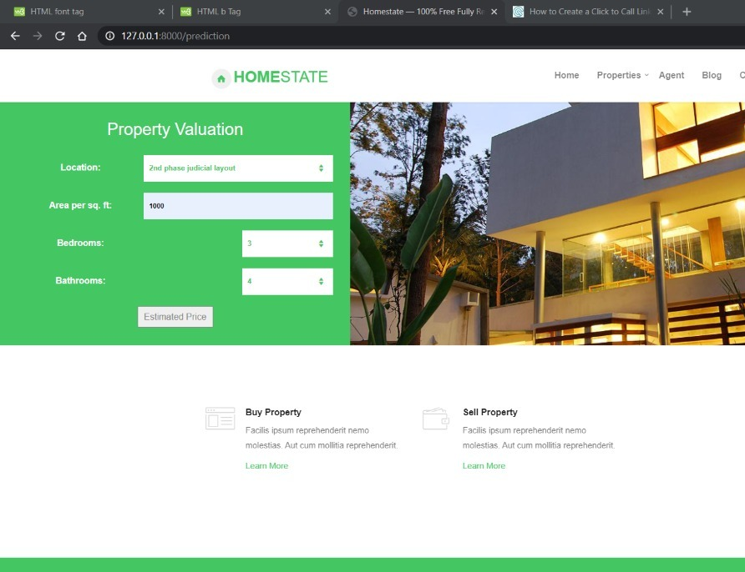
Price Prediction
We have a made a machine learning model for estimating the price of the property according to various parameter.
This will help buyer and seller both to calculate the market price of the property.
We have used linear regression for prediction.

Slide 9
How model works?
We have trained our model with dataset which was available on Kaggle.com and we perform data preprocessing and feature engineering on our dataset and trained it using linear regression.
You have to enter 4 parameters
Location
Area(sq. ft)
Bedrooms
Bathrooms
Model will give you the estimate price.
It is a generic model.

Slide 10
Buy Property:
Direct contact to Seller.
0 % brokerage charge
See and compare various property.
Check the price on price estimator.

Slide 11
Sell Property
Direct contact to buyer.
0 % brokerage.
Estimate your property before selling.

Slide 12
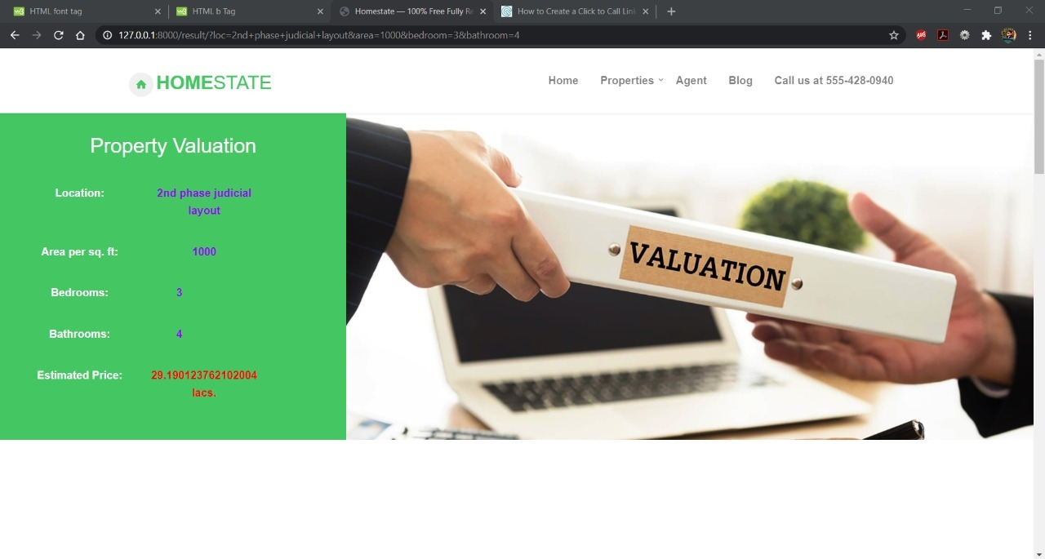
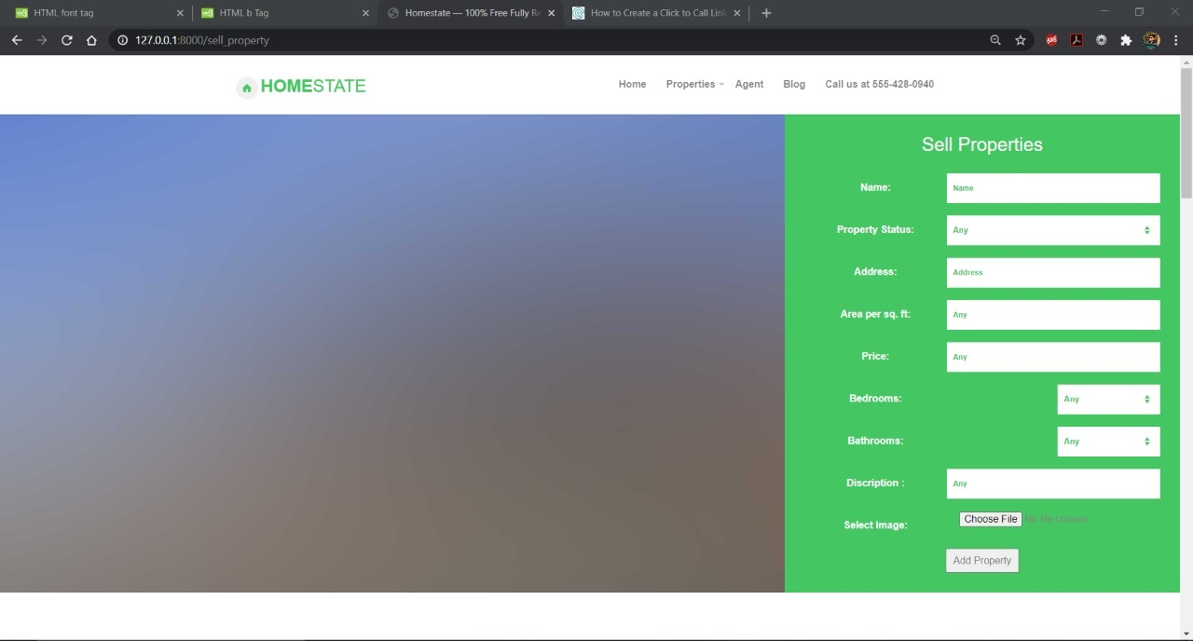
UI Design
Sell Property
Property valuation

Slide 13
Home State
Developers
Guided By
Patel Rakshit (180110107041)
Rathod Arth (180110107049)
Prof. Sneh Vyas
Prof. Kinjal Joshi

Slide 14

Thank You

