Slide 1
Accident Location on Indian Roads
Industrial Training Report presentation
By
Artham Vasu
Reg No. 210911162
Information Technology
Department of Information & Communication Technology
MIT, Manipal
Under the Guidance of
Pooja S
Assistant Professor
MIT Manipal

Slide 2

Introduction
Accurate identification and understanding of accident locations on Indian roads are critical for effective road safety management and accident prevention strategies.
India's vast and diverse road network, coupled with increasing traffic and varying road conditions, poses significant challenges in ensuring road safety.
This report addresses the problem of accident location identification by proposing a novel approach that utilizes advanced data analysis available on the Ministry of Road Transport and Highways website. Analysing accident data available and extracting the exact coordinates using Google Maps API made it more accurate in pinpointing those locations on the Map.

Slide 3

Motivation
The motivation behind addressing the problem of Accident Location on Indian Roads stems from the pressing need to improve road safety and reduce the country's alarming rate of road accidents.
India has one of the highest road traffic fatalities globally, with thousands of lives lost and many more injured yearly. These accidents not only result in immense human suffering but also impose a significant economic burden on society
A prime reason for this accident is the lack of information in the public domain. Hence, I chose to work on this problem statement in hopes of helping society by educating the youth about black spots.

Slide 4
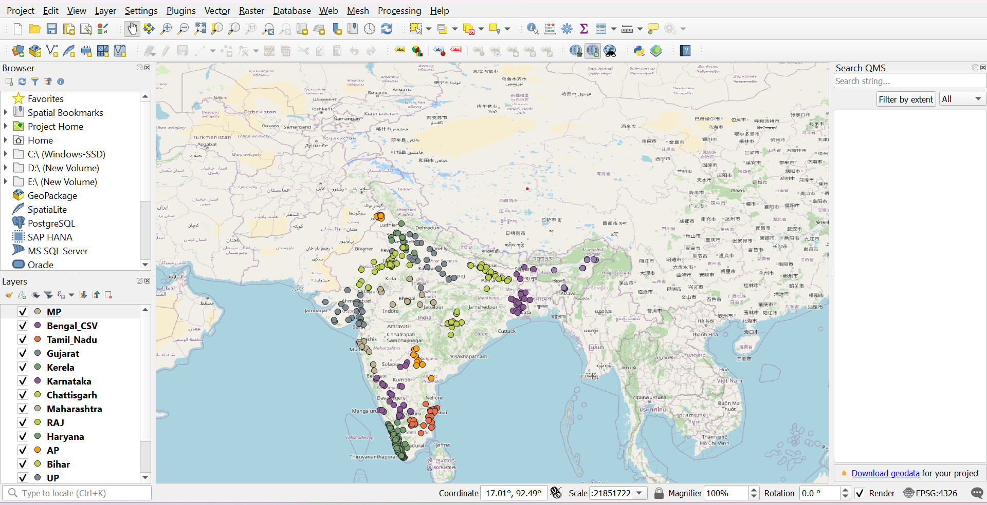
Approach and Result
So, I started by extracting data from the government websites about the blackspots and then mapping those blackspots on QGis software using the coordinates of the blackspots. The coordinates were obtained by running the data through the code, which was directly linked to Google Maps API and gave precise coordinates that contributed to increased accuracy.

