Slide 1

Choice-Head Distillation for
Dental Multiple-Choice Question Answering
Decision-Space Distillation for Deployable Medical QA
Presenter: Tianyuan Chen (陈天元)
Supervisor: Dr. Richard Tai-Chiu Hsung
MSc in Applied AI, Hong Kong Chu Hai College
AIEA 2026, Shenzhen
Notes:
Good afternoon, everyone.
[PAUSE - look at audience]
My name is Tianyuan Chen. I am a master's student in Applied Artificial Intelligence at Hong Kong Chu Hai College.
Today, I would like to present our work on Choice-Head Distillation for Dental Multiple-Choice Question Answering.
[PAUSE]
The core idea of our work is: instead of distilling the entire vocabulary of a large language model, we only distill the five answer options — A, B, C, D, and E — for medical exam questions.
This makes the distillation process much more efficient and, surprisingly, more effective.
[PAUSE - transition to next slide]
Let me start with an overview of the presentation.

Slide 2

Presentation Outline
01 Motivation & Problem Setting
02 Research Questions
03 Core Method: Choice-Head Distillation
04 Why Decision-Space Distillation Matters
05 Experimental Setup
06 Main Results & Analysis
07 Key Contributions
08 Practical Implications & Limitations
09 Conclusion
AIEA 2026 Conference Presentation 2/12
Notes:
Here is the outline of my talk.
[POINT TO SLIDE - trace the outline with hand]
First, I will explain the motivation and problem setting — WHY we need this work.
Then, I will present our three research questions.
After that, I will describe our core method — Choice-Head Distillation — and explain WHY decision-space distillation matters.
Next, I will go through the experimental setup and the main results.
Finally, I will summarize the key contributions, discuss practical implications and limitations, and conclude.
[PAUSE]
Let's begin with the motivation.

Slide 3

01 Motivation & Problem Setting
Problem: Accurate but Expensive
• Medical LLMs: 87%+ accuracy on exam benchmarks
• But: inference cost is very high for deployment
• Teacher access: DeepSeek-V3 API (not local deployment)
• Dental QA needs lower-cost deployable models
Why Knowledge Distillation?
• Transfer teacher capability to smaller student
• Student: Qwen2.5-7B/14B (smaller deployable models)
• Key question: what exactly should we distill?
• Full-vocab distillation = redundant for 5-option MCQ
→ Distillation should target decision space, not full vocab (50K+ tokens)
AIEA 2026 Conference Presentation 3/12
Notes:
Now, let me explain the motivation behind our work.
[POINT TO LEFT COLUMN]
On the left, you can see the problem. Large medical language models, such as DeepSeek-V3, can achieve over 87 percent accuracy on medical exam benchmarks. However, deploying these models is very expensive. They require GPUs with over 100 gigabytes of VRAM. For dental education and clinical QA, we need models that can run on cost-effective devices.
[PAUSE - point to right column]
On the right, you can see why knowledge distillation is a natural solution. We want to transfer the teacher's discriminative capability to a smaller student model — such as Qwen2.5-7B or 14B — which can run on a single consumer GPU.
[PAUSE]
But this raises a KEY question: what exactly should we distill? For a five-option multiple-choice question, the full vocabulary — which contains over 50,000 tokens — is mostly irrelevant. We only care about five options: A, B, C, D, and E.
[PAUSE - emphasize]
This is the core insight: distillation should target the DECISION SPACE, not the full vocabulary.

Slide 4
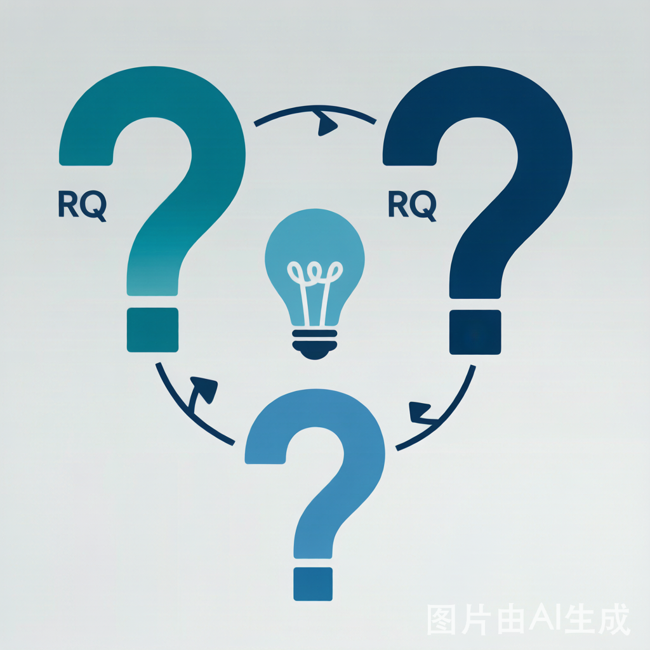
02 Research Questions
RQ1: What to Distill?
Whole vocabulary or only A/B/C/D/E?
Is full-vocabulary distillation redundant for MCQ?
RQ2: Can Students Exceed Teachers?
Under a task-aligned objective, can a smaller
student outperform its teacher?
RQ3: Can It Stay Black-Box Friendly?
Can the method work with API-only teachers?
Compatible with commercial LLM APIs?
Central Hypothesis: For a five-option medical exam task, the critical transfer target is the decision structure—not the full LM behavior.
AIEA 2026 Conference Presentation 4/12
Notes:
Our work is guided by three research questions.
[POINT TO EACH RQ]
Research Question 1: WHAT to distill? Should we distill the whole vocabulary, or only the five answer options? Is full-vocabulary distillation redundant for structured MCQ tasks?
Research Question 2: Can students EXCEED their teachers? Under a task-aligned objective, can a smaller student model outperform its larger teacher? If so, what are the mechanisms?
Can it work with API-only teachers — commercial LLM APIs where we cannot access internal model states?
[PAUSE - point to hypothesis]
Our central hypothesis is: For a five-option medical exam task, the critical transfer target is the DECISION structure — not the full language model behavior.
[PAUSE]
Now let me describe our method that addresses these questions.

Slide 5
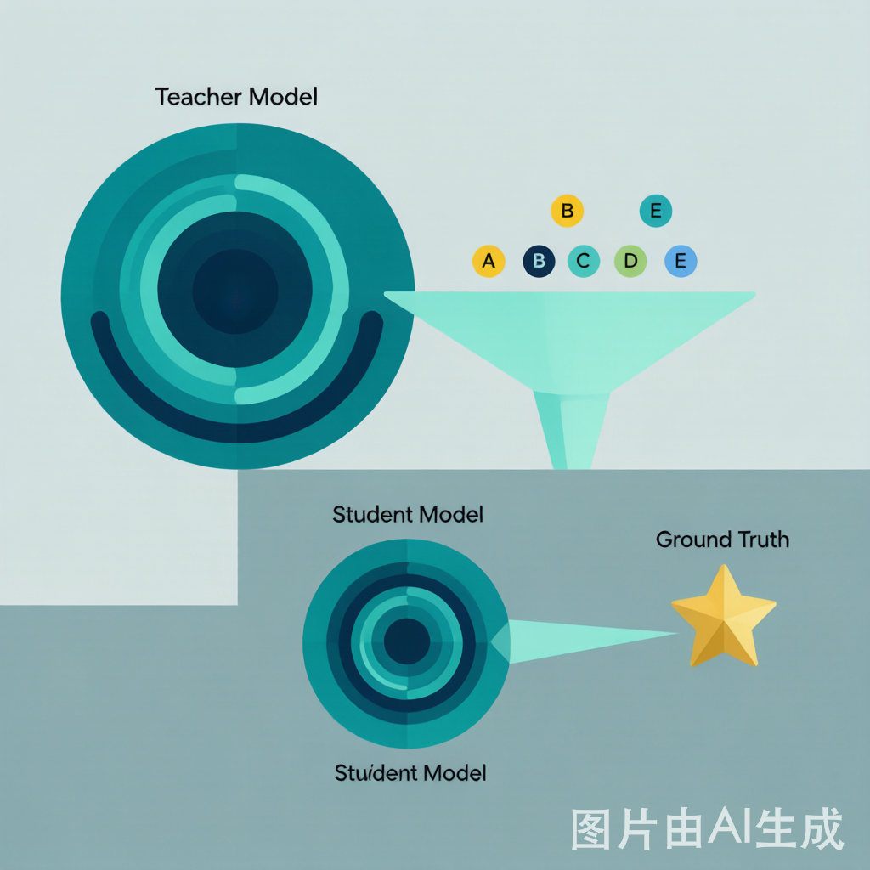
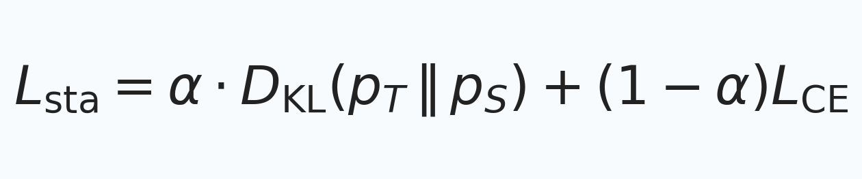
03 Core Method: Choice-Head Distillation
Stage 1: Choice-Head KL Distillation (Main Stage)
Distills only the teacher's distribution over the 5 answer options
• Loss: L = α·KL(p_T || p_S) + (1-α)·CE
• KL compares relative preferences across options
Stage 2: Gold-Answer SFT Calibration (Optional)
• Inherits Stage 1 LoRA weights
• Continues supervised fine-tuning with GT labels
• Stage 1 = relative map; Stage 2 = gold anchor
Design Intuition:
Keep teacher uncertainty that affects final option.
Drop dimensions that do NOT change the decision.
AIEA 2026 Conference Presentation 5/12
Notes:
Our method, Choice-Head Distillation, consists of two stages.
[POINT TO Stage 1]
Stage 1 is the MAIN stage — Choice-Head KL Distillation. Instead of distilling the full output distribution over 50,000 tokens, we only distill the teacher's distribution over the five answer options. The loss function combines KL divergence with cross-entropy. The KL term compares the teacher's and student's relative preferences across A, B, C, D, and E. The cross-entropy term ensures the student still learns from hard labels.
Variable Explanations:
L_sta : total loss of Stage 1
α : balance coefficient (α = 0.35 in main setting)
D_KL : KL divergence over 5 options (teacher vs student)
p_T : teacher distribution over A/B/C/D/E
p_S : student distribution over A/B/C/D/E
L_CE : cross-entropy loss vs gold-answer label
[PAUSE - point to Stage 2]
Stage 2 is OPTIONAL — Gold-Answer SFT Calibration. It inherits the LoRA weights from Stage 1 and continues with supervised fine-tuning using ground-truth labels. The intuition is: Stage 1 gives the student a relative preference map, and Stage 2 anchors it to the gold answers.
[PAUSE - emphasize the intuition]
The key design intuition is: keep the part of teacher uncertainty that directly affects the final option, and drop supervision dimensions that do NOT change the decision.

Slide 6

04 Why Decision-Space Distillation Matters
1. Task Alignment
Supervision follows five-option structure → better signal-to-noise
2. Efficiency
Full vocabulary → 5 options = much smaller target space
Lower memory, faster training, reduced teacher API cost
3. Black-Box Compatibility
Works with API-based teachers (DeepSeek-V3 API setup)
Uses option-level outputs or smoothed soft labels
4. Effective Transfer Signal
Option-level soft labels preserve relative preferences
among A/B/C/D/E
→ Decision-space transfer is a practical target for structured MCQs.
AIEA 2026 Conference Presentation 6/12
Notes:
Now, WHY does decision-space distillation matter? There are four key reasons.
[COUNT ON FINGERS]
First, TASK ALIGNMENT. Because the supervision follows the five-option structure, the signal-to-noise ratio is much better than full-vocabulary distillation.
We reduce the supervision space from tens of thousands of vocabulary dimensions down to just 5 — a reduction of four to five orders of magnitude.
We only need an approximate option-level soft label constructed from the teacher's returned answers — we do NOT need access to internal model states.
Option-level soft labels preserve the teacher's relative preferences among A, B, C, D, and E — the "dark knowledge" that actually affects the final decision.
[PAUSE - emphasize]
In summary, for structured MCQ tasks, decision-space transfer is a much better compression target than generic language modeling.

Slide 7

05 Experimental Setup
Dataset: CMExam-based resplit (6,590 medical MCQs)
• 70/15/15 partition (4,608 / 991 / 991)
• Full Test: 991 questions; Dental Subset: 125
Teacher: DeepSeek-V3 (87.18% on full test)
• Teacher-GT disagreement: 12.2% of training data
Students: Qwen2.5-7B / 14B-Instruct
• LoRA (rank=16, alpha=32), lr=1e-4
• Stage 1: 1 epoch; Stage 2: optional SFT epoch
Evaluation:
• Exact-match accuracy on final option
• 3 seeds to reduce run-to-run noise
• Closed answer space: only A/B/C/D/E
AIEA 2026 Conference Presentation 7/12
Notes:
Let me now describe our experimental setup.
[POINT TO EACH SECTION]
DATASET: We use a CMExam-based resplit with 6,590 single-choice medical questions. The data is split 70-15-15, resulting in 4,608 training, 991 validation, and 991 test questions. The split is stratified by difficulty. We evaluate on two test sets: the full test set of 991 questions, and a dental subset of 125 questions.
[PAUSE]
there is about 12 percent disagreement between the teacher's predictions and ground-truth labels
[PAUSE]
STUDENTS: We use Qwen2.5-7B-Instruct and Qwen2.5-14B-Instruct as student models. Training uses LoRA with rank 16 and alpha 32, learning rate 1e-4. Stage 1 runs for 1 epoch, and Stage 2 adds an optional SFT epoch.
[PAUSE]
EVALUATION: We use exact-match accuracy on the final option choice. We run 3 seeds to reduce run-to-run noise. The answer space is closed — only A through E are allowed, with no free-form generation.

Slide 8

06 Main Results & Analysis
Results on CMExam Test Sets
Model
Setting
Full Test
Dental
Qwen2.5-7B
Zero-shot
76.49%
68.80%
Qwen2.5-14B
Zero-shot
83.55%
74.40%
DeepSeek-V3
Teacher
87.18%
79.20%
Qwen2.5-7B
Stage 1 mean
85.60%
73.60%
Qwen2.5-14B
Stage 1 mean
88.67%
79.20%
Qwen2.5-14B
Stage 1 best
89.10%
78.40%
Key Findings:
• 14B best = 89.10% > Teacher = 87.18% (+1.92 pp)
• Stability: 3-seed range 88.40% ~ 89.10%
• Dental subset: 78.40% (≈ teacher 79.20%)
AIEA 2026 Conference Presentation 8/12
Notes:
Now, the main results.
[POINT TO TABLE]
Here are the results on both test sets. Let me walk you through the key comparisons.
[POINT TO ROWS]
First, the zero-shot baselines: Qwen2.5-7B gets 76.49 percent, and 14B gets 83.55 percent.
The teacher, DeepSeek-V3, gets 87.18 percent on the full test.
After our Stage 1 distillation, the 7B student improves to 85.60 percent, and the 14B student reaches 88.67 percent on average.
[EMPHASIZE - raise voice slightly]
Most importantly, the BEST 14B student achieves 89.10 percent — which SURPASSES the teacher's 87.18 percent by 1.92 percentage points.
[PAUSE - let this sink in]
On the dental subset, the 14B best result is 78.40 percent, which is close to the teacher's 79.20 percent.
The results are also stable: across 3 seeds, the spread is only 0.7 percentage points — from 88.40 to 89.10 percent.
[PAUSE]
This student-over-teacher result is one of our key findings.

Slide 9

07 Key Contributions
Contribution 1: Method
Proposes Choice-Head distillation — task-aligned
decision-space distillation for medical MCQs.
Compatible with black-box API teachers.
Contribution 2: Empirical Finding
Best 14B student outperforms the teacher
under task-aligned distillation.
Best 14B: 89.10% vs. Teacher: 87.18%.
Contribution 3: Analysis
Quantifies teacher-gold disagreement (12.2%).
Shows Stage 2 does NOT consistently help.
Provides deployment trade-off implications.
AIEA 2026 Conference Presentation 9/12
Notes:
Let me summarize the three key contributions of this work.
[HOLD UP ONE FINGER]
Contribution 1: METHOD. We propose Choice-Head distillation — a task-aligned, decision-space distillation framework for five-option medical MCQs. It replaces full-vocabulary distillation with option-level supervision. And importantly, it is compatible with black-box API teachers — you only need option probabilities, not internal states.
[HOLD UP TWO FINGERS]
Contribution 2: EMPIRICAL FINDING. We demonstrate that a smaller student can outperform a stronger teacher under task-aligned distillation. The best 14B student reaches 89.10 percent, compared to the teacher's 87.18 percent, on the 991-question test. And this result is stable across seeds.
[HOLD UP THREE FINGERS]
We quantify teacher label quality — about 12 percent disagreement with ground truth.

Slide 10

08 Practical Implications & Limitations
Practical Implications
Changes deployment trade-off:
Smaller student models for lower-cost deployment
Lower inference latency and deployment cost
Reduced dependence on large teacher inference
Applicable to any structured MCQ:
Medical exams, certifications, AI tutoring
Limitations
Task scope: only fixed-option MCQ
Experiment scope: 1 teacher, 1 student family
Stage 2: not always beneficial
No full-vocabulary baseline (teacher is API-only; internal logits unavailable)
AIEA 2026 Conference Presentation 10/12
Notes:
Now let me discuss the practical implications and limitations of our work.
[POINT TO LEFT - Implications]
On the practical side, our method changes the deployment trade-off. Instead of requiring a GPU with over 100 gigabytes of VRAM, the distilled student can run on a single consumer GPU. This means lower inference latency and no need for paid API calls.
Our approach is also applicable to any structured MCQ task — not just dental exams. It can be used for medical licensing exams, certification tests, and educational AI tutoring.
[PAUSE - point to right - Limitations]
However, there are important limitations.
First, TASK SCOPE: our method is designed for fixed-option MCQ. It does NOT directly apply to open-ended QA.
Second, EXPERIMENT SCOPE: we only tested with one teacher — DeepSeek-V3 — and one student family — Qwen2.5. More diverse combinations would strengthen the findings.
Third, Stage 2 is NOT always beneficial and requires careful tuning.
[PAUSE]
For future work, we plan to extend to other MCQ domains and test with more diverse teacher-student combinations.

Slide 11

09 Conclusion
This paper presented Choice-Head distillation
for dental MCQ answering.
The method distills only the five-option answer
distribution — computationally lighter and
black-box API compatible.
Key result: Qwen2.5-14B student reaches
89.10% accuracy, surpassing its DeepSeek-V3
teacher (87.18%) on the 991-question test.
For structured medical MCQs, decision-space
distillation provides an effective alternative
to full-vocabulary objectives for fixed-option tasks.
AIEA 2026 Conference Presentation 11/12
Notes:
To conclude,
[PAUSE - speak slowly and clearly]
This paper presented Choice-Head distillation for dental multiple-choice question answering.
The method distills only the five-option answer distribution from the teacher, making it computationally lighter and compatible with black-box API teachers.
[EMPHASIZE]
Our key result: the Qwen2.5-14B student reaches 89.10 percent accuracy, SURPASSING its DeepSeek-V3 teacher at 87.18 percent, on the 991-question test set.
For structured medical MCQs, decision-space distillation provides an effective alternative to full-vocabulary approaches.
[PAUSE]
Code and data will be publicly available.
Thank you for your attention. I am happy to take any questions.

Slide 12

Q & A / Backup Slides
Q1: Why distill only five options?
A: Task = five-option decision; full vocabulary is mostly irrelevant.
Q2: Why can the student beat the teacher?
A: Student combines teacher option preferences with
gold-label correction in the five-option decision space.
Q3: Can this extend to open-ended QA?
A: Not directly. Built for structured MCQs.
Q4: Does Stage 2 always help?
A: No. Best 14B result = Stage 1 only.
Thank you! Questions welcome.
AIEA 2026 Conference Presentation 12/12
Notes:
[BACKUP SLIDE - only use if asked]
Let me address some common questions you might have.
Q1: Why distill only five options? The answer is: the downstream task IS a five-option decision. Full-vocabulary supervision introduces several orders of magnitude more dimensions that do NOT affect the final answer. It is simply wasteful.
Q2: Why can the student outperform the teacher? The student learns the teacher's soft-label structure AND is directly optimized for the benchmark task. The teacher's full behavior is not constrained to MCQ — it generates fluently across many tasks, which may actually hurt its MCQ accuracy.
Q3: Can this extend to open-ended QA? Not directly. Our method is built for structured MCQs with fixed options. Open-ended QA would require different distillation targets, such as rationale generation.
Q4: Does Stage 2 always help? No. In our experiments, the best 14B result came from Stage 1 ONLY. Extra ground-truth fine-tuning can actually mildly hurt a well-distilled student.
[IF NO MORE QUESTIONS]
Thank you again for your attention! Feel free to reach out after the session.

