Slide 1





SCANVAS
Where Children’s Creativity Comes Alive
A creative learning platform that transforms children’s drawings into interactive digital experiences.
For children aged 3–10
Salsabila Khoirunnisa
CEO & Co-Founder
GESAwards 2026 · Female Founders Track
scanvas.id
Notes:
Scanvas turns a child’s own coloring sheet into an interactive experience: color on paper, scan in the browser, and the artwork comes alive.

Slide 2




Creativity Often Stops at the Paper
Children love drawing and coloring, but once the paper is finished, the learning moment often ends. Many screen-based activities are designed around watching and swiping rather than creating.
On paper
On screens
Creative and hands-on, but it ends when the page is done.
Engaging, but children mostly watch instead of make.
Create
Finished
Stop
Watch
Swipe
Watch
What if children’s own creations became the starting point of learning?
Notes:
Paper creativity is hands-on but ends at the page. Screens are engaging but mostly passive. Scanvas connects the two.

Slide 3






Learning Should Start
With Creating
Create
Scanvas is built around a simple idea: children should use digital technology to create, explore, and discover, not only consume.
Create
Again
Learn by
making
Explore
Create first
Start with the child’s own imagination.
Make it personal
Their own artwork becomes the experience.
Explore through interaction
Movement, sound, stories, and facts extend the activity.
Discover
Keep access simple
Open it in a browser, with no app installation required.
Notes:
This is our design philosophy, not a research claim: create first, make it personal, explore through interaction, keep access simple.

Slide 4




From Paper to Interactive Learning
Children color a physical sheet, scan it through the website, and watch their own artwork become an animated character with sound, motion, and educational content.
1
2
3
4
5
Color
Scan
Come Alive
Explore
Learn
Kids color a Scanvas paper sheet
Snap or upload a photo in the browser
The artwork comes alive in seconds
It swims inside a living world
A short story, sounds, and facts
Notes:
One simple loop: Color, Scan, Come Alive, Explore, Learn. Everything runs in the browser.

Slide 5






Already Live.
No App Required.
LIVE TODAY · scanvas.id
Physical → Digital
Paper coloring + photo/upload processing
Interactive worlds
Ocean & Vehicle worlds
Personalized animation
The child’s own artwork comes alive
Landing page
Scan / upload
Alive in the world
Learning layer
Vehicle world
Story & sound
Object sounds + short stories and facts
Digital trial
Try the experience before buying paper
Notes:
Everything on this slide is live today at scanvas.id: real screenshots from the current product.

Slide 6



Their Creation. Their Character.
Unlike generic videos or static worksheets, Scanvas makes the child’s own colored artwork the center of the digital experience.
Before: on paper
After: alive in Scanvas
Movement
Sound
Learning Facts
Notes:
The emotional core: the child is not watching a character, they are watching their own creation.

Slide 7
One Engine, Many Learning Experiences
1
Physical-Digital Bridge
2
Personalized Output
Children start with real paper and their own hands.
The scanned artwork, not a stock character, enters the experience.
3
Low-Friction Access
4
Reusable Learning Engine
Browser-based, with no mandatory app installation.
The same processing and interactive-world system can support animals, vehicles, nature, creative classes, and future themes.
Notes:
Why Scanvas can grow: one scan-to-animation engine, reused across many learning worlds.

Slide 8

From Magic Moment to Learning Platform
Today, Scanvas uses the child’s creation to trigger curiosity and discovery. Next, we are building structured learning activities around that engagement.
FUTURE
Learn → Practice → Create → Bring It Alive
NEXT
Create → Explore → Story → Quiz
CURRENT · LIVE
Digital drawing and coloring classes: learn step-by-step, practice digitally, and bring the creation into Scanvas worlds.
Color → Scan → Alive
An interactive learning layer with stories, guided questions, and simple quizzes.
Today’s magical coloring experience.
Notes:
Engagement engine exists today; structured learning comes next. Only the first step is live.

Slide 9
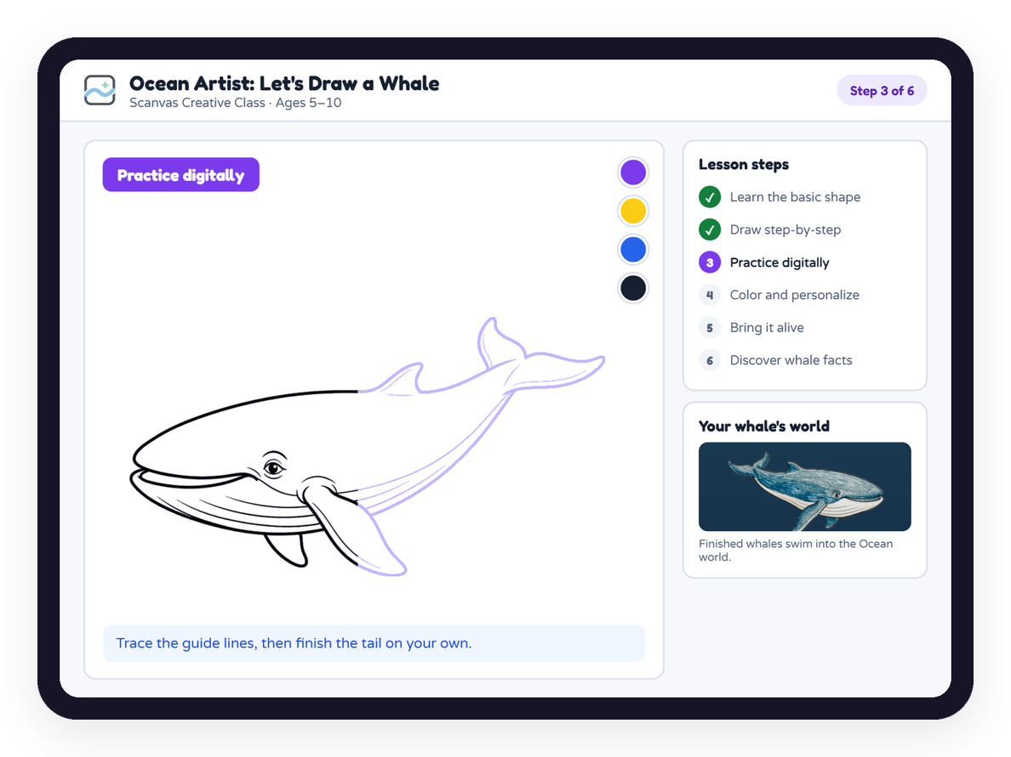
Learn by Creating
FUTURE ROADMAP · CONCEPT
Guided drawing classes that end inside a Scanvas world.
Example lesson Ocean Artist: Let’s Draw a Whale
1
Learn the basic shape
4
Color and personalize
2
Draw step-by-step
5
Bring it alive
3
Practice digitally
6
Discover whale sounds, habitat, and facts
Core loop
Learn
Practice
Create
Experience
Discover
Notes:
A future product: guided drawing classes that end with the child’s creation entering a Scanvas world.

Slide 10



One Platform, Multiple Paths to Scale
AVAILABLE NOW
IN DEVELOPMENT
FUTURE
B2C
B2B
B2C + B2B
Families
Schools & Events
Digital Learning
Physical creative packs combining coloring sheets with the Scanvas digital experience.
Scanvas Studio for organized sessions, participant management, bulk processing, and shared experiences.
Creative classes, learning worlds, content packs, and additional learning modules.
Revenue model
Per-pack purchase
Revenue model under validation
Per session / per participant / usage-based
Potential model
Subscriptions and content add-ons
Notes:
Families buy packs today. School and event pricing is being validated with the pilot before we commit to numbers.

Slide 11
Early Validation →
Scalable Learning Worlds
Early validation
1
PHASE 1
Live product · 2 worlds · scan-to-animation working
Validate the Magic
Improve scan reliability; grow from 1 TPA pilot to more families and schools.
30
1
5
pilot participants
real-world pilot (TPA)
improvements from feedback
PHASE 2
2
Build Learning
Feedback already changed the product
Stories, quizzes, guided creative lessons, teacher and session tools.
Shipped
Larger world for more creations
Shipped
Digital trial before purchase
In progress
Bulk drawing uploads
3
PHASE 3
Scale Platform
In progress
Learning space after play (Next stage)
Content library, Scanvas Studio, school partnerships, new learning worlds.
In progress
More worlds, e.g. a land version
Notes:
First real-world pilot: 30 participants at one TPA (Taman Pendidikan Anak-anak). The pilot surfaced five product improvements; two are shipped (larger world, digital trial) and three are in progress.

Slide 12



The Team Behind Scanvas
Salsabila Khoirunnisa
Haikal Hilmi
CEO & Co-Founder
CTO & Co-Founder
Business · partnerships · customer discovery · go-to-market
Product · engineering · computer vision · interactive platform
We want children to use technology not only to consume, but to imagine, create, and learn.
Scanvas — From imagination to interactive learning.
scanvas.id
GESAwards 2026 · Female Founders Track
Notes:
Salsabila leads business, partnerships, customer discovery and go-to-market; Haikal leads product, engineering and the computer-vision pipeline. Close on the vision: children as creators.

