Slide 1





SCANVAS
Where Children’s Creativity Comes Alive
Children turn their paper artwork into interactive characters and learning experiences, directly in the browser.
Top 30 · ITEC SEA 2026
Haikal Hilmi · CEO & Co-Founder
Salsabila Khoirunnisa · CMO & Co-Founder
Investor deck · October 2026
scanvas.id
Notes:
Scanvas turns a child’s paper artwork into an interactive character in the browser. Top 30 at ITEC SEA 2026. Live product, two worlds, one completed 30-child pilot, pre-revenue.

Slide 2




Parents and Schools Need Creative Activities
That Are Easy to Run and Worth Repeating
PARENTS
SCHOOLS & TPA
NEEDS
NEEDS
A creative activity they can easily accompany at home, that their child wants to do again.
A group activity that is easy to run, engages every child, and fits a school budget.
TODAY
TODAY
Coloring ends with the page; screens offer ready-made characters to watch.
Teachers prepare materials themselves; digital options often need apps or devices per child.
WHAT WE OBSERVED IN THE PILOT
WHAT WE STILL ASSUME (TO VALIDATE)
30 children participated in a color → scan → alive session at one TPA
Parents pay for a repeatable creative activity
Feedback asked for a larger world, a trial before buying, and faster group processing
Schools rebook sessions and later license a classroom format
Notes:
Separate what we saw from what we assume: 30 children took part in the pilot (participation, not a measured completion rate); willingness to pay and repeat use are hypotheses we test next.

Slide 3
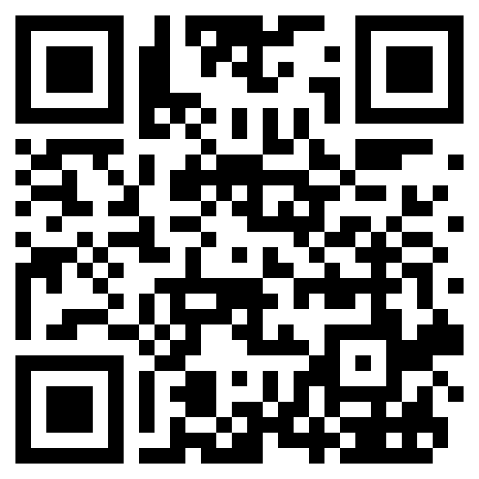



The Child Creates First; Technology Extends What They Created
1
2
3
4
TRY THE LIVE DEMO
COLOR
SCAN
COME ALIVE
EXPLORE
Child colors a printed Scanvas sheet.
Parent or teacher photographs it in the browser.
The child’s own artwork is extracted and animated.
It joins an interactive world with sound and facts.
Ocean + Vehicle worlds
No app installation
Free digital trial
Notes:
Real product screenshots. The QR opens the free digital trial at scanvas.id/trial.

Slide 4


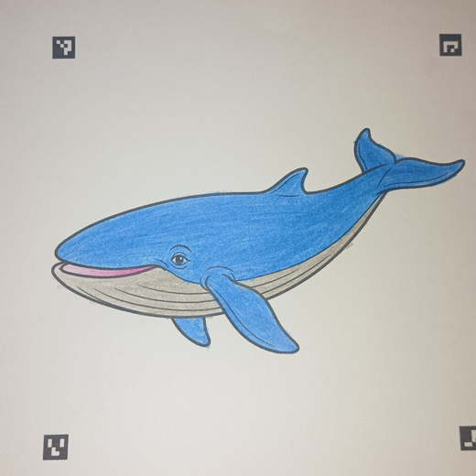
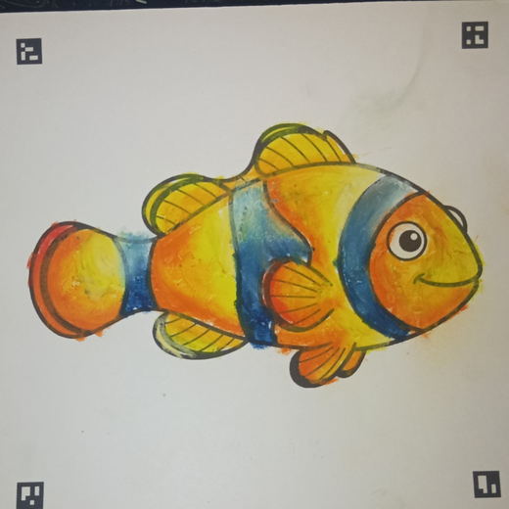
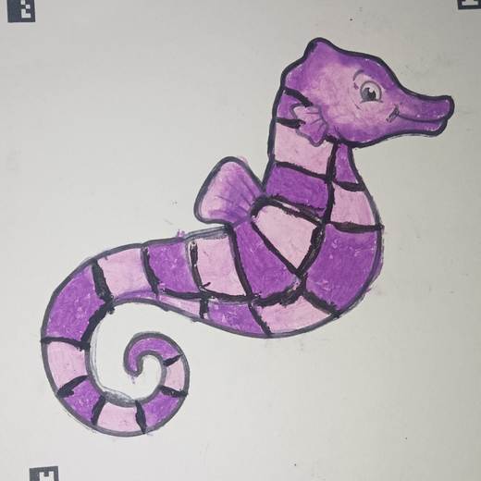
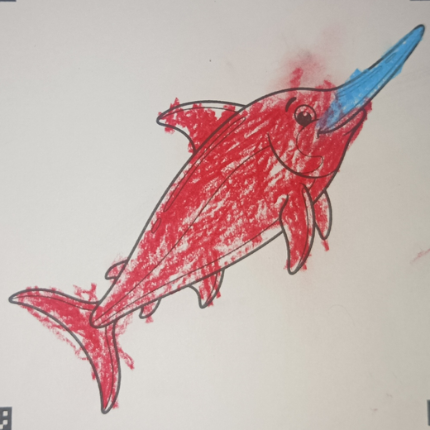

Live Product, First Pilot, and Clear Next Proofs
30
2
5
Top 30
children took part in first real-world pilot
interactive worlds live
product priorities from feedback
ITEC SEA 2026
SHIPPED
BUILDING
Larger interactive world
Bulk drawing processing
Digital trial before purchase
Story and learning space
Additional worlds
PROVEN
NEXT PROOFS · FROM JUDGE FEEDBACK
Product runs live in the browser
Paid demand: first paid sessions and packs
Children used it in a real group setting
Repeat: rebooking and second purchase (defined on slide 8)
First real-world pilot · TPA, D.I. Yogyakarta · pre-revenue
Feedback turns into shipped changes
Scan reliability ≥95% in group sessions
Delivery cost measured from real sessions
Notes:
We say "took part", not "completed": the pilot recorded participation, not a completion rate. ITEC Council feedback (Oct 2026) asked for financial clarity, unit economics, and validated demand.

Slide 5
Two Customer Channels, Sized Separately
INSTITUTIONS · sessions now, licenses later
FAMILIES · packs now, course later
BEACHHEAD
NEXT
NATIONAL
≈35.3M
7,123
62,797
420,886
children aged 3–10 in Indonesia (BPS-based estimate)
D.I. Yogyakarta
Central Java + DIY
Indonesia
Start where we can reach: families of children in our partner schools and online in Yogyakarta.
PAUD + primary-school units
YEAR-5 SALES TARGETS
250 licenses
10,000 course + 10,000 pack sales
≈0.4% of Central Java + DIY school units
Sales, not unique children: buyer share is measured once repeat rates are known
The two channels are not added together: a family reached through a school is counted once.
Sources: Kemendikdasmen Data Referensi Pendidikan (PAUD, SD), accessed Sep 2026 · BPS population by age group 2022, ages 3–10 estimated. Details in Appendix D.
Notes:
Institution counts are market coverage, not demand. Pack and course numbers are transactions, so no penetration of unique children is claimed.

Slide 6
Start With Packs and Sessions; Add Course and Licenses When Proven
OFFER
STATUS
PRICE
DIRECT COST
CONTRIBUTION
Family creative pack
Rp49K
Rp20K
Rp29K · 59%
LIVE · TEST PRICE
Managed school / event session
Rp1M
Rp250K
Rp750K · 75%
VALIDATING
Ocean Artist digital course
Rp99K
Rp20K
Rp79K · 80%
PLANNED · AFTER 3-LESSON PILOT
Studio / Classroom license (per year)
Rp2.4M / year
Rp240K
Rp2.16M · 90%
PLANNED · YEAR 3
Bundle rule: a course buyer who also wants a physical kit buys a pack, counted once in pack revenue. What each direct cost covers: Appendix A.
All prices and costs are commercial-testing assumptions (Oct 2026), not validated at scale.
Notes:
Session direct cost covers the facilitator, transport, and printed sheets, so it is not repeated in opex. License cost covers hosting and a scan quota, onboarding, and support; content updates are opex.

Slide 7
A Proven Category; Scanvas Combines What Others Split
Scanvas
Coloring-to-
animation apps
Guided creative
lessons
Venue / class
activities
Faber-Castell ARt Alive · Quiver
WAGZAK JUMP · video tutorials
teamLab Sketch Aquarium · art classes
Child’s own artwork becomes the character
LIVE
Some
Venue only
Runs in the browser, no app
LIVE
—
Some
—
Shared interactive worlds
LIVE
—
—
Facilitated group sessions
PILOT
—
Some
Guided lessons with progress
PLANNED
—
Classroom license / Studio
PLANNED
Edu plans
School license
—
Competitors validate demand for each piece. Our bet is that one engine combining them earns paid, repeat use. Evidence per product in Appendix E.
Notes:
We separate what Scanvas does today (live) from what is planned.

Slide 8
Two Funnels, Each Built for a Second Purchase
Schools & TPA
Outreach
Demo session
Paid session
Rebooking
License
MEASURE
SECOND PURCHASE
Demo → paid conversion · cost per session · scan success
Rebooking each term; license once Studio is ready
YEAR-1 MATH
400 schools contacted (5.6% of DIY) → 100 demos (25%) → 40 paying schools (40%) + 8 rebookings (20%) = 48 sessions · demos ≈Rp12M (≈Rp300K per paying school) · Salsabila + 1 facilitator from month 4
Families
Short video
Free trial
Pack (WhatsApp)
Level 1 course
Level 2
MEASURE
SECOND PURCHASE
Trial → pack conversion · course activation · next-lesson start
Next pack or Level 2; school sessions feed family trials
YEAR-1 MATH
≈200K views → 10,000 trials (5%) → 500 first buyers (5%) + 100 repeat packs (20%) = 600 packs; 100 courses · ads + content ≈Rp18M (≈Rp36K per first buyer; payback via repeat + course is a hypothesis to test)
YEAR-1 TARGETS · REPEAT DEFINED PER CHANNEL
48
paid sessions: 40 first + 8 rebooked
500 + 100
first buyers + repeat packs = 600; 100 courses
≥20%
of paying schools rebook within 90 days
≥20%
of pack buyers buy again within 90 days
Notes:
Conversion rates are planning assumptions to be measured, not results. GTM budget: schools ≈Rp12M + families ≈Rp18M = Rp30M (use of funds). First-buyer CAC (≈Rp36K) exceeds one pack’s contribution (Rp29K); per first buyer we expect ≈Rp51K (pack + 20% repeat + 1-in-5 course) — a hypothesis to test.

Slide 9



Founders Who Have Built, Shipped, and Run Programs
Haikal Hilmi
Salsabila Khoirunnisa
CEO & Co-Founder · 60% pre-investment
CMO & Co-Founder · 40% pre-investment
Product, engineering, computer vision, company strategy
Brand, customers, partnerships, go-to-market
Information Engineering, Universitas Gadjah Mada
Politics & Government, Universitas Gadjah Mada
Backend Engineer Intern, ByteDance: Go service at 100K+ requests/s
Exchange at Korea University, Hyundai CMK scholar (2024–2025)
Data engineer for a major Indonesian airline’s reporting pipelines
Chief of Social Impact, Gifood: partnerships with 7+ communities; platform reached 6,000+ users
Engineering PM, Gadjah Mada Aerospace Team: 40+ engineers; 3rd place Teknofest (Türkiye)
Program Manager, Sedekah Baju Yogyakarta: led 200+ volunteers, 20+ partner organizations
1st in Indonesia, 2nd in SEA, PwC Hack-A-Day
1st place, Global Social Enterprise Competition (Thailand, 2024)
Together: live product, 2 worlds, first 30-child pilot, Top 30 ITEC SEA 2026.
Notes:
Credentials as listed in each founder’s CV (Oct 2026). Numbers under Salsabila are results of the programs and teams she led. Ownership shown is before this round.

Slide 10

12-Month Plan With a Numeric Gate Before Each Build
MONTHS 1–3
MONTHS 4–6
MONTHS 7–9
MONTHS 10–12
Prove paid demand
Studio MVP + 3-lesson pilot
Lessons 4–10 (only if gate passes)
Scale what works
First paid sessions
Scanvas Studio MVP in ≥3 schools
Ocean Artist Level 1 (10 lessons)
48 paid sessions cumulative
Test pack and session pricing
Ocean Artist 3-lesson pilot
Course launch to pilot families
600 packs · 100 courses
Scan reliability in groups
Real paid offer
Rebooking offers to schools
2 → 4 worlds
Gate · 90 days: ≥12 paid sessions from ≥8 schools; ≥95% scan success over ≥300 scans
Gate · 30 days, ≥30 children: ≥60% start lesson 2; ≥40% finish 3; ≥20% of parents pay
Gate · 90 days: ≥50 paid courses; ≥20% of paying schools rebook
Year-1 target: Rp87.3M revenue; delivery cost per session measured
If a gate fails, we do not build the next layer: we fix the offer or the price first.
Notes:
Thresholds are proposals for the founders to confirm. Order from the roadmap: magic first (P0), then course foundation and the 3-lesson pilot, then lessons 4–10 only after the decision gate.

Slide 11
From One Engine to a Course Catalog and Classroom Distribution
YEAR 1
YEAR 2
YEAR 3
YEAR 4
YEAR 5
Validate
Repeat
Classroom
Catalog
Regional option
Packs + sessions
Level 2 + more worlds
Studio / Classroom licenses
Course catalog (new themes)
ASEAN via partners
Ocean Artist pilot → Level 1
More schools in DIY
Only if Indonesia is operating-positive and repeat targets hold
Central Java cities
Distribution partners
Packs · sessions
+ courses
+ licenses
All four
Option, not in base
BASE-CASE REVENUE BY YEAR (INDONESIA ONLY)
Rp2.68B
Rp1.19B
Rp531.0M
Rp87.3M
Rp204.3M
Packs
Sessions
Course
Licenses
Course and licenses are planned; each starts only after its validation gate.
Notes:
ASEAN is an option after the Indonesian model is proven, with a local partner; the base-case revenue is Indonesia only.

Slide 12

Operating-Positive From Year 3 in the Base Case
YEAR 1
YEAR 2
YEAR 3
YEAR 4
YEAR 5
REVENUE
REVENUE
REVENUE
REVENUE
REVENUE
Rp87.3M
Rp204.3M
Rp531.0M
Rp1.19B
Rp2.68B
OPERATING RESULT
OPERATING RESULT
OPERATING RESULT
OPERATING RESULT
OPERATING RESULT
−Rp118.7M
−Rp63.7M
+Rp65.0M
+Rp243.8M
+Rp870.0M
CASH AT YEAR END
CASH AT YEAR END
CASH AT YEAR END
CASH AT YEAR END
CASH AT YEAR END
Rp62.3M
Rp64.6M
Rp96.8M
Rp282.1M
Rp1.04B
Funding: Rp200M this round · planned additional funding in year 2: Rp75M, not committed (sized from the monthly cash low point plus a 3-month buffer, Appendix B)
Conservative case (60% of volumes, same costs): operating result stays negative until year 5 and needs more capital or lower costs from year 2.
Working scenario, Oct 2026: not an approved forecast. Cash includes capex and working capital; pre-tax. Full table in Appendix A.
Notes:
Show three lines live: revenue, operating result, and funding need. Details stay in the appendix.

Slide 13

Investment Ask: Rp200M for 12%
This round buys proof: customers pay, buy again, and can be served at a measured cost.
Rp200M
USE OF FUNDS
WHAT IT PROVES IN 12 MONTHS
48%
Team & operations
Rp96M
Paid demand: 48 sessions · 600 packs
for 12% equity (post-money)
15%
Go-to-market
Rp30M
Repeat: ≥20% of schools rebook, ≥20% of buyers buy again
12%
Product & technology
Rp24M
Delivery cost per session measured
Implied post-money valuation ≈ Rp1.67B
10%
Production
Rp20M
12-month runway to the milestones below
10%
Content & course
Rp20M
Ocean Artist pilot gate passed → Level 1
5%
Legal & contingency
Rp10M
≥95% scan success in groups
Haikal Hilmi · CEO
haikal.hilmi02@gmail.com
Let’s build it together.
Salsabila Khoirunnisa · CMO
scanvas.id · WhatsApp +62 895-3675-97379
salsabilakhn22@gmail.com
TRY THE DEMO
Notes:
Rp200M for 12% post-money. Implied post-money ≈ Rp1.67B (200 / 0.12), pre-money ≈ Rp1.47B. After the round: Haikal 52.8%, Salsabila 35.2%, investor 12%. (Internal only: negotiation room to 15%.)

Slide 14
Appendix A · Unit Costs, Volumes, and Annual Cash Flow
OFFER
PRICE
DIRECT COST
WHAT THE DIRECT COST COVERS
Family creative pack
Rp49K
Rp20K
Printing & packaging Rp10K + delivery Rp10K per pack
Managed school / event session
Rp1M
Rp250K
Facilitator fee, transport, printed sheets for up to 30 children (not in opex)
Ocean Artist digital course
Rp99K
Rp20K
Video hosting, payment fee, customer support (cash costs only; lesson production is in opex)
Studio / Classroom license / yr
Rp2.4M
Rp240K
Hosting & scan quota (up to 3,000 scans/yr), teacher onboarding, support; content updates in opex
BASE VOLUMES
Y1
Y2
Y3
Y4
Y5
Y1
Y2
Y3
Y4
Y5
Family packs
600
1,200
2,500
5,000
10,000
Revenue
87.3M
204.3M
531.0M
1.19B
2.68B
Sessions
48
96
200
360
600
Contribution
61.3M
146.3M
395.0M
903.8M
2.07B
Courses
100
500
1,500
4,000
10,000
Operating expenses
−180.0M
−210.0M
−330.0M
−660.0M
−1.20B
Licenses
—
—
25
80
250
Operating result
−118.7M
−63.7M
65.0M
243.8M
870.0M
Capex
−15.0M
−5.0M
−15.0M
−30.0M
−50.0M
Year-1 opex Rp180M: founders Rp4M/month each, GTM, product, content, legal
Change in working capital
−4.0M
−4.0M
−17.8M
−28.5M
−62.3M
Working capital: Y1–2 from the monthly model; Y3–5 = 1 month of receivables + 2 months of print stock
Funding in (Y2 planned)
200.0M
75.0M
—
—
—
Cash at year end · base
62.3M
64.6M
96.8M
282.1M
1.04B
Capex: devices and session kits; servers and devices as volumes grow
Operating result · conservative
−143.2M
−122.2M
−93.0M
−117.7M
42.0M
Pre-tax; per-drawing platform revenue and grants excluded
Cash at year end · conservative
39.4M
−15.2M
−133.9M
−298.8M
−344.2M
Notes:
Every number on this slide comes from the model at the top of content_investor.py.

Slide 15
Appendix B · Monthly Cash, Months 1–24
CASH BALANCE AT MONTH END (Rp JUTA)
WHY THE YEAR-2 RAISE
200
Without it, cash turns negative in month 22 and reaches −Rp10.4M in month 24.
A planned, not committed Rp75M keeps cash above a 3-month opex buffer.
Conservative case still dips to −Rp15.2M.
100
ASSUMPTIONS
Rp200M arrives in month 1
Schools pay 30 days after each session
0
Packs printed in prepaid batches (200, then 300)
M1
M6
M12
M13
M18
M24
Devices and session kits: Rp15M in month 1, Rp5M in month 13
Base, with Rp75M planned in month 13
Without the year-2 raise
Buffer Rp52.5M
Opex Rp15.0M/month in year 1, Rp17.5M/month in year 2
Notes:
The year-2 raise is planned, not committed: the amount that keeps cash above a 3-month opex buffer at the monthly low point.

Slide 16
Appendix C · Sales Engine and Team Capacity
TARGET
CHANNEL
CONVERSION (ASSUMED)
ACQUISITION COST
TEAM CAPACITY
Y1 · 48 paid sessions
Direct outreach + demo sessions in DIY
25% contact → demo; 40% demo → paid (40 schools); 20% rebook (8)
≈Rp12M demos (≈Rp300K per paying school)
Salsabila + 1 freelance facilitator from month 4
Y1 · 600 packs, 100 courses
Short videos, free trial, WhatsApp orders
5% view → trial; 5% trial → 500 first buyers; 20% buy again (100); 1 in 5 → course
≈Rp18M (≈Rp36K per first buyer; payback is a hypothesis)
Salsabila (content + orders)
Y5 · 600 sessions (50/month)
School network + rebooking in DIY and Central Java
≥50% of sessions from rebooking
Target ≤Rp150K per new paying school
4 freelance facilitators (~16 sessions/month each; fee in direct cost)
Y5 · 10,000 courses (≈833/month)
Partner-school family trials + digital ads
≥25% of Level 1 finishers buy Level 2
Ceiling ≤Rp40K per course (half of contribution)
2 content & growth staff (opex)
Y5 · 250 licenses
Schools that already rebooked sessions
Session → license after 2+ rebookings
Sales by school-success staff (opex)
2 school-success staff, ≈10 onboardings/month
Notes:
All conversion and cost figures are planning assumptions to be replaced by measured values in year 1.

Slide 17
Appendix D · Market Figures Use Kemendikdasmen Data and a BPS-Based Estimate
Figure
Value
How it is calculated / source
PAUD units, Indonesia
243,604
TK 134,789 + KB 86,429 + TPA 2,684 + SPS 19,702 · Kemendikdasmen
Primary schools (SD sederajat), Indonesia
177,282
Kemendikdasmen Data Referensi Pendidikan
PAUD + primary schools, Indonesia
420,886
243,604 + 177,282
Central Java + D.I. Yogyakarta
62,797
PAUD 32,839 + 5,071 · SD 22,835 + 2,052
D.I. Yogyakarta
7,123
PAUD 5,071 + SD 2,052
Children aged 3–10, Indonesia
≈35.3M
2/5 × 22,094,426 (0–4) + 22,013,768 (5–9) + 1/5 × 22,088,673 (10–14) · BPS 2022
Kemendikdasmen: referensi.data.kemendikdasmen.go.id (PAUD & Dikdas per province), accessed Sep 2026. BPS: Jumlah Penduduk Menurut Kelompok Umur, Long Form SP2020 (2022). TPA in Kemendikdasmen data = Taman Penitipan Anak.
Notes:
Single-year ages are not published in this table, so ages 3-10 are a proportional estimate.

Slide 18
Appendix E · Competitor Evidence
Scanvas
Faber-Castell
ARt Alive
Quiver
WAGZAK
JUMP
teamLab Sketch
Aquarium
Paper coloring → digital
Child’s artwork becomes character
No app required (web)
—
—
—
Venue only
Shared interactive worlds
—
—
—
Educational / story content
Some
Some
Institutional sessions
Pilot
—
Edu subscription
School license
Installation
Large ready-made content library
2 worlds
—
100+ lessons
—
Brand & distribution reach
Early
Retail brand
26M+ downloads
30 languages
Museums
Scanvas does not need to replace these products. The opportunity is to combine a low-friction web experience, child-generated characters, shared worlds, and a reusable content engine.
Evidence checked Sep 2026 on each product’s official site.
Notes:
We do not claim no competitors: they prove the category exists. Evidence checked Sep 2026 on each product’s official site.

Slide 19








Appendix F · Technology, Delivery, and Child Data
1
2
3
4
5
6
7
Physical creation
Capture
Computer vision
Digital asset
Interactive runtime
Content layer
Reusable world engine
Child colors a Scanvas sheet
Camera or photo upload
Marker detection
Child’s artwork becomes the character
Animation
Story
Ocean
Perspective correction
Movement
Facts
Vehicles
Sounds
Discovery
Future: culture, nature, characters
Crop
Interactive world
Object extraction
RESPONSIBLE CHILD DATA
VALIDATION PRINCIPLE
Collect only what is necessary. No child name, parent identity, email, phone, precise location, or artwork itself as analytics payload by default.
Build
Measure
Gate
Expand
Do not build the full course before a 3-lesson pilot validates progression and willingness to pay. Do not build large Mission/Story/AI layers before repeat usage is proven.
Notes:
Backend detects ArUco markers, corrects perspective, and extracts the object; the frontend shows it with motion, sound, and facts. Child data is minimised by default.

Slide 20
Appendix G · Course MVP: Ocean Artist Level 1 as a Learning Product
1
Kenalan dengan Warna
choose colors, experiment
A
LEARNING OUTCOMES
AGE & ROLES
By lesson 10 the child chooses and combines colors on purpose, controls strokes, makes patterns and textures, and explains their own design choices.
Main target 5–9 (to validate); 3–4 with an adult. Parent sets up and scans; teacher runs the classroom version. The child decides the final artwork.
2
Mewarnai Lebih Rapi
hand control
B
3
Kombinasi Warna
2–3 colors
C
4
Pola Seru
lines, dots, stripes
D
HOW PROGRESS IS SEEN
WHY LEVEL 2
5
Terang dan Gelap
pressure and tone
E
A simple skill checklist per lesson, filled by parent or teacher, plus the child’s artwork collection in My World, lesson by lesson.
New skills that build on Level 1, and a portfolio that shows the child’s growth; new characters are a bonus, not the reason.
6
Campur Warna
simple blending
F
7
Tekstur
scales, spots
G
8
Warna Imajinasi
beyond realistic
H
GATE 3 → 10 LESSONS · PILOT LESSONS 1–3 FIRST
9
Tema dan Suasana
palette by theme
I
≥60% start lesson 2 · ≥40% finish 3 · ≥20% of parents pay · Level 2 requests
10
Ocean Masterpiece
combine all skills
J
Notes:
From roadmap_new (P1D): do not produce lessons 4–10 before the 3-lesson pilot passes. Age target and checklist are proposals to validate in the pilot.

