Slide 1





SCANVAS
Where Children’s Creativity Comes Alive
Interactive digital culture for children: their own paper drawings become animated characters, worlds, and stories in the browser.
For children aged 3–10
Scanvas Co-Founders
Salsabila K. · Haikal H.
ITEC SEA 2026 · Digital Culture Track
scanvas.id
Notes:
Scanvas is a phygital (physical + digital) interactive-entertainment platform: a child colors a printed sheet, scans it in the browser, and their artwork comes alive as a character in a digital world.

Slide 2




Creativity Often Stops at the Paper
Printed coloring content ends when the page is finished. Most children’s digital entertainment is designed to be watched and swiped, not created.
Printed content
Digital media
Creative and hands-on, but it ends when the page is done.
Engaging, but children mostly watch instead of make.
Create
Finished
Stop
Watch
Swipe
Watch
What if a child’s own drawing became their character in a digital world?
Notes:
Two gaps: printed creative content has no digital life, and digital entertainment rarely lets children create. Scanvas connects the two.

Slide 3






Children Should Create
Digital Culture
Create
Scanvas is built around a simple idea: children should use technology to create, explore, and discover, not only consume.
Create
Again
Create,
not only watch
Explore
Create first
The story starts with the child’s own imagination on paper.
Make it personal
Their artwork becomes the character, not a stock asset.
Interactive, not passive
Movement, sound, stories, and facts extend the play.
Discover
Keep access simple
Open it in a browser, with no app installation required.
Notes:
Design philosophy, not a research claim: children as creators of digital content, not only consumers.

Slide 4




From Paper to Interactive Worlds
Children color a printed sheet, scan it through the website, and watch their own artwork become an animated character with sound, motion, and story content.
1
2
3
4
5
Color
Scan
Come Alive
Explore
Discover
Kids color a Scanvas paper sheet
Snap or upload a photo in the browser
The artwork comes alive in seconds
It swims inside a living world
A short story, sounds, and facts
Notes:
One loop: Color, Scan, Come Alive, Explore, Discover. Everything runs in the browser.

Slide 5






Already Live.
No App Required.
LIVE TODAY · scanvas.id
Physical → Digital
Printed sheets + photo/upload processing
Interactive worlds
Ocean & Vehicle worlds
Personalized animation
The child’s own artwork comes alive
Landing page
Scan / upload
Alive in the world
Story & sound layer
Vehicle world
Story & sound
Object sounds + short stories and facts
Digital trial
Try the experience before buying paper
Notes:
Everything on this slide is live today at scanvas.id: real screenshots from the current product.

Slide 6



Their Creation. Their Character.
Unlike generic videos or static printed pages, Scanvas makes the child’s own colored artwork the character of the digital experience.
Before: on paper
After: alive in Scanvas
Movement
Sound
Story & Facts
Notes:
The emotional core of the product: the child is not watching a character, they are playing with their own creation.

Slide 7
One Engine, Many Interactive Worlds
1
Computer-Vision Scan
2
Personalized Animation
Four printed markers guide perspective correction, cropping, and masking of the photo.
The extracted artwork, not a stock character, is animated in the world.
3
Code-Linked Sheets
4
Reusable Content Engine
Each printed sheet carries a unique access code tied to its template.
New worlds are new sheet templates plus world assets on the same pipeline: animals, vehicles, culture, and more.
Notes:
Product and technology: ArUco-marker detection, perspective warp, crop and mask, then animation in a browser world. Sheets are tied to access codes, which links the printed product to the digital one.

Slide 8

From Magic Moment to Content Platform
Today, Scanvas turns a child’s creation into an interactive character. Next, we build story and learning layers and a growing library of worlds.
FUTURE
Learn → Practice → Create → Bring It Alive
NEXT
Create → Explore → Story → Quiz
CURRENT · LIVE
Digital drawing classes and new content worlds, from nature to local culture and original Scanvas characters.
Color → Scan → Alive
An interactive layer with stories, guided questions, and simple quizzes.
Today’s interactive coloring experience.
Notes:
Only the first stage is live. Next and Future are roadmap: story/learning layers and a content library.

Slide 9
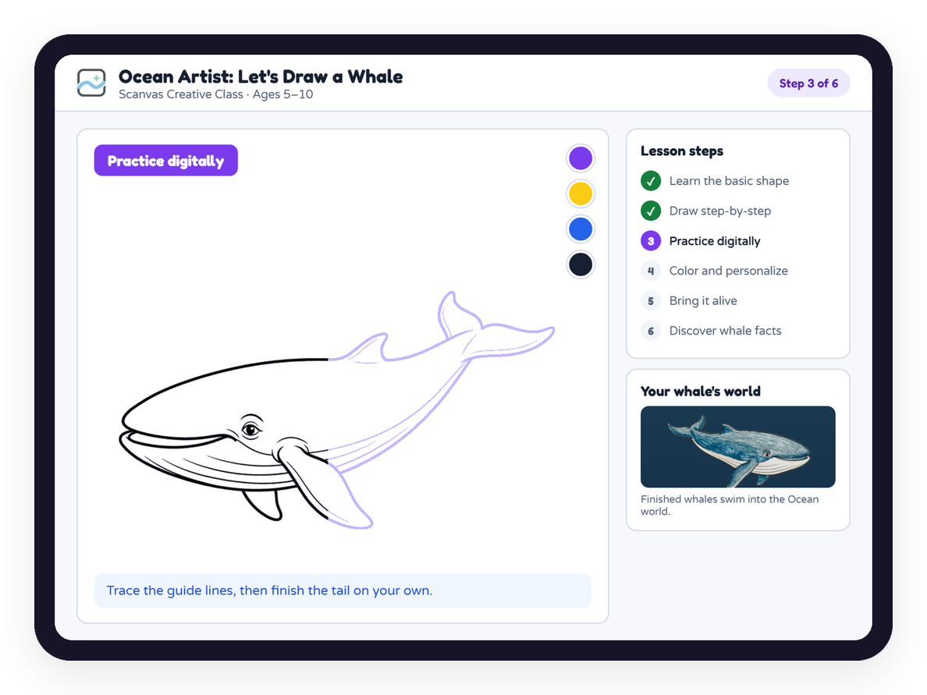
Learn by Creating
FUTURE ROADMAP · CONCEPT
Guided drawing classes that end inside a Scanvas world.
Example lesson Ocean Artist: Let’s Draw a Whale
1
Learn the basic shape
4
Color and personalize
2
Draw step-by-step
5
Bring it alive
3
Practice digitally
6
Discover whale sounds, habitat, and facts
Core loop
Learn
Practice
Create
Experience
Discover
Notes:
A future content format: guided drawing classes that end with the child’s creation entering a world.

Slide 10



Who Pays: Families, Schools, and Events
AVAILABLE NOW
IN DEVELOPMENT
FUTURE
B2C
B2B
B2C + B2B
Families
Schools & Events
Content Library
Printed creative packs that unlock the Scanvas digital experience with a code per sheet.
Scanvas Studio for organized sessions, participant management, bulk processing, and shared screens.
New worlds, character packs, creative classes, and licensed content collaborations.
Revenue model
Per-pack purchase
Revenue model under validation
Per session / per participant / usage-based
Potential model
Subscriptions and content add-ons
Notes:
Families buy packs today. School and event pricing is being validated with the pilot before we commit to numbers. Content library is the future platform model.

Slide 11
Early Traction →
What We Learned
Early validation
1
PHASE 1
Live product · 2 worlds · scan-to-animation working
Validate the Magic
Improve scan reliability; grow from 1 TPA pilot to more families and schools.
30
1
5
pilot participants
real-world pilot (TPA)
improvements from feedback
PHASE 2
2
Build the Layers
Feedback already changed the product
Stories, quizzes, guided creative lessons, session tools for schools.
Shipped
Larger world for more creations
Shipped
Digital trial before purchase
In progress
Bulk drawing uploads
3
PHASE 3
Scale Content
In progress
Story & learning space after play
World library, Scanvas Studio, partnerships, and regional content.
In progress
More worlds, e.g. a land version
Notes:
First real-world pilot: 30 participants at one TPA (Taman Pendidikan Anak-anak). The pilot surfaced five product improvements; two are shipped (larger world, digital trial) and three are in progress.

Slide 12



The Team Behind Scanvas
Salsabila Khoirunnisa
Haikal Hilmi
CEO & Co-Founder
CTO & Co-Founder
Business · partnerships · customer discovery · go-to-market
Product · engineering · computer vision · interactive platform
We want children to use technology not only to consume, but to imagine, create, and play.
Scanvas — From imagination to interactive worlds.
scanvas.id
ITEC SEA 2026 · Digital Culture Track
Notes:
Complementary founders: Salsabila leads business, partnerships and go-to-market; Haikal leads product, engineering and the computer-vision pipeline.

