Slide 1





SCANVAS
Where Children’s Creativity Comes Alive
Children turn their own paper drawings into characters, interactive worlds, and stories — directly in the browser.
For children aged 3–10
LIVE PRODUCT · 2 WORLDS · 30-CHILD PILOT · NO APP REQUIRED
Salsabila Khoirunnisa · CEO & Co-Founder
Haikal Hilmi · CTO & Co-Founder
ITEC SEA 2026 · Digital Culture Track
scanvas.id
Notes:
Scanvas: a child’s own paper drawing becomes an interactive character in a digital world, in the browser. Live today, 2 worlds, one completed 30-child pilot, no app required.

Slide 2




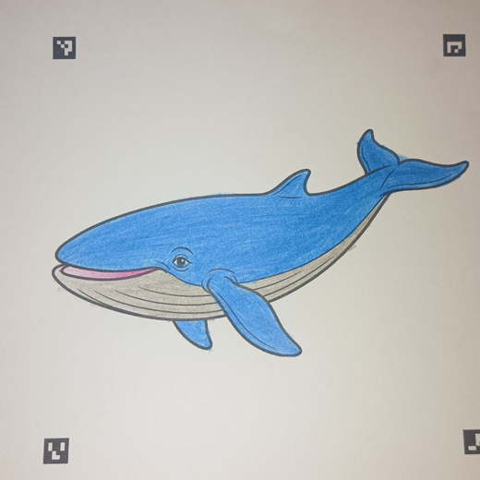
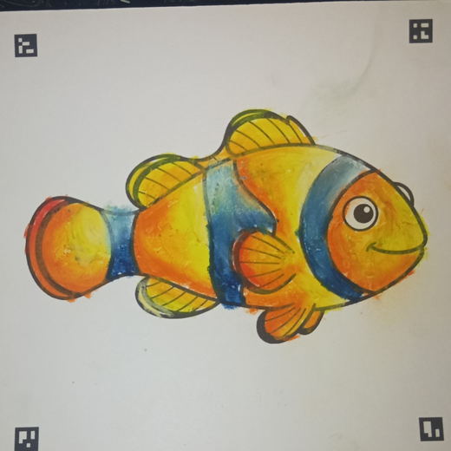
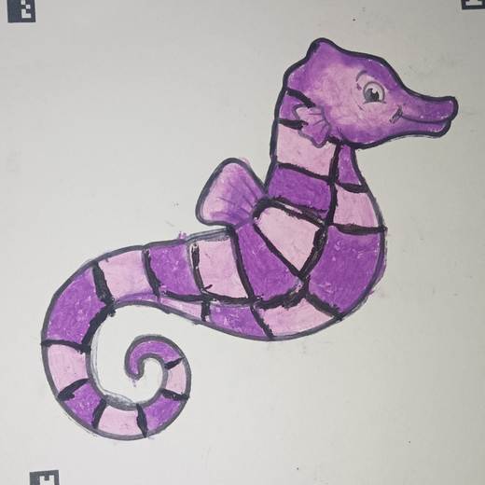
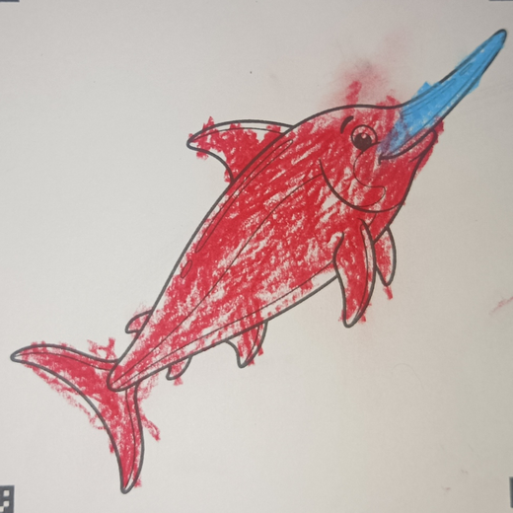

Creativity Starts With the Child —
But Often Stops at the Page
Physical creativity
Digital entertainment
Children draw, color, and imagine. But when the page is finished, the experience usually ends.
Engaging, but children often watch, swipe, and consume someone else’s content.
CREATE
FINISHED
STOP
WATCH
SWIPE
WATCH
WHAT WE HAVE TESTED
Sheets colored by children in the pilot
30 children · 1 real-world TPA pilot · D.I. Yogyakarta
What if the child’s own creation became the starting point of the digital experience?
Notes:
Physical creativity has no digital life; digital entertainment rarely lets children create. We tested this with 30 children in one TPA in D.I. Yogyakarta; the sheets shown are their real artwork.

Slide 3





A Child’s Own Drawing Becomes an Interactive Character in Seconds
TRY IT LIVE
1
2
3
4
5
Color
Scan
Come Alive
Explore
Discover
Child colors a Scanvas sheet
Photograph or upload it in the browser
The artwork is extracted and animated
Their character enters an interactive world
Stories, sounds, and facts extend it
Not a stock character. The child’s own creation becomes part of the world.
Notes:
Color, Scan, Come Alive, Explore, Discover. The QR opens the public digital trial at scanvas.id/trial.

Slide 4




Our First 30-Child Pilot
Already Changed the Product
2
30
1
5
interactive worlds live
children in first real-world pilot
TPA pilot completed
product improvements from feedback
BUILT
TESTED
LEARNED
SHIPPED
FEEDBACK → PRODUCT
SHIPPED
Larger interactive world
SHIPPED
Digital trial before purchase
BUILDING
Bulk drawing processing
BUILDING
Story & learning space
BUILDING
Additional worlds
First real-world pilot · TPA, D.I. Yogyakarta
Notes:
Pilot participants were not paying customers. Its value: five product improvements, two already shipped. Pre-revenue.

Slide 5




One Core Engine. Many Interactive Worlds.
New content reuses the same scanning, personalization, and interactive-world pipeline.
1
Computer-Vision Scan
2
Personalized Output
Printed markers guide perspective correction, cropping, and object extraction.
The child’s extracted artwork, not a stock character, enters the world.
3
Code-Linked Physical Content
4
Reusable World Engine
Each printed sheet links to its template and digital experience.
Animals · vehicles · nature · culture · characters · stories.
WEB ACCESS
PERSONALIZED CONTENT
SHARED WORLDS
REUSABLE ENGINE
Notes:
The pipeline is the asset: physical input, computer-vision processing, personalized asset, interactive runtime, content system. New worlds reuse it.

Slide 6
From a Magic Moment to Repeatable Value
The magic gets attention. The next question is whether children want to create again — and whether parents will pay for that repeat value.
TODAY
NEXT
LATER
Magic
Repeat
Engage
CREATE → SCAN → ALIVE
LEARN → CREATE → ALIVE → PROGRESS → NEXT
PLAY → STORY → DISCOVER
A child’s own artwork becomes a character in a live interactive world.
Ocean Artist — 3-lesson pilot
Each lesson teaches one creative skill, then the child’s artwork comes alive. A focused pilot, not a generic LMS.
Missions
Shared worlds
Interactive stories
Discovery
EVIDENCE
MEASURE
GATE
2 worlds · 30-child pilot
Next-lesson start · repeat creation · parent willingness to pay
Built only after repeat usage is proven
The core Scanvas experience remains unchanged: the child creates first, and their own artwork comes alive.
Notes:
Today we prove the magic. Next we test repeat value with a 3-lesson Ocean Artist pilot and measure next-lesson start, repeat creation, and willingness to pay. Later layers wait for that evidence.

Slide 7

A Business Model We Can Test and Scale
Pre-revenue today. Each path has a validation gate before we scale it.
AVAILABLE NOW
UNDER VALIDATION
FUTURE
B2C · Families
B2B · Schools & Events
Content & IP
Creative packs + the Scanvas digital experience. Repeat-value experiment: levels · worlds · programs.
Pilot sessions today → Scanvas Studio for repeatable institutional use.
New content built on the same engine.
Revenue model
Revenue model
Revenue model
Per-pack purchase
Per session · per participant · usage-based
Content add-ons · subscriptions · partnerships / licensing
Validate by
Validate by
Offer
Pack purchase
Demo → pilot
New worlds
Course activation
Pilot → second session
Original characters
Completion
Participants per session
Cultural themes
Repeat purchase
Operating cost per session
Creative programs
Partner content
Licensed collaborations
Notes:
Revenue models only; no nominal prices because pricing is not validated. B2C is available now, B2B is under validation, Content & IP is future.

Slide 8

Start With a Reachable Beachhead, Then Scale Distribution
Buyer
User
Use case
Target acquisition loop
INITIAL CUSTOMER
PAUD / TK / TPA owner or principal · school / activity organizer · parent
Children 3–10
Creative classroom / activity session
DEMO → PILOT → PAID SESSION → REPEAT
EXPAND
NATIONAL
SCALE
Southeast Asia
WEDGE
Indonesia
Central Java + DIY
SEA
D.I. Yogyakarta
420,886
62,797
7,123
same engine, local content
PAUD + primary schools
New languages, worlds, cultural content, partners.
PAUD + primary schools
≈35.3M children aged 3–10.*
PAUD + primary schools
School sessions, events, and Scanvas Studio.
First institutional beachhead, where our first pilot ran.
Institution counts represent the first distribution beachhead — not the entire Scanvas market. Families, events, and content expand beyond it.
Sources: Kemendikdasmen Data Referensi Pendidikan (PAUD, SD), accessed Sep 2026 · *estimated from BPS population by 5-year age group, 2022. Details in Appendix B.
Notes:
Initial buyer is the PAUD/TK/TPA owner or organizer; the loop is demo, pilot, paid session, repeat. School counts are the beachhead, not the whole market.

Slide 9

From Child Creativity to Digital Culture
CREATE
EXPERIENCE
CONTENT & IP
Child-generated creativity
Interactive digital worlds
Scalable worlds & IP
Children begin with their own imagination and physical artwork.
Their creation becomes part of a living world.
The same platform expands into new content.
Drawing
Coloring
Animation
Sound
Nature
Vehicles
Imagination
Stories
Interaction
Local culture
Characters
Discovery
Partners
SAME CORE ENGINE, LOCALISED CONTENT
INDONESIA
ASEAN
CHAOYANG / CHINA
Current worlds + local themes
Local languages · cultural themes · distribution / content partners
Mandarin localisation · partner-led pilot · children’s content / IP collaboration
What we want to validate through ITEC
Children do not only consume digital culture — they participate in creating it.
Notes:
Regional row = hypotheses to validate through ITEC. We have no China partner today; we want to explore a partner-led pilot.

Slide 10




Prove the Magic → Prove Repeat Value →
Expand the Experience → Scale Content
NOW
NEXT
THEN
SCALE
Prove the Magic
Prove Repeat Value
Expand the Experience
Content & IP Platform
Reliable CREATE → SCAN → ALIVE
Collection + 3-lesson creative pilot
Artwork children play with, return to, and explore
Additional worlds
Original characters
Product live
Missions
Cultural themes
2 worlds
Shared World
Classroom format
First 30-child pilot
MEASURE
Interactive Story
Partner / licensed content
Second creation · next-lesson start · 3-lesson completion · willingness to pay · repeat purchase / Level 2 intent
Discovery
ASEAN localisation
MEASURE
Scan success · time-to-magic · recovery
ONE CONTENT ENGINE → MULTIPLE DISTRIBUTION & REVENUE PATHS
THROUGH ITEC, WE WANT TO FIND
Content & IP partners
Institutional distribution partners
ASEAN / China pilot opportunities
Commercialisation and market-entry guidance
Notes:
Each stage is gated by the previous one. Through ITEC we want partners, distribution, pilot opportunities, and commercialisation guidance, not a claimed partnership.

Slide 11

Competitors Prove the Category; Scanvas Combines
Web Access, Personalisation, and Shared Worlds
Scanvas
Faber-Castell
ARt Alive
Quiver
WAGZAK
JUMP
teamLab Sketch
Aquarium
Paper coloring → digital
Child’s artwork becomes character
No app required (web)
—
—
—
Venue only
Shared interactive worlds
—
—
—
Educational / story content
Some
Some
Institutional sessions
Pilot
—
Edu subscription
School license
Installation
Large ready-made content library
2 worlds
—
100+ lessons
—
Brand & distribution reach
Early
Retail brand
26M+ downloads
30 languages
Museums
Scanvas does not need to replace these products. The opportunity is to combine a low-friction web experience, child-generated characters, shared worlds, and a reusable content engine.
Appendix A · rows include axes where competitors lead. Evidence checked Sep 2026 on each product’s official site.
Notes:
We do not claim no competitors: they prove the category exists. Evidence checked Sep 2026 on each product’s official site.

Slide 12
Market Figures Use Indonesian Education Data and a BPS-Based Child Population Estimate
Figure
Value
How it is calculated / source
PAUD units, Indonesia
243,604
TK 134,789 + KB 86,429 + TPA 2,684 + SPS 19,702 · Kemendikdasmen
Primary schools (SD sederajat), Indonesia
177,282
Kemendikdasmen Data Referensi Pendidikan
PAUD + primary schools, Indonesia
420,886
243,604 + 177,282
Central Java + D.I. Yogyakarta
62,797
PAUD 32,839 + 5,071 · SD 22,835 + 2,052
D.I. Yogyakarta
7,123
PAUD 5,071 + SD 2,052
Children aged 3–10, Indonesia
≈35.3M
2/5 × 22,094,426 (0–4) + 22,013,768 (5–9) + 1/5 × 22,088,673 (10–14) · BPS 2022
Kemendikdasmen: referensi.data.kemendikdasmen.go.id (PAUD & Dikdas per province), accessed Sep 2026. BPS: Jumlah Penduduk Menurut Kelompok Umur, Long Form SP2020 (2022). TPA in Kemendikdasmen data = Taman Penitipan Anak.
Notes:
Single-year ages are not published in this table, so ages 3-10 are a proportional estimate.

Slide 13






One Pipeline, Responsible Child Data, and a Validation Gate Before Every Build
1
2
3
4
5
6
7
Physical creation
Capture
Computer vision
Digital asset
Interactive runtime
Content layer
Reusable world engine
Child colors a Scanvas sheet
Camera or photo upload
Marker detection
Child’s artwork becomes the character
Animation
Story
Ocean
Perspective correction
Movement
Facts
Vehicles
Sounds
Discovery
Future: culture, nature, characters
Crop
Interactive world
Object extraction
RESPONSIBLE CHILD DATA
VALIDATION PRINCIPLE
Collect only what is necessary. No child name, parent identity, email, phone, precise location, or artwork itself as analytics payload by default.
Build
Measure
Gate
Expand
Do not build the full course before a 3-lesson pilot validates progression and willingness to pay. Do not build large Mission/Story/AI layers before repeat usage is proven.
Notes:
Backend detects ArUco markers, corrects perspective, and extracts the object; the frontend shows it with motion, sound, and facts. Child data is minimised by default.

