Slide 1




PITCH DECK · ITEC SEA 2026 · DIGITAL CULTURE TRACK
SCANVAS
Where Children’s Creativity
Comes Alive
Children turn their own paper drawings into interactive characters and worlds, directly in the browser.
Haikal Hilmi · CEO & Co-Founder
Salsabila Khoirunnisa · CMO & Co-Founder
Scanvas · scanvas.id
LIVE PRODUCT · 2 WORLDS · 30-CHILD PILOT · NO APP REQUIRED
Notes:
Scanvas: a child’s own paper drawing becomes an interactive character in a digital world, in the browser. Live today, 2 worlds, one completed 30-child pilot, no app required.

Slide 2




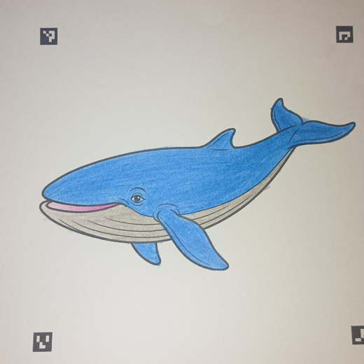
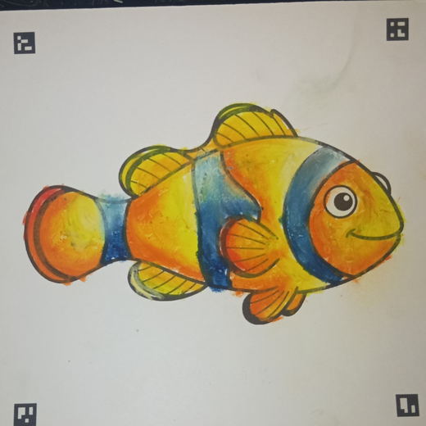
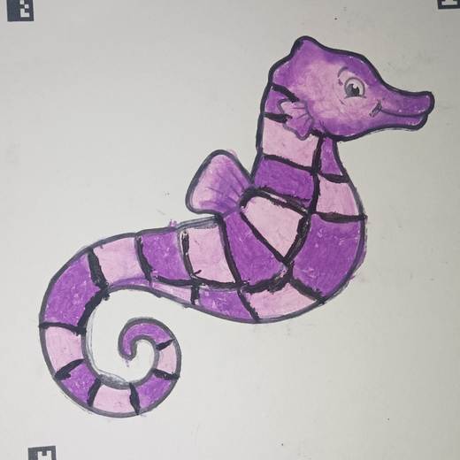
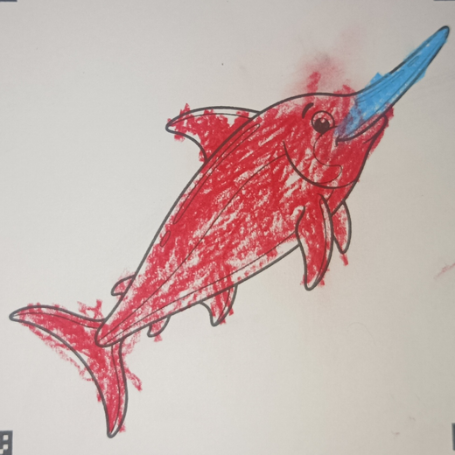

PROBLEM
Creativity Starts With the Child —
But Often Stops at the Page
Physical creativity
Digital entertainment
Children draw, color, and imagine. But when the page is finished, the experience usually ends.
Engaging, but children often watch, swipe, and consume someone else’s content.
CREATE
FINISHED
STOP
WATCH
SWIPE
WATCH
WHAT WE HAVE TESTED
Sheets colored by children in the pilot
30 children · 1 real-world TPA pilot · D.I. Yogyakarta
What if the child’s own creation became the starting point of the digital experience?
Notes:
Physical creativity has no digital life; digital entertainment rarely lets children create. We tested this with 30 children in one TPA in D.I. Yogyakarta; the sheets shown are their real artwork.

Slide 3





SOLUTION
A Child’s Own Drawing Becomes
an Interactive Character in Seconds
TRY IT LIVE
1
2
3
4
5
Color
Scan
Come Alive
Explore
Discover
Child colors a Scanvas sheet
Photograph or upload it in the browser
The artwork is extracted and animated
Their character enters an interactive world
Stories, sounds, and facts extend it
Not a stock character. The child’s own creation becomes part of the world.
Notes:
Color, Scan, Come Alive, Explore, Discover. The QR opens the public digital trial at scanvas.id/trial.

Slide 4









PRODUCT OR SERVICE
LIVE TODAY · scanvas.id
Scanvas Runs Live
in Any Browser
TRY IT LIVE
Physical → Digital
Print → photo/upload → interactive
2 interactive worlds
Ocean + Vehicle
Personalized animation
The child’s own artwork is the character
Landing page
Scan / upload
Alive in the world
Story & sound
Objects unlock sound, story, and facts
Vehicle world
Story & sound
Digital trial
Try the experience before buying a pack
Browser-based
No mandatory app installation
Notes:
Everything on this slide is live today at scanvas.id: real screenshots from the current product.

Slide 5
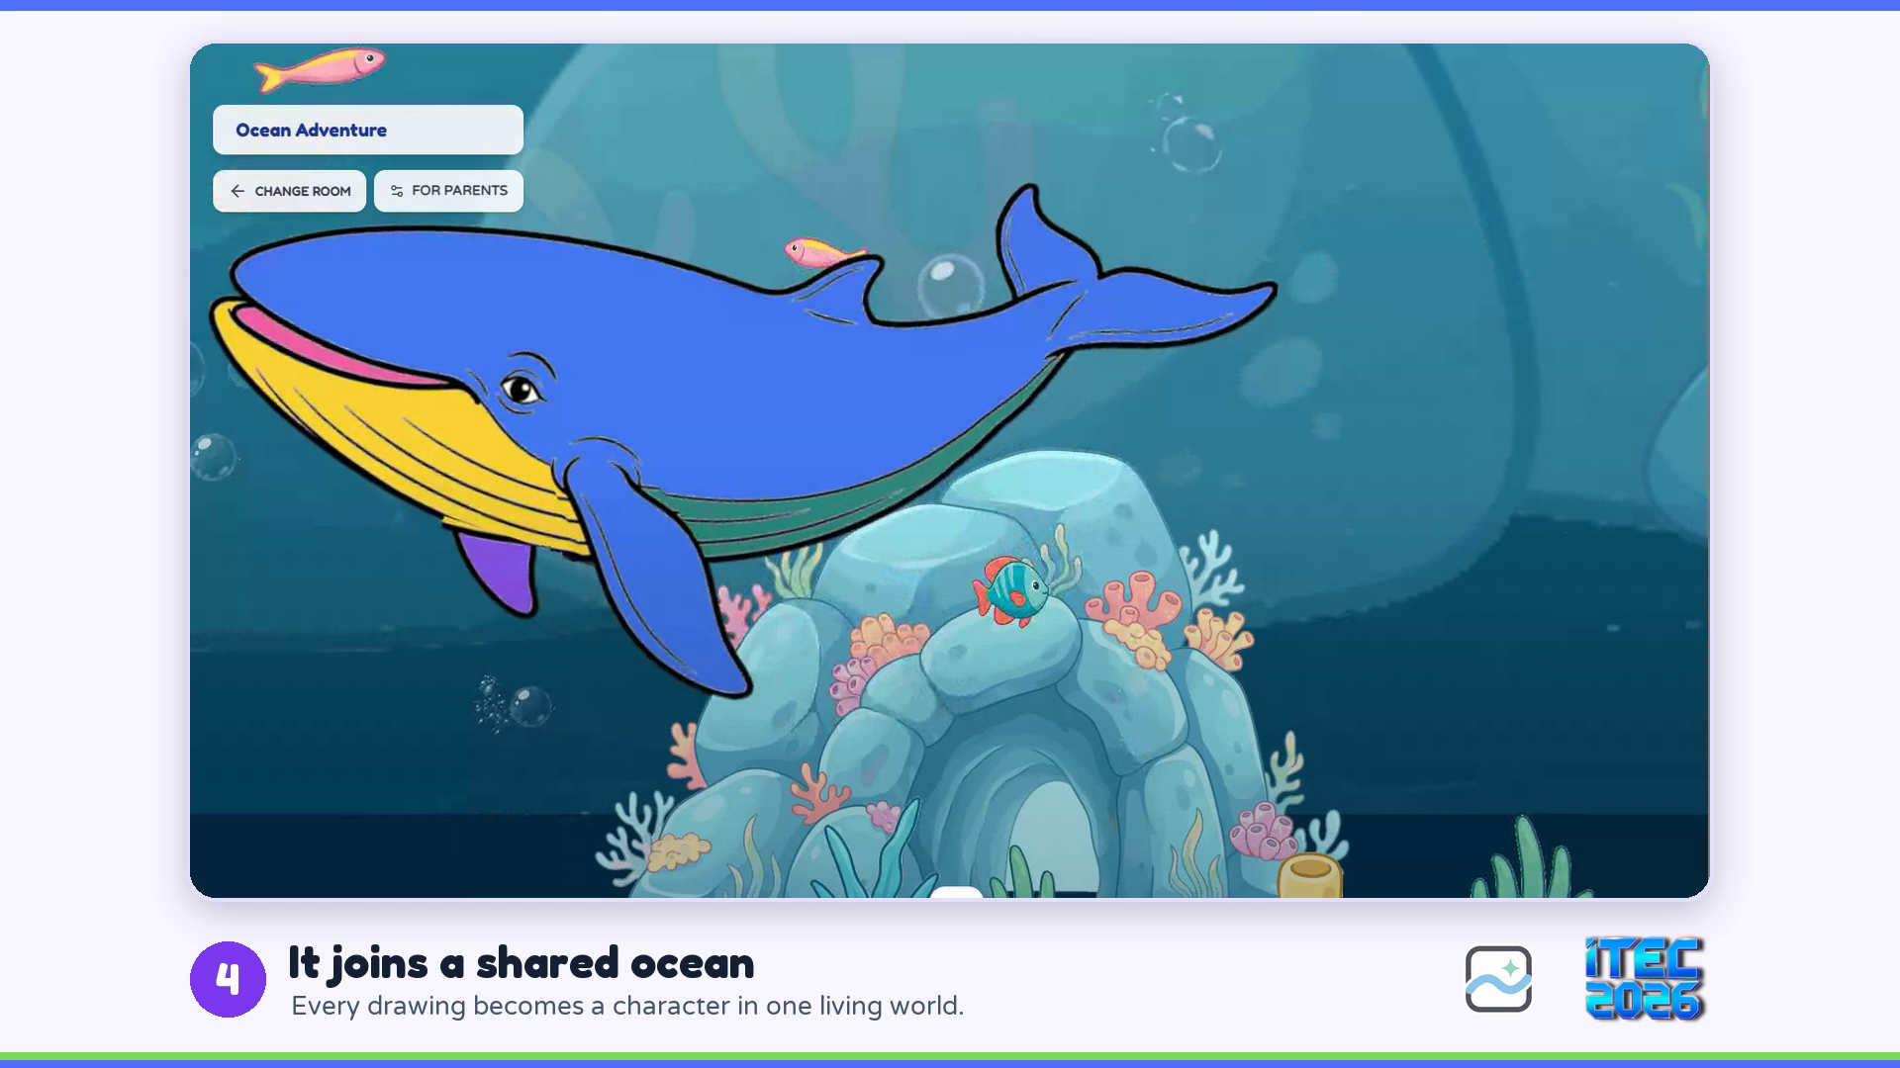
PRODUCT OR SERVICE · LIVE DEMO
LIVE DEMO
See the Digital Trial
in 37 Seconds
1
Pick a drawing
Free, in any browser
2
Color it in the browser
Tap inside the lines
3
Watch it come alive
The child’s own colors swim
4
It joins a shared ocean
One living world for every drawing
5
Learn a fact, hear its sound
Play turns into learning
Recorded on the live product: no app, no account. Click the video to play.
No app
No account
Any browser
Notes:
A 37-second walk through the free digital trial, recorded on the live product. A child picks the whale, colors it in the browser, brings it to life, sees it swim in a shared ocean, then reads a fact and hears the whale. Click the video to play; it runs without sound until the whale’s call at the end.

Slide 6

ABOUT OUR COMPANY
Scanvas Builds a Physical-to-Digital
Creation Engine for Children
Children aged 3–10 color a printed Scanvas sheet, scan it in the browser, and their own artwork becomes an animated character inside an interactive world with sound, stories, and facts.
Our mission: children do not only consume digital culture — they participate in creating it.
Live product
2 interactive worlds
scanvas.id · public digital trial · no app required
Ocean + Vehicle
First 30-child pilot
Pre-revenue
One TPA in D.I. Yogyakarta · five product changes from feedback
Pricing and repeat value are being validated
Notes:
What Scanvas does in one breath, then the four facts that are true today.

Slide 7




ABOUT OUR COMPANY · TRACTION
Our First 30-Child Pilot
Already Changed the Product
2
30
1
5
interactive worlds live
children in first real-world pilot
TPA pilot completed
product improvements from feedback
BUILT
TESTED
LEARNED
SHIPPED
FEEDBACK → PRODUCT
SHIPPED
Larger interactive world
SHIPPED
Digital trial before purchase
BUILDING
Bulk drawing processing
BUILDING
Story & learning space
BUILDING
Additional worlds
First real-world pilot · TPA, D.I. Yogyakarta
Notes:
Pilot participants were not paying customers. Its value: five product improvements, two already shipped. Pre-revenue.

Slide 8
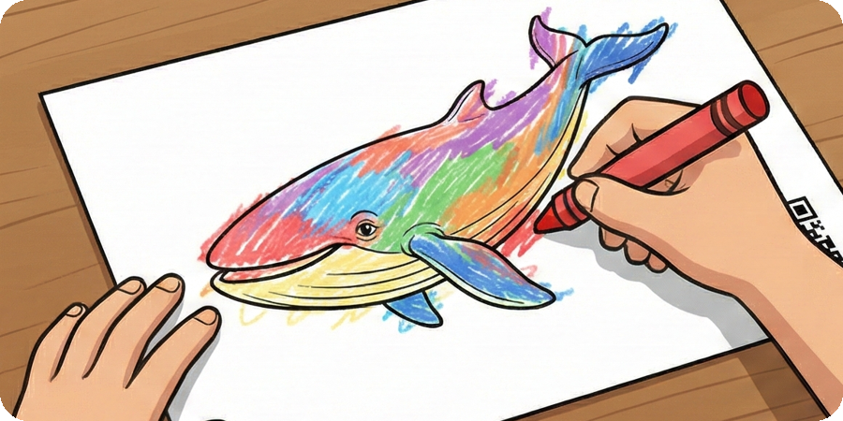

TARGET MARKET
Two Buyers, One User: Children Aged 3–10
TARGET MARKET 1 · FIRST BEACHHEAD
TARGET MARKET 2 · AVAILABLE NOW
Institutions
Families
Buyer
Buyer
PAUD / TK / TPA owner or principal · school or activity organizer
Parents of children aged 3–10
Use case
Use case
Creative classroom or activity session
Creative play at home with a physical pack
Why they buy
Why they buy
A ready-made creative activity that ends with every child’s artwork alive
Screen time that starts with their child creating, not swiping
Target acquisition loop
How we reach them
DEMO → PILOT → PAID SESSION → REPEAT
SHORT VIDEO → DIGITAL TRIAL → CREATIVE PACK → NEW WORLD
USER · children aged 3–10 who create first
Notes:
Institutions are the first distribution beachhead (demo, pilot, paid session, repeat is the target loop, not history). Families can buy packs today.

Slide 9
MARKET SIZE / POTENTIAL
Start With a Reachable Beachhead,
Then Scale Distribution
Bottom-up: count of PAUD + primary-school units (our institutional buyers), plus a BPS-based estimate of children aged 3–10.
EXPAND
NATIONAL
TAM
SCALE
SAM
Southeast Asia
WEDGE
SOM
Indonesia
SEA
Central Java + DIY
420,886
D.I. Yogyakarta
62,797
same engine, local content
7,123
PAUD + primary schools
New languages, worlds, cultural content, partners.
PAUD + primary schools
≈35.3M children aged 3–10.*
PAUD + primary schools
School sessions, events, and Scanvas Studio.
First institutional beachhead, where our first pilot ran.
Institution counts represent the first distribution beachhead — not the entire Scanvas market. Families, events, and content expand beyond it.
Sources: Kemendikdasmen Data Referensi Pendidikan (PAUD, SD), accessed Sep 2026 · *estimated from BPS population by 5-year age group, 2022. Details in Appendix B.
Notes:
Initial buyer is the PAUD/TK/TPA owner or organizer; the loop is demo, pilot, paid session, repeat. School counts are the beachhead, not the whole market.

Slide 10

COMPETITORS
Competitors Prove the Category; Scanvas Combines
Web Access, Personalisation, and Shared Worlds
DIRECT
INDIRECT
Scanvas
Faber-Castell
ARt Alive
Quiver
WAGZAK
JUMP
teamLab Sketch
Aquarium
Paper coloring → digital
Child’s artwork becomes character
No app required (web)
—
—
—
Venue only
Shared interactive worlds
—
—
—
Educational / story content
Some
Some
Institutional sessions
Pilot
—
Edu subscription
School license
Installation
Large ready-made content library
2 worlds
—
100+ lessons
—
Brand & distribution reach
Early
Retail brand
26M+ downloads
30 languages
Museums
Scanvas does not need to replace these products. The opportunity is to combine a low-friction web experience, child-generated characters, shared worlds, and a reusable content engine.
Indirect competition also includes video and game apps that compete for screen time. Evidence checked Sep 2026 on each product’s official site.
Notes:
We do not claim no competitors: they prove the category exists. Evidence checked Sep 2026 on each product’s official site.

Slide 11
UNIQUE VALUE PROPOSITION
Why Choose Scanvas?
The child’s own drawing becomes an interactive character in a shared world — in the browser, with no app to install.
Own creation
Web access
Shared worlds
Own creation
Web access
Faber-Castell ARt Alive
—
—
The child’s artwork is the character, not a stock one
Works in the browser on a phone or laptop
Quiver
—
—
WAGZAK JUMP
—
—
SCANVAS
teamLab Sketch Aquarium
—
Scanvas
Shared worlds
Characters live together in interactive worlds
Among the products we compared (Faber-Castell ARt Alive, Quiver, WAGZAK JUMP, teamLab Sketch Aquarium), Scanvas is the only one combining all three.
Notes:
UVP = the overlap of own creation, web access, and shared worlds. Scope of the claim: the four products in our comparison table.

Slide 12


COMPETITIVE ADVANTAGE
One Core Engine. Many Interactive Worlds.
New content reuses the same scanning, personalization, and interactive-world pipeline.
1
Computer-Vision Scan
2
Personalized Output
Printed markers guide perspective correction, cropping, and object extraction.
The child’s extracted artwork, not a stock character, enters the world.
3
Code-Linked Physical Content
4
Reusable World Engine
Each printed sheet links to its template and digital experience.
Animals · vehicles · nature · culture · characters · stories.
WEB ACCESS
PERSONALIZED CONTENT
SHARED WORLDS
REUSABLE ENGINE
Notes:
The pipeline is the asset: physical input, computer-vision processing, personalized asset, interactive runtime, content system. New worlds reuse it.

Slide 13
DIGITAL CULTURE TRACK FIT
From Child Creativity to Digital Culture
CREATE
EXPERIENCE
CONTENT & IP
Child-generated creativity
Interactive digital worlds
Scalable worlds & IP
Children begin with their own imagination and physical artwork.
Their creation becomes part of a living world.
The same platform expands into new content.
Drawing
Coloring
Animation
Sound
Nature
Vehicles
Imagination
Stories
Interaction
Local culture
Characters
Discovery
Partners
SAME CORE ENGINE, LOCALISED CONTENT
INDONESIA
ASEAN
CHAOYANG / CHINA
Current worlds + local themes
Local languages · cultural themes · distribution / content partners
Mandarin localisation · partner-led pilot · children’s content / IP collaboration
What we want to validate through ITEC
Children do not only consume digital culture — they participate in creating it.
Notes:
Regional row = hypotheses to validate through ITEC. We have no China partner today; we want to explore a partner-led pilot.

Slide 14
BUSINESS OR REVENUE MODEL
A Business Model We Can Test and Scale
Pre-revenue today. Each path has a validation gate before we scale it.
AVAILABLE NOW
UNDER VALIDATION
FUTURE
B2C · Families
B2B · Schools & Events
Content & IP
Creative packs + the Scanvas digital experience. Repeat-value experiment: levels · worlds · programs.
Pilot sessions today → Scanvas Studio for repeatable institutional use.
New content built on the same engine.
Revenue model
Revenue model
Revenue model
Per-pack purchase
Per session · per participant · usage-based
Content add-ons · subscriptions · partnerships / licensing
Validate by
Validate by
Offer
Pack purchase
Demo → pilot
New worlds
Course activation
Pilot → second session
Original characters
Completion
Participants per session
Cultural themes
Repeat purchase
Operating cost per session
Creative programs
Partner content
Licensed collaborations
Notes:
Revenue models only; no nominal prices because pricing is not validated. B2C is available now, B2B is under validation, Content & IP is future.

Slide 15
BUSINESS MODEL · REPEAT VALUE
From a Magic Moment to Repeatable Value
The magic gets attention. The next question is whether children want to create again — and whether parents will pay for that repeat value.
TODAY
NEXT
LATER
Magic
Repeat
Engage
CREATE → SCAN → ALIVE
LEARN → CREATE → ALIVE → PROGRESS → NEXT
PLAY → STORY → DISCOVER
A child’s own artwork becomes a character in a live interactive world.
Ocean Artist — 3-lesson pilot
Each lesson teaches one creative skill, then the child’s artwork comes alive. A focused pilot, not a generic LMS.
Missions
Shared worlds
Interactive stories
Discovery
EVIDENCE
MEASURE
GATE
2 worlds · 30-child pilot
Next-lesson start · repeat creation · parent willingness to pay
Built only after repeat usage is proven
The core Scanvas experience remains unchanged: the child creates first, and their own artwork comes alive.
Notes:
Today we prove the magic. Next we test repeat value with a 3-lesson Ocean Artist pilot and measure next-lesson start, repeat creation, and willingness to pay. Later layers wait for that evidence.

Slide 16



MEET OUR TEAM
Complementary Founders: Business and Technology
Haikal Hilmi
Salsabila Khoirunnisa
CEO & Co-Founder
CMO & Co-Founder
Product & engineering
Business & partnerships
Computer vision
Customer discovery
Interactive platform
Go-to-market
Scanvas turns children from digital-content consumers into creators inside interactive worlds.
Notes:
Two co-founders: Salsabila leads business, partnerships, and GTM; Haikal leads product, engineering, and computer vision.

Slide 17


ROADMAP
Prove the Magic → Prove Repeat Value →
Expand the Experience → Scale Content
NOW
NEXT
THEN
SCALE
Prove the Magic
Prove Repeat Value
Expand the Experience
Content & IP Platform
Reliable CREATE → SCAN → ALIVE
Collection + 3-lesson creative pilot
Artwork children play with, return to, and explore
Additional worlds
Original characters
Product live
Missions
Cultural themes
2 worlds
Shared World
Classroom format
First 30-child pilot
MEASURE
Interactive Story
Partner / licensed content
Second creation · next-lesson start · 3-lesson completion · willingness to pay · repeat purchase / Level 2 intent
Discovery
ASEAN localisation
MEASURE
Scan success · time-to-magic · recovery
ONE CONTENT ENGINE → MULTIPLE DISTRIBUTION & REVENUE PATHS
Notes:
Each stage is gated by the previous one. Through ITEC we want partners, distribution, pilot opportunities, and commercialisation guidance, not a claimed partnership.

Slide 18


THE ASK
Through ITEC, We Want to Find
Our ask: Rp200M for 12 months of validation (next slide), plus partners and guidance through ITEC.
UNLOCKS · SCALE
UNLOCKS · NEXT
Content & IP partners
Institutional distribution partners
Children’s content, cultural, and character partners to co-create new worlds.
School networks, PAUD / TK / TPA groups, and activity organizers for demo → pilot.
UNLOCKS · SCALE
UNLOCKS · NEXT
ASEAN / China pilot opportunities
Commercialisation & market entry
Partner-led localisation pilots: language, cultural themes, children’s content.
Guidance on pricing validation, go-to-market, and regional entry.
Notes:
No funding amount in this deck. The ask is partners and guidance, each tied to a roadmap stage.

Slide 19



THE ASK · USE OF FUNDS
Rp200M Funds 12 Months to Prove
Paid, Repeat Use
USE OF FUNDS
12-MONTH CAPITAL NEED
MILESTONES IT UNLOCKS · 12 MONTHS
Team & operations
Rp96M · 48%
Rp200M
Two founders at Rp4M / month each
48 paid school / event sessions
Go-to-market
Rp30M · 15%
1,440 children in paid sessions
≈ US$12K (at Rp16,500 / US$, indicative)
School pilots, demos, community activation
Product & technology
Rp24M · 12%
600 family packs
Founder runway, scan reliability, Scanvas Studio, school acquisition, production, and new worlds, so the next round is raised on proven repeat use.
Infrastructure, scan reliability, Studio
4 interactive worlds
Production
Rp20M · 10%
Packs, samples, demo materials
Scanvas Studio operational
Content
Rp20M · 10%
≥20% repeat purchase / rebooking
2 → 4 interactive worlds
Legal & contingency
Rp10M · 5%
Rp77.4M first-year revenue (base case)
12 MONTHS
Administration, accounting, contracts
Founders’ 12-month financial model, Sep 2026. Base case assumes family pack Rp49K and managed session Rp1M (up to 30 children): current test assumptions, not yet validated at commercial volume.
Notes:
Why Rp200M when year-1 revenue is Rp77.4M? The first 12 months build the repeatable system and prove repeat use; unit contribution is positive (pack 59%, session 75%). Team is Rp4M per founder per month.

Slide 20
EXIT STRATEGY
Exit Strategy: Build a Content & IP Engine
That Strategic Buyers Want
Indicative path, not a commitment: build proven value first, keep exit options open.
0–12 MONTHS
YEARS 1–3
YEARS 3–5
YEAR 5+
Prove repeat use
Scale distribution
Content & IP platform
Exit window
48 paid sessions · ≥20% repeat · Rp77.4M base case
More worlds, school networks, ASEAN localisation
Licensing, partner content, regional institutions
Strategic acquisition or later-stage buyout
PRIMARY
BRIDGE
ALTERNATIVE
LONG-TERM
Strategic acquisition
Licensing & partnerships
Secondary sale
IPO
Edtech platforms, children’s publishers, stationery and toy brands, or media / IP companies gain a ready engine, a content library, and school distribution.
License the engine and worlds to brands and publishers: revenue now, acquirer relationships later.
Later-stage investors buy early shareholders out as Scanvas scales across ASEAN.
Only at regional scale; not part of the near-term plan.
What makes Scanvas acquirable: reusable world engine · child-generated content format · institutional distribution · privacy-by-design child data
Notes:
Exit is indicative. Most realistic: strategic acquisition by a company that wants the engine, the content, and school distribution. No acquirer talks exist today.

Slide 21

CONTACT US
SCANVAS
Website
scanvas.id
WhatsApp
+62 895-3675-97379
Haikal Hilmi · CEO | Salsabila Khoirunnisa · CMO
ITEC SEA 2026 · Digital Culture Track
TRY IT LIVE · scanvas.id/trial
Notes:
Contacts from the public website (scanvas.id).

Slide 22
SUPPORTING SLIDES
Appendix · market data · technology & child data

Slide 23
OTHER INFO · MARKET DATA
Market Figures Use Indonesian Education Data
and a BPS-Based Child Population Estimate
Figure
Value
How it is calculated / source
PAUD units, Indonesia
243,604
TK 134,789 + KB 86,429 + TPA 2,684 + SPS 19,702 · Kemendikdasmen
Primary schools (SD sederajat), Indonesia
177,282
Kemendikdasmen Data Referensi Pendidikan
PAUD + primary schools, Indonesia
420,886
243,604 + 177,282
Central Java + D.I. Yogyakarta
62,797
PAUD 32,839 + 5,071 · SD 22,835 + 2,052
D.I. Yogyakarta
7,123
PAUD 5,071 + SD 2,052
Children aged 3–10, Indonesia
≈35.3M
2/5 × 22,094,426 (0–4) + 22,013,768 (5–9) + 1/5 × 22,088,673 (10–14) · BPS 2022
Kemendikdasmen: referensi.data.kemendikdasmen.go.id (PAUD & Dikdas per province), accessed Sep 2026. BPS: Jumlah Penduduk Menurut Kelompok Umur, Long Form SP2020 (2022). TPA in Kemendikdasmen data = Taman Penitipan Anak.
Notes:
Single-year ages are not published in this table, so ages 3-10 are a proportional estimate.

Slide 24



OTHER INFO · TECHNOLOGY & CHILD DATA
One Pipeline, Responsible Child Data,
and a Validation Gate Before Every Build
1
2
3
4
5
6
7
Physical creation
Capture
Computer vision
Digital asset
Interactive runtime
Content layer
Reusable world engine
Child colors a Scanvas sheet
Camera or photo upload
Marker detection
Child’s artwork becomes the character
Animation
Story
Ocean
Perspective correction
Movement
Facts
Vehicles
Sounds
Discovery
Future: culture, nature, characters
Crop
Interactive world
Object extraction
RESPONSIBLE CHILD DATA
VALIDATION PRINCIPLE
Collect only what is necessary. No child name, parent identity, email, phone, precise location, or artwork itself as analytics payload by default.
Build
Measure
Gate
Expand
Do not build the full course before a 3-lesson pilot validates progression and willingness to pay. Do not build large Mission/Story/AI layers before repeat usage is proven.
Notes:
Backend detects ArUco markers, corrects perspective, and extracts the object; the frontend shows it with motion, sound, and facts. Child data is minimised by default.

