Slide 1




PITCH DECK
SCANVAS
Where Children’s Creativity
Comes Alive
Children turn their paper artwork into interactive characters and learning experiences, directly in the browser.
Haikal Hilmi — CEO & Co-Founder
Salsabila Khoirunnisa — CMO & Co-Founder
ITEC SEA 2026 · Digital Culture Track
scanvas.id
Notes:
0:15 · Scanvas: where children’s creativity comes alive. I am Salsabila, co-founder and CMO; with me is Haikal, our CEO.

Slide 2


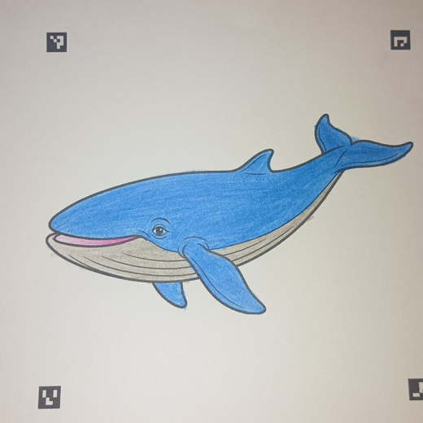
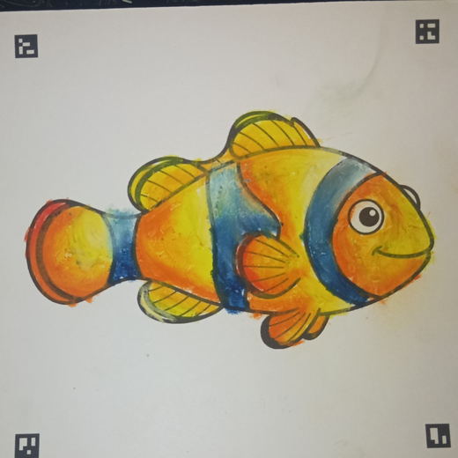
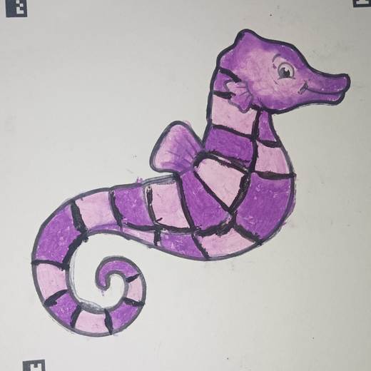
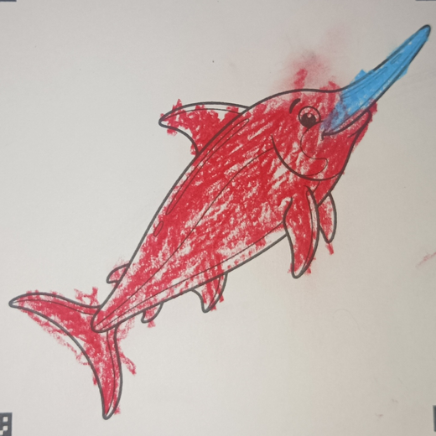

PROBLEM
Creativity Starts With the Child, But Often Stops at the Page
1
PHYSICAL CREATIVITY ENDS
Children draw, color, and imagine, but once the page is finished, the experience often ends.
2
DIGITAL EXPERIENCES ARE OFTEN PASSIVE
Many digital activities give children ready-made characters to watch, swipe, and consume.
3
LEARNING AND CREATING STAY SEPARATE
Animals, nature, and other topics are often learned through worksheets or content created by someone else.
What if the child’s own creation became the starting point of play and learning?
Tested with 30 children in our first real-world TPA pilot in D.I. Yogyakarta.
From our pilot at a TPA in D.I. Yogyakarta
Notes:
0:35 · Physical creativity ends with the page; screens are passive; learning and creating stay separate. What if the child’s own creation became the starting point? (No learning-outcome claims.)

Slide 3





SOLUTION
Their Artwork Becomes the Character
1
2
3
4
COLOR
SCAN
COME ALIVE
EXPLORE & LEARN
Create on a printed Scanvas sheet.
Photograph or upload the artwork in the browser.
The child’s own artwork is extracted and animated.
It enters an interactive world with movement, sound, stories, and facts.
The child creates first. Technology extends what they created.
No app installation required
Notes:
0:25 · Color, scan, come alive, explore and learn. The child creates first; technology extends it.

Slide 4

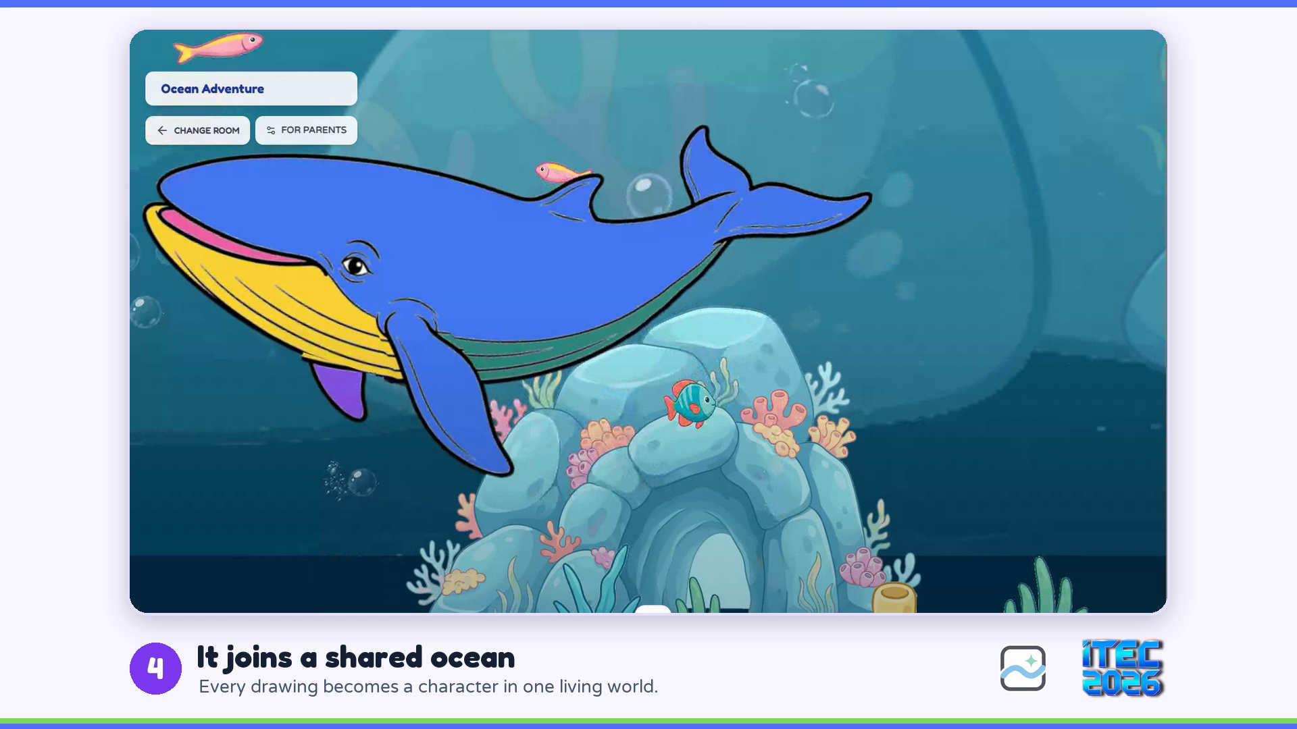

PRODUCT OR SERVICE · LIVE DEMO
LIVE DEMO · 37 SECONDS
See Scanvas
in Action
Our free digital trial lets families experience the core Scanvas moment before purchasing a physical pack.
LIVE TODAY
Ocean World
Vehicle World
Paper artwork scanning
Digital coloring trial
Personalized animation
COLOR → SCAN → COME ALIVE → EXPLORE
Character sounds and facts
Notes:
0:55 incl. video · Say before playing: "This video shows our digital trial. Our physical packs use the same animation experience after children photograph their paper artwork." Backup: the MP4 file assets/video/trial_digital_itec.mp4.

Slide 5





TRACTION
Our First Pilot Already Changed the Product
30
1
2
5
children in first real-world pilot
TPA pilot completed
interactive worlds live
product priorities from feedback
SHIPPED
BUILDING
Larger interactive world
Bulk drawing processing
Digital trial before purchase
Story and learning space
Additional worlds
WHAT WE PROVED
WHAT WE MUST PROVE NEXT
Children can complete the Scanvas experience in a real setting.
Paid demand and repeat use.
PRE-REVENUE
First real-world pilot · TPA, D.I. Yogyakarta
Notes:
0:30 · 30 children, one TPA pilot, two worlds live, five priorities from feedback: two shipped, three building. Proved: children complete the experience in a real setting. Next: paid demand and repeat use. Pre-revenue.

Slide 6

TARGET MARKET · MARKET SIZE
Start With a Reachable Beachhead, Then Scale
TAM
Indonesia
PAUD + primary schools
BUYER
Principals · teachers · activity coordinators
420,886
SAM
Central Java + D.I. Yogyakarta
PAUD + primary schools
USER
Children aged 3–10
62,797
YEAR-1 COMMERCIAL TARGET
SOM · BEACHHEAD
D.I. Yogyakarta
PAUD + primary schools
48 paid sessions
7,123
Transaction target, not 48 unique institutions.
Why here: our first real-world pilot was already conducted in D.I. Yogyakarta.
Source: Kemendikdasmen education reference data (public and private units), accessed September 2026. Institution counts describe market coverage, not confirmed demand. Breakdown in the appendix.
Notes:
0:30 · TAM 420,886 PAUD and primary schools in Indonesia; SAM 62,797 in Central Java and DIY; our beachhead is DIY with 7,123, where we already piloted. Buyers: principals, teachers, coordinators; users: children 3–10. Year-1 target: 48 paid sessions, a transaction target.

Slide 7
COMPETITORS · UNIQUE VALUE
A Proven Category, With a Different Access Model
Paper-to-digital coloring already has established alternatives, including:
Child’s artwork is the character
SCANVAS COMBINES
Child-generated artwork as the character
Faber-Castell ARt Alive
Mobile app
Browser-based: no app installation
Quiver
Mobile app
Runs in the browser
Shared interactive worlds
WAGZAK JUMP
Mobile app
Reusable engine for new themes
teamLab Sketch Aquarium
Venue-based
Shared ocean world
Designed toward repeat institutional use
Competitors validate the category. Our question is whether this combination creates paid, repeat use.
Notes:
0:25 · Faber-Castell, Quiver, WAGZAK need an app; teamLab is a venue. They validate the category. Scanvas combines the child’s artwork, browser access, shared worlds, and a reusable engine. Our question: does this combination create paid, repeat use?

Slide 8

BUSINESS OR REVENUE MODEL
Paid Sessions First. Family Packs Alongside.
B2B · PRIMARY VALIDATION
B2C · ALONGSIDE
Managed School / Event Session
Family Creative Pack
Up to 30 children
For use at home
TEST PRICE
TEST PRICE
Rp1,000,000 / session
Rp49,000 / pack
ACQUISITION
ACQUISITION
DIRECT OUTREACH → DEMO → PAID SESSION → REBOOKING
SHORT VIDEO → FREE TRIAL → WHATSAPP ORDER → REPEAT PURCHASE
VALIDATE
VALIDATE
Paid booking · delivery cost · rebooking
Conversion · contribution margin · repeat purchase
Both prices are commercial-testing assumptions and are not yet validated at scale.
Notes:
0:30 · B2B first: a managed session for up to 30 children at a test price of Rp1M; we validate paid booking, delivery cost, rebooking. B2C alongside: a family pack at Rp49K via short video, free trial, WhatsApp order. Both prices are test assumptions.

Slide 9



MEET OUR TEAM
Two Founders Cover Product and Go-to-Market
Equity: Haikal 60% · Salsabila 40%
Haikal Hilmi
Salsabila Khoirunnisa
CEO & Co-Founder
CMO & Co-Founder
Product and company strategy
Brand and marketing
Product and engineering
Customer discovery
Computer-vision scanning
Institutional outreach
Interactive web platform
Community
Partnership strategy
Go-to-market
EXECUTION TO DATE
NEXT CAPABILITY TO STRENGTHEN
Live product · 2 interactive worlds · first 30-child pilot
Institutional sales and repeatable session delivery.
Notes:
0:35 · Haikal, CEO with 60%, leads product, strategy, and technology; Salsabila, CMO with 40%, leads brand, customers, and go-to-market. Together: live product, two worlds, first pilot.

Slide 10
ROADMAP
Prove Paid Demand → Prove Repeat Use → Expand
COMPLETED
MONTHS 1–3
MONTHS 4–6
MONTHS 7–12
Built & tested
Prove paid demand
Prove repeat use
Scale what works
Live product
Test B2B session pricing
Pilot Scanvas Studio
48 cumulative paid sessions
Ocean + Vehicle worlds
Test B2C pack pricing
Run a 3-lesson creative pilot
600 family packs
First 30-child pilot
Measure delivery cost
Measure institutional rebooking
2 → 4 worlds
Digital trial
Begin paid sessions
Scanvas Studio operational
Measure scan reliability
Measure family repeat purchase
Partner-led localization pilot
Measure 3-lesson progression
Expansion happens only after evidence of paid demand and repeat use.
Notes:
0:30 · Months 1–3 prove paid demand; months 4–6 prove repeat use; months 7–12 scale what works: 48 sessions, 600 packs, four worlds, Studio, a partner-led localization pilot.

Slide 11
THE ASK · ECONOMICS
Rp200M to Prove Repeatable Economics
B2C PACK · TEST ECONOMICS
12-MONTH BASE CASE
CAPITAL REQUIRED
Price
Rp49K
600 packs · 48 paid sessions
Rp200M / 12 months
Direct cost
Rp20K
REVENUE
Contribution
Rp29K
Rp77.4M
48%
Team & operations
59% contribution margin
DIRECT COSTS
15%
Go-to-market
Rp24.0M
12%
Product & technology
MANAGED SESSION · TEST ECONOMICS
GROSS CONTRIBUTION
10%
Production
Price
Rp1M
Rp53.4M
Direct cost
Rp250K
10%
Content
Contribution
Rp750K
69% contribution margin
5%
Legal & contingency
75% contribution margin
Founders’ model, Sep 2026 · assumptions
CAC and LTV are not yet claimed as proven metrics. This validation period is designed to measure acquisition cost, repeat purchase, and institutional rebooking before scaling.
Notes:
0:40 · Test economics: pack Rp49K, direct cost Rp20K, 59%; session Rp1M, direct cost Rp250K, 75%. Base case: 600 packs and 48 sessions, Rp77.4M revenue, Rp53.4M contribution. We need Rp200M for 12 months; half is founder time. CAC and LTV are what this period measures. Full projection in the appendix.

Slide 12

ITEC FIT · CHAOYANG PILOT
What We Want to Validate Through ITEC
Institutional pilot partners
Content & localization partners
1
2
Schools and activity organizers for paid, repeatable sessions.
Children’s content creators and cultural partners for localized worlds.
3
A small partner-led Chaoyang pilot
LOCAL PARTNER
LOCALIZE
PILOT
MEASURE & DECIDE
Select one institution or activity partner
Mandarin interface + one adapted Scanvas theme
Proposed small session with 20–30 children
Completion · partner feedback · willingness to repeat or pay · localization effort
RESOURCES
FUNDING PRINCIPLE
Scanvas product and founder lead
Local partner / translator
Initial localization is a validation experiment funded from the go-to-market and content budget. We do not commit to a broader China rollout until the pilot shows demand.
Localized print templates
Adapted digital content
Validate locally. Adapt with a partner. Expand only with evidence.
Haikal Hilmi, CEO · Salsabila Khoirunnisa, CMO · scanvas.id
TRY IT
Notes:
0:40 · Through ITEC: institutional pilot partners, content and localization partners, and a small partner-led Chaoyang pilot: one partner, Mandarin interface and one adapted theme, 20–30 children, then measure and decide. Funded from our GTM and content budget; no broader China rollout before evidence. (No partner or commitment exists yet.)

Slide 13
SUPPORTING SLIDES
For Q&A · competition · market data · technology · financial assumptions · Chaoyang pilot

Slide 14
APPENDIX · COMPETITOR MATRIX
Competitors Prove the Category; Scanvas Combines
Web Access, Personalisation, and Shared Worlds
DIRECT
INDIRECT
Scanvas
Faber-Castell
ARt Alive
Quiver
WAGZAK
JUMP
teamLab Sketch
Aquarium
Paper coloring → digital
Child’s artwork becomes character
No app required (web)
—
—
—
Venue only
Shared interactive worlds
—
—
—
Educational / story content
Some
Some
Institutional sessions
Pilot
—
Edu subscription
School license
Installation
Large ready-made content library
2 worlds
—
100+ lessons
—
Brand & distribution reach
Early
Retail brand
26M+ downloads
30 languages
Museums
Scanvas does not need to replace these products. The opportunity is to combine a low-friction web experience, child-generated characters, shared worlds, and a reusable content engine.
Indirect competition also includes video and game apps that compete for screen time. Evidence checked Sep 2026 on each product’s official site.
Notes:
We do not claim no competitors: they prove the category exists. Evidence checked Sep 2026 on each product’s official site.

Slide 15
APPENDIX · MARKET EXPANSION
Start With a Reachable Beachhead,
Then Scale Distribution
Bottom-up: count of PAUD + primary-school units (our institutional buyers), plus a BPS-based estimate of children aged 3–10.
EXPAND
NATIONAL
SCALE
Southeast Asia
WEDGE
Indonesia
SEA
Central Java + DIY
420,886
D.I. Yogyakarta
62,797
same engine, local content
7,123
PAUD + primary schools
New languages, worlds, cultural content, partners.
PAUD + primary schools
≈35.3M children aged 3–10.*
PAUD + primary schools
School sessions, events, and Scanvas Studio.
First institutional beachhead, where our first pilot ran.
Institution counts represent the first distribution beachhead — not the entire Scanvas market. Families, events, and content expand beyond it.
Sources: Kemendikdasmen Data Referensi Pendidikan (PAUD, SD), accessed Sep 2026 · *estimated from BPS population by 5-year age group, 2022. Details in Appendix B.
Notes:
Initial buyer is the PAUD/TK/TPA owner or organizer; the loop is demo, pilot, paid session, repeat. School counts are the beachhead, not the whole market.

Slide 16
APPENDIX · MARKET DATA
Market Figures Use Indonesian Education Data
and a BPS-Based Child Population Estimate
Figure
Value
How it is calculated / source
PAUD units, Indonesia
243,604
TK 134,789 + KB 86,429 + TPA 2,684 + SPS 19,702 · Kemendikdasmen
Primary schools (SD sederajat), Indonesia
177,282
Kemendikdasmen Data Referensi Pendidikan
PAUD + primary schools, Indonesia
420,886
243,604 + 177,282
Central Java + D.I. Yogyakarta
62,797
PAUD 32,839 + 5,071 · SD 22,835 + 2,052
D.I. Yogyakarta
7,123
PAUD 5,071 + SD 2,052
Children aged 3–10, Indonesia
≈35.3M
2/5 × 22,094,426 (0–4) + 22,013,768 (5–9) + 1/5 × 22,088,673 (10–14) · BPS 2022
Kemendikdasmen: referensi.data.kemendikdasmen.go.id (PAUD & Dikdas per province), accessed Sep 2026. BPS: Jumlah Penduduk Menurut Kelompok Umur, Long Form SP2020 (2022). TPA in Kemendikdasmen data = Taman Penitipan Anak.
Notes:
Single-year ages are not published in this table, so ages 3-10 are a proportional estimate.

Slide 17









APPENDIX · TECHNOLOGY & CHILD DATA
One Pipeline, Responsible Child Data,
and a Validation Gate Before Every Build
1
2
3
4
5
6
7
Physical creation
Capture
Computer vision
Digital asset
Interactive runtime
Content layer
Reusable world engine
Child colors a Scanvas sheet
Camera or photo upload
Marker detection
Child’s artwork becomes the character
Animation
Story
Ocean
Perspective correction
Movement
Facts
Vehicles
Sounds
Discovery
Future: culture, nature, characters
Crop
Interactive world
Object extraction
RESPONSIBLE CHILD DATA
VALIDATION PRINCIPLE
Collect only what is necessary. No child name, parent identity, email, phone, precise location, or artwork itself as analytics payload by default.
Build
Measure
Gate
Expand
Do not build the full course before a 3-lesson pilot validates progression and willingness to pay. Do not build large Mission/Story/AI layers before repeat usage is proven.
Notes:
Backend detects ArUco markers, corrects perspective, and extracts the object; the frontend shows it with motion, sound, and facts. Child data is minimised by default.

Slide 18
APPENDIX · FINANCIAL PROJECTION
12-Month Financial Projection
CONSERVATIVE
BASE
CASH PLAN
B2C packs sold
300
600
Operating burn ≈ Rp13.2M per month (Rp158M / 12).
Paid sessions
24
48
B2C pack revenue
Rp14.7M
Rp29.4M
With Rp200M, cash at month 12 stays positive in both cases.
B2B session revenue
Rp24.0M
Rp48.0M
Remaining cash covers inventory (production budget), contingency, and runway into year 2.
Customer revenue
Rp38.7M
Rp77.4M
Direct costs
−Rp12.0M
−Rp24.0M
Gross contribution (69%)
Rp26.7M
Rp53.4M
ASSUMPTIONS
Team (2 founders × Rp4M × 12)
−Rp96.0M
−Rp96.0M
Pack Rp49K; direct cost Rp20K (print & packaging Rp10K, delivery Rp10K)
Go-to-market
−Rp24.0M
−Rp24.0M
Product, infrastructure & tools
−Rp18.0M
−Rp18.0M
Session Rp1M, up to 30 children; direct cost Rp250K
Content creation
−Rp15.0M
−Rp15.0M
Volume: 25–50 packs and 2–4 sessions per month
Legal & admin
−Rp5.0M
−Rp5.0M
Operating expenses
−Rp158.0M
−Rp158.0M
Platform-only (per-drawing) revenue excluded
Net result, year 1
−Rp131.3M
−Rp104.6M
CAC and LTV measured during validation, not assumed
Cash at month 12 with Rp200M
Rp68.7M
Rp95.4M
Founders’ 12-month financial model, Sep 2026. All prices, costs, and volumes are planning assumptions, not validated at commercial volume. Grant or prize money would be financing, never revenue.
Notes:
If asked for 18 months: months 13–18 are not projected yet; the plan is to re-forecast from real conversion, rebooking, and delivery cost after the first six months.

Slide 19
APPENDIX · CHAOYANG PILOT
Chaoyang Pilot: Validation Before Expansion
OBJECTIVE
Test whether Scanvas can transfer to a new language and cultural context through a local partner.
SCOPE
MEASURE
One partner
Activation / completion
One localized theme
Scan success
Mandarin adaptation
Children’s engagement
Small child session
Partner willingness to repeat
No permanent China operation
Parent / institution willingness to pay
Localization cost and effort
GO / NO-GO GATE
Scale only if demand, repeat intent, and localization economics justify the next pilot.
Notes:
A proposal, not a commitment: no partner exists yet. Funded from the GTM and content budget.

