Slide 1




PITCH DECK
SCANVAS
Where Children’s Creativity
Comes Alive
Children turn their paper artwork into interactive characters in the browser.
Haikal Hilmi — CEO & Co-Founder
Salsabila Khoirunnisa — CMO & Co-Founder
ITEC SEA 2026 · Digital Culture Track
scanvas.id
Notes:
0:15 · Scanvas: where children’s creativity comes alive. Children turn their paper artwork into interactive characters in the browser. I am Salsabila, co-founder and CMO; with me is Haikal, our CEO.

Slide 2

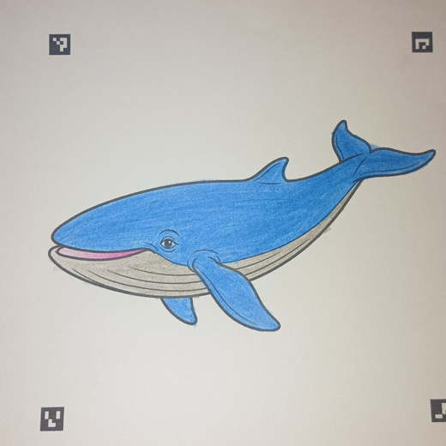
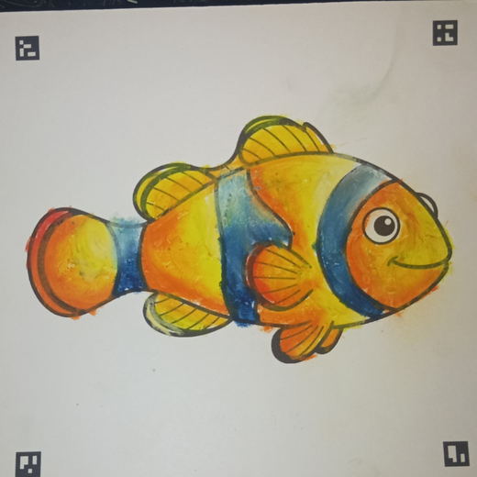
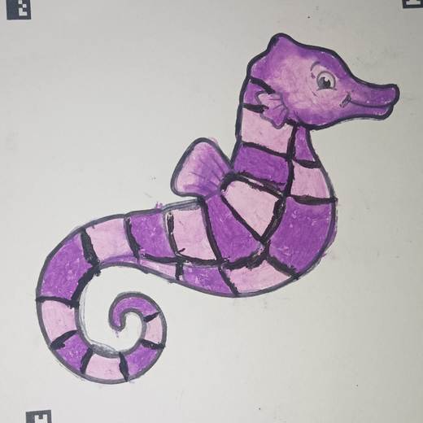
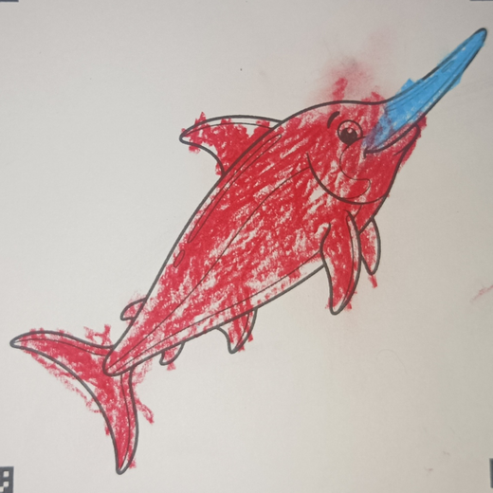
PROBLEM
Interactive Learning Is Still Hard to Reach in Yogyakarta
1
ACCESS
Yogyakarta is a student city, yet modern interactive learning is mostly found in international schools, or in big-city museums with 3D animation, such as in Jakarta.
2
STAYS ON THE PAGE
Learning about animals of the ocean, land, and air often stays in books and worksheets. When the coloring ends, the activity ends.
3
PASSIVE SCREENS
Digital entertainment gives children ready-made characters to watch, not to create.
THEREFORE
Scanvas is an affordable interactive animation learning platform: children learn about animals through their own artwork.
From our pilot at a TPA in D.I. Yogyakarta
Notes:
0:45 · Yogyakarta is a student city, but modern interactive learning is mostly in international schools or big-city museums, like the 3D animation museums in Jakarta (our observation). Learning about animals stays on paper: a child in our TPA pilot colored a fish, and then the page was done. Screens give ready-made characters. Therefore: Scanvas, an affordable interactive animation learning platform. (No learning-outcome claims: not measured.)

Slide 3





SOLUTION
Their Artwork Becomes the Character
1
2
3
4
COLOR
SCAN
COME ALIVE
EXPLORE
Create on a printed Scanvas sheet.
Photograph or upload the artwork in the browser.
See the drawing move inside an interactive world.
Discover sounds and facts connected to the character.
The child’s colors and artwork stay at the center of the experience.
No app installation required
Notes:
0:25 · Color, scan, come alive, explore. The same whale on paper, in the browser, then swimming in the ocean with its sound and facts. The child’s colors stay at the center. No app to install.

Slide 4

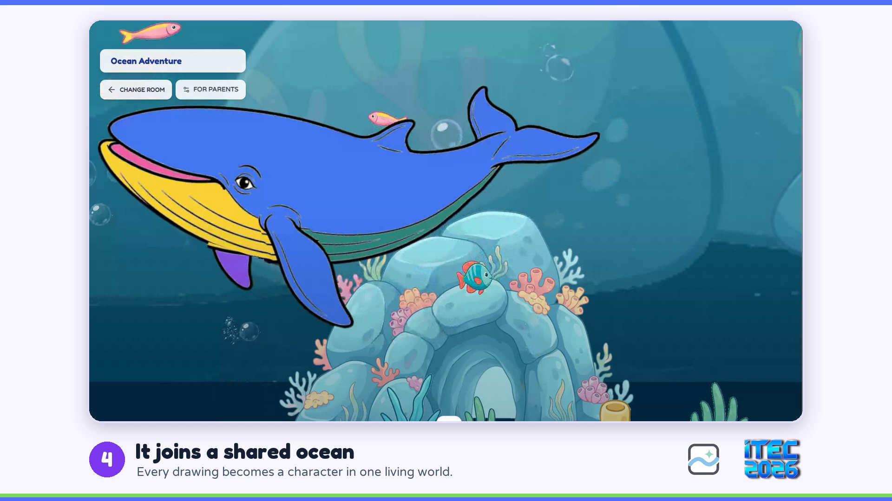

PRODUCT OR SERVICE · LIVE DEMO
LIVE DEMO · 37 SECONDS
See Scanvas
in Action
Our free digital trial lets families experience Scanvas before buying a physical pack.
Choose a drawing, color it in the browser, and watch it come alive in the ocean.
LIVE TODAY
Ocean and Vehicle worlds
Paper artwork scanning
Free digital coloring trial
Character sounds and facts
Recorded on the live product. Click the video to play.
Notes:
0:55 incl. video · Say before playing: "This video shows our digital trial. Our physical packs use the same animation experience after children photograph their paper artwork." Backup: the MP4 file assets/video/trial_digital_itec.mp4.

Slide 5





TRACTION
Our First Pilot Shaped the Product
30
2
5
children · one real-world TPA pilot in D.I. Yogyakarta
interactive worlds live
product priorities identified from feedback
SHIPPED
IN DEVELOPMENT
Larger interactive world
Bulk drawing processing
Digital trial before purchase
Story and learning space
Additional worlds
WHAT WE HAVE DEMONSTRATED
WHAT WE NEED TO VALIDATE NEXT
We ran the experience with children and used feedback to guide development.
Willingness to pay and repeat use.
First real-world pilot · TPA, D.I. Yogyakarta
PRE-REVENUE
Notes:
0:35 · 30 children, one TPA pilot in Yogyakarta, two worlds live. Feedback gave us five product priorities: two shipped, three in development. Next we must validate willingness to pay and repeat use. We are pre-revenue.

Slide 6


TARGET MARKET · MARKET SIZE
Starting With Public Schools in Yogyakarta, Then Other Cities
FIRST CUSTOMER SEGMENT
WHERE WE GO · PAUD + PRIMARY SCHOOL UNITS
Public PAUD, TK, and primary schools in Yogyakarta, plus TPA, where we ran our pilot.
7,123
D.I. Yogyakarta · start
62,797
Central Java + DIY · next cities
BUYER
Principals, teachers, and activity coordinators.
420,886
Indonesia
USER
Children aged 3–10, supported by adults.
FIRST-YEAR COMMERCIAL TARGET
INITIAL OFFER
48 paid sessions
A facilitated session where children see their artwork come alive: about Rp33K per child at our test price.
A transaction target, not 48 unique customers.
Families can also purchase creative packs for use at home.
Source: Kemendikdasmen education reference data (public and private units), accessed September 2026. Institution counts describe market coverage, not confirmed demand.
Notes:
0:35 · We start with public PAUD, TK, and primary schools in Yogyakarta, plus TPA where we piloted. Buyer: principals, teachers, coordinators. Offer: a facilitated session, about Rp33K per child at the test price. Yogyakarta has 7,123 units; next the cities of Central Java (62,797 with DIY), then Indonesia (420,886). First-year target: 48 paid sessions. Families buy packs alongside.

Slide 7
COMPETITORS · UNIQUE VALUE
Personal Artwork, Browser Access, and Shared Worlds
Paper-to-digital coloring already has established alternatives, including:
Child’s artwork is the character
SCANVAS COMBINES
Faber-Castell ARt Alive
The child’s artwork as the animated character
Mobile app
Quiver
Browser access without installing an app
Mobile app
Runs in the browser
WAGZAK JUMP
Shared interactive worlds
Mobile app
teamLab Sketch Aquarium
Venue-based
A reusable engine for additional themes
Shared ocean world
Our next test: whether this combination earns paid, repeat use.
Notes:
0:25 · Alternatives exist: Faber-Castell ARt Alive, Quiver, WAGZAK JUMP need an app; teamLab is a venue. Scanvas combines the child’s artwork, browser access, and shared worlds; new themes reuse the same pipeline. Next test: does this combination earn paid, repeat use? Full matrix in the appendix.

Slide 8



BUSINESS OR REVENUE MODEL
Paid Sessions First, Family Packs Alongside
OFFER
TEST PRICE
NEXT VALIDATION
FIRST
Managed school or event session
Rp1,000,000
Paid booking · delivery cost · rebooking
up to 30 children
ALONGSIDE
Family creative pack
Rp49,000
Purchase conversion · contribution margin · repeat purchase
for use at home
Institutional acquisition
Family acquisition
DIRECT OUTREACH → DEMONSTRATION → FIRST PAID SESSION → REBOOKING
SHORT PRODUCT VIDEOS → FREE TRIAL → PACK ORDER VIA WHATSAPP
Session feedback and follow-up offers support rebooking.
Short videos introduce the experience; the free trial leads to ordering.
Both prices are assumptions for commercial testing.
Notes:
0:35 · Paid sessions first: a managed session for up to 30 children at a test price of Rp1M; we validate booking, delivery cost, rebooking. Family packs at Rp49K alongside. Schools: outreach, demo, first paid session, rebooking. Families: short videos, free trial, order via WhatsApp. Both prices are test assumptions.

Slide 9



MEET OUR TEAM
Two Founders Cover Business and Product
Equity: Haikal 60% · Salsabila 40%
Haikal Hilmi
Salsabila Khoirunnisa
CEO & Co-Founder
CMO & Co-Founder
Product and engineering
Customer discovery
Computer-vision scanning
Institutional partnerships
Interactive web platform
Marketing and go-to-market
EXECUTION TO DATE
NEXT CAPABILITY TO STRENGTHEN
Live browser product
Institutional sales and repeatable session delivery.
Two interactive worlds
One completed pilot with 30 children
Notes:
0:30 · Salsabila leads customer discovery, partnerships, and sales; Haikal leads product, computer-vision scanning, and the web platform. Together we shipped a live product, two worlds, and a 30-child pilot. Next capability: institutional sales and repeatable session delivery.

Slide 10
ROADMAP
A 12-Month Plan to Validate Paid, Repeat Use
COMPLETED
MONTHS 1–3
MONTHS 4–6
MONTHS 7–12
Built and tested
Validate the offer
Test repeat use
Expand what works
Live product
Test session and pack pricing.
Pilot Scanvas Studio with institutional users.
Target 48 paid sessions and 600 family packs cumulatively.
Ocean and Vehicle worlds
Measure scan reliability and delivery costs.
Test a three-lesson creative program.
First 30-child pilot
Expand from two to four worlds.
Begin paid sessions.
Measure family repurchase and institutional rebooking separately.
Explore partner-led localization.
Expansion follows evidence of paid demand and repeat use.
Notes:
0:30 · Done: live product, two worlds, first pilot. Months 1–3: validate the offer and start paid sessions. Months 4–6: test repeat use with Studio and a three-lesson program. Months 7–12: target 48 sessions and 600 packs, two to four worlds, explore localization. Expansion only after evidence.

Slide 11




THE ASK
Seeking Rp200 Million for 12 Months of Validation
USE OF FUNDS
12-MONTH TARGETS
Founder compensation · Two founders at Rp4M / month each
Rp96M
48 paid school / event sessions
Go-to-market and pilot acquisition
Rp30M
600 family packs
Four interactive worlds
Product and infrastructure
Rp24M
Scanvas Studio operational
Packs, samples, and demo materials
Rp20M
Repeat purchase and rebooking measured separately
Content and additional worlds
Rp20M
ILLUSTRATIVE REVENUE SCENARIO
Legal, administration, and contingency
Rp10M
Rp77.4M
Total
Rp200M
48 sessions at Rp1M + 600 packs at Rp49K
Targets and prices are planning assumptions. Revenue represents sales, before costs.
Notes:
0:35 · We are seeking Rp200 million for 12 months of validation: Rp96M founder compensation at Rp4M each per month, Rp30M go-to-market, Rp24M product, Rp20M packs and demo materials, Rp20M content, Rp10M legal and contingency. Targets: 48 sessions, 600 packs, four worlds, Studio running. Illustrative revenue Rp77.4M, before costs. All planning assumptions.

Slide 12



ITEC FIT · CONTACT
Our Next Step Through ITEC
Institutional pilot partners
Schools and activity organizers to test paid, repeatable sessions.
Content and localization partners
Children’s content creators and cultural partners to develop relevant worlds.
A potential Chaoyang pilot
Work with a local partner to select a use case, adapt language and content, and test demand before committing to expansion.
TRY THE DIGITAL TRIAL
Scanvas gives children a world shaped by their own creativity.
scanvas.id
Haikal Hilmi, CEO · Salsabila Khoirunnisa, CMO
Notes:
0:30 · Through ITEC we want institutional pilot partners, content and localization partners, and to explore a Chaoyang pilot with a local partner: pick a use case, adapt language and content, test demand before committing. (No partner or commitment exists yet.) Scanvas gives children a world shaped by their own creativity. Thank you.

Slide 13
SUPPORTING SLIDES
For Q&A · competitor matrix · market data · technology & child data · financial detail · exit strategy

Slide 14
APPENDIX · COMPETITOR MATRIX
Competitors Prove the Category; Scanvas Combines
Web Access, Personalisation, and Shared Worlds
DIRECT
INDIRECT
Scanvas
Faber-Castell
ARt Alive
Quiver
WAGZAK
JUMP
teamLab Sketch
Aquarium
Paper coloring → digital
Child’s artwork becomes character
No app required (web)
—
—
—
Venue only
Shared interactive worlds
—
—
—
Educational / story content
Some
Some
Institutional sessions
Pilot
—
Edu subscription
School license
Installation
Large ready-made content library
2 worlds
—
100+ lessons
—
Brand & distribution reach
Early
Retail brand
26M+ downloads
30 languages
Museums
Scanvas does not need to replace these products. The opportunity is to combine a low-friction web experience, child-generated characters, shared worlds, and a reusable content engine.
Indirect competition also includes video and game apps that compete for screen time. Evidence checked Sep 2026 on each product’s official site.
Notes:
We do not claim no competitors: they prove the category exists. Evidence checked Sep 2026 on each product’s official site.

Slide 15
APPENDIX · MARKET SIZE
Start With a Reachable Beachhead,
Then Scale Distribution
Bottom-up: count of PAUD + primary-school units (our institutional buyers), plus a BPS-based estimate of children aged 3–10.
EXPAND
NATIONAL
SCALE
Southeast Asia
WEDGE
Indonesia
SEA
Central Java + DIY
420,886
D.I. Yogyakarta
62,797
same engine, local content
7,123
PAUD + primary schools
New languages, worlds, cultural content, partners.
PAUD + primary schools
≈35.3M children aged 3–10.*
PAUD + primary schools
School sessions, events, and Scanvas Studio.
First institutional beachhead, where our first pilot ran.
Institution counts represent the first distribution beachhead — not the entire Scanvas market. Families, events, and content expand beyond it.
Sources: Kemendikdasmen Data Referensi Pendidikan (PAUD, SD), accessed Sep 2026 · *estimated from BPS population by 5-year age group, 2022. Details in Appendix B.
Notes:
Initial buyer is the PAUD/TK/TPA owner or organizer; the loop is demo, pilot, paid session, repeat. School counts are the beachhead, not the whole market.

Slide 16
APPENDIX · MARKET DATA
Market Figures Use Indonesian Education Data
and a BPS-Based Child Population Estimate
Figure
Value
How it is calculated / source
PAUD units, Indonesia
243,604
TK 134,789 + KB 86,429 + TPA 2,684 + SPS 19,702 · Kemendikdasmen
Primary schools (SD sederajat), Indonesia
177,282
Kemendikdasmen Data Referensi Pendidikan
PAUD + primary schools, Indonesia
420,886
243,604 + 177,282
Central Java + D.I. Yogyakarta
62,797
PAUD 32,839 + 5,071 · SD 22,835 + 2,052
D.I. Yogyakarta
7,123
PAUD 5,071 + SD 2,052
Children aged 3–10, Indonesia
≈35.3M
2/5 × 22,094,426 (0–4) + 22,013,768 (5–9) + 1/5 × 22,088,673 (10–14) · BPS 2022
Kemendikdasmen: referensi.data.kemendikdasmen.go.id (PAUD & Dikdas per province), accessed Sep 2026. BPS: Jumlah Penduduk Menurut Kelompok Umur, Long Form SP2020 (2022). TPA in Kemendikdasmen data = Taman Penitipan Anak.
Notes:
Single-year ages are not published in this table, so ages 3-10 are a proportional estimate.

Slide 17




APPENDIX · TECHNOLOGY & CHILD DATA
One Pipeline, Responsible Child Data,
and a Validation Gate Before Every Build
1
2
3
4
5
6
7
Physical creation
Capture
Computer vision
Digital asset
Interactive runtime
Content layer
Reusable world engine
Child colors a Scanvas sheet
Camera or photo upload
Marker detection
Child’s artwork becomes the character
Animation
Story
Ocean
Perspective correction
Movement
Facts
Vehicles
Sounds
Discovery
Future: culture, nature, characters
Crop
Interactive world
Object extraction
RESPONSIBLE CHILD DATA
VALIDATION PRINCIPLE
Collect only what is necessary. No child name, parent identity, email, phone, precise location, or artwork itself as analytics payload by default.
Build
Measure
Gate
Expand
Do not build the full course before a 3-lesson pilot validates progression and willingness to pay. Do not build large Mission/Story/AI layers before repeat usage is proven.
Notes:
Backend detects ArUco markers, corrects perspective, and extracts the object; the frontend shows it with motion, sound, and facts. Child data is minimised by default.

Slide 18

APPENDIX · FINANCIAL DETAIL
Rp200M Funds 12 Months to Prove
Paid, Repeat Use
USE OF FUNDS
12-MONTH CAPITAL NEED
MILESTONES IT UNLOCKS · 12 MONTHS
Team & operations
Rp96M · 48%
Rp200M
Two founders at Rp4M / month each
48 paid school / event sessions
Go-to-market
Rp30M · 15%
1,440 children in paid sessions
≈ US$12K (at Rp16,500 / US$, indicative)
School pilots, demos, community activation
Product & technology
Rp24M · 12%
600 family packs
Founder runway, scan reliability, Scanvas Studio, school acquisition, production, and new worlds, so the next round is raised on proven repeat use.
Infrastructure, scan reliability, Studio
4 interactive worlds
Production
Rp20M · 10%
Packs, samples, demo materials
Scanvas Studio operational
Content
Rp20M · 10%
≥20% repeat purchase / rebooking
2 → 4 interactive worlds
Legal & contingency
Rp10M · 5%
Rp77.4M first-year revenue (base case)
12 MONTHS
Administration, accounting, contracts
Founders’ 12-month financial model, Sep 2026. Base case assumes family pack Rp49K and managed session Rp1M (up to 30 children): current test assumptions, not yet validated at commercial volume.
Notes:
Why Rp200M when year-1 revenue is Rp77.4M? The first 12 months build the repeatable system and prove repeat use; unit contribution is positive (pack 59%, session 75%). Team is Rp4M per founder per month.

Slide 19
APPENDIX · EXIT STRATEGY
Exit Strategy: Build a Content & IP Engine
That Strategic Buyers Want
Indicative path, not a commitment: build proven value first, keep exit options open.
0–12 MONTHS
YEARS 1–3
YEARS 3–5
YEAR 5+
Prove repeat use
Scale distribution
Content & IP platform
Exit window
48 paid sessions · ≥20% repeat · Rp77.4M base case
More worlds, school networks, ASEAN localisation
Licensing, partner content, regional institutions
Strategic acquisition or later-stage buyout
PRIMARY
BRIDGE
ALTERNATIVE
LONG-TERM
Strategic acquisition
Licensing & partnerships
Secondary sale
IPO
Edtech platforms, children’s publishers, stationery and toy brands, or media / IP companies gain a ready engine, a content library, and school distribution.
License the engine and worlds to brands and publishers: revenue now, acquirer relationships later.
Later-stage investors buy early shareholders out as Scanvas scales across ASEAN.
Only at regional scale; not part of the near-term plan.
What makes Scanvas acquirable: reusable world engine · child-generated content format · institutional distribution · privacy-by-design child data
Notes:
Exit is indicative. Most realistic: strategic acquisition by a company that wants the engine, the content, and school distribution. No acquirer talks exist today.

