Slide 1
J.K.K MUNIRAJAH COLLEGE OF TECHNOLOGY
IBM PROJECT PHASE 3
FLOOD MONITORING AND EARLY WARNING SYSTEM
TEAM LEADER:
NARMATHA M
TEAM MEMBERS :
SHARMILA V
SOUNDARIYA S
ARTHI V
SHARMILA V

Slide 2
Introduction:
The flood warning system utilizes computer technology, database technology, communication technology, and sensor technology. Powered by IoT technology, rainfall and water levels are monitored and floods are predicted.
Early warning of impending flooding can save lives and reduce extensive property damage.

Slide 3
Hardware Required
ESP32 Development Board
Water level sensor
Buzzer
Software Required
Cloud (for simulating the project)

Slide 4
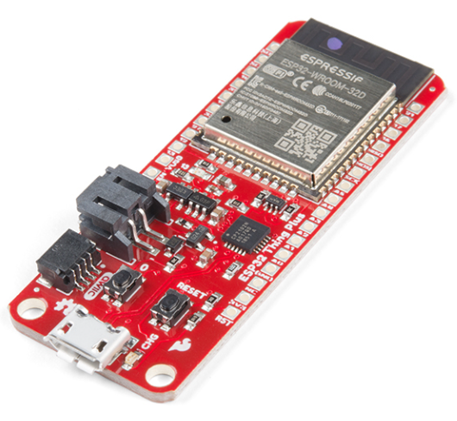
ESP32
ESP32 is the name of the chip that was developed by Espressif Systems. This provides Wi-Fi (and in some models) dual-mode Bluetooth connectivity to embedded devices.
While ESP32 is technically just the chip, modules and development boards that contain this chip are often also referred to as “ESP32” by the manufacturer.

Slide 5
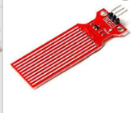
Water level sensor
The working principle of the water level sensor is that when the sensor is put into a certain depth in the liquid to be calculated, the pressure on the sensor's front surface is converted into the water level height.
H is the depth at which the sensor drops into the liquid

Slide 6
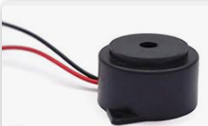
Buzzer
Also known as a sounder, audio alarm or audio indicator, a buzzer is a basic audio device that generates a sound from an incoming electrical signal.
Buzzers come in two primary forms — piezo buzzers and magnetic buzzers

Slide 7
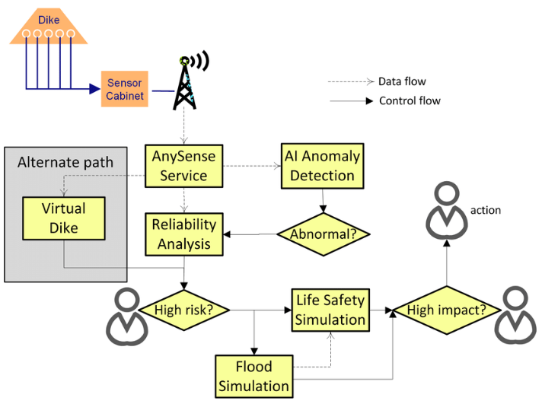
Flow chart

Slide 8
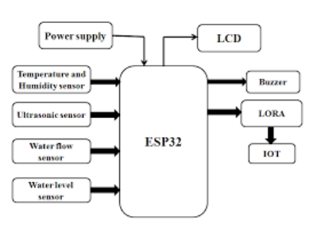
Block diagram

Slide 9
Program
//<LiquidCrystal.h> is the library for using the LCD 16x2
#include <LiquidCrystal.h>
//"DHT.h" is the library for using the Temperature sensor DHT22
#include "DHT.h"
#define DHTPIN A0 //here we are initialising a pin for DHT22
#define DHTTYPE DHT22 //We have to declare the type of DHT sensor we are using for its correct functionality
LiquidCrystal lcd(2,3,4,5,6,7); // Create an instance of the LiquidCrystal library
DHT dht(DHTPIN, DHTTYPE); // Create an instance of the DHT library for the DHT22 sensor
const int in=8; //This is the ECHO pin of The Ultrasonic sensor HC-SR04

Slide 10
const int out=9; //This is the TRIG pin of the ultrasonic Sensor HC-SR04 // Define pin numbers for various components const int green=10; const int orange=11; const int red=12; const int buzz=13; void setup() { // Start serial communication with a baud rate of 9600 Serial.begin(9600); // Initialize the LCD with 16 columns and 2 rows lcd.begin(16, 2); // Set pin modes for various components pinMode(in, INPUT);

Slide 11
pinMode(out, OUTPUT);
pinMode(green, OUTPUT);
pinMode(orange, OUTPUT);
pinMode(red, OUTPUT);
pinMode(buzz, OUTPUT);
// Initialize the DHT sensor
dht.begin();
// Set initial states for LEDs and buzzer to LOW (off)
digitalWrite(green,LOW);
digitalWrite(orange,LOW);
digitalWrite(red,LOW);
digitalWrite(buzz,LOW);
// Display a startup message on the LCD
lcd.setCursor(0, 0);
lcd.print("Flood Monitoring");

Slide 12
lcd.setCursor(0,1);
lcd.print("Alerting System");
// Wait for 5 seconds and then clear the LCD
delay(5000);
lcd.clear();
}
void loop()
{
// Read temperature and humidity from the DHT22 sensor
float T = dht.readTemperature();
float H = dht.readHumidity();
// Check if the sensor data is valid
if (isnan(H) && isnan(T)) {
lcd.print("ERROR");

Slide 13
return; } float f = dht.readTemperature(true); // Read distance from the ultrasonic sensor (HC-SR04) long dur; long dist; long per; digitalWrite(out,LOW); delayMicroseconds(2); digitalWrite(out,HIGH); delayMicroseconds(10); digitalWrite(out,LOW); dur=pulseIn(in,HIGH); dist=(dur*0.034)/2; // Map the distance value to a percentage value

Slide 14
per=map(dist,10.5,2,0,100);
// Ensure that the percentage value is within bounds
if(per<0)
{
per=0;
}
if(per>100)
{
per=100;
}
// Print sensor data and percentage value to serial
Serial.print(("Humidity: "));
Serial.print(H);
Serial.print(("% Temperature: "));
Serial.print(T);
Serial.print("% Water Level:");
Serial.println(String(per));
lcd.setCursor(0,0);
lcd.print("Temperature:");
lcd.setCursor(0,1);

Slide 15
lcd.print("Humidity :");
lcd.setCursor(12,0);
lcd.print(T);
lcd.setCursor(12,1);
lcd.print(H);
delay(1000);
lcd.clear();
lcd.print("Water Level:");
lcd.print(String(per));
lcd.print("% ");
// Check water level and set alert levels
if(dist<=3)
{
lcd.setCursor(0,1);
lcd.print("Red Alert! ");
digitalWrite(red,HIGH);
digitalWrite(green,LOW);
digitalWrite(orange,LOW);
digitalWrite(buzz,HIGH);
delay(2000);

Slide 16
digitalWrite(buzz,LOW); delay(2000); digitalWrite(buzz,HIGH); delay(2000); digitalWrite(buzz,LOW); delay(2000); } else if(dist<=10) { lcd.setCursor(0,1); lcd.print("Orange Alert! "); digitalWrite(orange,HIGH); digitalWrite(red,LOW); digitalWrite(green,LOW); digitalWrite(buzz,HIGH); delay(3000); digitalWrite(buzz,LOW);

Slide 17
delay(3000); }else { lcd.setCursor(0,1); lcd.print("Green Alert! "); digitalWrite(green,HIGH); digitalWrite(orange,LOW); digitalWrite(red,LOW); digitalWrite(buzz,LOW); }

Slide 18
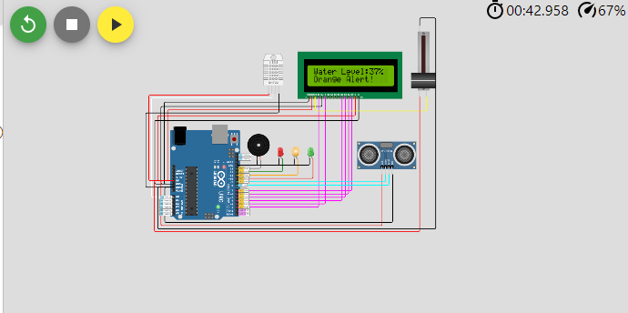
Simulation Diagram

Slide 19
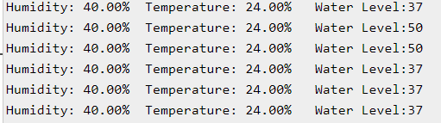
Output

