Slide 1
JKK MUNIRAJAH COLLEGE OF
TECHNOLOGY
DEPARTMENT OF
ELECTRONICS AND COMMUNICATION
ENGINEERING

Slide 2
IBM PROJECT
INTERNET OF THINGS
PHASE 4
TEAM LEADER:
NARMATHA M
TEAM MEMBERS:
ARTHI V
SHARMILAV
SOUNDARIYA S
SHARMILA V

Slide 3
Introduction:
A flood warning system is an early flood monitoring solution that deploys accurate and well-maintained sensing instruments, like rain gauges, water Flooding is not new to the Terai districts of Nepal.
Every year, the monsoon floods have caused significant damage and loss to human lives and livelihoods within these southern flood plains.
Yet each time the rescue and relief operations seem slow and insufficient and the government comes under fire for not responding quickly enough.
A critical review – that is, reflecting and building on lessons from past flood events along with institutional memory – is seriously lacking, particularly across the government entities.er level sensors, and flow rate sensors.

Slide 4
IOT BASED FLOOD MONITORING AND EARLY WARNING
USING NODE-RED:
The early-warning model for flash floods is based on a hydrological and geomorphological concept connected to the river basin, with the principle that flash floods will only occur where there is a high potential risk and when rainfall exceeds the threshold.
The real time flood monitoring and warning system include liquid level sensors, meteorological sensors, communication equipment, and data collectors.

Slide 5
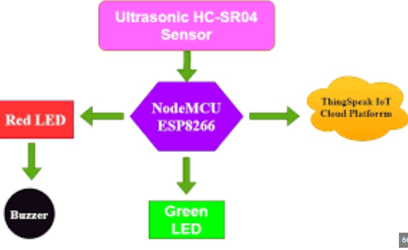
BLOCK DIAGRAM:

Slide 6
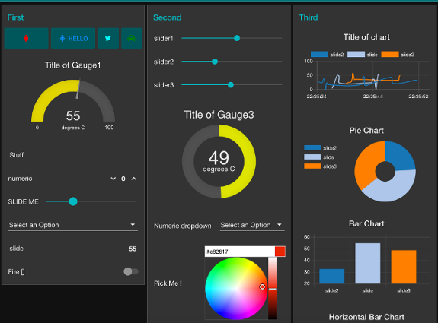
NODE-RED:
Node-RED is a programming tool for wiring together hardware devices, APIs and online services in new and interesting ways. It provides a browser-based editor that makes it easy to wire together flows using the wide range of nodes in the palette that can be deployed to its runtime in a single-click.

Slide 7
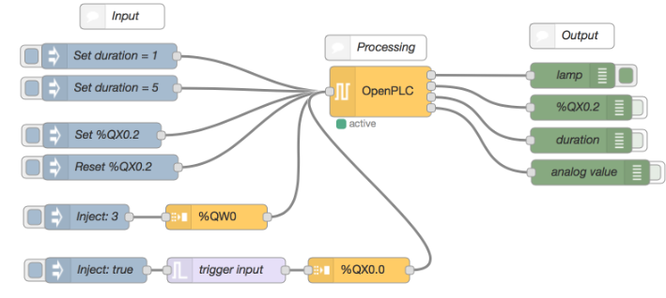
NODE-RED PLC:
Node-RED is a user-friendly open-source software for programming PLC behaviour through the so-called flow-based method.

Slide 8
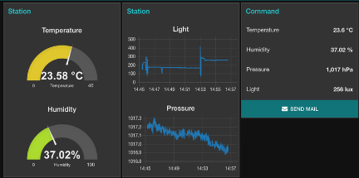
BASICS OF NODE-RED:
A project is called a flow, and consists of data and functions linked together.
The messages carry data from one node to another.
The nodes are functions that generate, transform or use messages.

Slide 9
NODE-RED IOT APPLICATIONS:
In the rest of this article, I will show you how to build and deploy a Node-RED application step-by-step.
Using u-create web, the web-based development environment for u-control controllers, we will build an application that sends an email alert to maintenance technicians when a process parameter reaches a critical level.
When building the application, we will see how to collect, process, and send data from a control system using Node-RED.

Slide 10
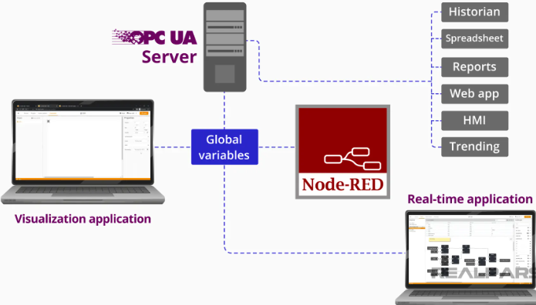
NODE-RED FEATURES:
I want to highlight that Global Variables are truly global. All of the Global Variables defined here are added to a global data pool and can be accessed by all of the applications running on the controller including Node-RED and visualization applications.

