Slide 1
J.K.K MUNIRAJAH COLLEGE OF TECHNOLOGY
IBM PROJECT PHASE 5
FLOOD MONITORING AND EARLY WARNING SYSTEM
TEAM LEADER:
NARMATHA M
TEAM MEMBERS :
SHARMILA V
SOUNDARIYA S
ARTHI V
SHARMILA V

Slide 2
Introduction:
The flood warning system utilizes computer technology, database technology, communication technology, and sensor technology. Powered by IoT technology, rainfall and water levels are monitored and floods are predicted.
Early warning of impending flooding can save lives and reduce extensive property damage.

Slide 3
Hardware Required
ESP32 Development Board
Water level sensor
Buzzer
Software Required
Cloud (for simulating the project)

Slide 4
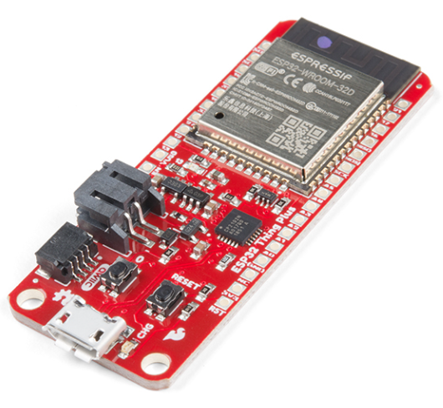
ESP32
ESP32 is the name of the chip that was developed by Espressif Systems. This provides Wi-Fi (and in some models) dual-mode Bluetooth connectivity to embedded devices.
While ESP32 is technically just the chip, modules and development boards that contain this chip are often also referred to as “ESP32” by the manufacturer.

Slide 5
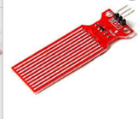
Water level sensor
The working principle of the water level sensor is that when the sensor is put into a certain depth in the liquid to be calculated, the pressure on the sensor's front surface is converted into the water level height.
H is the depth at which the sensor drops into the liquid

Slide 6
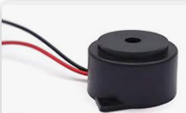
Buzzer
Also known as a sounder, audio alarm or audio indicator, a buzzer is a basic audio device that generates a sound from an incoming electrical signal.
Buzzers come in two primary forms — piezo buzzers and magnetic buzzers

Slide 7
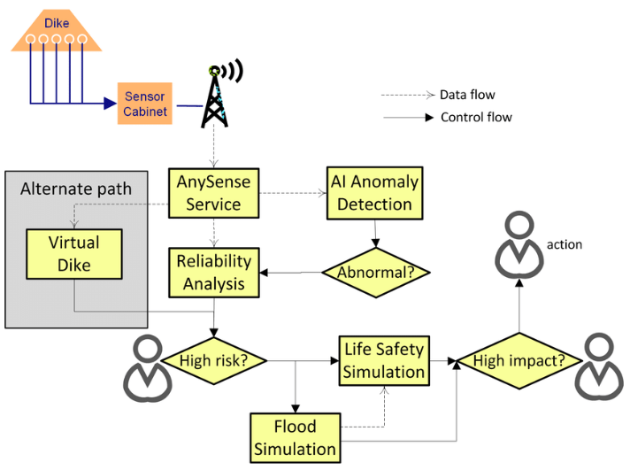
Flow chart

Slide 8
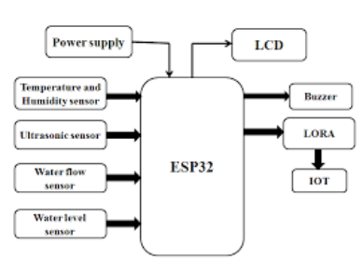
Block diagram

Slide 9
Program
import time
import machine
import dht
# Define GPIO pins
TRIG_PIN = machine.Pin(2, machine.Pin.OUT)
ECHO_PIN = machine.Pin(3, machine.Pin.IN)
BUZZER_PIN = machine.Pin(4, machine.Pin.OUT)
DHT_PIN = machine.Pin(5)
LED_PIN = machine.Pin(6, machine.Pin.OUT)
def distance_measurement():
# Trigger ultrasonic sensor
TRIG_PIN.on()
time.sleep_us(10)
# Wait for echo to be HIGH (start time)
while not ECHO_PIN.value():
pass

Slide 10
# Wait for echo to be LOW (end time) while ECHO_PIN.value(): pass pulse_end = time.ticks_us() # Calculate distance pulse_duration = time.ticks_diff(pulse_end, pulse_start) distance = pulse_duration / 58 # Speed of sound (343 m/s) divided by 2 return distance def read_dht_sensor(): d = dht.DHT22(DHT_PIN) d.measure() return d.temperature(), d.humidity()

Slide 11
buzz_start_time = None # To track when the buzzer started
while True:
dist = distance_measurement()
temp, humidity = read_dht_sensor()
# Check if the distance is less than a threshold (e.g., 50 cm)
if dist < 50:
# Turn on the buzzer and LED
BUZZER_PIN.on()
LED_PIN.on()
status = "Flooding Detected"
buzz_start_time = time.ticks_ms()
elif buzz_start_time is not None and time

Slide 12
# Turn off the buzzer and LED after 1 minute
BUZZER_PIN.off()
LED_PIN.off()
status = "No Flooding Detected"
else:
status = "No Flooding Detected"
print(f"Distance: {dist:.2f} cm")
print(f"Temperature: {temp:.2f}°C, Humidity: {humidity:.2f}%")
print("Status:", status)
time.sleep(2)

Slide 13
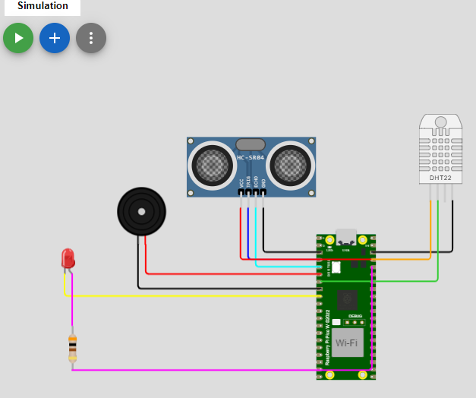
SIMULATION

Slide 14
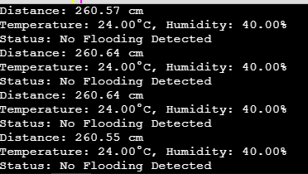
OUTPUT

Slide 15
THANK YOU

