Slide 1
Student Performance Prediction
Arthi Komma
Campus Id – GF89659

Slide 2
Agenda
Introduction
Dataset Overview
Data Cleaning/Pre-Processing
Data Visualization
Model Prediction
Summary

Slide 3
Introduction
The student performance prediction project aims to develop a predictive model that can forecast or estimate the academic performance of students based on various factors and data available. The project involves analyzing historical student data, identifying relevant features, and building a machine learning model to predict future student performance.
The project typically starts with data collection, which may include information such as student demographics, previous academic records, socio-economic factors, attendance, study habits, and other relevant attributes. The data is then preprocessed and cleaned to ensure its quality and consistency. Later the features are found

Slide 4
Dataset Overview
This dataset contains information on the performance of high school students in mathematics, including their grades and demographic information. The data was collected from three high schools in the United States. "This dataset was created for educational purposes and was generated, not collected from actual data sources.“
Features:
Gender: The gender of the student (male/female)
Race/ethnicity: The student's racial or ethnic background (Asian, African-American, Hispanic, etc.)
Parental level of education: The highest level of education attained by the student's parent(s) or guardian(s)
Lunch: Whether the student receives free or reduced-price lunch (yes/no)
Test preparation course: Whether the student completed a test preparation course (yes/no)
Math score: The student's score on a standardized mathematics test
Reading score: The student's score on a standardized reading test
Writing score: The student's score on a standardized writing test

Slide 5
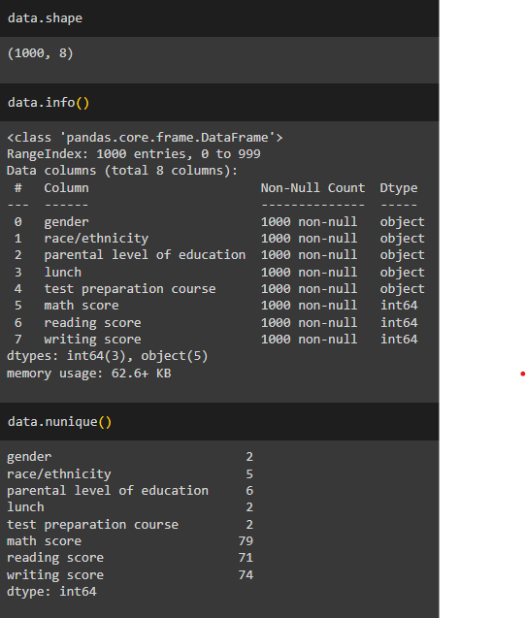
Data Cleaning/Pre-processing
After importing all the necessary libraries, importing the dataset file, I have performed some pre-processing on the dataset to know about it. Later I have found that the dataset has 1000 rows of records and 8 columns of data. And later I have the unique values of each column from the dataset.

Slide 6
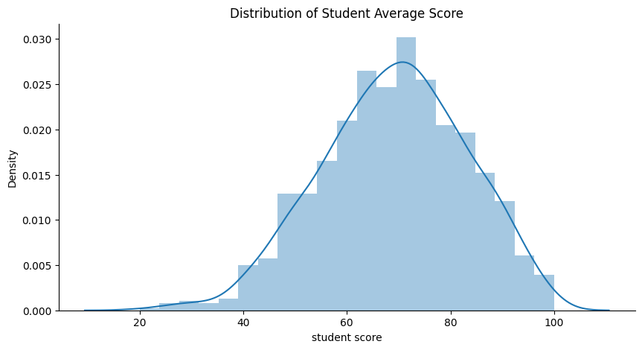
Data Visualization
The chart illustrates the distribution of Student Average Score

Slide 7
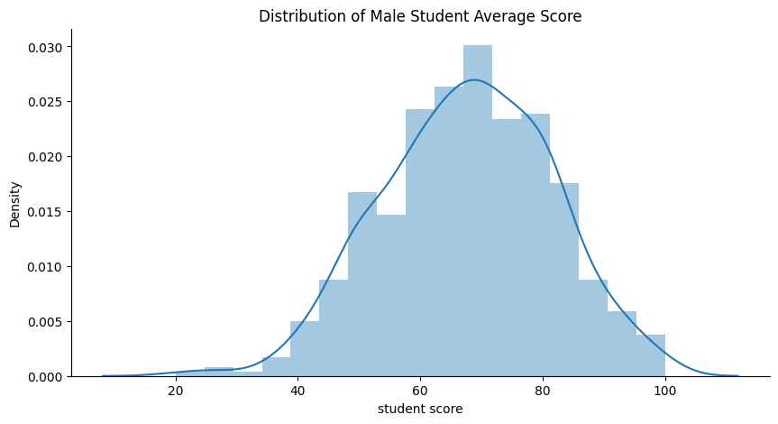
The chart illustrates the distribution of Student Score by Gender

Slide 8
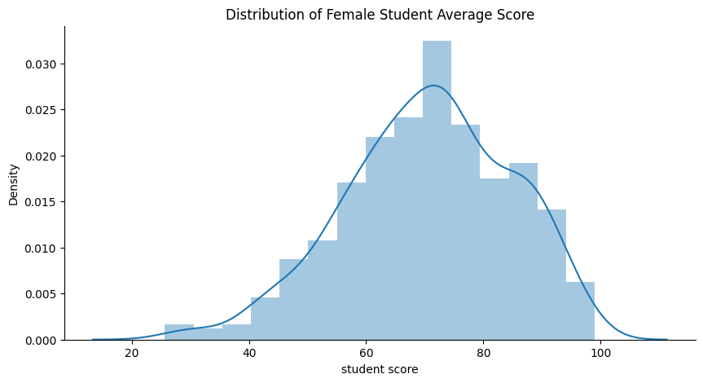
The chart illustrates the distribution of Female Student Average Score

Slide 9
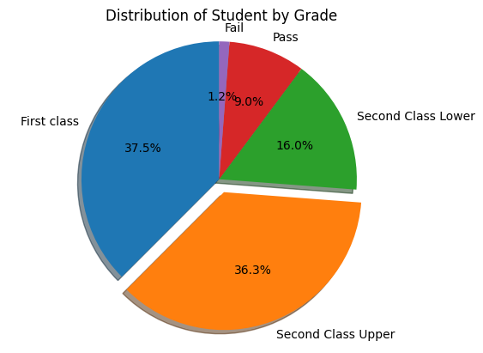
The chart illustrates the classification of Students by grades

Slide 10
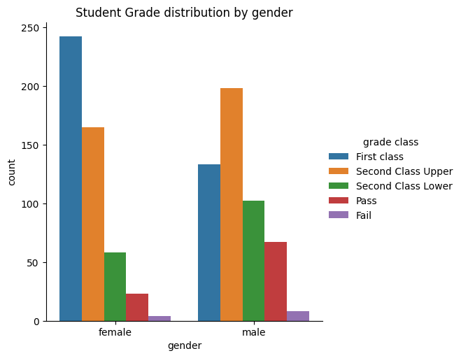
The chart illustrates the distribution of Student grades by gender

Slide 11
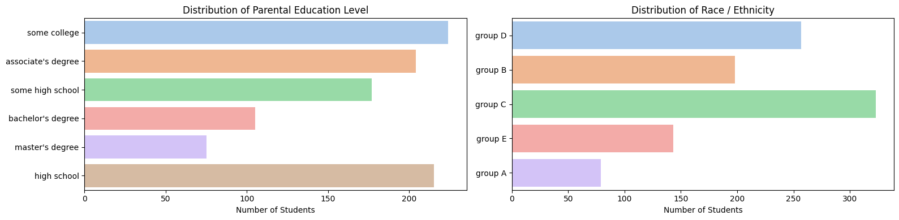
The chart illustrates the distribution of Parental Edication level and Race/ethnicity

Slide 12
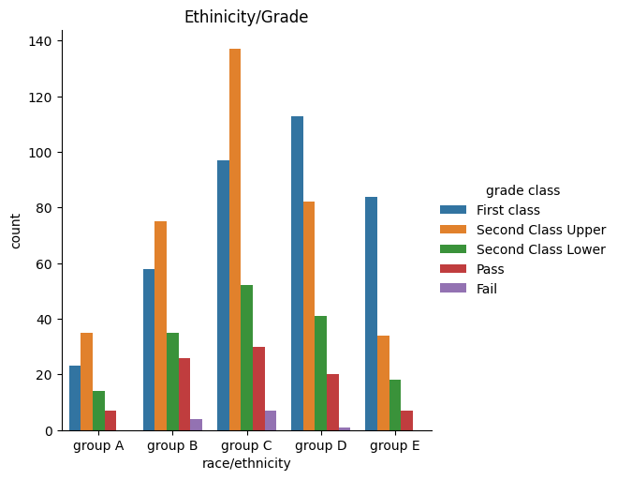
The chart illustrates the distribution of performance by Race/Ethnicity and Grade Class

Slide 13
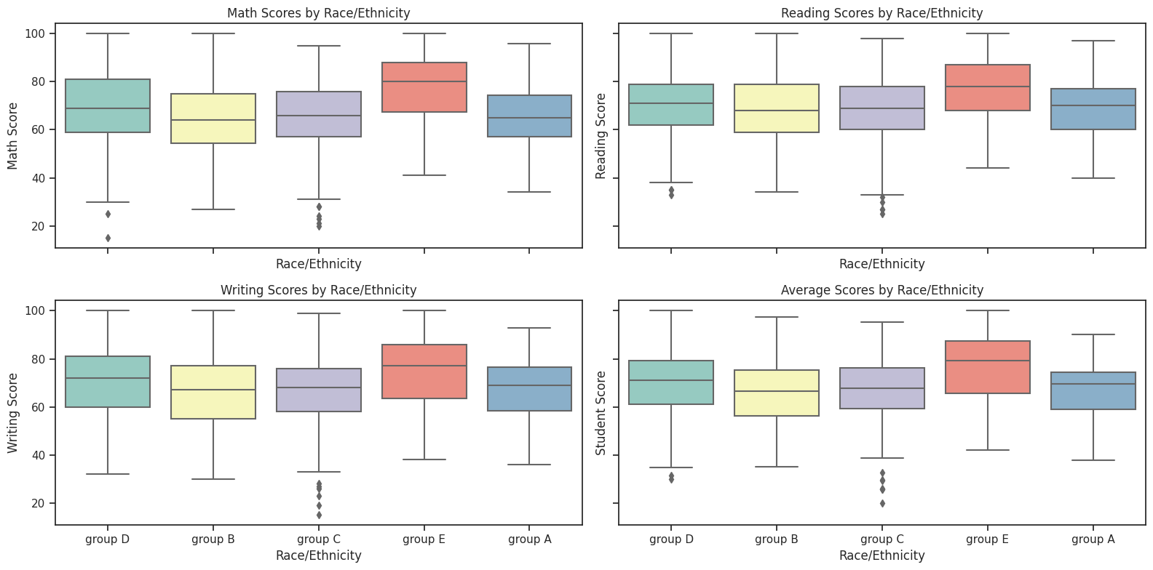
The chart illustrates the distribution of performance by Parental Level of Education and Grade Class

Slide 14
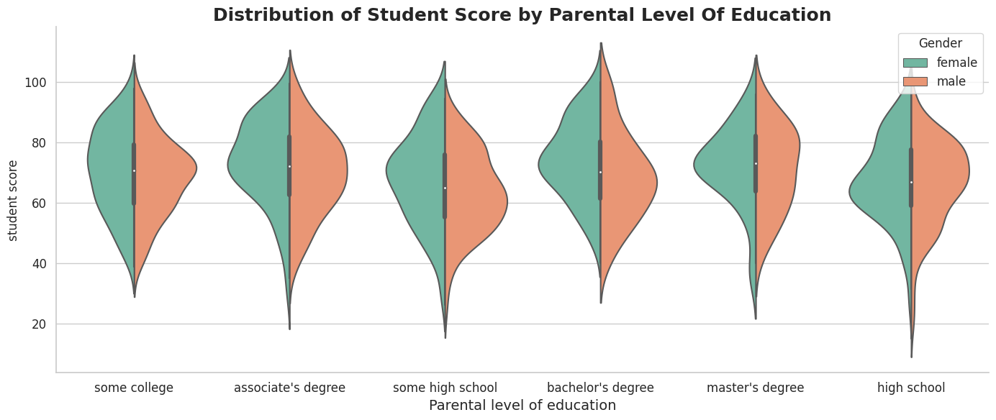
The chart illustrates the distribution of Student Score with Parental Level Of Education

Slide 15
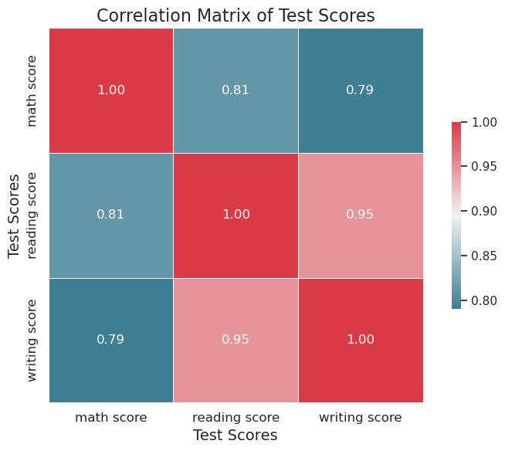
The chart illustrates the correlation Matrix Of Student Scores

Slide 16
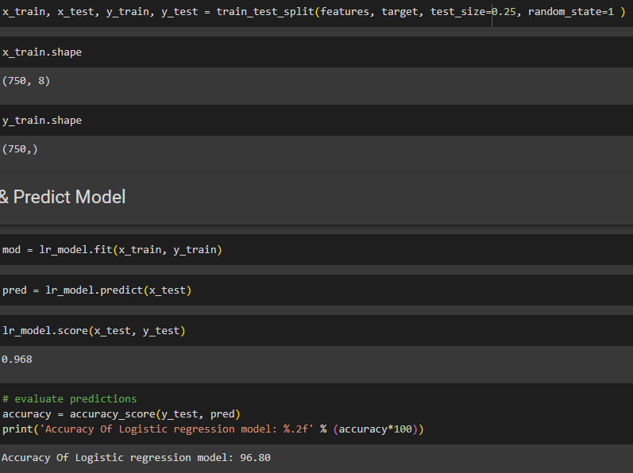
Model Prediction
The dataset is split into train and test datasets to predict the grade of the students. To predict the grades, I have used Logistic Regression, Naïve Bayes and Stochastic Gradient Descent. After finding the accuracy of all the models it is found that the Logistic regression model has highest accuracy of 96% to predict the grade of the students.

Slide 17
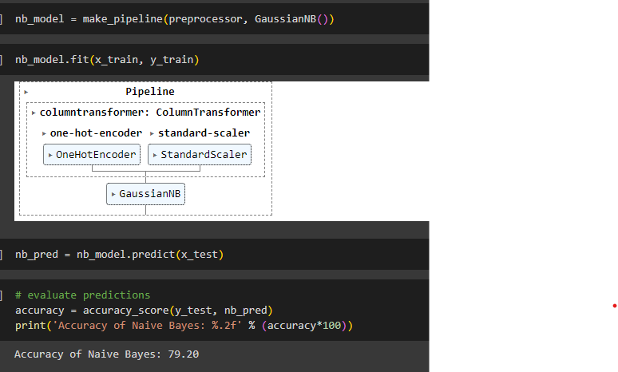
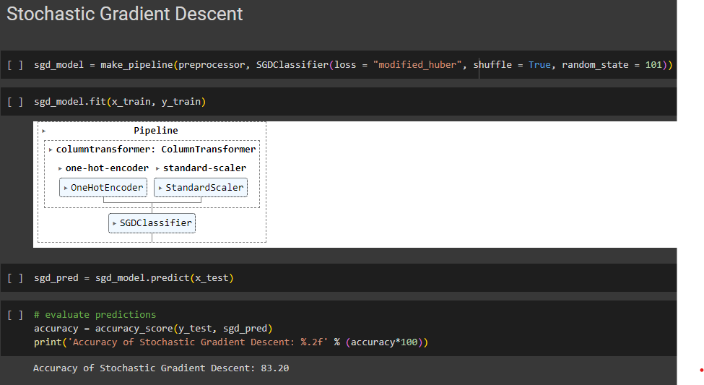

Slide 18
Conclusion
This brings us to an end to the student’s performance prediction. Let us review our work. First, we started by defining our problem statement, looking into the algorithms we were going to use and the regression implementation pipeline. Then we moved on to practically implementing the identification and regression algorithms like Logistic Regression and other algorithms. Moving forward, we compared the performances of these models. Lastly, we built a logistic regression model that proved that it works best for student performance prediction problems.
The key takeaways from this student performance prediction are:
Identification of student performance prediction is important for many institutions. Logistic regression gives better accuracy compared to other regression problems. Logistic regression is the best fit for the problem Logistics regression provides an accuracy of 96%, giving out the most accurate results.

Slide 19
References
Dataset link - https://www.kaggle.com/code/raimiazeezbabatunde/student-performance-prediction/input
Code References -
https://www.analyticsvidhya.com/blog/2023/04/student-performance-analysis-and-prediction/
https://www.frontiersin.org/articles/10.3389/fpsyg.2021.698490/full

Slide 20
Thank you

