Slide 1

SHIPMENT OPTIMIZATION
Sri Sai Srikar Bollapragada
Nazari Sai Deepak
Arthi Komma

Slide 2
Problem Statement
The main aim of the project is to find the optimal distance between various cities like Baltimore, New York, Seattle,etc., to deliver the parcels in different cities. Assuming that the truck is parked in Dallas.

Slide 3
Implementations
The geographical information of various cities is fetched from OpenStreetMapsAPI(osmnx).
All the roadway coordinates are stored in the MongoDB between all the city's highways.
Using all the coordinates from the MongoDB database, building each city's roadway graph network.
Using the NetworkX module in python we found the optimal path between the selected cities by using a user defined function.

Slide 4
Progress From previous reports
From the previous report we found the shortest distance between 2 cities Dallas, New York using NetworkX.
Earlier in our report we used dijkstras algorithm to find the shortest path between these 2 cities.
In the final report we found the optimal distance between the considered cities to deliver the parcels on time and also to reduce the fuel consumption of the truck.

Slide 5
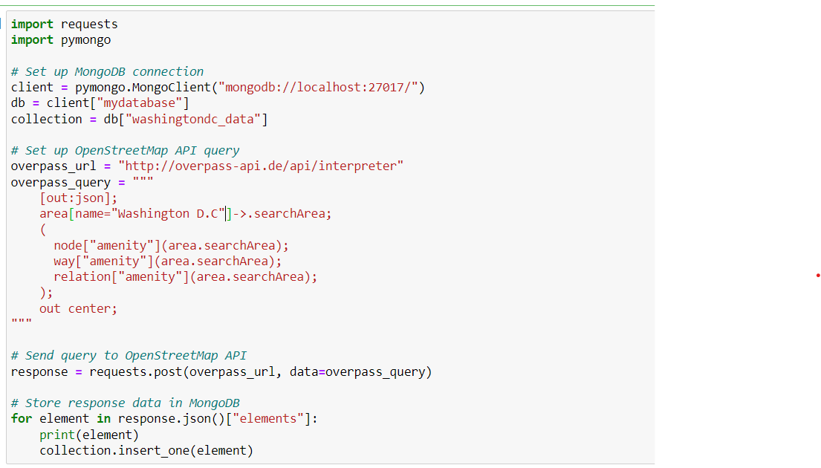
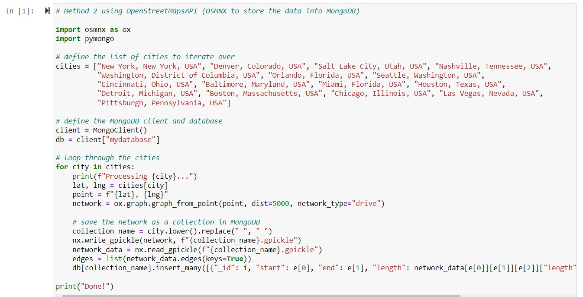
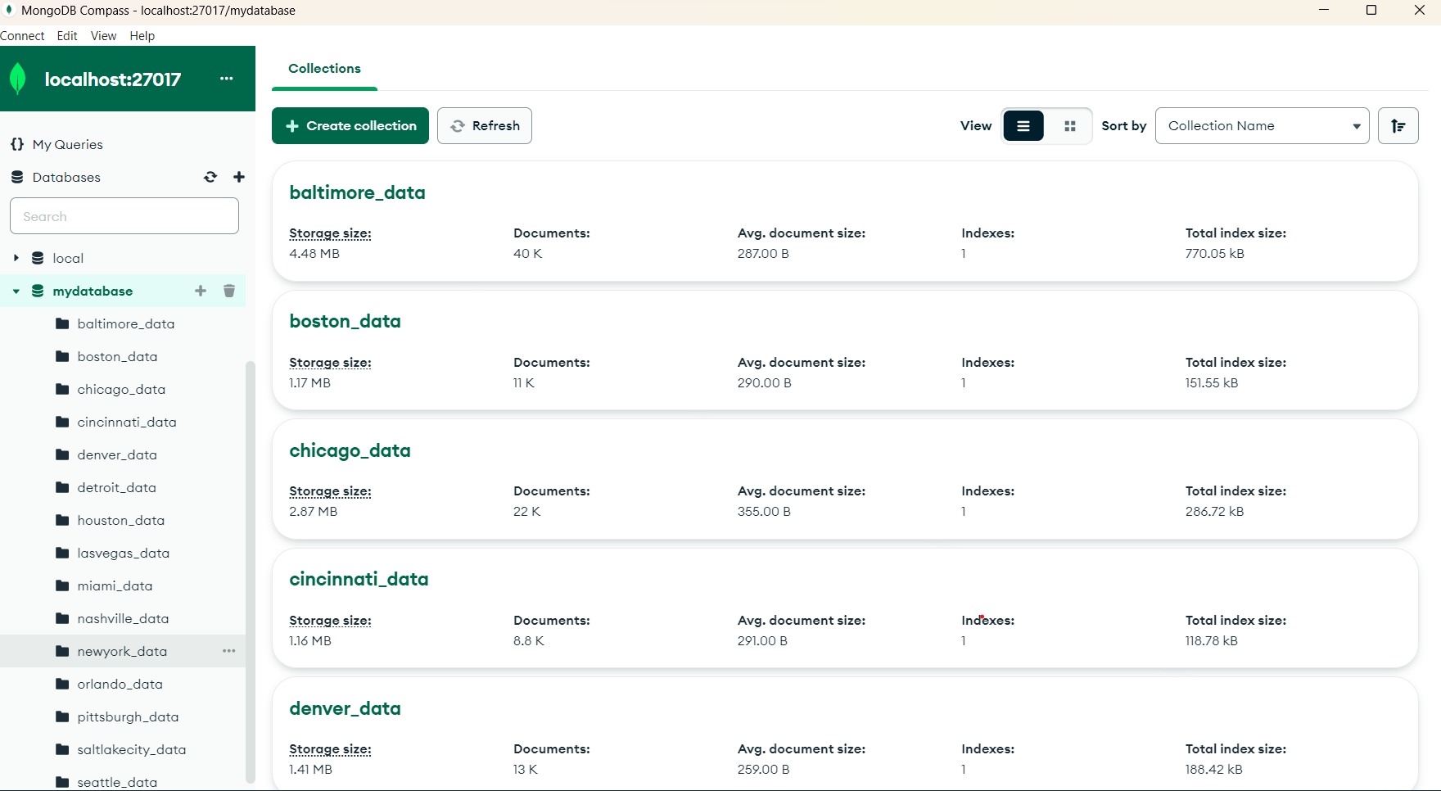
Outputs
Fetching the data from OpenStreetMapAPI

Slide 6
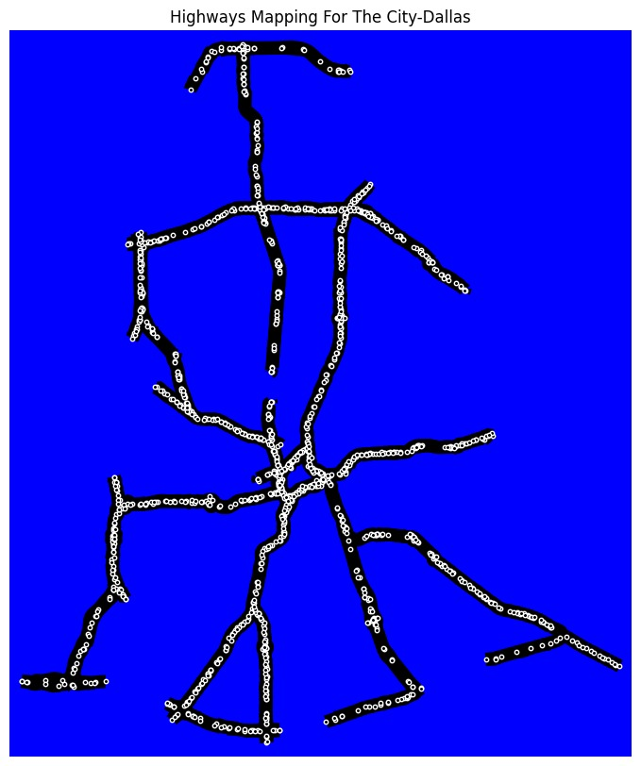
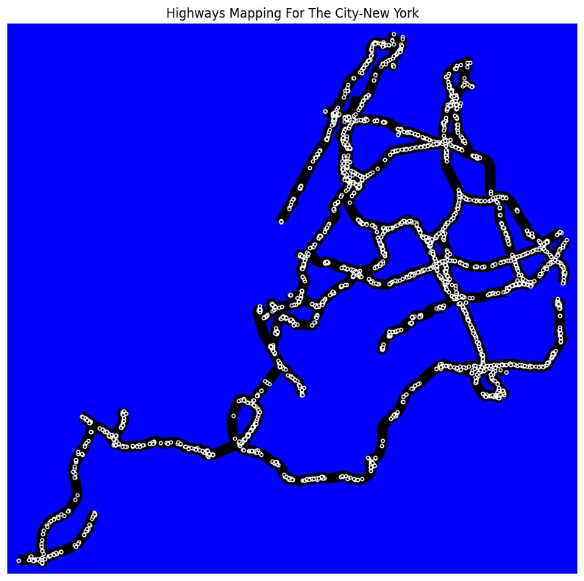
The selected cities are "Dallas, Texas, USA", "New York, New York, USA", "Washington, D.C., USA", "Baltimore, Maryland, USA", "Boston, Massachusetts, USA", "Denver, Colorado, USA", "Orlando, Florida, USA“.
The highways for each cities are plotted using NetworkX and Matplotlib.

Slide 7
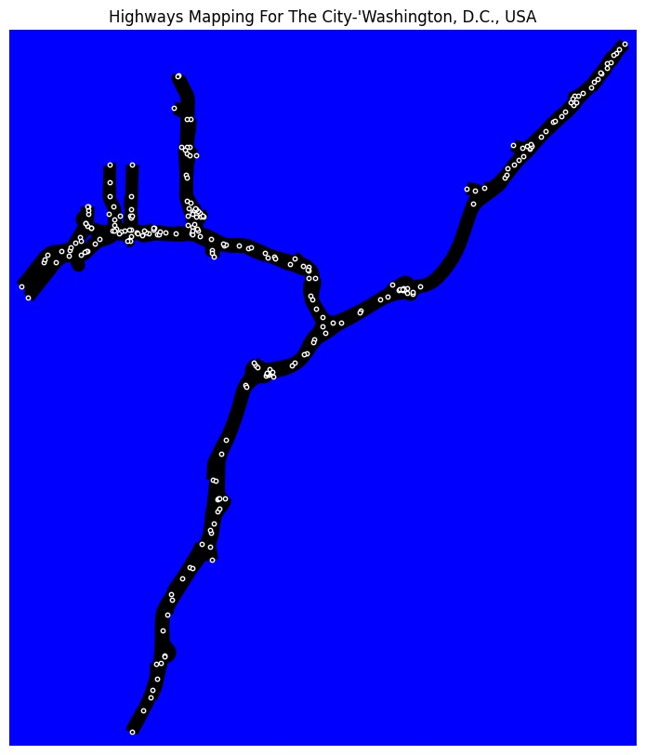
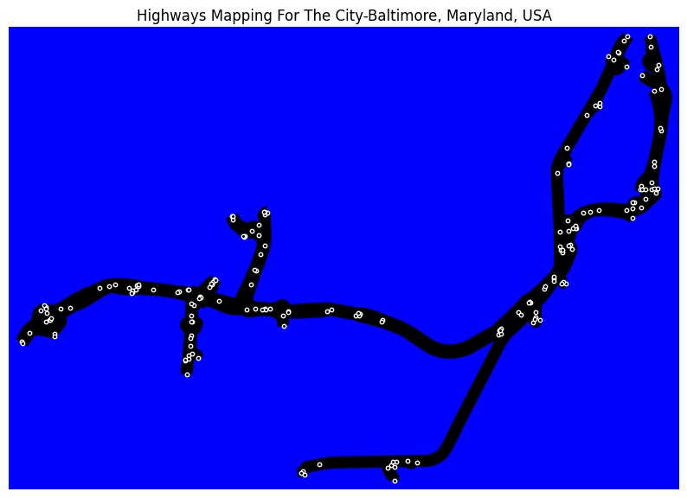

Slide 8
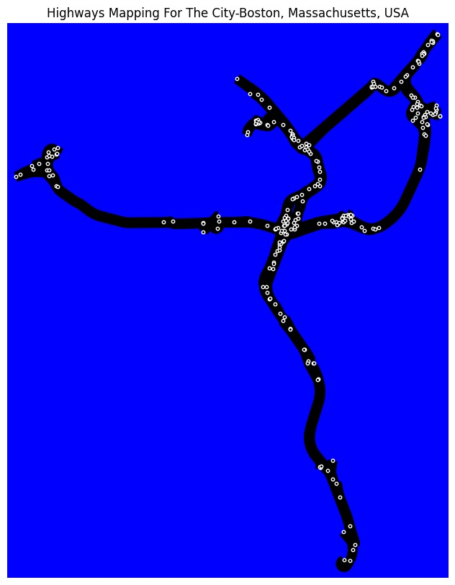
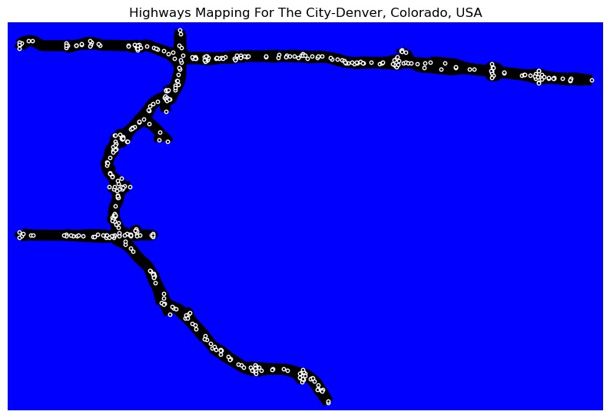

Slide 9
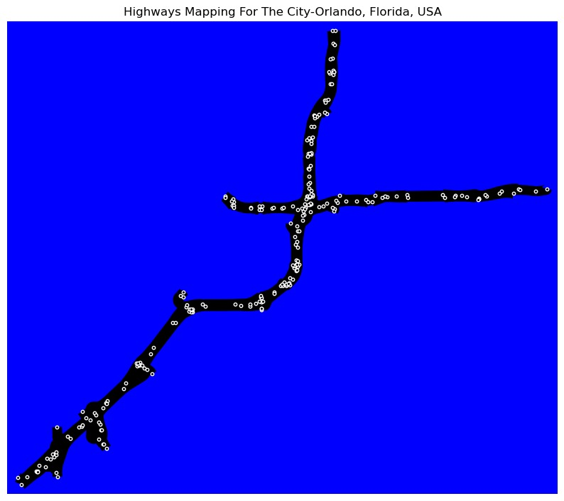

Slide 10
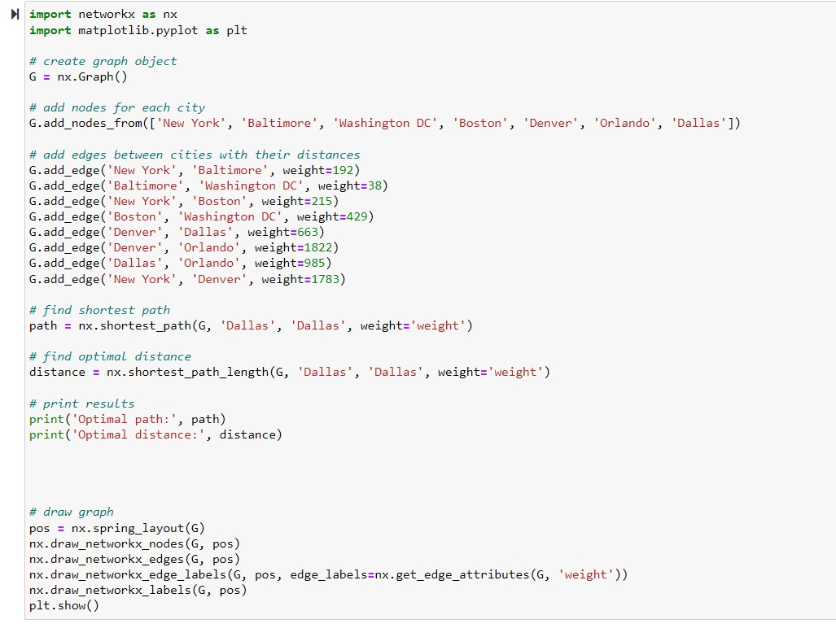
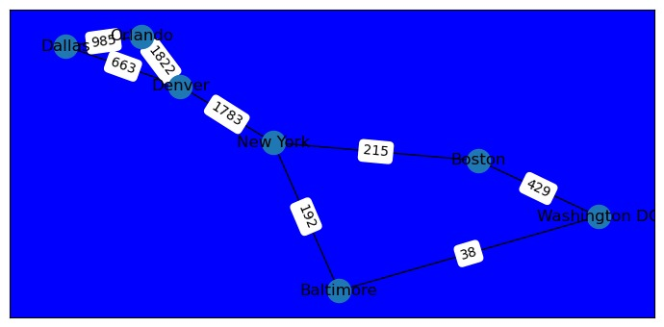
The chart showing the distance between all the considered cities

Slide 11
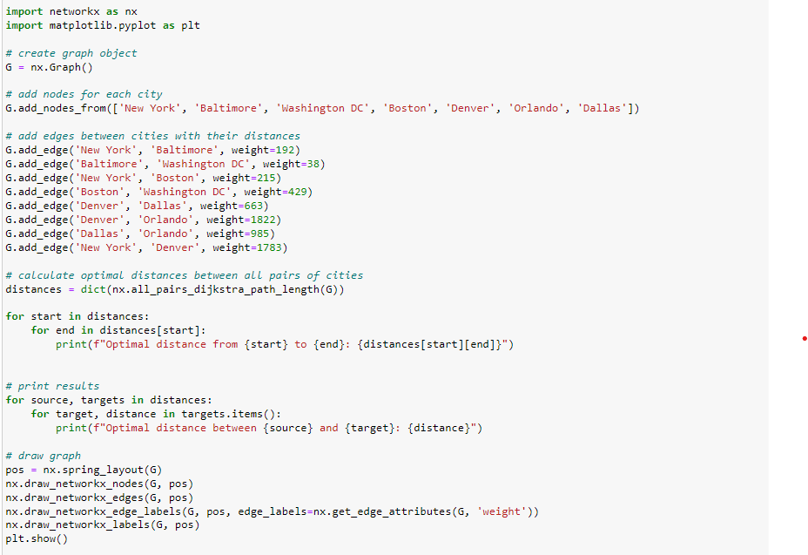
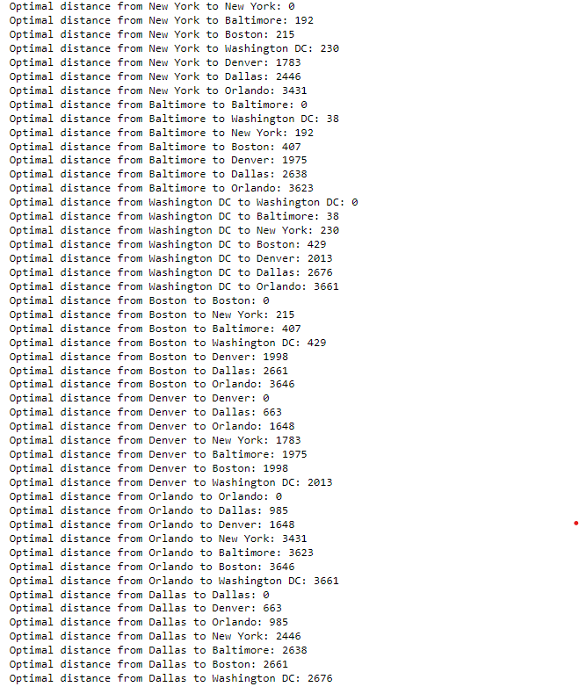
Displaying the optimal distance between the considered cities

Slide 12
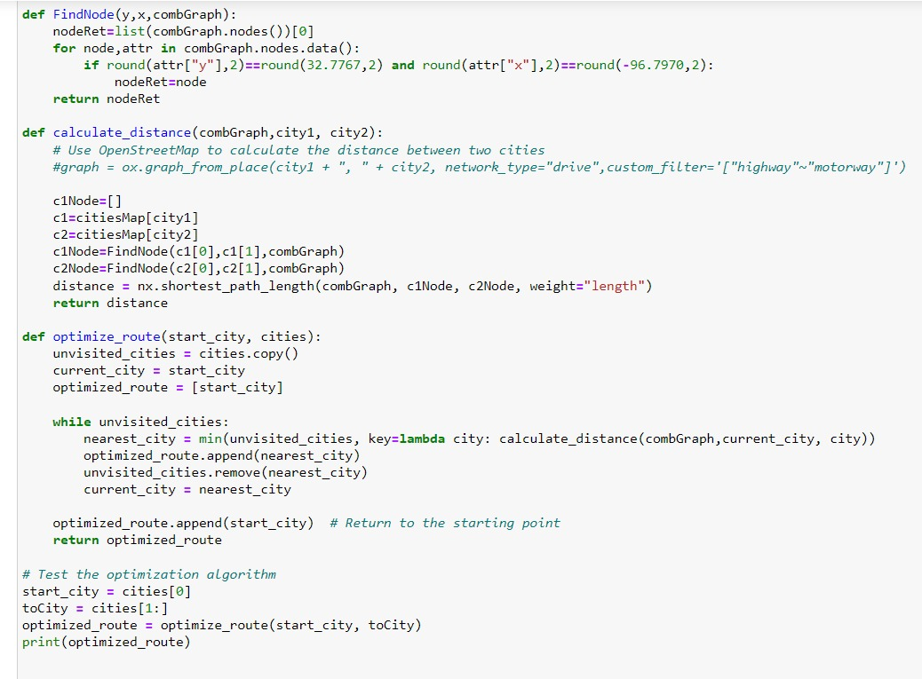
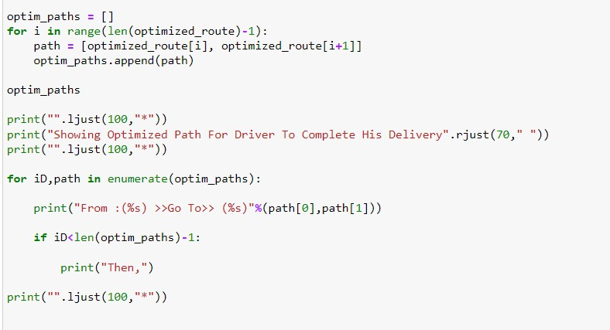
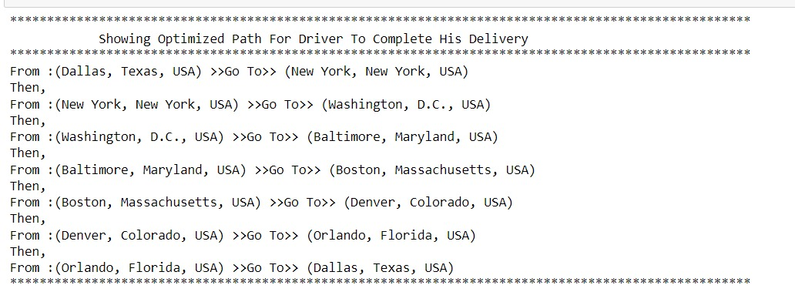
Displaying the from-to route to get the optimal distance

Slide 13
Conclusion
In this project, we aimed to identify the optimized shipment path between different cities. We utilized the graphframes module in pyspark, networkX module in python along with openstreetmapAPI and MongoDB for storage. We initially tried using GraphX, but found it to be incompatible with Python, so we had to try several options before settling on networkX. Through this project we tackled many challenges in our path to achieve desired results.

Slide 14
What we learned from this project
We explored GraphFrames module from pyspark.
Worked with NetworkX module in python.
Extracting and storing data from API’s and databases.

Slide 15
Thank you

