Slide 1

DA
DATA ANALYST PROJECT
Retail Sales Analytics Using Excel, SQL, Python and Power Bi
Domain: Retail, Sales & Inventory Analytics
Presented by Amuthalakshmi K.

Slide 2

OVERVIEW
What This Presentation Covers
01
Problem Statement & Business Use Cases
05
Dataset & Data Model
Why this project matters and what decisions it supports
Tables, relationships, and the ER diagram
02
Skills & Tools
06
Phase 3 – Python
The end-to-end stack used across every phase
EDA, RFM features, and customer segmentation
03
Phase 1 – Excel
07
Phase 4 – Power BI Dashboard
Cleaning, validation, and pivot-based summaries
Interactive Home, Sales, Store & Customer pages
04
Phase 2 – SQL
08
Key Insights & Results
Schema creation, joins, and analytical queries
What the analysis revealed
2

Slide 3
THE CHALLENGE
Problem Statement
BUSINESS USE CASES
In a competitive retail market, businesses need to track sales performance, understand customer behavior, and identify growth opportunities.
1
Analyze sales performance across stores and staff
2
Identify high-value customers and buying patterns
This project builds an end-to-end analytics solution that generates insights from raw transactional data using a multi-tool approach — Excel, SQL, Python, and Power BI working together as one pipeline.
3
Perform customer segmentation for targeted marketing
4
Monitor inventory levels and product performance
Domain
Retail, Sales & Inventory Analytics
5
Deliver an interactive Power BI dashboard for management
Approach: multi-tool pipeline (Excel → SQL → Python → Power BI)
3

Slide 4
CAPABILITIES DEMONSTRATED
Skills & Tools Used
1
2
Excel
SQL
Data cleaning, VLOOKUP/XLOOKUP, pivot tables, validation
Schema design, joins, aggregations, analytical queries
3
4
Python
Power BI
Pandas, NumPy, Matplotlib/Seaborn for EDA & visuals
Interactive dashboards, DAX measures, drill-through
4

Slide 5
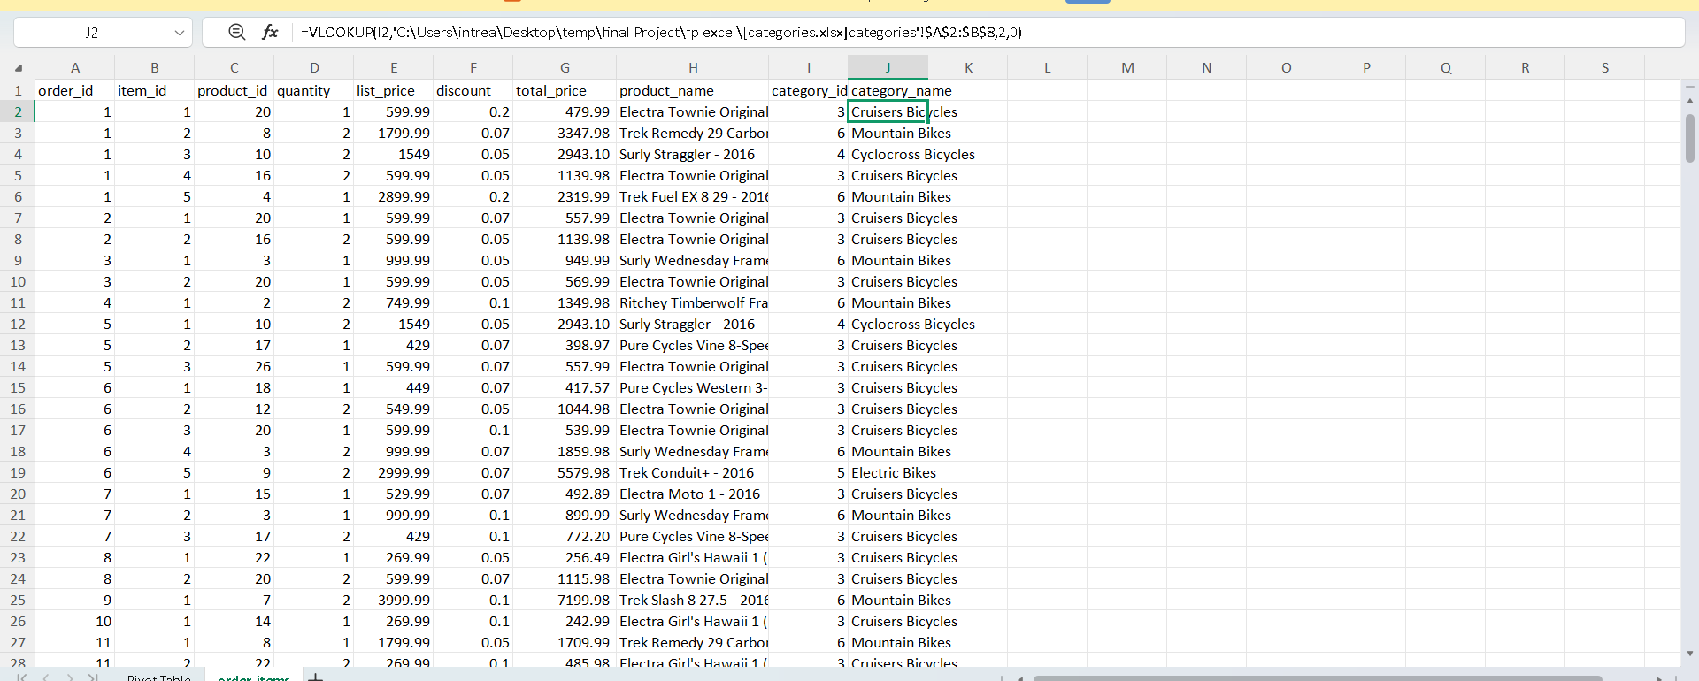
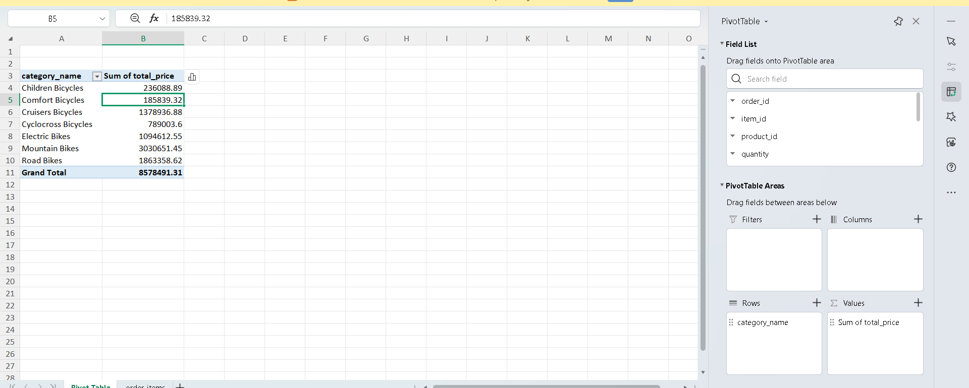
PHASE 1
Excel — Data Cleaning & Preparation
✓
Standardized column headers across all sheets (snake_case)
✓
Removed duplicate records and handled missing values
✓
Converted dates and numeric fields to correct formats
✓
Added data validation dropdowns for order_status
✓
Created total_price = (list_price × quantity) − discount
VLOOKUP merging category names into order_items
✓
Merged product names into order_items using VLOOKUP
✓
Built pivot tables summarizing sales by category
✓
Exported cleaned sheets to CSV for SQL import
5

Slide 6
PHASE 2
SQL — Database & Querying
✓
Created tables replicating the ER diagram, with constraints
QUERY — TOP STORE REVENUE
✓
Loaded cleaned CSVs into MySQL
SELECT s.store_id, s.store_name,
ROUND(SUM(oi.total_price),2)
AS total_sales
FROM stores s
INNER JOIN orders o
ON s.store_id = o.store_id
INNER JOIN order_items oi
ON o.order_id = oi.order_id
GROUP BY s.store_id, s.store_name
ORDER BY total_sales DESC;
✓
Inner-joined orders, order_items & products for line-item detail
✓
Grouped total sales by store, and revenue by staff
✓
Ranked top 5 products by quantity sold
✓
Classified customers into Low / Medium / High spend brackets
✓
Flagged low-stock products (quantity < 10) per store
✓
Created customer_segment table for segmentation results
Result: Baldwin Bikes leads all stores at 5.22M in revenue
6

Slide 7
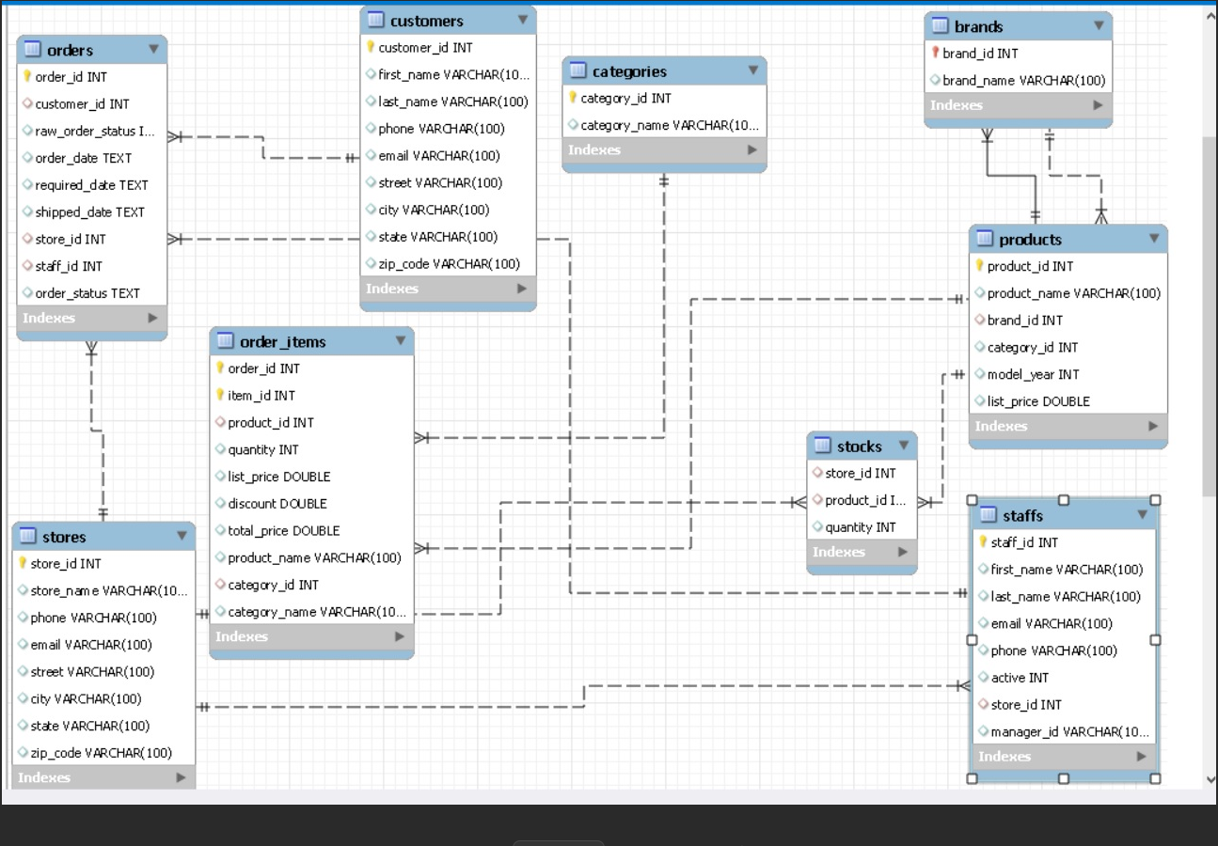
DATA FOUNDATION
Dataset & Relational Model
Relational retail dataset spanning 8 linked tables — customers, orders, order_items, products, brands, categories, stocks, and stores/staffs — exported to CSV and loaded into SQL for the full analysis pipeline.
customers
Buyer info incl. contact & location
orders
Transaction log with staff/store refs
order_items
Detailed item info per order
products
Item details with category & brand
brands / categories
Metadata about items
stocks
Inventory levels across stores
stores / staffs
Organizational structure
Entity-relationship diagram used to create the SQL schema
7

Slide 8
PHASE 3
Python
Loaded cleaned tables from SQL with pandas.read_sql(), ran exploratory data analysis, then computed RFM (Recency, Frequency, Monetary) features per customer to power segmentation.
LIBRARIES USED
Recency
Days since each customer's last order
pandas · matplotlib · seaborn
Frequency
Number of orders placed
df.describe(), df.info(), and df.value_counts() were used for EDA before building RFM-based clustering.
Monetary
Total value of all purchases
Segments (e.g. At-Risk, Loyal, Regular) were exported back to SQL as customer_segment for use directly inside Power BI.
8

Slide 9
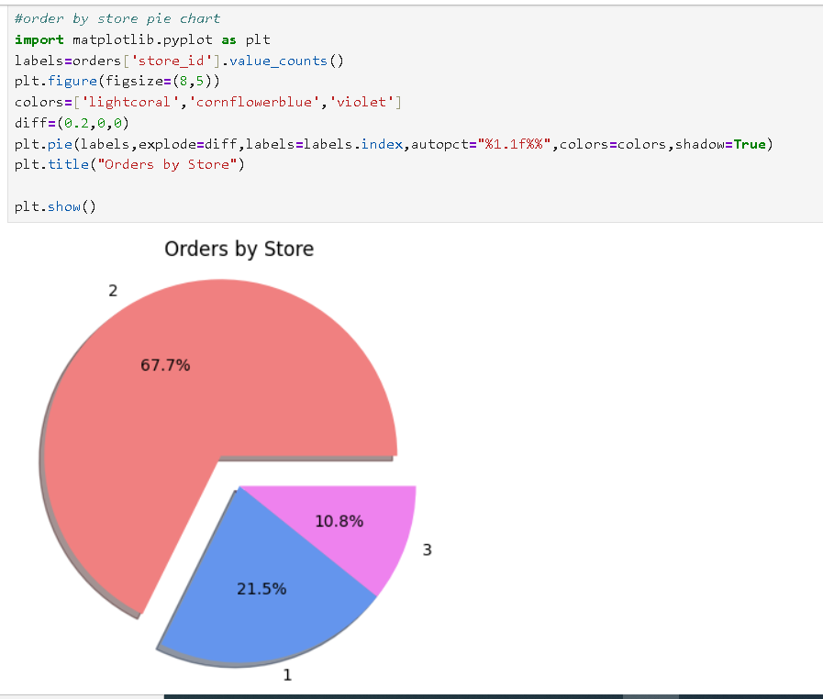
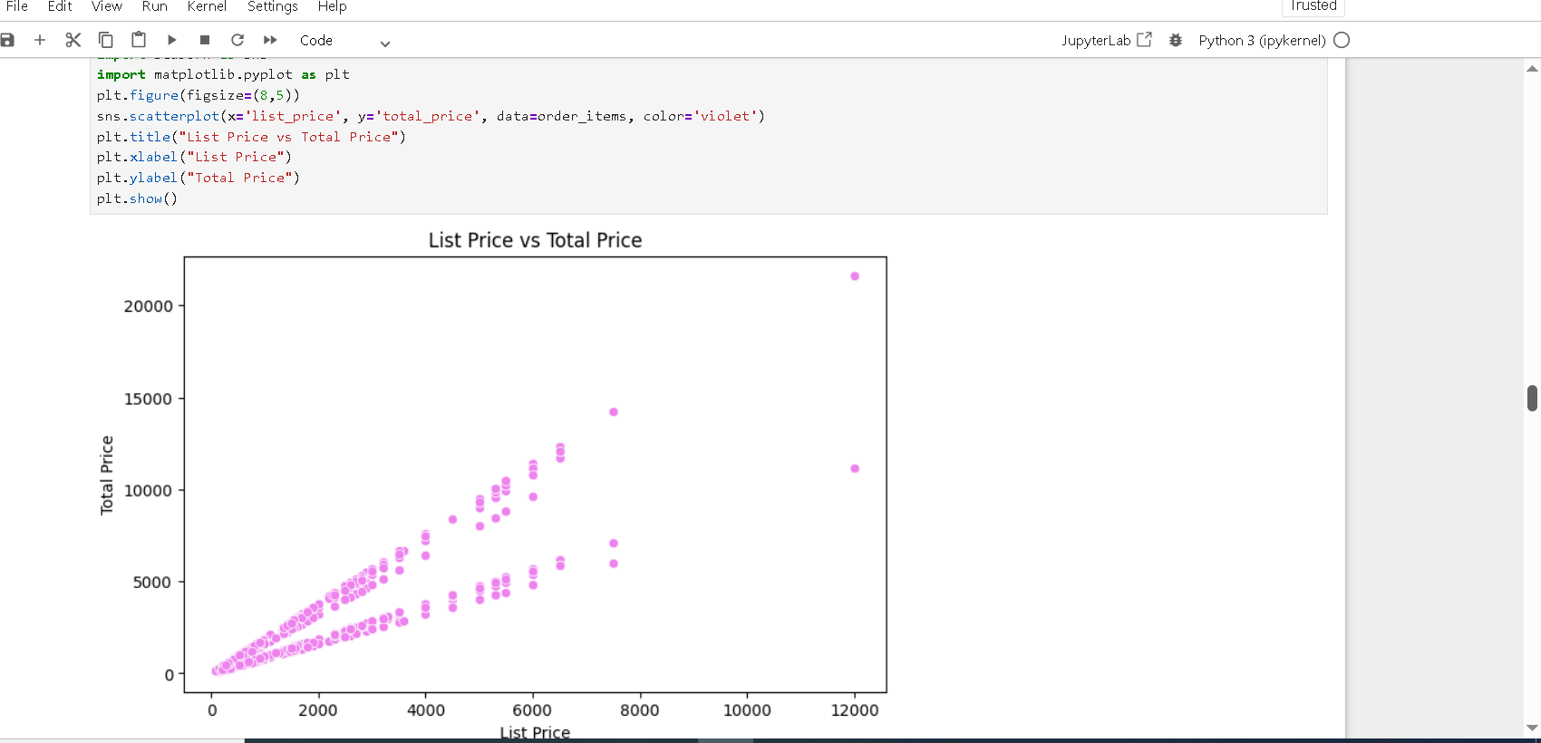

Slide 10
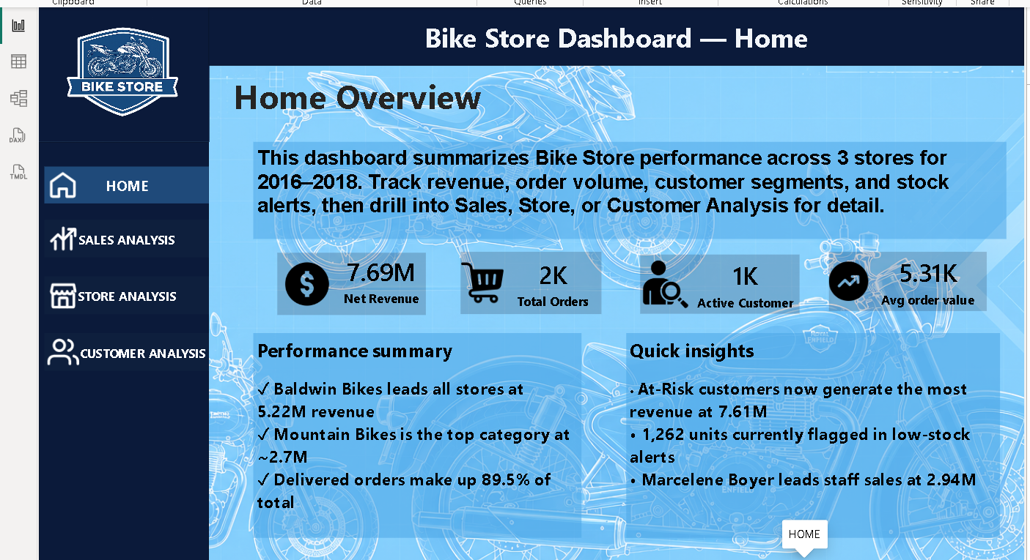
PHASE 4 — POWER BI
Dashboard: Home Overview
The Home page summarizes overall performance with headline KPIs, quick performance highlights, and navigation into each detailed analysis page.
10

Slide 11
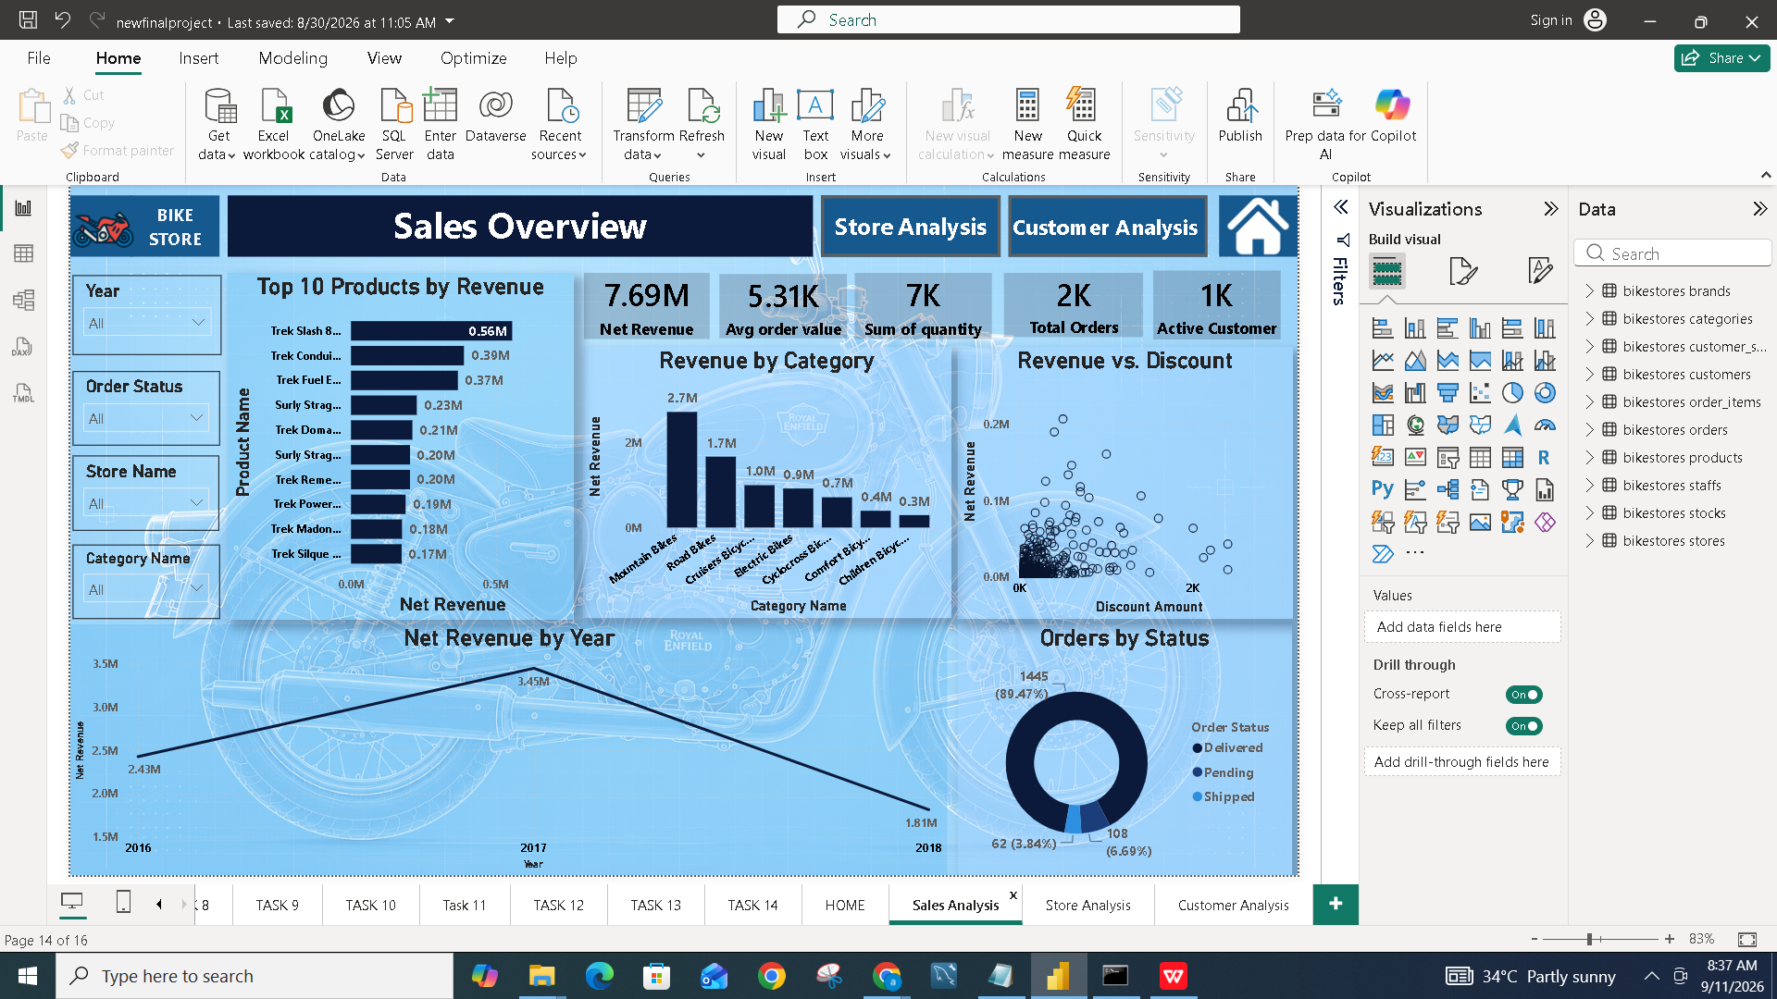
PHASE 4 — POWER BI
Dashboard: Sales Analysis
Top products, revenue by category, net revenue by year, order status split, and revenue-vs-discount relationship — all filterable by year, store, and category.
11

Slide 12
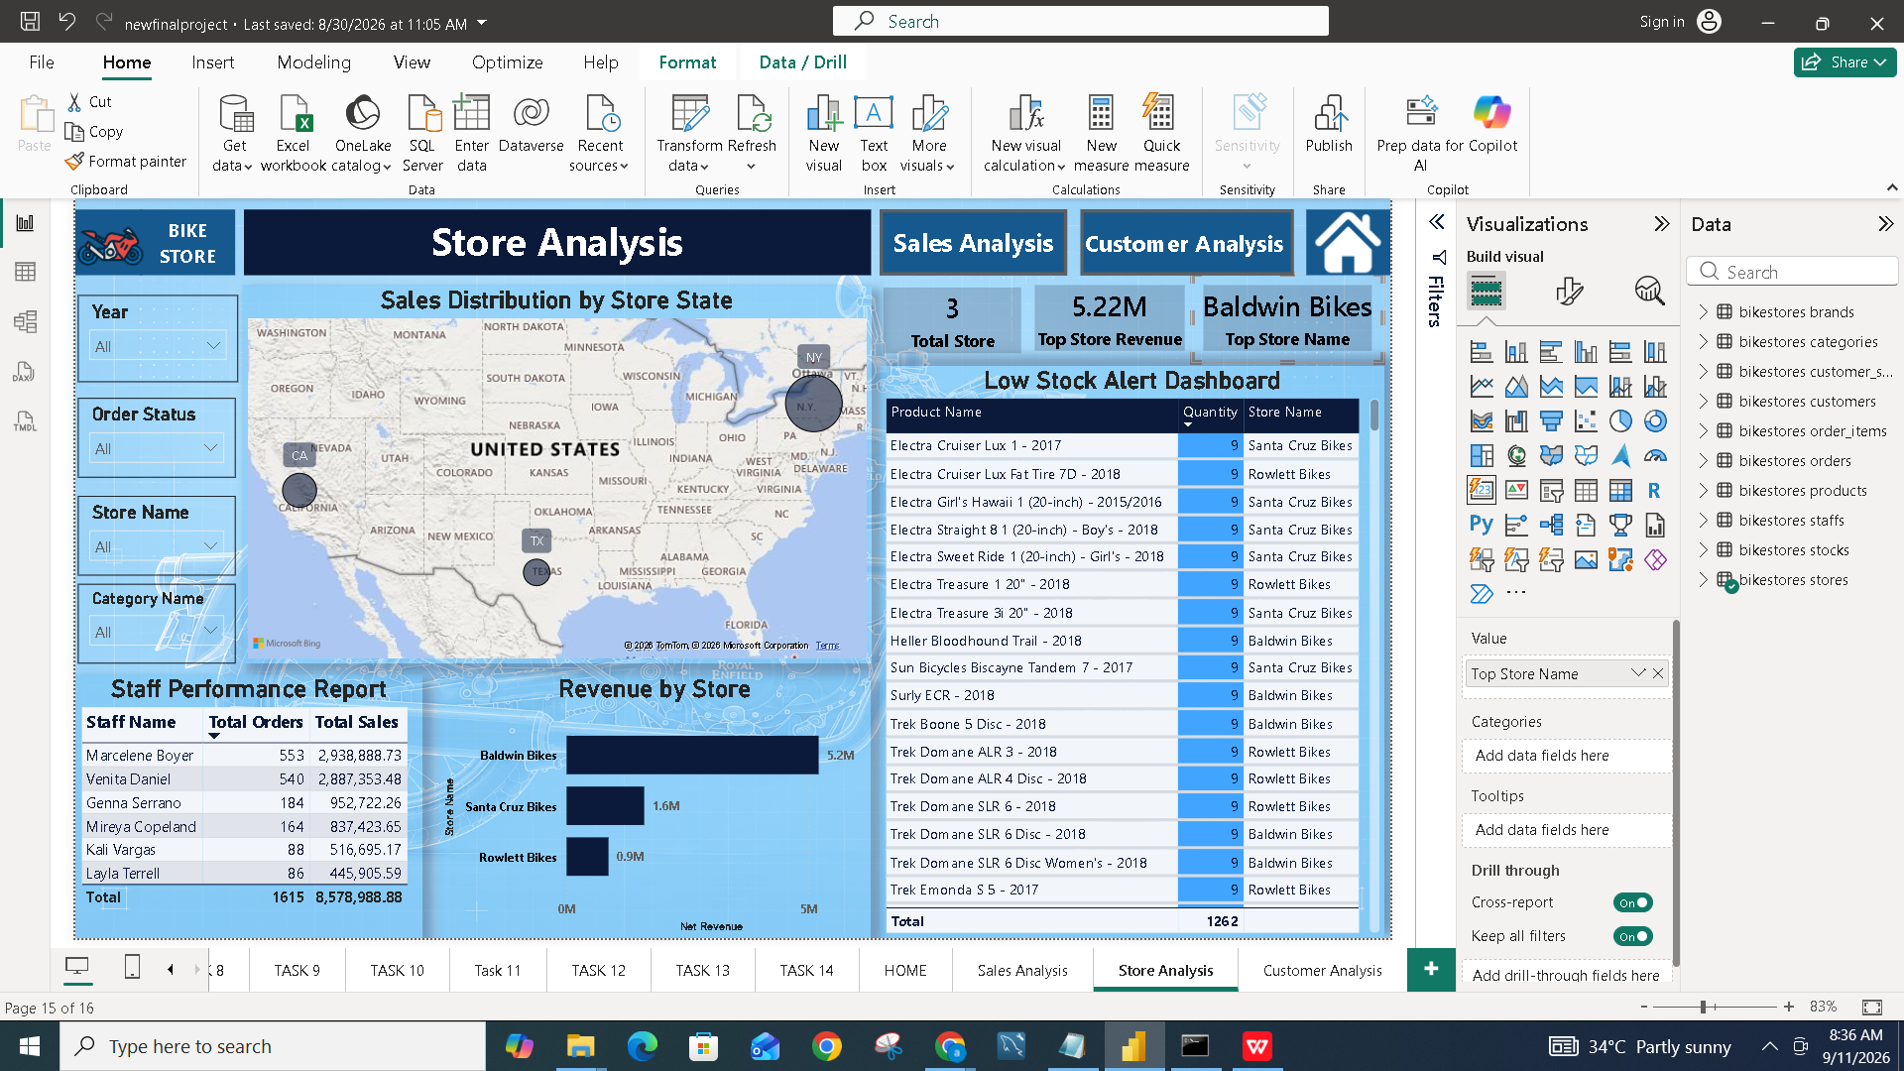
PHASE 4 — POWER BI
Dashboard: Store Analysis
Store-level revenue, a geographic sales-distribution map, staff performance report, and a live Low Stock Alert Dashboard.
12

Slide 13
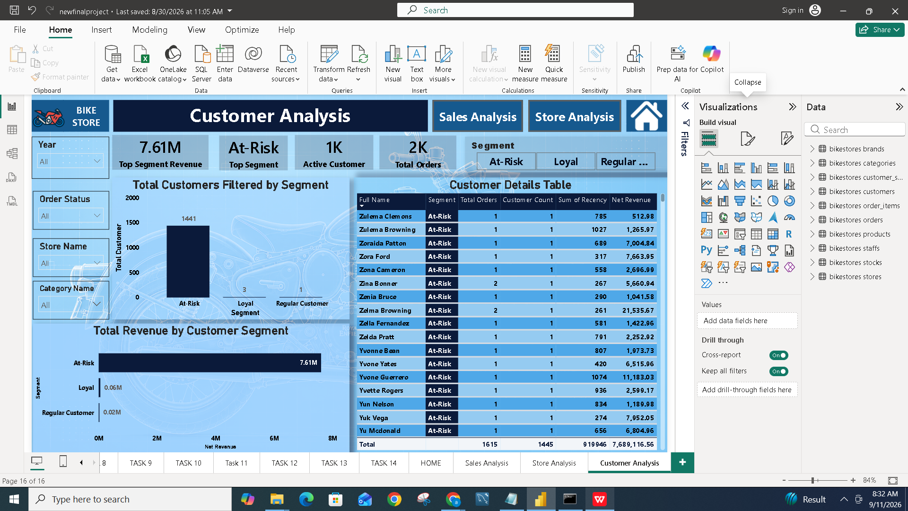
PHASE 4 — POWER BI
Dashboard: Customer Analysis
Customer segments (At-Risk, Loyal, Regular) built from the Python RFM model, with segment-level revenue breakdown and a full customer details table — usable as a report-wide filter.
13

Slide 14
RESULTS
Key Insights
8.58M
1,615
5.22M
1,262
Total sales across all 3 stores
Total orders processed
Revenue from Baldwin Bikes, the top store
Units currently flagged in low-stock alerts
Mountain Bikes is the top-performing category at ~2.7M in net revenue
Delivered orders make up 89.5% of all orders — fulfillment is healthy
RFM segmentation surfaced At-Risk customers generating 7.61M in revenue — a retention priority, not just a growth signal
Marcelene Boyer leads staff performance with 2.94M in sales
14

Slide 15
CONCLUSION
A Complete, Reproducible Analytics Pipeline
✓
Fully cleaned, relational dataset stored in SQL
✓
Insightful analytics and visualizations using Python
✓
An interactive, multi-page Power BI dashboard
✓
A complete ETL pipeline from Excel through to Power BI
Thank you

